Slide 1
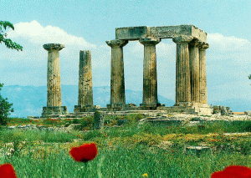

First Corinthians
Overcoming and avoiding
Church problems.

Slide 2
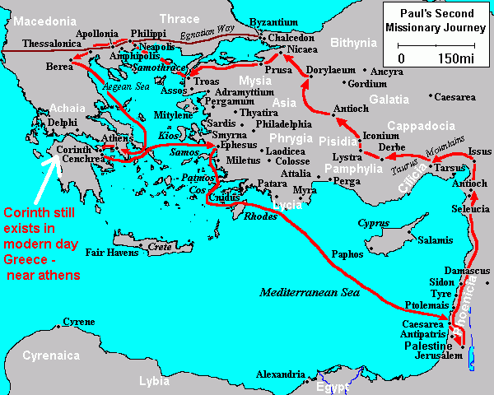

INDVIDUALITY and INDEPENDENCE.
FALSE WISOM
APHRODITES
Church was, like the City…
COSMOPOLITAN
The Historical Context:
AGE: Spectacular growth due to WEALTH.
LOCATION: At ‘ISHMUS’ with ACROPOLIS.
COMPOSITION: COSMOPOLITAN.
MORALLY: IMMORAL – Aphrodites.
INTELLECTUALLY: PHILOSOPHERS.
RELIGION: RELIGIOUS and IMMORAL.

Slide 3
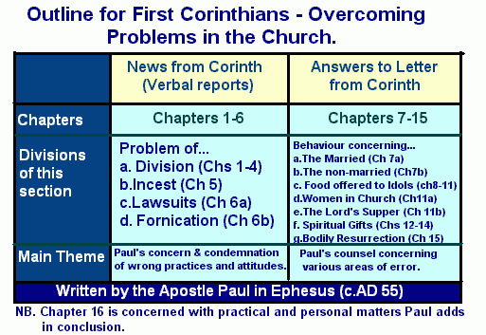
(ii) The Literary Context
Reason for letter:
Verbal report from some of
Chloe’s household.
Letter written to Paul by
Corinthian leaders.

Slide 4

An Overview of Chapters 1-4:
There are divisions among believers.
Not just differences of opinion but
‘contentions’ – literally ‘quarrels’.
There were envy and strife and divisions
(Gk. ‘schisma’ – seperation into factions’)
‘katartizo’ = perfectly joined together = to complete
Thoroughly, to repair or adjust.
(b) There is FALSE WISDOM causing the division.
Which leader is the ‘WISEST’.
(c) Opposition of Paul by some.

Slide 5
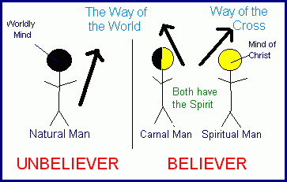
(2) Paul’s Answer (1:12-4:21)
In Conclusion:
One major reason for the division in the
church was a misunderstanding of Paul’s anointed teaching on the Cross (true wisdom). They had elevated the teaching style and made it an art, not a LIFE CHANGING SPIRIT EMPOWERED MESSAGE.
Verses 2:14-16 show difference between:
SPIRITUAL and NATURAL man.
Verses 3:1-5 show differences between:
CARNAL and SPIRITUAL man.
Wrong Concept of the TEACHING
– upsidedown or opposite to normal.
Message of the Cross is FOOLISH.
God chooses NOBODIES.
Paul’s preaching lacked ELOQUENCE
The source of wisdom =
SPIRIT OF GOD

Slide 6
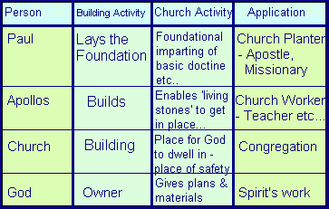
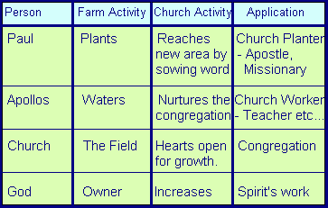
(b) Wrong concept of the TEACHERS
Who the Teachers/Leaders are:
(a) Not Lords but SERVANTS.
(b) Are God’s PROPERTY.
(c) Are wise BUILDERS.
(d) Leaders are PRIESTS.
(ii) How Leaders are to be treated.
Not to be BOASTED about.
Not to be JUDGED.
Not to be PROUD on behalf of.
Not to be merely instructors but
FATHERS.

Slide 7

The Case of Incest
The Problem: 1 Cor 5:1-13
PART ONE: A man in church is having continued sexual relations with his ‘fathers wife’ (Step-mother).
PART TWO: The Church is proud and boastful with the knowledge of this happening (they feel they are still ‘spiritual’ in spite of this).
The ‘Gnostic view of the body:
The body was seen as evil and destined for
destruction. Therefore, they thought it didn’t
matter what they did with their bodies as long
as their spirit was pure.
This led to 3 problems…
(d)The Application:
Should hand someone over the Satan if they are unrepentant about a sin that effects whole Church.
The purpose is always REDEMPTIVE – to destroy sinful habit.
Those who are effected are involved in the discipline (in this case it is the whole Church).
Our attitude should be the same as Jesus – ‘friend of sinners’.
(b) The Solution: 1 Cor 5:5
‘Hand the man over to Satan’ – from the realm
of God (church/temple) to the realm of Satan
(world).
(c) The Response: 1 Cor 5:9-1
They must not ‘mingle’ with immoral people
Professing to be Christians and in Church.
This is not cutting off from them but treating them
As sinners (Jesus was a friend of sinners).

Slide 8
(2) The Case of Lawsuits.
(b) The Application:
Members of the Church should NEVER initiate proceeding to take another Church member to secular court if it is a matter that can be dealt with within the Church.
What Paul says to:
The Church: Should take the role of judging which is what it is destined to do when Christ returns.
To Man B: Should practice Jesus' teaching on NON-RETALIATION – if needed should bring to Church leaders in love.
To Man A: If he continues in sin he will not enter Kingdom blessings – must yield to Church discipline and repent to be restored.
The Problem:
One man has wronged another man
(both church members) and the situation as been
taken to secular court.
This should not have happened –
the unrighteous should not judge the saints –
Saints should judge within the Church.

Slide 9
(3) The Case of Fornication
The Problem:
Some had been going to prostitutes as part of partaking in Pagan feasts.
This could have been caused by wives depriving husband of sex and also their own Gnostic view of the body.
Paul shows that the body belongs to the Lord and is the Temple of the Holy Spirit.
Their wrong idea of freedom is that they are free
to do anything in their bodies as the body is evil
and God will forgive them as long as their spirit is
pure.
True freedom is to be the servant of the
Lord – all things are permitted but not all are
expedient (not good for own body or others).

Slide 10

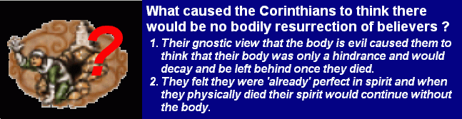
(c) Paul’s answer to the Problems…
(i) The Resurrection of CHRIST.
(ii) The Resurrection of the DEAD.
(b) Reasons for the problem:
Paul says that if the dead are not raised up then….
V16: Christ has not be raised either.
V29: Baptizing for the dead is absurd.
V32: We might as well eat and drink and forget about the future.
(iii) The Resurrection BODY.
Nature of.
Picture of seed.
Different bodies.
Natural and spiritual bodies.
Application: Whole man is redeemed.
SECTION ONE:
Main Point: To deny the future is also to deny our past.
Two things are in vain – our preaching (leaders) and your faith (congregation).
SECTION TWO:
MAIN POINT: The ORDER of resurrection – Christ is first fruits and believers raised later.
SECTION THREE:
MAIN POINT: No resurrection = No Future
Chapter 15 is totally THEOLOGICAL and not
BEHAVIOURAL.
The Problem:
Some were saying there is no resurrection of the dead.
The problem is that some Corinthians are denying the future resurrection of believers.

Slide 11

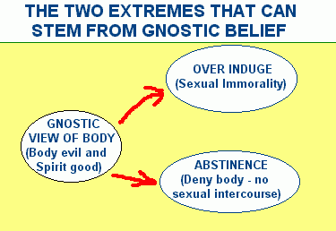

Slide 12
SECTION ONE : To the MARRIED (7:1-24)
ANSWERS TO MULTIPLE CHOICE QUESTIONS:
A
C
B
SECTION TWO : To the NOT YET MARRIED.
Reconstruction of the problem.
‘The Virgins’ are representatives of ALL SINGLE PEOPLE.
They were saying that all single people should REMAIN SINGLE (die to Gnostic view that sex should be avoided).
(b) Paul’s answer.
Only reasons this may be true is…
Because of present distressing situation.
Would take away freedom to really care for the things of God.
(b) Paul’s answer to the Corinthians:
SECTION 1 – Marriage partners should not forbid SEXUAL RELATIONS unless by MUTUAL CONSENT.
SECTION 2: SINGLEHOOD is best for the widow or widower, unless the SEXUAL URGE is too strong, then MARRIAGE is best.
SECTION 3: Women should adhere to the teaching of Jesus and not DIVORCE THEIR HUSBANDS.
SECTION 4: A Christian should not DIVORCE an unbelieving partner unless the unbelieving partner INITIATES A DIVORCE.
V14: Marriage is a holy state and pleasing to God even with only one Christian in the relationship.
SECTION 5:
Jesus said ‘No Divorce” as He also said ‘Love your enemies!” – it’s a covenant relationship.
A divorce is only an option if the unbelieving partner pushes for it.
No, a Christian should generally not initiate a divorce.
Paul does not see man as greater than woman.
Reconstruction of the problem.
It is good for a man not to touch a woman
= Husbands should not have sexual relations with their wives.
This was the Corinthian’s view of which they had written to Paul.

Slide 13

SECTION FOUR:
The specific problem is: C – it would be fellowshipping with demons if they attended pagan feasts at the Temples.
We can apply this for today: B – Nothing to do with the demonic or any form of worshipping idols.
SECTION FIVE:
Eating food offered to idols from market place is not wrong because IT IS NOT IN THE CONTEXT OF WORSHIPPING THE IDOL.
It would be wrong if ANOTHER’S CONSIENCE WOULD BE DEFILED (Stumbling Block Principle)
PAUL’S CONCLUSION:
IMITATE me as I IMITATE Christ.
PRINCIPLES FOR TRUE CHRISTIAN FREEDOM
Where Bible specifically prohibits don’t do.
Many are matters of indifference.
Principles of LOVE rules.
SECTION THREE:
Paul responds to the Corinthians feeling SECURE in the sacraments.
Celebrating Passover did not protect them from destruction (hence taking communion is not a magical safeguard against illness etc..)
SECTION TWO:
Paul was free to do many thing but he has willingly GIVEN THEM UP for the sake of the Gospel.
Answer to multiple choice:
D – True freedom is being free to be a servant of the Lord and others.
They were ATTENDING IDOL FEASTS.
Due to wrong view of CHRISTIAN FREEDOM
Paul’s Answer:
SECTION ONE:
The Stumbling Block Principle =
“As Christians we may be free to do many things but it is not loving to do these things if they make others stumble and fall in their faith.”

Slide 14

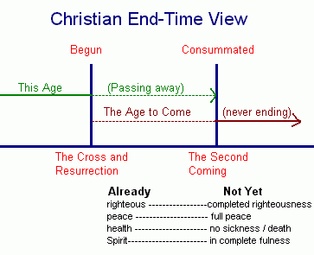

Veiling of Women in Church (11:2-6)
(a) What is the problem?..detective work!
(3) This meant that the women were going against the prevailing CUSTOM which was to wear a veil.
They did this due to a WRONG VIEW OF CHRISTIAN FREEDOM – emphasizing the ALREADY. See diagram…
The women participated in PRAYER and PROPHECY in the Church service.
Some women in the church were praying without a HEAD COVERING.

Slide 15
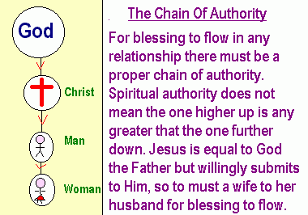
(b) Paul’s Answer
(B) The Cultural Argument:
v4-6: Shameful for woman to be shorn (prostitute) – women might as well be shorn if they do not wear a veil as it’s culturally shameful.
V13-15: Is proper’ for a woman to wear a ‘covering’ – long hair considered glorious then.
V16: “We have no such custom’ – customs that are non-theological issues should be followed.
He answers the problem by using both THEOLOGY and CULTURE.
(A) The THEOLOGICAL argument…summed up in following diagram…
It would be right for women today to wear veils if it is the prevailing custom in the society.
It would not be right if the prevailing custom is not to wear head coverings.

Slide 16
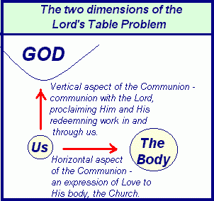
(ii) The Lord’s Table (11:17-34)
(c) Paul’s Answer….
The Appeal – Paul’s appeal is to stop ABUSING the Lord’s table (v19)
The Instruction: The two elements of a really good meal are GOOD FOOD and GOOD FELLOWSHIP.
The Application: v27: Unworthy refers not to general sins but to ‘not discerning the body’. That is having bitterness or anything against another in the body (unforgiveness etc.). Must examine and mend relationships first before partaking.
The Lord’s Supper as Christian Feast – the LOVE FEAST.
The problem – abuse of Lord’s supper.
The problem was too much FEASTING and too little LOVING.
Correct way is seen in the following diagram…

Slide 17
(iii) The Use of the Gifts of the Spirit (12:1-14:40)
This section is based on 1 Cor 12-14 – Paul is addressing the question of ORDER in the assembling of the Church.
The Problem
(iii) Tongues is the problem gift!
They were OVERLY enthused with it.
They were SINGULARLY enthused with it.
They were ‘all’ using the gift in a most DISORDERLY way.
They used tongues as a criteria for being
“SPIRITUAL”!

Slide 18
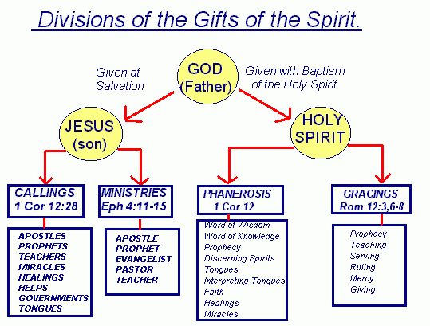
(b) Paul’s Answer:
(i) Section One: Diversity in the Gifts…
This section emphasizes the VARIETY there is in the PHANEROSIS gifts.

Slide 19
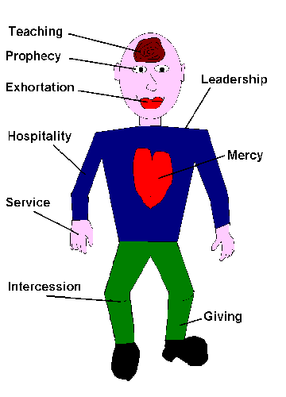
(ii) Section Two: The Picture of the Body (12;12-31)
V28-30 – God has appointed each person to have a different GIFT-MIX.
What the Corinthians were doing was emphasizing solely on ONE gift, the Gift of Tongues, not allowing the members to express variety in service.
A Gift is only the most ‘important’ when it is the most NEEDED.
V12-14 - Paul uses a common analogy from the ancient world to stress the point of DIVERSITY within UNITY.
V15-20 – There is a need to show them that all gifts are NEEDED.
V21-27 – All parts of body are INTERDEPENDANT.

Slide 20
(iii) Section Three: The Most Excellent Way (Ch 13).
That way is: Agape LOVE
Priority of Love (v1-3)
Character of Love (v4-7)
Quality of Love (v8-13)

Slide 21
(iv) Section Four: In Church , Only What Edifies (14:1-40)
Paul here emphasizes the need for EDIFICATION in Church meetings.
The importance of INTELLIGIBILITY
The importance of ORDER.
VARIETY and EDIFICATION are essential.
Answer to multiple choice: A
(b) Guidelines for prophecy.
(c) The Silence of Women.
(d) The Conclusion:
There must be VARIETY of gifts.
The gifts must be used in LOVE.
The aim is always that of EDIFICATION
The must be ORDER in the service.

Slide 22

Paul’s Concluding Words (Ch 16)
A Giving and Large-hearted Community (v1-4)
A Going and Labouring Community (v5-12)
A Guided and Learning Community (v13)
A Gracious and Loving Community (v14-18)
A Greeting and Linked Community (v19-21)
A Guiltless and Lasting Community (v22)
The Benediction (v23-24)

