Slide 1
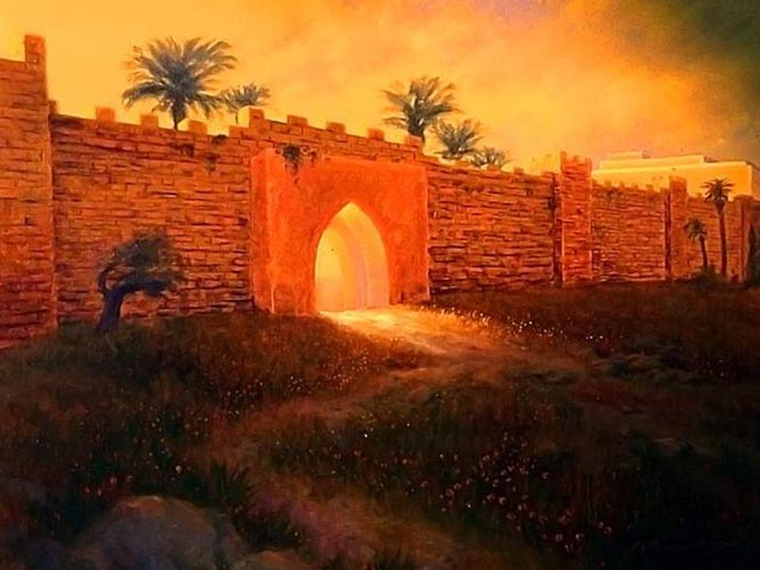
The Gates of Jerusalem
Spiritual Restoration
Nehemiah 3
Notes:
This study looks at the restoration of the walls and gates of Jerusalem at the time of Nehemiah. Throughout the history of Jerusalem there have been many different gates and we do not have time to consider all of them. Nehemiah’s task of restoring these ten gates is particularly interesting as it can be seen as a spiritual picture of our own and the church’s restoration (it is a foreshadowing of this).

Slide 2
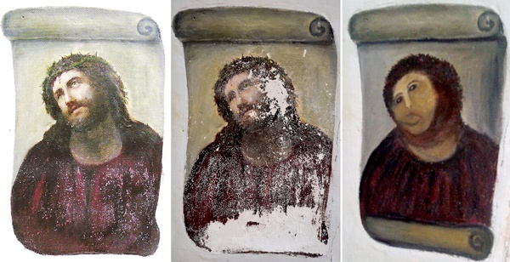
Restoration must be done the right way!
Notes:
Ecce Homo (Behold the Man) was a prized Spanish fresco — the pride of the Sanctuary of Mercy Church in Borja, near Zaragoza, where it has delighted parishioners for more than 100 years.
But after a botched restoration attempt by a well-meaning DIY pensioner, Elias Garcia Martinez’s 19th-century masterpiece looks more like a child’s finger-painting.
The unauthorized alterations were made by a Spanish woman in her 80s who had apparently grown upset over the worsening state of the painting.
The leftmost image is how the painting looked two years ago; the middle image is how it looked in July, when it was photographed for a catalogue of regional religious art. The image on right is how it looked on Aug. 6, when the Centro de Estudios Borjanos, a local cultural organisation, went to check on it after receiving a donation for its restoration.
A spokesman from the Centre said: “The value of the original work was not very high but it was more of a sentimental value.” It was painted by Elias Garcia Martinez who is the father of two well known local artists and the family had made a donation towards its preservation.
“The lady, who is in her 80s, acted without authorisation from anyone.
“The church is always open because many people visit and although there is a guard, no one realised what the old woman was doing until she had finished,” the spokesman said.
The woman contacted Juan Maria Ojeda, the city councillor in charge of cultural affairs, after recognizing her error. Ojeda says that art historians are now discussing if the painting can be saved.

Slide 3
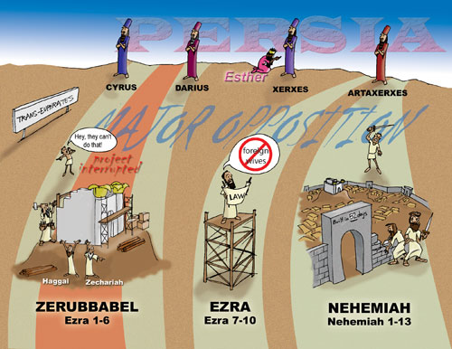
Notes:
This timeline clearly shows that there were three definite stages in the restoration of the nation of Israel after the exile.
Under Zerubbabel (c. 515BC) the Temple was restored as recorded in Ezra 1-6.
Under Ezra the reading and practicing of the Law (God’s Word) was restored (c.458BC) as recorded in Ezra 7-10 and Nehemiah 8-9.
Under Nehemiah (c.445BC) the walls and gates were restored as recorded in Nehemiah 1-7,10-13.

Slide 4
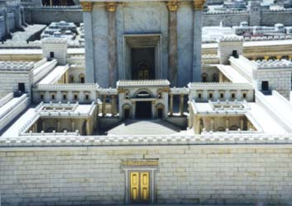
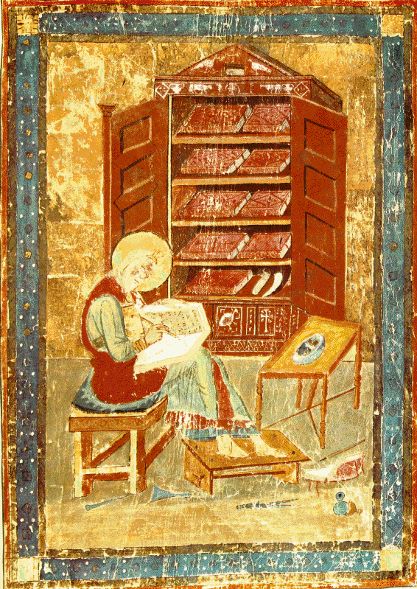
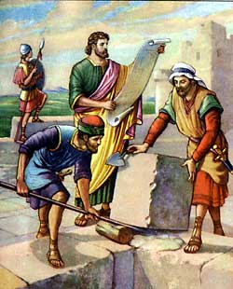
The Three Restorations
King Zerubbabel
(Restores Worship)
Ezra
(Restores Word)
Nehemiah
(Restores Walls)
Notes:
The first return under Zerubbabel was a restoration of the Temple and the Worship that was associated with it.
The second return under Ezra was a restoration of the reading of the Law, thus a restoration of the Word of the Lord among God’s people.
The third and last return under Nehemiah was a restoration of the city itself, rebuilding the Walls and the Gates.
These three returns speak prophetically of the restoration of Worship, the Word and the Walls of salvation in God’s people, Israel and the Church.

Slide 5
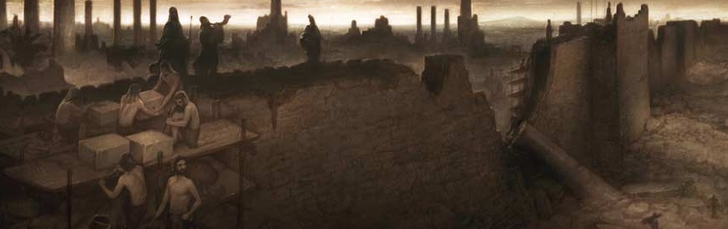
“And they said to me, “The survivors who are left from the captivity in the province are there in great distress and reproach. The wall of Jerusalem is also broken down, and its gates are burned with fire.” Nehemiah 1:3
Notes:
“And they said to me, “The survivors who are left from the captivity in the province are there in great distress and reproach. The wall of Jerusalem is also broken down, and its gates are burned with fire.” Nehemiah 1:3

Slide 6
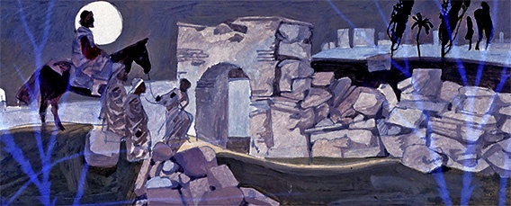
“And I went out by night through the Valley Gate to the Serpent Well and the Refuse Gate, and viewed the walls of Jerusalem which were broken down and its gates which were burned with fire. Then I went on to the Fountain Gate and to the King’s Pool, but there was no room for the animal under me to pass.” Nehemiah 2:13-14
Notes:
“And they said to me, “The survivors who are left from the captivity in the province are there in great distress and reproach. The wall of Jerusalem is also broken down, and its gates are burned with fire.” Nehemiah 1:3

Slide 7
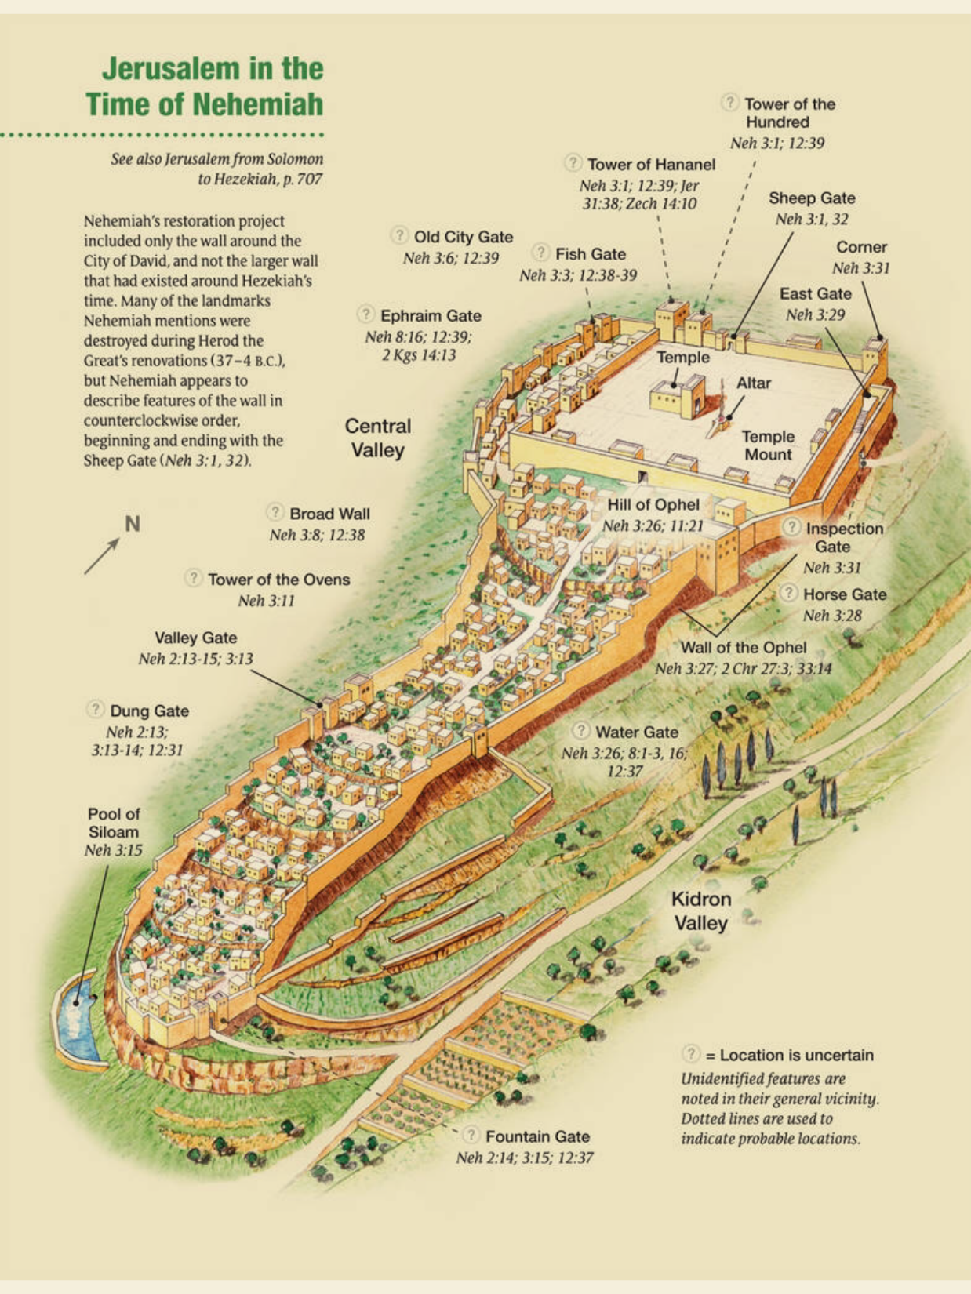
Notes:
“And they said to me, “The survivors who are left from the captivity in the province are there in great distress and reproach. The wall of Jerusalem is also broken down, and its gates are burned with fire.” Nehemiah 1:3

Slide 8
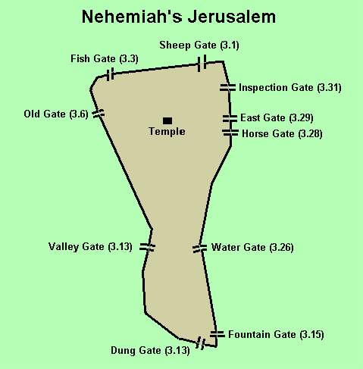
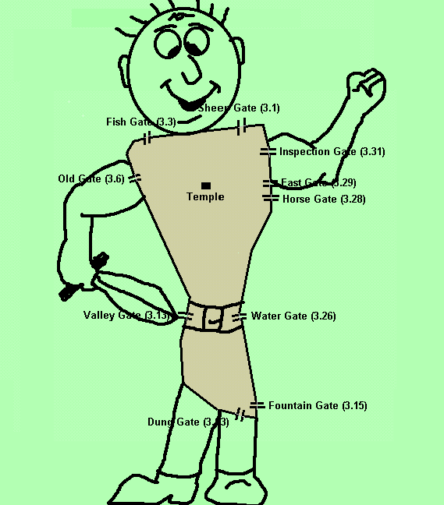
Restored to be a Warrior
Notes:
This map shows the City of Jerusalem at the time of Nehemiah and the possible locations of each gate. It is interesting to see that the picture of a warrior can be drawn oven this map, showing God’s desire for the restoration of His people so that they are a mighty man of war, a mighty end time army. As the walls and gates are restored in our lives and in the church this picture will come into reality.

Slide 9
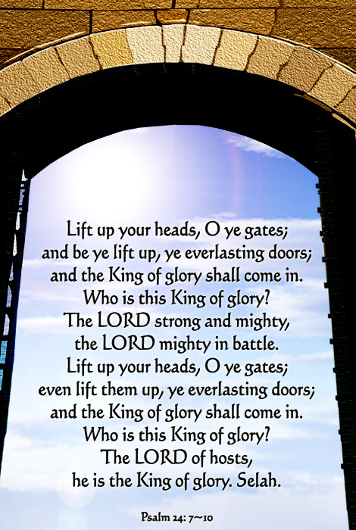

Slide 10
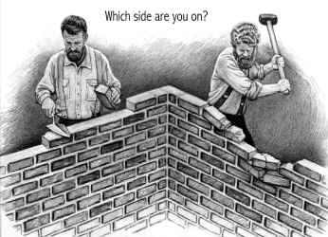
“Let us rise up and build” Nehemiah 2:18
RESTORING THE WALLS = RESTORING GOD’S PEOPLE
Notes:
Let us respond to God’s call in Nehemiah to rise up and build the walls and gates. We should be builders (the literal meaning of the word “edification”) and not destroyers of these. We can be destroyers if we live in fleshly criticism and judgement, backbiting, gossip and so forth.
Ask yourself, “Which side am on?” I pray you are on the building side, loving God and others and actively seeking a restoration in your own life and in the lives of others and the church as a whole.

Slide 11
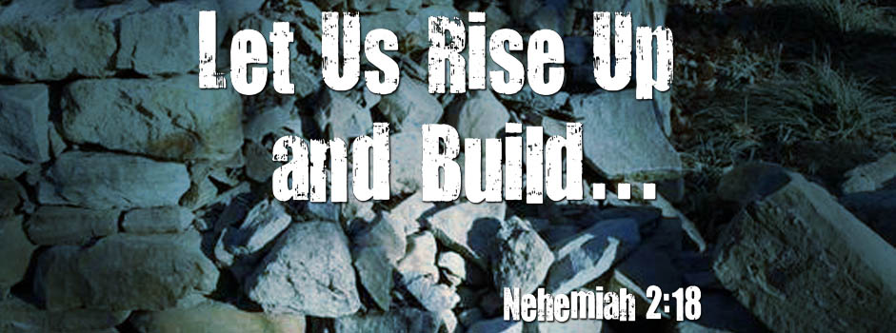
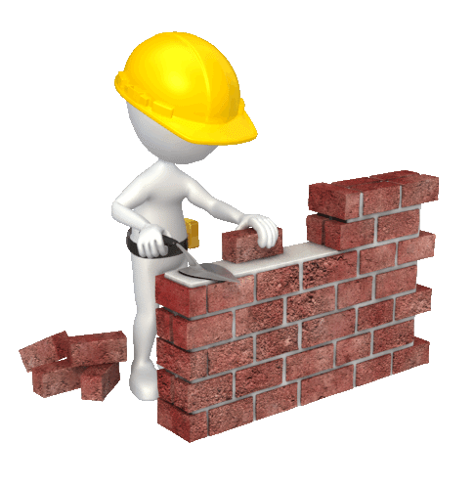
Notes:
Let us respond to God’s call in Nehemiah to rise up and build the walls and gates. We should be builders (the literal meaning of the word “edification”) and not destroyers of these. We can be destroyers if we live in fleshly criticism and judgement, backbiting, gossip and so forth.
Ask yourself, “Which side am on?” I pray you are on the building side, loving God and others and actively seeking a restoration in your own life and in the lives of others and the church as a whole.

Slide 12
Gate 1:
The Sheep Gate
Notes:
The Sheep Gate, also known today as Stephen's Gate (as it was by this gate that St. Stephen was martyred), or the Lions Gate (As Suleiman, one of the Muslim leaders who captured Jerusalem, had a dream that Lions were attacking Jerusalem, so he build this gate with pictures of lions on it to protect the city - little did he know that one lion was Satan, trying to bar God's people from entering His city and the other was Jesus, the Lion of Judah, claiming Jerusalem for His own). It is located on the east wall, north of the Temple Mount.

Slide 13
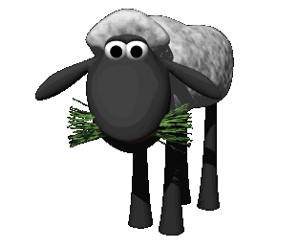
Notes:
This map shows the City of Jerusalem at the time of Nehemiah and the possible locations of each gate. It is interesting to see that the picture of a warrior can be drawn oven this map, showing God’s desire for the restoration of His people so that they are a mighty man of war, a mighty end time army. As the walls and gates are restored in our lives and in the church this picture will come into reality.

Slide 14
Eliashib the high priest and his fellow priests went to work and rebuilt the Sheep Gate. They dedicated it and set its doors in place, building as far as the Tower of the Hundred, which they dedicated, and as far as the Tower of Hananel. Next to Eliashib the men of Jericho built. And next to them Zaccur the son of Imri built.“ Nehemiah 3:1-2 (NKJV)
Notes:
"Eliashib the high priest and his fellow priests went to work and rebuilt the Sheep Gate. They dedicated it and set its doors in place, building as far as the Tower of the Hundred, which they dedicated, and as far as the Tower of Hananel. Next to Eliashib the men of Jericho built. And next to them Zaccur the son of Imri built."
Nehemiah 3:1-2 (NKJV)
The Sheep Gate was the first to be restored, and was rebuilt by the High Priest and his fellow priests (see Hebrews 4:14-15; 7:24-8:2). It was called the Sheep Gate because it led out to the sheep markets, where lambs were sold for sacrifice in the Temple (see John 1:29; 1 Corinthians 5:7), and in to the Sheep pool where sheep were washed for sacrificing (later it became the Pool of Bethesda). This gate also led to Golgotha, the path Jesus took to the crucifixion.
This gate was built by the High Priest and was the entrance for all the lambs to come through for sacrifice, especially the Passover Lamb. Jesus is both the High Priest and the Sacrifice, the Shepherd and the Sheep! It was the only gate to be consecrated or made holy. Only though Christ’s sacrifice can we be made holy, there is no other way.
Hence, restoring the Sheep Gate represents the restoration of the truth of salvation through the sacrificial death of the Lamb of God, Jesus Christ.
NB. Note that after this gate came The Tower of the Hundred (or Tower of Multiplication). Real salvation in Christ leads to abundance in our life, to multiplication of the fruit of God’s character in us. The Tower of Hananel means the Tower of Favour. Salvation is only through God undeserved favour and leads us into the towering favour of God in our lives!

Slide 15
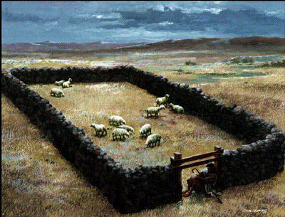
Jesus is the Sheep Gate
I tell you the truth, I am
the gate for the sheep….
Yes, I am the gate. Those
who come in through me
will be saved.
John
10:7,9
(NLT)
Notes:
“I tell you the truth, I am the gate for the sheep. All who came before me were thieves and robbers. But the true sheep did not listen to them. Yes, I am the gate. Those who come in through me will be saved. They will come and go freely and will find good pastures.” John 10:6-9 (NLT)

Slide 16
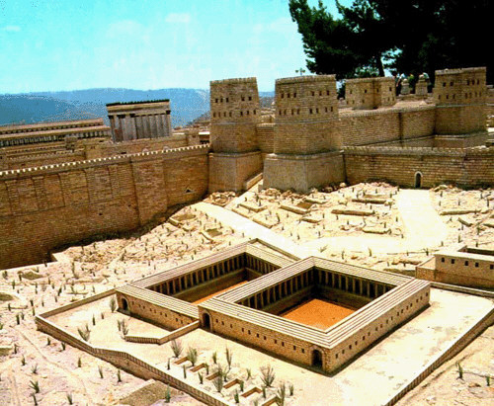
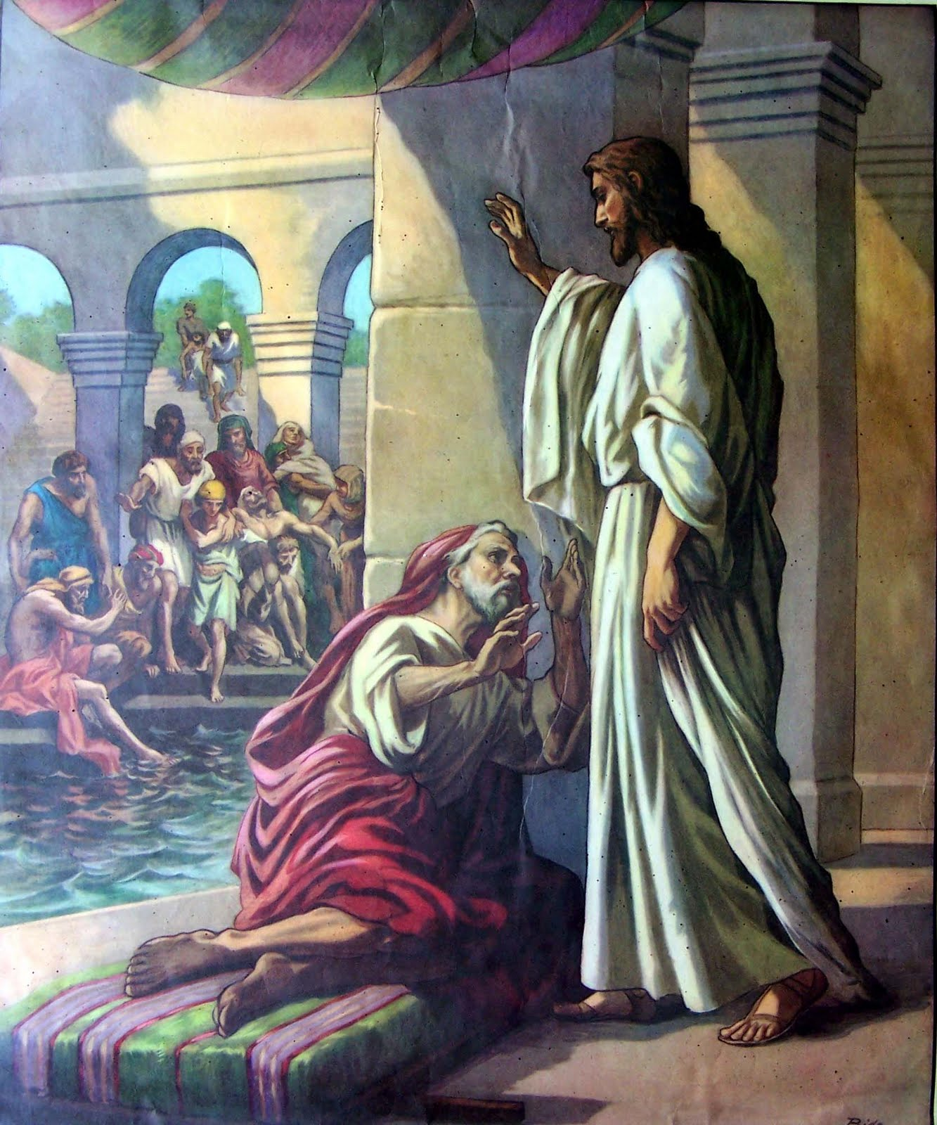
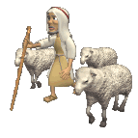
“Now there is in Jerusalem by the Sheep Gate a pool, which is called in Hebrew, Bethesda, having five porches. In these lay a great multitude of sick people, blind, lame, paralyzed, waiting for the moving of the water.” John 5:2
Notes:
It has been noted that most of the time, Jesus entered into the city, it was though the Sheep gate. It was at this gate (Pool of Bethesda) that Jesus healed the palsied man as he entered into the city (John 5:1-9) and later told him to go and sin no more (John 5:14). If Jesus came into the city through the sheep gate it was significant. He was saying, behold the Lamb of God who takes away the sin of the world.
Eliashib the high priest and his fellow priests went to work and rebuilt the Sheep Gate. They dedicated (or consecrated) it and set its doors in place, building as far as the Tower of the Hundred, which they dedicated, and as far as the Tower of Hananel. This is the only gate that was consecrated (set apart as holy) as it was used for the holy purpose of bringing in the sacrifices for the temple.
Christ, our High Priest, has restored the Sheep Gate by coming as the Passover Lamb, taking all our sins upon Himself. Through our belief in Him we are cleansed of our sins and healed to serve and be consecrated to Him (the palsied man being healed is a picture of this – taking up his bed means he no longer needed to sleep in sin and sickness but rise up to serve God).
The Pool of Bethesda represents the waters of baptism (just as the sacrificial lambs needed to be washed in these pools before they could be offered in the temple, so we need to take step of obedience to be water baptized so we can really offer up our lives as a living sacrifice (Romans 12:1) to serve Him with all our hearts.

Slide 17
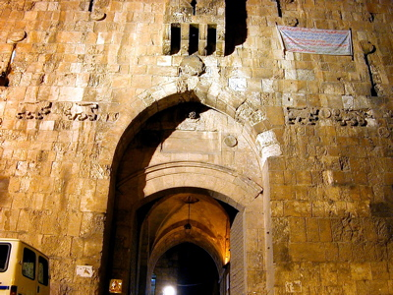
Today known as the Lion Gate
Notes:
The Sheep Gate, also known today as Stephen's Gate (as it was by this gate that St. Stephen was martyred), or the Lions Gate (As Suleiman, one of the Muslim leaders who captured Jerusalem, had a dream that Lions were attacking Jerusalem, so he build this gate with pictures of lions on it to protect the city - little did he know that one lion was Satan, trying to bar God's people from entering His city and the other was Jesus, the Lion of Judah, claiming Jerusalem for His own). It is located on the east wall, north of the Temple Mount.

Slide 18
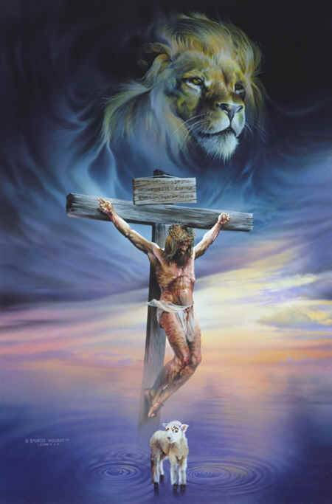
The Lion and the Lamb
“Behold, the Lion of the tribe of Judah, the Root of David, has prevailed to open the scroll and to loose its seven seals.” Rev 5:5
“Behold! The Lamb of God who takes away the sin of the world!” John 1:29
Notes:
Hence this gates points to Jesus, the Lamb of God who takes away the sins of the world and the Lion of Judah. When He first came He came as the Lamb of God, bringing salvation through His sacrifice. When He comes again He will come as the Lion of Judah, completing our salvation.
“Behold! The Lamb of God who takes away the sin of the world!” John 1:29
“Behold, the Lion of the tribe of Judah, the Root of David, has prevailed to open the scroll and to loose its seven seals.” Rev 5:5

Slide 19
The First and Last Gate
“And between the upper room at the corner, as far as the Sheep Gate, the goldsmiths and the merchants made repairs.” Nehemiah 3:32
Notes:
“And between the upper room at the corner, as far as the Sheep Gate, the goldsmiths and the merchants made repairs.” Nehemiah 3:32
This was the first gate to be built and the building process comes all the way round back to this gate, showing this is actually the first and last gate and all other gates are encompassed by this one. Hence, this gates speaks of the process of salvation through Christ. We are saved in our spirits, are being saved in our souls and will be saved in our bodies when Christ returns.

Slide 20
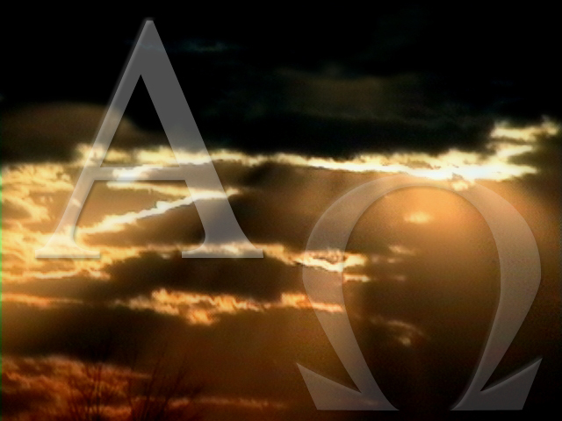
Notes:
Jesus is the Alpha and Omega, the First and the Last. It all begins and ends in Him. All that we do must be IN CHRIST just as all the other gates we in-between the Sheep Gate.

Slide 21
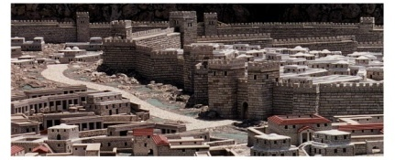
Gate 2:
The Fish Gate
Notes:
The Fish Gate was an ancient gate on the east wall, just west of the Gihon spring, where men gathered to sell fish, sometimes in violation of the Sabbath (2 Chronicles 33:14, Nehemiah 3:3, 13:16).
This is a reconstruction of what this gate would have looked like in ancient times.

Slide 22
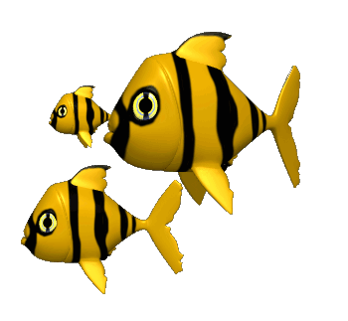
Notes:
This map shows the City of Jerusalem at the time of Nehemiah and the possible locations of each gate. It is interesting to see that the picture of a warrior can be drawn oven this map, showing God’s desire for the restoration of His people so that they are a mighty man of war, a mighty end time army. As the walls and gates are restored in our lives and in the church this picture will come into reality.
Look at the first two gates that are restored – The Sheep Gate and the Fish Gate. If you remember the picture of the warrior that we superimposed over this map you will see that these two gates are the two “shoulders” of the warrior. Shoulders speaks of strength and carrying of burdens – as these two gates are spiritually restored we receive God’s strength as we cast all our burdens onto Him and carry His yoke, His work. His work is to seek and save the lost. Just as he found us and saved us (Sheep Gate) so we are to reach out to the world with His good news (Fish Gate).

Slide 23
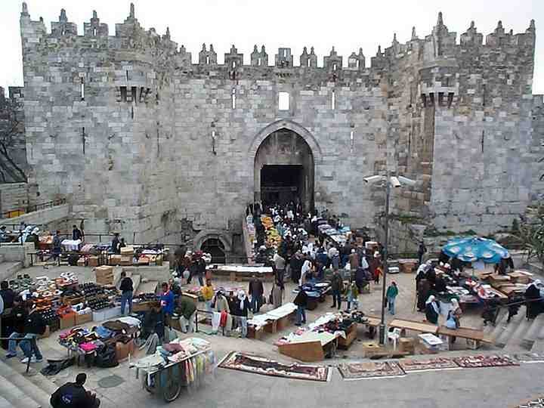
Today known as the Damascus Gate
Notes:
It may be the same as the Middle Gate (Jeremiah 39:3) but is more likely to be the modern day Damascus Gate. This gate had been one of the main entrances into Jerusalem, especially for merchants (2 Chronicles 33:14; Zephaniah 1:10). There has always been a market place outside this gate, initially for fish from the Mediterranean and the sea of Galilee.

Slide 24
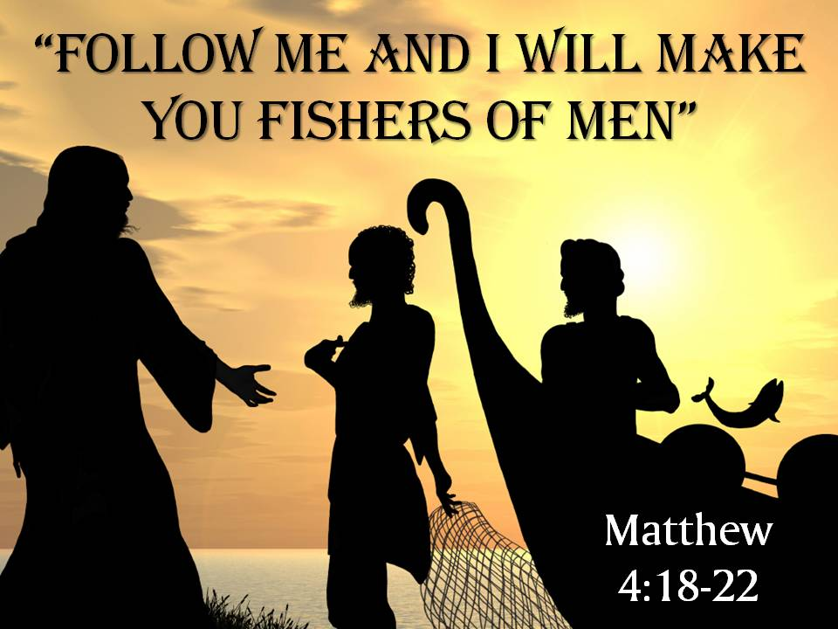
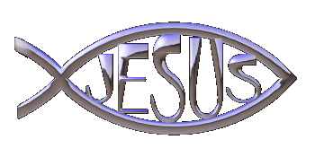
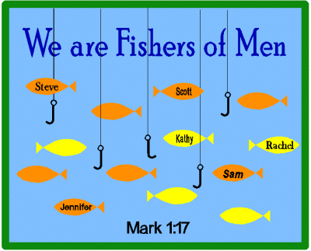
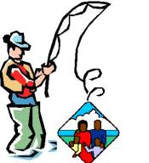
Notes:
The Fish Gate represents our witness, the Church reaching out to the world (Matthew 4:19). For us, it speaks of evangelism as we have been called to be 'fishers of men'. It is a natural progression in our Christian life that after seeing that Jesus dies for our sins (Sheep Gate), that we would want to tell others about it. Even surveys have shown that believers who have been saved less than two years win the most people to the Lord. Their simple testimony of what Jesus has done in their lives qualifies them to be great 'fishers of men.‘
It must be noted that fishing does not only mean bringing in the fish, the fish must also be processed. In the same way evangelism without Discipleship is not effective.

Slide 25
The Present Condition
“And there shall be on that day,” says the Lord, “The sound of a mournful cry from the Fish Gate, A wailing from the Second Quarter, And a loud crashing from the hills. Wail, you inhabitants of Maktesh! For all the merchant people are cut down; All those who handle money are cut off.” Zephaniah 1:10-11
Notes:
The Present Condition of the Fish Gate
“And there shall be on that day,” says the Lord, “The sound of a mournful cry from the Fish Gate, A wailing from the Second Quarter, And a loud crashing from the hills. Wail, you inhabitants of Maktesh! For all the merchant people are cut down; All those who handle money are cut off.” Zephaniah 1:10-11
Zephaniah was a prophet who prophesied during the reign of King Josiah. Though this king’s reign was marked by revival and blessed by God the prophet looked ahead to the ultimate judgment on Judah due to the sins of previous kings, especially King Manasseh. Zephaniah prophecies that there would be wailing from the Fish Gate as the merchants were not coming with the fish! If the church fails to reach out in evangelism the blood of many cries out. We should wail too for a fresh love and passion for the lost who are in the marketplaces of the world.

Slide 26
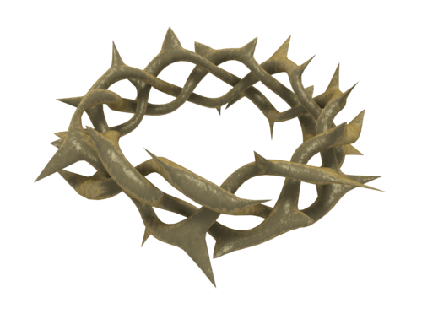

Overview
“Also the sons of Hassenaah built the Fish Gate; they laid its beams and hung its doors with its bolts and bars.” Nehemiah 3:3
Hassenaah = To prick/thorny
To pierce through/be on cutting edge
Bolts & Bars = Make sure they stay!
Notes:
"The Fish Gate was rebuilt by the sons of Hassenaah. They laid its beams and put its doors and bolts and bars in place.” Nehemiah 3:3 (NKJV)
The sons of Hassenaah did the work of rebuilding the gate while others helped. Hassenaah means 'thorny, piercing' and represents those on the cutting edge of God's purposes – evangelism, who pierce through the spiritual darkness to prick the consciences of the lost. This gate represents the importance of reaching out in evangelism to the lost. To be fishers of men.
With the Sheep Gate there was no mention of the lock as it is to be kept open until Christ returns as He desires all to be saved. However, all gates up to the fountain gate had locks/bolts put on them (beyond the Fountain gate all gates needed no restoration as they represent God’s incorruptible truths in the Spirit).
The Fish Gate is where we bring in the fish (lost souls) and make sure they do not go back out and be lost – the backdoor of the church must be closed. This is done by proper discipleship.

Slide 27
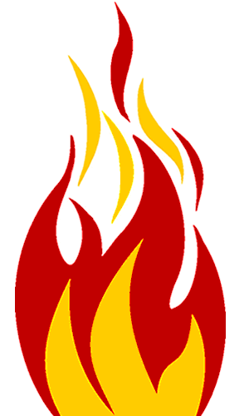
1. The Challenge
“And next to them Meremoth the son of Urijah, the son of Koz, made repairs.” Nehemiah 3:4a
Meremoth = To rise up
Urijah = Flame of Jah
Koz = Thorn/Prick
Notes:
1. The Challenge
“And next to them Meremoth the son of Urijah, the son of Koz, made repairs.” Nehemiah 3:4a
The meaning of these names lays forth a challenge for us to arise to evangelism and be fishers of men.
Meremoth = To rise up
Urijah = Flame of Yahweh
Koz = Thorn/prick (to pierce through)
Taken together it spells out that we are to pray for the flame of God to rise up in us so we are passionate in reaching out with the Gospel to the lost, piercing through the darkness and the hearts of those we reach out to.

Slide 28
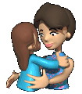
2. The Conduct
“Next to them Meshullam the son of Berechiah, the son of Meshezabel, made repairs.” Nehemiah 3:4b
Meshullam = Be friendly/safe
Urijah = Blessing of Jah
Meshezabel = Delivered by God
Notes:
2. The Conduct
"Next to them Meshullam the son of Berechiah, the son of Meshezabel, made repairs.” Nehemiah 3:4b
The meaning of these names lay forth the proper way and conduct of reaching out in evangelism.
Meshullam = Be friendly/safe
Urijah = Blessing of Jah
Meshezabel = Delivered by God
We are to reach out with the Gospel to the lost in a friendly way, bringing Gods blessing and deliverance.

Slide 29
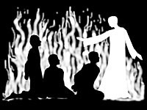
3. The Character
“Next to them Zadok the son of Baana made repairs.” Nehemiah 3:4c
Zadok = Just/ Righteous
Baana = In affliction
Notes:
3. The Character
“Next to them Zadok the son of Baana made repairs.” Nehemiah 3:4c (NKJV)
The next names reveal to us the character of effective evangelists.
Zadok = Just/ Righteous
Baana = In affliction
Evangelism must be done by the morally upright, clothed in Christ’s righteousness. There will be opposition when we share the good news so e must remain righteous even in affliction. This will be a powerful testimony to the lost.

Slide 30
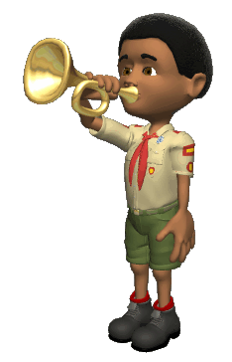
4. The Call
“Next to them the Tekoites made repairs; but their nobles did not put their shoulders to the work of their Lord.” Nehemiah 3:5
Tekoites = Trumpets
The nobles were too proud to respond.
Notes:
4. The Call
“Next to them the Tekoites made repairs; but their nobles did not put their shoulders to the work of their Lord."
Nehemiah 3:5 (NKJV)
Tekoites = Trumpets
We are to be clear trumpets, reaching out in love to the Lost. Those who are too proud and full of themselves will not respond to this call.

Slide 31
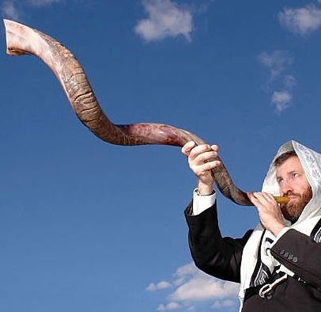
Calling in the Fish!
Notes:
Conclusion

Slide 32
Gate 3:
The Old Gate

Slide 33
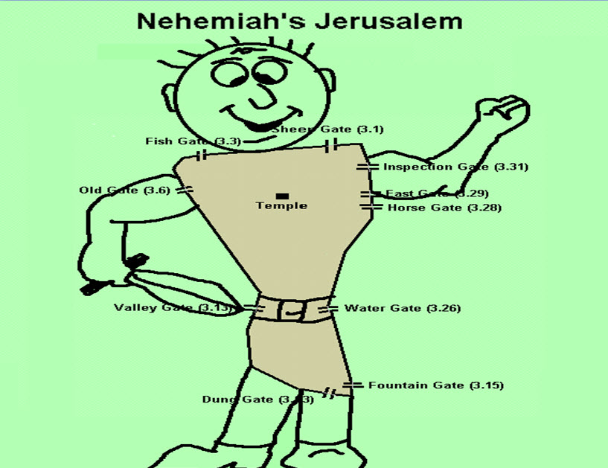
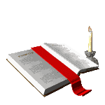
Priority Gates
Notes:
This map shows the City of Jerusalem at the time of Nehemiah and the possible locations of each gate. It is interesting to see that the picture of a warrior can be drawn oven this map, showing God’s desire for the restoration of His people so that they are a mighty man of war, a mighty end time army. As the walls and gates are restored in our lives and in the church this picture will come into reality.
The Old Gate is the last of the Priority Gates (the first three gates representing priorities needed in our Christian life). The priorities we need for restoration are proper salvation with a heart of sacrificial worship (SHEEP GATE), a love for the lost and reaching out to them (FISH GATE) and a love for and living in the Word of God (OLD GATE).

Slide 34
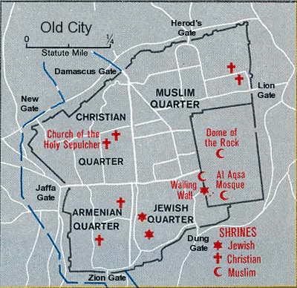
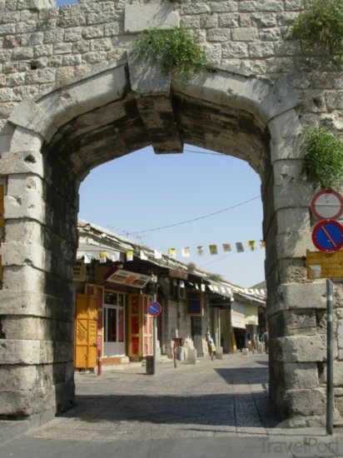
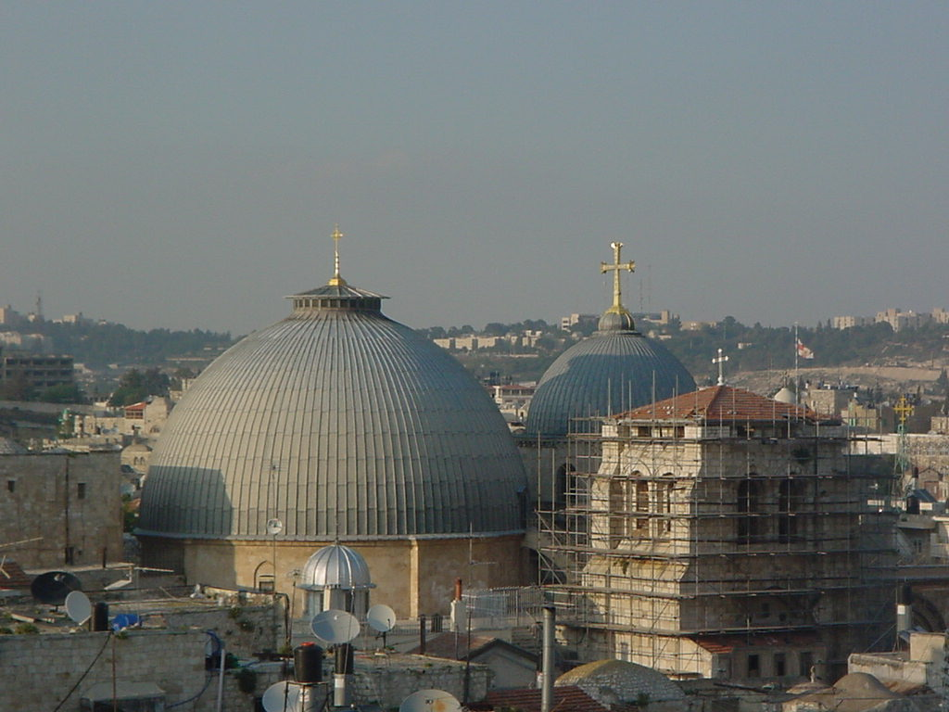
Old Gate was where Church of Holy Sepulcher is today
New Gate Built Near Where Old Gate Was!
Notes:
The Old Gate was the pivotal corner gate. It could also have been the 'Corner Gate' which was the entry for the old paths (2 Kings 14:13; Jeremiah 31:38), located at the northwest corner of the city. Some students identify this with the "Mishneh Gate". The Hebrew word means "second quarter" or "new quarter" (Zephaniah 1:10, NIV). In Nehemiah's day, the northwest section of the city was "The Mishneh" or "New Quarter"; and this gate led into it. What a paradox: the old gate leads into the new quarter! But it is from the old that we derive the new; and if we abandon the old, there can be nothing new (see Jeremiah 6:16 and Matthew 13:52). It was through this gate that Jesus was led out to the cross where he died in our place for ours sins. It led from the old into the new but was all based on the old.
The Old Gate, or Jeshanah Gate, was located near the location of the present-day Holy Sepulchre (Nehemiah 3:6). The present “New Gate” is built very near or even over the spot where the Old Gate was.
Once we have entered through the sheep gate and the gate of witness then there must be subjection to the old paths that were from the beginning. It is the gate of Lordship. God's Word represents the old paths we are to seek. Christ is the Corner stone and head of the corner (see 1 Peter 2:4-10) why not the corner gate as well.

Slide 35
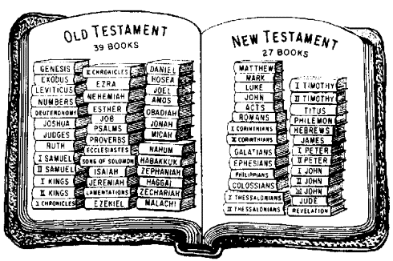
The Old Gate Represents the Logos Word Of God
Notes:
The Old Gate Represents the Logos Word Of God
This gate speaks to us of the Bible, the written Word of God, made up of both Old and New Testaments. We need the whole Bible, not just the new. Indeed the New is in the Old concealed and the Old is in the New revealed and Christ is revealed in every book of the Bible.

Slide 36
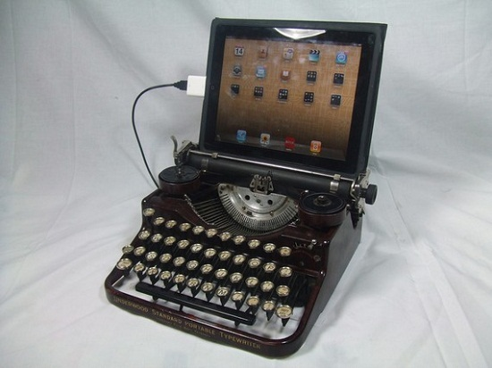
“Then He said to them, “Therefore every scribe instructed concerning the kingdom of heaven is like a householder who brings out of his treasure things new and old.” Matthew 13:52

Slide 37
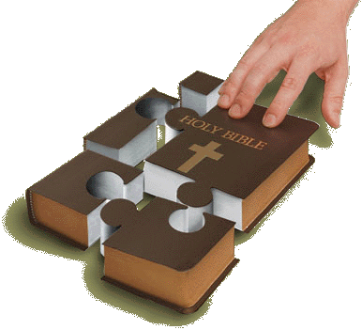
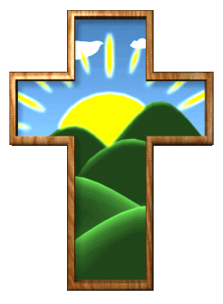
“Thus says the Lord, Stand by the ways and see and ask for the ancient paths, where the good way is and walk in it; And you will find rest for your souls.” Jeremiah 6:16
Notes:
Jeremiah 6:16 states
'Thus says the Lord, Stand by the ways and see and ask for the ancient paths, where the good way is and walk in it; And you will find rest for your souls.'
This gate represents our coming into the truths of the Logos - the written Word of God. Later, we will see that the Water Gate represents the Rhema - the quickened, spoken, prophetic word of God. After being born again (Sheep Gate) and excitedly reaching out to the Lost (Fish Gate), we must enter into the eternal, ancient truths of God's written Word. We must see the importance of obedience, tithing, baptism, daily devotions and all that is revealed in His general will, His written Word. We learn these by sitting at the feet of anointed teachers of God's Word and studying the Word diligently for ourselves.

Slide 38
“The Jeshanah Gate was repaired by Joiada son of Paseah and Meshullam son of Besodeiah. They laid its beams and put its doors and bolts and bars in place”. Nehemiah 3:6 (NKJV)
Notes:
"The Jeshanah Gate was repaired by Joiada son of Paseah and Meshullam son of Besodeiah. They laid its beams and put its doors and bolts and bars in place”. Nehemiah 3:6 (NKJV)
The meaning of the names of those directly involved in the rebuilding of this gate are significant and reveal the aspects of God's 'logos' Word.
Up until verse 10 the rest of the verses are also linked with the Old Gate and have relevance. Look at the meaning on the names and note the emphasis on ruling (being under authority and having authority) – the Word of God is to be our authority and gives us authority to rule and reign in life.
“And next to them Melatiah (Jah has Delivered) the Gibeonite, Jadon (Thankful) the Meronothite, the men of Gibeon and Mizpah (Watchtower), repaired the residence of the governor of the region beyond the River. Next to him Uzziel (Strength of God) the son of Harhaiah (Fearing Jah), one of the goldsmiths, made repairs. Also next to him Hananiah (Jah has Favoured), one of the perfumers, made repairs; and they fortified Jerusalem as far as the Broad Wall. And next to them Rephaiah (Jah has Cured) the son of Hur (White Linen), leader of half the district of Jerusalem, made repairs. Next to them Jedaiah (Praised of Jah) the son of Harumaph (Consecrated Face) made repairs in front of his house. And next to him Hattush (?) the son of Hashabniah (Thought of Yah) made repairs.” Nehemiah 3:7-10

Slide 39
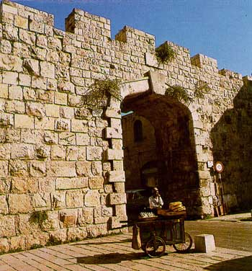
1. The Word of God Fills Us
“I have stored up your word in my heart, that I might not sin against you. Psalm 119:11
“Let the word of Christ dwell in you richly in all wisdom, teaching and admonishing one another in psalms and hymns and spiritual songs, singing with grace in your hearts to the Lord.”
Colossians 3:16
“The Jeshanah Gate”
Jeshanah means “old” or “Storage”
Notes:
The Word of God Fills Us
The New Gate, pictured here, was built near the location of the Old Gate that no longer remains. The Old Gate led from the Old to New Quarters and was called the Jeshanah Gate at the time of Nehemiah.
The word "jeshanah" means "old". The elders of the city would meet at the gate to discuss matters of community importance and issue judgement on disputes (Joshua 20:4; Ruth 4:11; Proverbs 31:23). This gate represents both the eldership of the city (the leaders of the Body) and their guidance in the "ancient paths" of God (Jeremiah 6:16) in spiritual growth.
Another possible meaning of Jeshanah in Hebrew is "storage", therefore this gate represents the fact that we need to study the Word of God and "store away" as much as we can while we are in this early, joyful, hungry stage of our Christian lives! The Old gate speaks to us of the old ways of truth. A young Christian having experienced the sheep gate, then the fish gate soon sees the need for experiencing the old gate. This means learning the old ways of truth that never change.

Slide 40
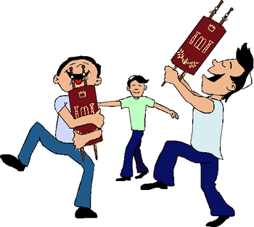
2. The Word of God Fulfills Us
“Your words were found, and I ate them, And Your word was to me the joy and rejoicing of my heart; For I am called by Your name, O Lord God of hosts. Jeremiah 15:16
“.......was repaired by Joiada son of Paseah”
Joiada = “Jehovah known”
Paseah = “to skip or dance”
Notes:
2. The Word of God Fulfills Us
The Jeshanah Gate was repaired by Joiada son of Paseah
Joiada means 'Jehovah known' and shows that God's Word is His intention, His knowledge that we can know. Paseah means 'to leap and skip for joy and shows the great joy that there is in knowing and living in God's general Word. His word satisfies us and brings rejoicing to our hearts.

Slide 41
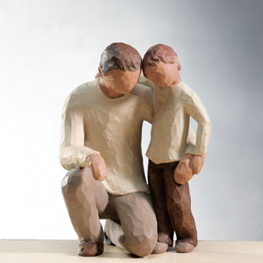
3. The Word of God Fathers Us
“Because they rebelled against the words of God, And despised the counsel of the Most High. Therefore He brought down their heart with labor; They fell down, and there was none to help.”
Psalm 107:11
“….and Meshullam son of Besodeiah.”
Meshullam = “to be completed”
Besodeiah = “counsel of God”
Notes:
3. The Word of God Fathers Us.
“…..and Meshullam son of Besodeiah.”
Meshullam means 'allied' or 'friendly' showing our relationship with God as we keep His Word, it also means “to be completed” showing that we are completed, perfected and matured by His Word. Besodeiah means 'counsel of Jehovah' showing that God's Word gives His perfect counsel and guidance as a father to a son.

Slide 42
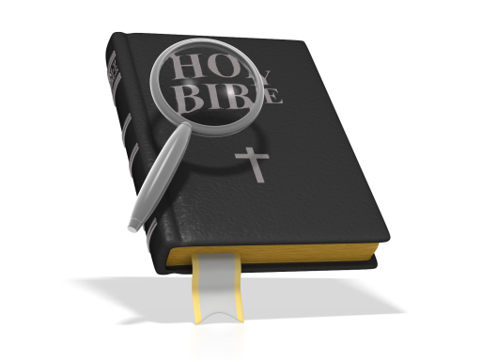
The Old Gate
= The Written Word of God
1. The Word of God Fills Us
2. The Word of God Fulfills Us
3. The Word of God Fathers Us
Notes:
\

Slide 43
Gate 4:
The Valley Gate
Notes:
The Valley Gate speaks of Valley Experiences we will go through in our Christian life. These are ‘low’ times when things can be dry, tough, uncomfortable and we go through a testing time.

Slide 44

Purity Gates
Notes:
This map shows the City of Jerusalem at the time of Nehemiah and the possible locations of each gate. It is interesting to see that the picture of a warrior can be drawn oven this map, showing God’s desire for the restoration of His people so that they are a mighty man of war, a mighty end time army. As the walls and gates are restored in our lives and in the church this picture will come into reality.
The Old Gate is the last of the Priority Gates (the first three gates representing priorities needed in our Christian life).

Slide 45
“And I went out by night through the Valley Gate to the Serpent Well and the Refuse Gate, and viewed the walls of Jerusalem which were broken down and its gates which were burned with fire. Then I went on to the Fountain Gate and to the King’s Pool, but there was no room for the animal under me to pass.” Nehemiah 2:13-14
Notes:
“And I went out by night through the Valley Gate to the Serpent Well and the Refuse Gate, and viewed the walls of Jerusalem which were broken down and its gates which were burned with fire. Then I went on to the Fountain Gate and to the King’s Pool, but there was no room for the animal under me to pass.” Nehemiah 2:13-14
It is interesting to note that the first gate Nehemiah went through to examine the state of the walls and gates of Jerusalem, before starting the construction work, was this one (Nehemiah 2:13-15). As Nehemiah went through the valley he would have had the best view of the walls and gates. We get the best understanding of the state of our spiritual walls and gates (our spiritual well being) from the valley experiences in our lives!

Slide 46
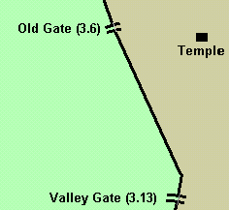



BROAD WALL (v8)
Tower of
The Ovens
(v11)
The Hinnom Valley
Notes:
Examining the map you notice that there is a long distance before you come to this gate. For a new Christian the Lord allows a 'honeymoon' type period where He teaches you and His presence is strong in your life. This can go on for some time as indicated by the positioning of the old and valley gates. But sooner or later the valley gate must come. The valley gate speaks to us of humbling and trials - valley type experiences used by the Lord for our personal growth. These times are never easy, but the Christian needs to remember that in the natural nothing really grows on the mountain tops, but it certainly does down in the valleys. So it is in the spiritual. Valley times are never nice experiences but always produce fruit.
Two tests leading to the Valley Gate...
a] The Broad Wall. In Hebrew this means "the wall of Rahab". I believe this is our first test as a Christian. Do you know what Rahab was? A prostitute. How much do you believe in the Mercy of God? How much do you believe in the Saving Power of God? Will you accept a born-again former prostitute sitting in your church family with unconditional love? I believe a lot of Christian stop right here .. their self righteousness is more important to them than the mercy of God! Will a wife forgive and live with a husband who has committed adultery? Would a man forgive his wife? God did (Hosea & Gomer). Let's accept what God is doing in the lives of those of us around us and go on and grow up with God.
b] Tower of the Ovens. It is normal after being a Christian for a time, to begin to feel the next test - the heat and pressure of being a Christian with the tribulations that will surely come. Jesus said, "In this world you shall have tribulation". In Proverbs it says, "If you crumble in the day of adversity, your strength is small". This is when you begin to walk by faith (act as if the Word of God is true). This is when our mettle is tested. We are tested by fire (1 Peter 4:12-14)! Will we stand for God? He stood for us!
This gate led to the Hinnom Valley that separated Mount Zion from the Hill of Evil Counsel and the "plain of Rephaim" to the south (Deuteronomy 2:20-21; 2 Samuel 21:16-22). Solomon erected high places for Molech in this valley (1 Kings 11:7), to whom children were sacrificed by fire (2 Kings 16:3; 23:10; 2 Chronicles 28:3; 33:6; Jeremiah.7:31). Josiah rendered the valley "ceremonially unclean" by spreading human bones over it (2 Kings 23:10,13-14). From then it became the garbage tip of the city. Because of its ceremonial defilement and its history of human sacrifice by fire, this valley came to be called "Ge Hinnom" or "Gehenna" - the name used for hell itself, the Lake of Fire (Matthew 5:22; 10:28; 23:15,33).

Slide 47


"Hanun and the inhabitants of Zanoah repaired the Valley Gate. They built it, hung its doors with its bolts and bars, and repaired a thousand cubits of the wall as far as the Refuse Gate."
Nehemiah 3:13(NKJV)
Hanun = Favoured
Zanoah = Rejected
Notes:
"Hanun and the inhabitants of Zanoah repaired the Valley Gate. They built it, hung its doors with its bolts and bars, and repaired a thousand cubits of the wall as far as the Refuse Gate."
Nehemiah 3:13(NKJV)
Hanun and the inhabitants of Zanoah built this gate. Their names mean 'favoured' and 'rejected'. Valley experiences are the times when we will be favoured by God, but rejected by man and seem to even descend into hell in our experience. But with the priority gates strong and n place we will be kept in our relationship with God, being safe and finding refuge in Him.

Slide 48

In the valley…
- God is with you.
- There is growth
- The river flows!
Notes:
“Even though I walk through the valley of the shadow of death, I will fear no evil, for you are with me..” Psalm 23:4
In the valley…
- God is with you.
- There is growth
- The river flows!

Slide 49

7 Valleys in the Bible
The Valley of…
Siddim (SIN)
Eschol (DECISION)
Kidron (SUFFERING)\
Elah (BATTLE)
Achor (CHASTENING)
Gehenna (DEATH)
Jezreel (END TIMES)
Repent
Obey
Trust
Fight
Yield
Cling
All the Above
Notes:
The Seven Valleys
1. The Valley of Siddim (Genesis 14:10)
This is the valley of the slime pits. Why? The valley of Siddim is on the very spot where the cities of Sodom and Gomorrah were. You recall the awful story in the Bible of the destruction of Sodom and Gomorrah. God looked down and saw the wickedness of those wicked and vile cities and said, "I am going to rain fire and brimstone on them." This is a valley where sin abounded. This represents a valley in our lives, the valley of sin.
Do you know that when you go out to the nightclubs and the pubs and go into the depths of sin, God still loves you and God is still there? Do you know that when you go down to the very bottom of sin and taste the last drop in the cup of the dregs of sin, God is there? Do you know that when you have gone to the bottom and no one else cares and you have spent all and have begun to be in want, God is there? When you come to yourself and have nobody to go to and you arise and say, "I will arise and go to my Father," God is always there.
God is here this morning. If you are not saved, He knocks on the door of your heart. He wants to be your Saviour. He wants to forgive every sin. He wants to come into your life. He wants to write your name in Heaven. He wants to make you His child. He wants to take you to Heaven when you die. God wants to make you a new creature. God wants to send His Holy Spirit to indwell you. God wants to say to you, "Your sins are forgiven." God wants to come into your life.
When I finished preaching recently, a little lady came to me and met me at the office. She was a lovely girl. As the world counts attractiveness, I think she would have been called beautiful. She said, "Could I see you for a minute, Mister?"
I said, "Yes, come in." She came into my office, was seated, and said, "I am what you call a 'call girl.' I wear the nicest of furs." She said that several men had gone together and rented an apartment for her. They bought her nice clothes and a Lincoln Continental. They would give her anything she wanted. When those wicked men would want her, they would come to her apartment, one after the other, to commit sin. She said, "I'm on dope. I don't have anybody that loves me. I heard you preach and I heard you say that God loves everybody. Brother Hyles, do you think that God could forgive me?"
I said, "Why, of course, He will forgive you. He loves you. He gave His son for you. God gave His Son for sinners. He died for you. Jesus went to the cross for sinners. Jesus came to earth for sinners. Jesus dipped His own soul into hell for sinners. Jesus gave the Holy Spirit for sinners."
It does not matter where you are this morning or how deep in sin you have gone; He is there. Are you in the valley of Siddim? Are you in the city of Sodom this morning? Are you in the city of Gomorrah in deep awful sin? Have you gone to the bottom? Is your life empty and friendless? Are you without anybody who seems to care? He says, "I am there."
This morning He knocks on your door and says, "If you will just trust Me as your Saviour, I will forgive you your every sin. I will make you My child. I will write your name in Heaven." Oh, dear unconverted friend, if you are in the valley of Siddim, come to Christ this morning!
2. The Valley of Eschol (Numbers 13:23)
Eschol is located just inside the Promised Land. Do you recall the grapes of Eschol? The Israelites came to the door of the Promised Land at Kadesh-Barnea and they appointed twelve spies. Those twelve spies went over into the Promised Land. They said it was a land that flowed with milk and honey. They brought back some grapes that were so big that it took two men to carry one bunch. Those were the grapes of Eschol. They were gotten in the valley of Eschol, one of the seven great valleys of the Bible.
What is the valley of Eschol? Eschol is where the Jews made the decision of their life. It was at Eschol where they had to decide, "Shall we go forward or shall we go backward?" It was in the valley of Eschol where they decided, "Shall we obey God, or shall we go back into the wilderness?" It was at Eschol that they decided, "Shall we be at our fullest or shall we be less than we ought to be?" The Valley of Eschol is the valley of decision. Yea, though you walk through the valley of Eschol, He is there in that valley of decision!
This week 103 people came by my office. Of those, at least 50% were young people with decisions to face. Oh, my young friends, right now you are in the valley of decision. Oh, God wants to make your choices! A young girl came by the other day, and I knew what she ought to do. I knew that she ought to give her entire life to God, but I was afraid she would not do it. I got on my knees by my office door and I said, "Oh, God, don't let her make a mistake."
Whenever you come to the valley of Eschol, the valley of decision, always do what God wants you to do. Ask God to help you. Ask God to lead you. Do His will!
3. The Valley of Kidron (John 18:1)
The valley of Kidron is called now the valley of Jehoshophat. It is the valley just outside the east wall of the city of Jerusalem. It is the valley between Jerusalem and the Mount of Olives. The valley of Kidron is a big, deep valley.
How many of you have been to the Holy Land? Several of you have. Do you recall what is mainly in the valley of Kidron between the Mount of Olives and the city of Jerusalem? There is a cemetery there. Ever since the time of Josiah, it has been a cemetery. Samson is buried there. Samuel, I think, is buried there. James is buried there. Absalom is buried there. Many others are buried there in this cemetery in the valley of Kidron. This is the valley of suffering. David says, "Yea, though I walk through the valley of the shadow of death, I will fear no evil: for Thou are with me."
God is in the valley of Siddim, the valley of sin. God is in the valley of Eschol, the valley of decision. He is also there in the valley of suffering.
This morning, in the service, there are people who think the sun will never rise. There is a young man in this service this morning who has cancer all through his body. He is taking radium treatments. He is a fine young man who grew up in our church. He has a wife and a little baby. As I was saying, there are many here this morning that are in the valley of suffering, but our Lord is also there in the valley of suffering.
Have you come to the place in your life where you are at the bottom of sin? If you face a decision, if you are in the valley of decision, God is there. If you face suffering and heartache, our Lord is there.
A young preacher boy said to me the other night, "Brother Hyles, I am too critical."
I hate criticism. I mean it. There is nothing so unbecoming a child of God as criticizing. There is nothing as wicked as complaining, being critical, gossiping, etc.. It is pride at its height. It is you putting down another. Folks do not need to be put down; they need to be encouraged. I often say on our radio broadcast, "This is not a broadcast with a kick in the pants but with a pat on the back." The young man asked, "How do you keep from being critical?"
I said, "What do you mean?"
He said, "Well, you preach hard against sin. How can you help but be critical of people? How do you look at your people when they go into sin?"
I said, "I look at them the same way you look at your child when you know he has done wrong. It is the same way a mother looks at a child who has a high fever at night. The mother rushes to the bedside; she hates the germ, hates the sickness and hates the thing that would wreck the child, but she loves the child and tenderly watches him." I told him, "The other night I was asleep and began to dream. I dreamed about two couples in our church. (I won't call their names.) I know they have burdens and sorrows. I dreamed about them. I woke up crying, 'Oh God, help them. Oh God, help them.' I woke up, got down on my knees and prayed for them and their need for help."
Oh, young people, maybe you do not know about this valley yet. To you life may be one big ball game. To you life is one big laugh. It will not always be that way. The day is going to come when you will have heartaches, burdens, problems and valleys. You will be in the valley of Kidron, the valley of heartache. When those days come, our Lord is there!
4. The Valley of Elah (1 Samuel 17:19, 21:9)
Elah is where David looked out and heard Goliath shout his challenges across the valley. David with his slingshot met Goliath in the valley of Elah. There he felled Goliath.
In the valley of Elah, the valley of battle, God is there. In the valley of decision, God is there. In the valley of suffering, He is there. In the valley of battle, He is there.
"What do you mean, Preacher?"
Is some battle or some sin about to conquer you? Is there one temptation you feel you cannot resist? God is there. "There hath no temptation taken you but such as is common to man: but God is faithful, Who will not suffer you to be tempted above that ye are able; but will with the temptation also make a way of escape, that ye may be able to bear it." I Corinthians 10:13
There is a young lady here this morning who has been into sin. She is just a teenager. I think very much of her. Her life was about ruined. I have been meeting with her and trying to help her. She has been facing the tempter. Every day she is facing two or three temptations to which she has been yielding. I am trying to help her. Each day I pray with her, encourage her and try to help her.
Do you go back to the job since you have been saved and find they are laughing at you and making fun of you? Lean heavy upon God. In the valley of battle, He is there!
5. The Valley of Achor (Joshua 7:26)
Achor is the valley of punishment. Achor is the valley where Achan was stoned to death. The Lord said, "Do not take anything that is in Jericho."
Achan saw a coat and said, "My wife sure would like to have that coat." The Lord said not to take anything. He knew he shouldn't. Achan saw $185 and said, "I sure could use that." Achan took the money and the coat, and sin came into the camp. Then the battle of Ai was lost. Joshua called all the people and cast lots. The lot fell on Achan. God said, "Take him out to the valley and stone him to death." They stoned Achan and his wife and his children. They named that place the valley of Achor (the valley of chastening).
You know, one of the sweetest things about being a Christian is getting spanked.
When I was a child my mother spanked me. She and I lived alone. Earlyne, eight years older than I, was married, so she moved away. My dad had left home. Mother and I were left together. If Mother had turned her back on me, there wasn't anybody else! We were very poor. I can recall when Mother would spank me. The spanking hurt, but it did not hurt the most. The thing that hurt the most was the broken fellowship. She would spank me and put me in the back bedroom on my bed, and I would cry. Then she would pull the door shut like she was gone. I thought mother was gone! I began to tip-toe (She told me not to get up, but since I thought she was gone, she wouldn't know that I was up) to look for Mother. When I could see her, I would say to myself, "She's still here!"
Even in the valley of chastening, the Lord is still there. He has to spank us, doesn't He? He has to take the rod of chastening and put it across our backs, but even when God has had to put us in the valley of chastening, spank us, put is in the hospital, cause us to lose a job, put us in the middle of a road in an automobile accident, or knock us down and spank us, it is always blessed because even in the valley of chastening, God is there!
In the valley of Siddim or sin, He is there. In the valley of Eschol or decision, He is there. In the valley of Kidron or suffering, He is there. In the valley of Elah or battle, He is there. In the valley of Achor or chastening, He is there.
6. The Valley of Gehenna (Jeremiah 7:31)
Gehenna (or Hinnom in some translations) was the garbage dump of Jerusalem. There was a fire going on there all the time. When our Lord spoke about hell, He said there shall be "eternal Gehenna." In other words, there is going to be eternal fire there. That is the way it will be forever. For those of you who will die without God, I am calling this the valley of death. You have to die someday. "Yea, though I walk through the valley of the shadow of death, I will fear no evil: for Thou are there."
One night I was called from my study in Garland, Texas, to a home in the Lakewood section of Dallas. One of our dear men was dying. I walked into the back room. He had heart trouble for many years, and he was near death.
I walked in and said, "How are you feeling?"
He whispered, "I thought I died last night."
"What do you mean?" I asked.
"The prettiest nurse came by my room. I looked up and said, 'Ooooo, I must be in Heaven, 'cause there is an angel.'" He and I laughed and laughed. Soon he died, and in dying he said, "Yea though I walk through the valley of the shadow of death, I will fear no evil: for Thou art with me."
You know, death is highly exaggerated. It is highly overrated. Death is overrated as an enemy. It is no enemy at all! Do you know why? He is there. Look, it matters not where you go if He is there. If you suffer, He is there. If you are tempted, He is there. If you are in battle, He is there. If you are facing decision, He is there. If you are facing death, He is there if you are saved!
7. The Valley of Jezreel (Hosea 1:11)
The valley of Jezreel is important in the Bible because in that valley the great end-time battle shall be fought. Russia will come on the valley of Jezreel and fight against Palestine. Egypt will come from the south to the valley of Jezreel and fight against Palestine. China will come from the east to the valley of Jezreel and fight against Palestine. There the armies of the world will be gathered together in the great end-time battle. Russia and her horses, a great cavalry, and the nations of the East and the North shall be gathered together in the valley of Jezreel against Palestine. All of a sudden, the Western powers, the United States, England and the revived Roman Empire will come and fight against Russia in the valley of Jezreel.
It is in the valley of Jezreel where there is found Mount Megiddo, from which comes the word "Armageddon." It is in the valley of Jezreel where the battle shall be fought. It is in the valley of Jezreel where the Antichrist shall rise up as the victor and conqueror of the entire world. The man of sin shall be king of all the world. The valley of Jezreel is where our Lord shall descend from Heaven and shall come back with His own people, coming back riding on white horses. He shall come back as King of Kings and Lord of Lords, and forever we shall be with Him. Even in the valley of Jezreel He is there.
Thirty-five years ago last fall, as a little poor boy (if I had be in the First Baptist Church of Hammond, I would have been a "bus kid") I walked down the aisle of the Fernwood Baptist Church in Dallas, Texas, and said, "Dear God, if You will have a poor little boy like me, I'll take You." I trusted Christ. From that day as long as I live, He will be there!
He said, "I will never leave thee nor forsake thee." There are five negatives there. "No, I will not never, never, no never, leave thee nor never forsake thee." It is bad English but it is good Greek. In Greek excessive negatives underline importance. He will never leave.
When I was an eleven-year-old boy, my drunkard dad came home at five o'clock one morning. I heard dad as he drove in and as he turned, he missed the driveway. He hit a tree and all the neighbours came out. I said "Dear Lord, why can't I have a daddy like everybody else?" Even then, Jesus was there.
When I was in World War II, I left home to go into the army. He was there! When I have faced the darkest hours of my life, He was there.
"Yea, though I walk through the valley of the shadow of death, I will fear no evil: for Thou art with me." Isn't that wonderful!
Someone this morning who is in the valley of sin, come to Christ; trust Him as your Saviour. Somebody who is in the valley of decision, obey Him; do His will. Somebody who is in the valley of suffering, depend on Him. Somebody who is in the valley of chastening, just say, "Thank God. If He is spanking me, He must be there." Somebody who is facing death, realize that He is there. Realize, too, that He is coming!
When He shall come with trumpet sound,
O may I then in Him be found,
Dressed in His righteousness alone,
Faultless to stand before the throne!
As long as there be a Heaven, as long as God lives, as long as the eternal God Who was and is and shall be forever, as long as God lives, He'll be with thee. In the valley or on the mountain top, He is there.

Slide 50
The valley experience is a time that:
1. You need to know and remind yourself that you are Gods child.
2. You need to know Gods word and His promises to you.
3. There is a divine purpose for you being in the valley.
4. You are really at a strong time in your life because the Lord is strong in your weakness.
5. You grow spiritually.
6. You learn of God’s sustaining power.
7. You learn how to walk your walk in the Lord.
8. You learn how deep your faith is and God further develops your faith.
9. Any doubt you may have is exposed.
10. You seek out the prayers of the righteous.
Notes:
The valley experience is a time that:
1. You need to know and remind yourself that you are Gods child.
2. You know Gods word and His promises to you.
3. That there is a divine purpose for you being the valley.
4. You are really at a strong time in your life because the Lord is strong in your weakness.
5. You grow spiritually.
6. You learn of God’s sustaining power.
7. You learn how to walk your walk in the Lord.
8. You learn how deep your faith is and Gods further development to your faith.
9. Any doubt you may have is exposed.
10. You seek out the prayers of the righteous.

Slide 51
11. You need to be in church…around the saints.
12. You will find strength in your praise to God.
13. You are an example to others who know your situation and see your strength.
14. Brings you to the next level in the Lord.
15. Helps you reflect on your mountaintop experiences and reminds you of God’s power.
16. You learn patience and about waiting.
17. You learn how to be still in the Lord.
18. It’s OK to moan, groan and cry out to the Lord.
19. You will experience the comforting and healing power of the Holy Spirit over your life.
20. You will see and experience God’s victory first hand.
Notes:
The valley experience is a time that:
11. You need to be in church…around the saints.
12. You will find strength in your praise to God.
13. You are an example to others who know your situation and see your strength.
14. Brings you to the next level in the Lord.
15. Helps you reflect on your mountaintop experiences and reminds you of God’s power.
16. You learn patience and about waiting.
17. You learn how to be still in the Lord.
18. It’s OK to moan, groan and cry out to the Lord.
19. You will experience the comforting and healing power of the Holy Spirit over your life.
20. You will see and experience victory first hand.

Slide 52
Gate 5:
The Dung Gate

Slide 53

Purity Gates
Notes:
This map shows the City of Jerusalem at the time of Nehemiah and the possible locations of each gate. It is interesting to see that the picture of a warrior can be drawn oven this map, showing God’s desire for the restoration of His people so that they are a mighty man of war, a mighty end time army. As the walls and gates are restored in our lives and in the church this picture will come into reality.
The Dung Gate is the second and last of the Purity Gates.
There is quite a distance to this gate from the Valley Gate indicating that, unfortunately, the valley experience can carry on for some time. But the result of that experience is clearly seen in this gate - the dung gate. This is the gate that they would take all the refuse and rubbish out of Jerusalem, down to the valley of Hinnom to be burned. This is what happens in our own life. Valley experiences are used by the Lord to clear away the rubbish so that true faith, refined by the fire, can come forth and produce fruit. Clearing away the rubbish in our lives is never easy but the benefits of this experience can be seen in the next gate. You will notice also (From the map) that at this point of your Christian life there is a dramatic 'turning of the corner' that takes place. Up until this point we have been moving downward and the experiences have been hard, but having come to this point there is a sharp turn in the road and we begin to move upward again.

Slide 54





“Then Judah said, “The strength of the laborers is failing, and there is so much rubbish that we are not able to build the wall.” Nehemiah 4:10
Notes:
The Dung Gate was located at the southeast corner of the wall, and used for the disposal of garbage and dung. It led out to the Valley of Hinnom where all refuse was burnt.
If you look in Nehemiah chapter four we see "The strength of the laborers is giving out, and there is so much rubble that we cannot rebuild the wall." (Neh. 4:10). Rubbish and accumulated debris needed to be carried out and burned so that the work could be completed. I wonder if Nehemiah said something like this. "Well, what are you going to do about it. Get rid of the garbage and energy will increase.“

Slide 55


Notes:
The sanitary disposal of waste materials is essential to the health of a city. This gate did not have a beautiful name, but it did perform an important service! It reminds us that, like the city, each of us individually must get rid of whatever defiles us, or it may destroy us." (Warren Wiersby)

Slide 56
“Malchijah the son of Rechab, leader of the district of Beth Haccerem, repaired the Refuse Gate; he built it and hung its doors with its bolts and bars.” Nehemiah 3:14
Malchijah = “King of Jah”
Rechab = “To ride (on horseback)”
Beth Haccerem = “House of the Vineyard”
Notes:
“Malchijah the son of Rechab, leader of the district of Beth Haccerem, repaired the Refuse Gate; he built it and hung its doors with its bolts and bars.” Nehemiah 3:14
Malchijah = “King of Jah”
Rechab = “To ride (on horseback)”
Beth Haccerem = “House of the Vineyard”
THE PEOPLE WHO BUILT THE DUNG GATE
"Ruler of the district of Beth Hakkerem."
The rulers did the work. This was undignifying work for rulers. It was humbling, unexciting, uninviting. It was the kind of work one wouldn't wish on his enemy, let alone friend. However the leaders of Jerusalem must lead the way. They must build the dung gate. If you look up the meaning of Beth Hakkerem you will see that it means 'House of the Vineyard', that is 'The Church'. Also it was a place where flares were sent up to warn people of danger! The leaders of the Church must send out warning flares of God's merciful word, warning people of the dangers of sin and the need for repentance.
Peter tells us that Judgment must begin with the family of God. For it is time for judgment to begin with the family of God; and if it begins with us, what will the outcome be for those who do not obey the gospel of God? And, "If it is hard for the righteous to be saved, what will become of the ungodly and the sinner?" So then, those who suffer according to God's will should commit themselves to their faithful Creator and continue to do good (1 Peter 4:17-19) - This passage holds the leaders responsible for building this gate.
Our Lord established a chain of command in all his creation. God held Adam responsible for Eve eating the forbidden fruit. God spoke to Adam in the garden. He did the same in the family when he made the man the head off the family. He did the same in Government.

Slide 57

Spiritual Dung
“Hear me, Levites! Now sanctify yourselves, sanctify the house of the Lord God of your fathers, and carry out the rubbish from the holy place.”
2 Chronicles 29:5
The Shame of
the old life
Notes:
Spiritual "dung" represents two things:
1. The shame of the old life (2 Chronicles 29:5;Romans 7:24; 6:1-4,6; Revelation 21:27; 22:14-15) - this talks about what we normally count as sin such as lust, anger and
so forth.

Slide 58

Spiritual Dung
“But what things were gain to me, these I have counted loss for Christ. Yet indeed I also count all things loss for the excellence of the knowledge of Christ Jesus my Lord, for whom I have suffered the loss of all things, and count them as rubbish, that I may gain Christ .”
Philippians 3:7-8
The Shame of
the old life
The Glory of
the old life
Notes:
2. The glory of the old life (Philippians 3:7-10) - this talks about the pride of
the old life and accomplishments such as qualifications, family background
and so forth.
As God's new creation, we count both the shame and the glory of the old life as "dung" compared to knowing and experiencing the glory of Christ. We dump all this refuse out the Dung Gate.
This is where we decide to get holy, set apart for His use .. no longer guided by every human whim, but guided by the Word and the Love of our Father God (2 Cor 6:14-18)
The Lord's people have always had to contend with rubbish. There is trash in the church. There is refuse in our personal lives. In this sense every one of us have an appointment at the Dung Gate.
Just when we begin to suffer hardship or some kind of permissive suffering in our lives we begin to take notice of our weaknesses and sin in our own lives. Just because we suffer at the valley gate doesn't mean that we have arrived spiritually.
This gate is the port for cleansing from defilement. Here are some references for the kind of garbage that we need to deal with at the dung agate (Eph, 4:29,30; James 3:1-12; 1 Cor. 10:1-13). Garbage in our lives will drain the strength and power of the whole body of believers. Get rid of it and God will bring victory:
"Submit yourselves, then, to God. Resist the devil, and he will flee from you. Come near to God and he will come near to you. Wash your hands, you sinners, and purify your hearts, you double-minded. Grieve, mourn and wail. Change your laughter to mourning and your joy to gloom. Humble yourselves before the Lord, and he will lift you up." (James 4:7-11)

Slide 59


Spiritual Dung
The Shame of
the old life
“If we confess our sins, He is faithful and just to forgive us our sins and to cleanse us from all unrighteousness.” 1 John 1:9
The Glory of
the old life
Notes:
The key to this gate is repentance (1 John 1:9). If the valley experiences we go through do not lead us into repentance then they are wasted on us and we are not cleansed. During valley experiences, ask the Lord to reveal things we need to repent of and seriously come before the Lord to be cleansed and prepared for God's power as revealed in the next gates.

Slide 60
Gate 6:
The Fountain Gate

Slide 61

Power Gates
Notes:
This map shows the City of Jerusalem at the time of Nehemiah and the possible locations of each gate. It is interesting to see that the picture of a warrior can be drawn oven this map, showing God’s desire for the restoration of His people so that they are a mighty man of war, a mighty end time army. As the walls and gates are restored in our lives and in the church this picture will come into reality.
The Fountain Gate is the first of the Power Gates, coming straight after the Purity Gates.

Slide 62

"On the last and greatest day of the Feast, Jesus stood and said in a loud voice, 'If anyone is thirsty, let him come to me and drink. Whoever believes in me, as the Scripture has said, streams of living water will flow from within him". John 7:37-38
Baptism in
The Holy
Spirit
Notes:
"On the last and greatest day of the Feast, Jesus stood and said in a loud voice, 'If anyone is thirsty, let him come to me and drink. Whoever believes in me, as the Scripture has said, streams of living water will flow from within him". John 7:37-38 (see also verse 39; Revelation 7:17; Psalm 23).
This is the experience accessed by the Fountain Gate - the living water, and its resulting fruitfulness (Genesis 49:22). Further, it is at the spring of living water that the Holy Spirit is looking for the Bride (as pictured in Genesis 24:16,42-45; see also Revelation 22:17).
Therefore, this gate represents the Baptism of the Holy Spirit and subsequent infillings of His Spirit. It is the first of the power gates, where we enter into the power of God. We receive this power for the purpose of outworking His missions purpose in the earth (See Acts 1:8).

Slide 63

The Fountain Gate
Was the gate in most ruin (2:14)- Place of concentrated attack!
Was by Gihon Spring – main source of water for Jerusalem.
Dung Gate
Notes:
The Fountain Gate was located at the southeast corner of the wall (Nehemiah 3:15).The Fountain Gate appeared to be the gate in most ruin, so much so that it blocked Nehemiah's midnight inspection (Nehemiah 2:14). This meant that, in the natural, the Fountain Gate must have been a centre of concentrated attack during the siege of Jerusalem by the Babylonian army (2 Kings 25:4). Likewise, this gate's spiritual counterpart is a target of concentrated Satanic attack.
The Fountain Gate derived its name from the fact that it was the primary access to the Fountain - the Gihon Spring, Jerusalem's sole perennial source of water. This fountain represented the life source of God Himself (Psalm 36:9; Isaiah 8:6). Prior to the captivity, Jeremiah prophesied:
"My people have committed two sins: They have forsaken me, the spring of living water, and have dug their own cisterns, broken cisterns that cannot hold water" Jeremiah 2:13.
Of all the sins of Jerusalem, these two were singled out by God as the most severe. These two sins remain the most severe in the Church too:
1. Forsaking the spring of living water (Jeremiah 17:5-8,13).
2. Building broken cisterns (Jeremiah 14:3-4; 38:6; Genesis 37:24; Zechariah 9:11).
A cistern was like a well, built into the ground, but had no independent source of water. Water was brought from another source to the cistern, which held it in storage for later use. The Lord likens those who trust in their own resources to those who build broken cisterns - their lives leak joy, peace, faith and strength. Jesus encouraged us to come to Himself - the spring of living water (John 4:10-14).
"You will notice from the map that the fountain gate is located extremely close to the dung gate. In other words, after a valley type experience where rubbish in our lives is cleared out and true faith comes forth, then the fountains begin to flow and it doesn't take long! This speaks to us of the living waters of the Holy Spirit that cleanse our lives and empower us for our Christian life.

Slide 64

Three Gorges Dam, China
Notes:
The Baptism of the Holy Spirit can be likened to opening of the flood-gates of a Hydroelectric Dam such as Three Gorges Dam shown in the picture. When we are born again we are a new creation, all the structure in our lives is in place. But without the opening of the flood gates there’s no power.
Before we are Christians the Spirit is with us to convict us and bring us to Christ. When we become Christians the Spirit lives in us. However, when we are Baptized with the Spirit , He comes upon us (Acts 1:8) and we are immersed in Him. Spirit Baptism is a further experience that brings power, the first of many outpourings of the Spirit in our lives. Acts 2:38 shows us that being born again , water baptized and Spirit baptized (receiving the gift of the Spirit) are three distinct experiences. This is also backed up in Acts 19:1-6, where Paul finds Disciples of John in Ephesus who have repented and become Christians but they still need to be baptized in water in the name of Jesus and then baptized in the Holy Spirit with tongues and prophecy as evidence.

Slide 65
"Shallun the son of Col-Hozeh, leader of the district of Mizpah, repaired the Fountain Gate; he built it, covered it, hung its doors with its bolts and bars, and repaired the wall of the Pool of Shelah (Siloam) by the King's Garden, as far as the stairs that go down from the City of David. After him Nehemiah the son of Azbuk, leader of half the district of Beth Zur, made repairs as far as the place in front of the tombs of David, to the man-made pool, and as far as the House of the Mighty. … And next to him Ezer the son of Jeshua, the leader of Mizpah, repaired another section in front of the Ascent to the Armory at the buttress.” Nehemiah 3:15-16,19
Notes:
Shallum means “Reward”
Col-Hozeh means “Every Prophet”
Spirit Baptism is the reward of every prophet.
Siloam means “Sent” (see next section)
Nehemiah means “Comfort of God”
Azbuk means “Power”
Beth Zur means “House of Rock”
The Spirit comes to comfort and empower us.
Ezer means “Help”
Jeshua means “He will save”
The Spirit is our helper and assures us of our salvation and delivers us out of every distress.

Slide 66

JERUSALEM AT THE TIME OF NEHEMIAH
Water Gate
The Armoury
The King’s Garden
House of the Mighty
The Pool of Siloam
Watering Pool
Tomb of David
Dung
Gate
The Gihon Spring
Step to Zion
Fountain Gate

Slide 67

7 Blessings of Spirit Baptism
1. Fresh Vision
“And He said to him, "Go, wash in the pool of Siloam" (which is translated, Sent). So he went and washed, and came back seeing.” John 9:7
The Pool of Siloam
Notes:
The King's Pool - Pool of Shiloah/Siloam (Isaiah 8:6; John 9:7) - It was here that the blind man received healing and vision. The word 'Siloam' means 'sent' - so this pool speaks of the healing and envisioning of infilling of the Spirit, sending us into God's purposes in the world.

Slide 68

7 Blessings of Spirit Baptism
2. Spiritual Fruitfulness
“Awake, O north wind, and come, O south! Blow upon my garden, that its spices may flow out. Let my beloved come to his garden and eat its pleasant fruits.”
Songs 4:16
The King’s Garden
Notes:
The King's Garden (Song of Songs 4:12-16; Isaiah 58:11-12; John 15:1-8) - this was a place of fruitfulness for the king to partake of. The Baptism of the Holy Spirit leads us into spiritual fruitfulness.

Slide 69

7 Blessings of Spirit Baptism
3. Spiritual Guidance
“They go from strength to strength; Each one appears before God in Zion.”
Psalm 84:7
The Steps to Zion
Notes:
Steps to Zion (Neh.12:37; Psa. 84:7; 87:2; Heb. 12:22) - These are the steps the pilgrims ascended, singing the Psalms of Ascent, as they came to sacrifice to the Lord, step by step reaching the heights of Zion. It talks of step by step guidance of the Lord taking us from one level to another.

Slide 70

7 Blessings of Spirit Baptism
4. Released Worship
“Men and brethren, let me speak freely to you of the patriarch David, that he is both dead and buried, and his tomb is with us to this day. Therefore, being a prophet, and knowing that God had sworn with an oath to him that of the fruit of his body, according to the flesh, He would raise up the Christ to sit on his throne, he, foreseeing this, spoke concerning the resurrection of the Christ, that His soul was not left in Hades, nor did His flesh see corruption.” Acts 2:29-31
The Tomb of David
Notes:
Tombs of David (2 Chron.32:33; Act. 2:25-32, Acts 15:16) - This is the place King David was buried. His life represents a life of released worship and rulership. The Baptism of the Holy Spirit leads us into dynamic worship like never before and also to a place of authority where we move in anointing in our God-given callings.

Slide 71

7 Blessings of Spirit Baptism
5. Times of Refreshing
“ Repent therefore and be converted, that your sins may be blotted out, so that times of refreshing may come from the presence of the Lord.” Acts 3:19
Solomon’s Pool
Notes:
Man made pool (Solomon's pool) - This was a camel drinking pool where travellers would stop to be refreshed. It speaks of the times of refreshing, mentioned by Peter, that come with every fresh infilling of the Spirit (Acts 3:19).

Slide 72

7 Blessings of Spirit Baptism
6. Mighty Anointing
“Now these were the heads of the mighty men whom David had, who strengthened themselves with him in his kingdom, with all Israel, to make him king, according to the word of the Lord concerning Israel.”
1 Chronicles 11:10
House of the Mighty
Notes:
The House of the Mighty – This was where the King’s might men, especially the captains of armies, resided. It speaks of coming under a mighty anointing of God to do great exploits for Him as David’s mighty men did (1 Chron 11:10).

Slide 73


7 Blessings of Spirit Baptism
7. Spiritual Armour & Weapons
The Armoury
Notes:
The Armoury – This is where the armour and weapons were kept and speaks of us being fully clothed with the armour of God (Ephesians 6:13-17) and equipped with the Spiritual Gifts (1 Corinthians 12).

Slide 74
7 Blessings of Spirit Baptism
1. Fresh Vision
2. Spiritual Fruitfulness
3. Spiritual Guidance
4. Released Worship
5. Times of Refreshing
6. Mighty Anointing
7. Spiritual Armour & Weapons
Notes:
After having been brought to a place of repentance we will enter into a refreshing - being the first time we are filled with the Spirit (Baptism of Holy Spirit) or the subsequent infillings of His Spririt (Eph 5:18). The Fountain Gate is the first Power Gate and shows that the infilling of the Spirit empowers us for God's purposes embodied in the next gates. The other structures leading from this gates represent seven blessings of this infilling, leading us to the place where we receive our marching orders as one of God's mighty men and women...the Water Gate.

Slide 75
Gate 7:
The Water Gate

Slide 76

Power Gates
Notes:
This map shows the City of Jerusalem at the time of Nehemiah and the possible locations of each gate. It is interesting to see that the picture of a warrior can be drawn oven this map, showing God’s desire for the restoration of His people so that they are a mighty man of war, a mighty end time army. As the walls and gates are restored in our lives and in the church this picture will come into reality.
The Water Gate is the second of the Power Gates, speaking of the power of God’s word, particularly His Rhema, quickened word.

Slide 77
JERUSALEM AT THE TIME OF NEHEMIAH
Water Gate
Dung
Gate
Fountain Gate

Slide 78
“Moreover the Nethinim who dwelt in Ophel made repairs as far as the place in front of the Water Gate toward the east, and on the projecting tower.” Nehemiah 3:26
Notes:
“Moreover the Nethinim who dwelt in Ophel made repairs as far as the place in front of the Water Gate toward the east, and on the projecting tower.” Nehemiah 3:26
“Nethinim” means “ones given” – they were given into the menial service of the Levites and the Temple (Ezra 8:20) and were the water-bearers who carried water from the Gihon Spring into Jerusalem through the Water Gate. The Gibeonites were the first Nethinim (Joshua 9:21) and at the time of Nehemiah were probably prisoners of war who had become proselytes (1 Chronicles 9:2; Ezra 2:43; 7:7; Nehemiah 7:46).
“Ophel” means “fortress” and is the area in Jerusalem that was where the original Jubusite town was located and later fortified by David (2 Chronicles 27:3; 33:14).
Hence, the Water Gate is where the ones given over to service in the Church (the New Testament Temple), who live in the Lord, their fortress, carry in the water of His Word (Rhema).

Slide 79


The Nethinim
Water Gate
Projecting Tower
Notes:
Modern excavations show that the Water Gate looked something like the reconstruction in the picture. The Water Gate itself was protected by a projecting tower wall, explaining why the gate itself does not need to be repaired, only the outer projecting tower. Indeed, the Water Gate is the first Gate that does not need any repair at all.
Spiritually this is because spoken the Word of the Lord (rhema) stands forever and will never fail, we need to plug into it by faith. The Old Gate was broken down as it represents our understanding of the old truths in written Word of God (logos) that is not perfect and needs restoring.
The water gate is a picture I believe of the Rhema word of God and it's effect in our life. Ephesians 5:26 states '… having washed her by the water of the word (Rhema).' It is no coincidence that this gate was located next to the fountain gate as the two often go together. The Holy Spirit is the one who makes the word of God alive to us personally, allowing cleansing, encouragement and direction to take place in our life.

Slide 80

Nehemiah 8 – Restoration of
Prophetic Reading of the Word
Notes:
"If the Fountain Gate reminds us of the Spirit of God, the Water Gate reminds us of the Word of God. In fact, it was at the Water Gate that Ezra and the priests conducted a great "Bible conference" and explained the Scriptures to the people (8:1ff). That this gate is not said to have been repaired, as were the others, suggests that the Word of God stands forever and will not fail (Ps. 119:89; Matt. 24:35). The Bible does not need to be repaired or improved." (Warren Wiersby -Be Determined) - The 'Bible Conference' mentioned in Nehemiah Chapter 8 that took place at this gate, was a restoration of hearing God's living, prophetic word. The people were cut to the heart and wept because the Word was personal to them and spoke directly into their hearts.
We walk through the Sheep gate for salvation. Then the believers go in and out of the Fish Gate for witness. Then at the Old Corner Gate we find that Jesus Christ is Lord and we need to obey His written Word. Yet, that is not all. The Bible tells us that all that believe will suffer for Christ so we go through the Valley Gate of suffering and affliction. Suffering reveals sin in our lives so we apply the Dung gate and get rid of sin and disobedience. Now we might think that we have arrived spiritually and that's all to Christian living. No, not at all. Then we walk through the Fountain Gate and we find that out of our innermost beings flows fountains of living waters. Here we find out what it means to live under the power of the Holy Spirit. The Fountain Gate outlines the place of the Holy Spirit flowing our lives making us fruitful and abounding in every good work.
But that's not the end...only the beginning! The Baptism of the Holy Spirit will open up God's Word to us and quicken specific words from it to our spirits (The Rhema Word) that will be specific 'Marching Orders' for us to obey. As mentioned before, the Old Gate represents God's general, written Logos Word, but the Water Gate represents God's quickened, spoken, NOW Rhema Word of God to us.

Slide 81

LOGOS VS. RHEMA
Spoken
Word
Written
Word
Notes:
There are two basic words for “word” in Greek, logos and rhema.
Logos refers to the general, written word of God (the Bible), whereas Rhema refers to the spoken, specific, quickened word of God to a person or peoples in a specific time and situation.
One can only experience the Rhema of God after the Baptism with the Holy Spirit as it comes as we live in the realm of the Spirit.

Slide 82

“Rhema”
Notes:
“Man shall not live by bread alone but by every word that proceeds from the mouth of God” Matthew 4:4
The first ever use of the word “rhema” in the New Testament is Matthew 4:4. This is during the temptation of Jesus by the Devil in the wilderness. Notice that Rhema comes from the mouth of God (spoken) whereas logos comes from the finger of God (written).
Rhema here does not refer only to God’s speaking forth the words of the completed Bible. “Comes from the mouth of God” is in the present continuous tense meaning “always coming from the mouth of God”. Hence God is continuously speaking specific words to His people, quickening the written Word of God and speaking into specific situations.

Slide 83

“ Husbands, love your wives, just as Christ also loved the church and gave Himself for her, that He might sanctify and cleanse her with the washing of water by the word (rhema), that He might present her to Himself a glorious church, not having spot or wrinkle or any such thing, but that she should be holy and without blemish.” Ephesians 5:25-27
Notes:
It is the Rhema Word, not the Logos, that prepares us to be the spotless Bride of Christ:
"Husbands, love your wives, just as Christ also loved the church and gave Himself for her, that He might sanctify and cleanse her with the washing of water by the word (Rhema), that He might present her to Himself a glorious church, not having spot or wrinkle or any such thing, but that she should be holy and without blemish."
Ephesians 5:25-27(NKJ)

Slide 84

Romans 10:17
“Rhema”
Notes:
According to Revelation 19:8, the linen garments of the Bride are the 'Righteous Acts of the Saints'. These 'righteous acts' are works of faith that come through listening to and acting upon the rhema word of God.
"So then faith comes by hearing, and hearing by the word (Rhema) of God."
Romans 10:17(NKJ)
"For we are His workmanship, created in Christ Jesus for good works (Works of Righteousness), which God prepared beforehand that we should walk in them."
Ephesians 2:10(NKJ)
God has specific works of faith we are to do. We can only do these works in the power of the Holy Spirit by faith, which comes from receiving the Rhema Word of God.

Slide 85
R
H
E
M
A
evealed by the Spirit
eard in our spirits
ngineered for us
arching orders
grees with God’s logos
Notes:
To understand how God’s Rhema works the following acronym is helpful:
Revealed by the Spirit – Revelation is an unveiling not a completely new, unheard of before truth but a deeper understanding personally of God’s word. This is only possible by the Spirit.
Heard in our spirits – We hear God’s quickened rhema with the ears of our spirits not with the natural ear. Our spirits will be quickened and witness to the word.
Engineered for us – Logos is the general counsel of God’s word all are to follow, Rhema is a specific word for us at a particular time.
Marching orders – After the Water Gate is the Horse Gate where God’s army goes out to conquer – before going out to conquer we need the King’s marching orders, His rhema words.
Agrees with God’s logos – Rhema is never false revelation that is contrary the counsel of God’s Word, it will be in full agreement of the whole counsel of His written Word.

Slide 86
Gates 8, 9 and 10:
The Horse Gate
The East Gate
The Inspection Gate

Slide 87
Prophetic Gates
Notes:
This map shows the City of Jerusalem at the time of Nehemiah and the possible locations of each gate. It is interesting to see that the picture of a warrior can be drawn oven this map, showing God’s desire for the restoration of His people so that they are a mighty man of war, a mighty end time army. As the walls and gates are restored in our lives and in the church this picture will come into reality.
The last three gates are the Prophecy Gates as they prophetically speak of the end times, Christ’s return and eternal judgment.

Slide 88


Slide 89


The Horse Gate
"Beyond the Horse Gate the priests made repairs, each in front of his own house.” Nehemiah 3:28
Notes:
"Beyond the Horse Gate the priests made repairs, each in front of his own house. After them Zadok the son of Immer made repairs in front of his own house.“ Nehemiah 3:28-29 (NKJV)
The Horse gate stood north of the Water Gate, adjacent to the temple area. It was here that wicked Athaliah was executed (2 Chron. 23:15). God warned His people not to trust in horses and chariots (Deut. 17:14-20), but Solomon imported them from Egypt (1 Kings 10:26-29), and they became an important part of the nation's defense system (Isa. 2:7).
The Kings Palace was right by the warrior's stables which led to the Horse Gate, an underground passage that the warriors took their horses through after receiving marching orders from the King.
The Horse Gate reminds us that there is warfare in the Christian life (2 Tim. 2:1-4) and that we must always be ready to do battle (Eph. 6:10-18). It is significant that the priests repaired this gate as well as the Sheep Gate. Both were near the temple area. This gate was on the East Side of city wall of Jerusalem near the Temple. Jeremiah promised its rebuilding (Jer. 31:40), and the priests under Nehemiah rebuilt it (Neh. 3:28).
Horses were used in battle and became a symbol of war.
'I saw Heaven opened, and behold a white horse; and he that sat upon him was called Faithful and True, and in righteousness does He judge and make war.' Revelation 19:11
Spiritual warfare, as we will see in this entire study on Nehemiah, is a requirement of every Christian because we are all in a battle whether we know it or not. If we are to part of the end-time army that joins Jesus on white horses in white linen (our righteous acts based on the Rhema Word of God revealed at the Water Gate), then we must be hearers and doers of God's marching orders to us.
It is obvious that if we began our journey at the Sheep Gate and passed through the Fish Gate, the Corner Gate the Valley Gate and the Dung Gate, and the Fountain Gate that we should reap some positive benefits. The Horse Gate outlines some of these benefits.

Slide 90
"Do you give the horse his strength or clothe his neck with a flowing mane? Do you make him leap like a locust, striking terror with his proud snorting? He paws fiercely, rejoicing in his strength, and charges into the fray. He laughs at fear, afraid of nothing; he does not shy away from the sword. The quiver rattles against his side, along with the flashing spear and lance. In frenzied excitement he eats up the ground; he cannot stand still when the trumpet sounds. At the blast of the trumpet he snorts, 'Aha!' He catches the scent of battle from afar, the shout of commanders and the battle cry."
Job 39:19-25 (NIV)
Learn from the Horse..
Notes:
THE POWER OF THE HORSE
The Ass and the Horse figure prominently in the Bible. You will recall that Jesus rode a donkey when he presented himself as their Lamb and Future King. The Ass as it is used in the King James was a Noble animal. It was the animal of kings. It symbolized peace. Christ is descried as lowly riding on an Ass; this time he came in peace to the nation of Israel.
The horse was entirely different, speaking of strength and power.
"Do you give the horse his strength or clothe his neck with a flowing mane? Do you make him leap like a locust, striking terror with his proud snorting? He paws fiercely, rejoicing in his strength, and charges into the fray. He laughs at fear, afraid of nothing; he does not shy away from the sword. The quiver rattles against his side, along with the flashing spear and lance. In frenzied excitement he eats up the ground; he cannot stand still when the trumpet sounds. At the blast of the trumpet he snorts, 'Aha!' He catches the scent of battle from afar, the shout of commanders and the battle cry." Job 39:19-25
So you can see that the horse speaks of strength and power. When we come to the horse gate we are taught that when we have passed through each of the gates we will have strength for spiritual warfare. We will have warrior strength. When we meet at the Horse Gate we put on the whole armor of God to do battle against the demonic powers at work in the world. (Read Eph. 6:10-18; Isa. 63:1-4; Joshua 1:8,9).
Actually this wasn't a gate in a logical sense. It was more of an underground passageway under the walls that led to the palace grounds. Nothing is said about its reconstruction, only that the wall under it was repaired. Jeremiah promised its rebuilding (Jer. 31:40) along with the whole city of Jerusalem, and the priests under Nehemiah rebuilt it (Neh. 3:28).
THE HORSE GATE LEADS TO THE KING'S HOUSE
Once our lives are in focus to the plan of God we are in position to Receive our Marching Orders, and Advance.
It seems to me that the marching orders were obtained at the Water gate. It only follows that after we are instructed at the Water gate we must follow through and fulfill our orders as soldier servants. In doing this we need the spirit of David's mighty men. Next to him was Eleazar son of Dodai the Ahohite. As one of the three mighty men, he was with David when they taunted the Philistines gathered at Pas Dammim for battle. Then the men of Israel retreated, but he stood his ground and struck down the Philistines till his hand grew tired and froze to the sword. The LORD brought about a great victory that day. The troops returned to Eleazar, but only to strip the dead. (2 Samuel 23:9,10)
When we have access to the King's house we also enjoy life with the King, in His presence. The Bible tells us that when we are in the King's house that he dwells with us and reveals himself to us.
"Now the dwelling of God is with men, and he will live with them. They will be his people, and God himself will be with them and be their God."
Revelation 21:3
We live in a day of laxity and indifference toward the Word of God. The Bible always speaks directly to our lives as the Holy Spirit speaks to us through it. It always sounds good and we wouldn't have it any other way. After all it's just matter of opinion isn't it. However, the Bible speaks in plain words. We need to take it as a message from God.
Harry Ironside quotes from a preacher of the 19th century, Archibald Brown. His words could well be written in letters of fire for us today.
"Renounce all the policy of the age. Trample upon Saul's armor. Grasp the book of God. Trust the Spirit who wrote its pages. Fight with this weapon only and always. Cease to amuse, and seek to arouse. Shun the clap of delighted audience, and listen to the sobs of a convicted one. Give up trying to please men who have only the thickness of their ribs between their souls; warn and plead, entreat, as those who feel the waters of eternity creeping upon them."
Remember that as we take up the sword of the Spirit that the day of eternity is rapidly passing away. It will be soon to late to minister Christ to people who need him.
"As long as it is day, we must do the work of him who sent me. Night is coming, when no one can work."
John 9:4
So, get your marching orders from the Lord at the King's house and go forth in the power and strength of the Lord. Beware of treating the Word of God with the mind of a skeptic. Take it seriously. Listen to the words of Joshua 1:6-9:
"Be strong and courageous Be strong and very courageous. Be careful to obey all the law my servant Moses gave you; do not turn from it to the right or to the left, that you may be successful wherever you go. Do not let this Book of the Law depart from your mouth; meditate on it day and night, so that you may be careful to do everything written in it. Then you will be prosperous and successful. Have I not commanded you? Be strong and courageous. Do not be terrified; do not be discouraged, for the LORD your God will be with you wherever you go."
THE BATTLES THE HORSE WAGES
Present Battles (Eph. 6:10-18)
Sooner or later every believer discovers that the Christian life is a battleground, not a playground, and that he faces an enemy who is much stronger than he is; apart from the Lord. That Paul should use the military to illustrate the believer's conflict with Satan is reasonable. He himself was chained to a Roman soldier (Eph. 6:20), and his readers were certainly familiar with soldiers and the equipment they used. In fact, military illustrations were favorites with Paul (2 Cor. 10:4; 1 Tim. 6:12; 2 Tim. 2:3; 4:7).
As Christians, we face three enemies: the world, the flesh, and the devil (Eph. 2:1-3)"The world" refers to the system around us that is opposed to God, that caters to "the lust of the flesh, and the lust of the eyes, and the pride of life" (1 John 2:15-17). "Society apart from God" is a simple, but accurate, definition of "the world." "The flesh" is the old nature that we inherited from Adam, a nature that is opposed to God and can do nothing spiritual to please God. By His death and resurrection, Christ overcame the world (John 16:33; Gal. 6:14), and the flesh (Rom. 6:1-6; Gal. 2:20), and the devil (Eph. 1:19-23). In other words, as believers, we do not fight for victory "we fight from victory!" The Spirit of God enables us, by faith, to appropriate Christ's victory for ourselves.
When Joshua fought his great battles for entrance into Canaan the Lord spoke directly to him and told him to have courage and take heart. He needed an infusion of strength that only the Lord could give him. The battle is the Lords.
Prophetic Battles- (Rev. 19:11-17)
The first time Jesus came he came in peace. He will come in power and great glory riding on a White Horse.
"I saw heaven standing open and there before me was a white horse, whose rider is called Faithful and True. With justice he judges and makes war. His eyes are like blazing fire, and on his head are many crowns. He has a name written on him that no one knows but he himself. He is dressed in a robe dipped in blood, and his name is the Word of God. The armies of heaven were following him, riding on white horses and dressed in fine linen, white and clean. Out of his mouth comes a sharp sword with which to strike down the nations. "He will rule them with an iron scepter." He treads the winepress of the fury of the wrath of God Almighty. On his robe and on his thigh he has this name written: KING OF KINGS AND LORD OF LORDS."
Rev. 19:11-16
First, John described the Conqueror (Rev. 19:11-16) and then His conquests (Rev. 19:17-20:3). The rider on the white horse (Rev. 6:2) is the false Christ, but this Rider is the true Christ. He is not coming in the air to take His people home (1 Thes. 4:13-18), but to the earth with His people, to conquer His enemies and establish His kingdom.
Jesus is not alone in His conquest, for the armies of heaven ride with Him. Who are they? Certainly the angels are a part of this army (Matt. 25:31; 2 Thes. 1:7); but so are the saints (1 Thes. 3:13; 2 Thes. 1:10).
Jude describes the same scene "See, the Lord is coming with thousands upon thousands of his holy ones to judge everyone, and to convict all the ungodly of all the ungodly acts they have done in the ungodly way, and of all the harsh words ungodly sinners have spoken against him." (Jude 14-15).
The word saints means "holy ones" and could refer to believers or angels. It will be unnecessary for the army to fight, for Christ Himself will defeat the enemy through three great victories. Note that the armies that followed him were also riding white horses and robed in white. They are riding as a vast army of saints who will come with Him to the earth. The army with Christ will defeat the Kings of the earth. Satan and His anti-Christ and false prophet will be captured and utterly defeated and the saints will rule with Christ.
The Horse Gate is the last of the Power Gates and leads us on to the last two, Prophetic Gates.
Conclusion:
Once we have walked though all the other gates then we are fit to go through the Horse Gate, into the King's house to get our marching orders. God gives us power to do so. Once we receive God's Rhema Word (marching orders) at the Water Gate, we must act in obedience to it, waging the good warfare by galloping out through the Horse Gate.
The Horse gate is the first gate where there is a moving our of God's people to surrounding nations. It speaks of reaching out in His mission to save the lost from every tongue tribe and nation. If we truly go through the Horse Gate then we will prepare the way for the King's return. That is through the East Gate.
By Rev.Tim Gibson (timshen@pacific.net.sg)

Slide 91


The Eastern Gate
“After him Shemaiah the son of Shechaniah, the keeper of the East Gate, made repairs.” Nehemiah 3:29
Notes:
"After them Zadok the son of Immer made repairs in front of his own house. After him Shemaiah the son of Shechaniah, the keeper of the East Gate, made repairs.“ Nehemiah 3:29 (NKJ)
The East Gate led directly to the temple and is probably what we know today as the Golden Gate. Tradition says that Jesus entered the temple on Palm Sunday through this gate. In the sixteenth century, the gate was sealed up with blocks of stone by the Turkish sultan, Sulayman the Magnificent. Jewish and Christian tradition both connect the Golden Gate with the coming of the Messiah to Jerusalem, and Muslims associate it with the future judgment.
'… the gate that looked toward the east, and it was shut. The Lord said to me, 'This gate shall be shut; it shall not be opened, and no one shall enter by it, for the Lord God of Israel has entered by it.'
Ezekiel 44:1-3
The east gate opens and looks toward the Mount of Olives and we know that when Jesus returns He will return to this mount. (Zech 14:4). He will then enter Jerusalem by the east gate which will miraculously open up (maybe due to an earthquake).

Slide 92

Notes:
The east gate then speaks of the return of Jesus Christ. For our Christian life is shows us of our need to live with this hope and to long for His return. A specific crown is even given to those who do this (2 Tim 4:8). Prophetically this gate is very close to the horse gate because the day of God's wrath ends with the coming of the Lord Jesus on a white horse with His armies on white horses as described in Revelation 19.
The Lord will return to the city the same way (Ezekiel 43:1-5). So, we have every reason to associate this gate with the coming of the Lord and to remind ourselves to "abide in Him; that, when He shall appear, we may have confidence, and not be ashamed before Him at His coming" (1 John 2:28).
The Lord will be the light. From the temple will flow living waters and the Lord will be King over all the earth. Jerusalem will be secure and the whole world will worship the King. The radiance of the Lord will fill the land. What a wonderful transformation will be brought about on that day. On that day the waters of the Dead Sea will join the Mediterranean Sea and the waters will be healed. Fishermen will spread their nets on the shores of the Dead Sea. There will be a day of celebration and there will be One Lord and Jesus is His name.
If you know Christ as your saviour you will be a part of the church and will share in this glory.
The gates of Jerusalem are certainly Gateways to Glory.

Slide 93

The Inspection Gate
“ Finally, there is laid up for me the crown of righteousness, which the Lord, the righteous Judge, will give to me on that Day, and not to me only but also to all who have loved His appearing.” 2 Tim 4:8
“After him Malchijah, one of the goldsmiths, made repairs as far as the house of the Nethinim and of the merchants, in front of the Miphkad Gate, and as far as the upper room at the corner.” Nehemiah 3:31-32
Notes:
"After him Malchijah, one of the goldsmiths, made repairs as far as the house of the Nethinim and of the merchants, in front of the Miphkad Gate, and as far as the upper room at the corner. And between the upper room at the corner, as far as the Sheep Gate, the goldsmiths and the merchants made repairs."
Nehemiah 3:31-32 (NKJV)
The final gate is the inspection gate, also called The Prison Gate, Miphkad Gate, Muster Gate and Gate of the Gathering.
The words "appointed place" in the Hebrew is the word "miphqad." Miphqad comes from the verb 'paqad' which means 'to number'. The gate of the city that led to the "appointed place" was called the Miphkad Gate.
The Miphkad Gate (referred to in Nehemiah 3:31) was located on the east wall just north of the east gate leading to the Temple. The Miphkad Gate opened onto the road leading up the Mount of Olives just north of the place where the bodies were burned.
This road led to the Miphkad, or "appointed place," where people registered for the Temple tax. Each person [head count] was taxed at this location. The word "Golgotha," used in the Gospels to describe the place of the crucifixion, is an Aramaic word which suggests this area of registry known as Miphkad. The related Hebrew word bears the same meaning. It is 'gulgoleth', which means "skull, head, or poll." It is a head count.
'And the silver of them that were numbered [paqad, to appoint or number] of the congregation was an hundred talents, and a thousand seven hundred and threescore and fifteen shekels, after the shekel of the sanctuary: A bekah for every man [gulgoleth, head], that is half a shekel, after the shekel of the sanctuary, for every one that went to be numbered [paqad]...‘ Exodus 38:25-26
In the time of Jesus Christ, this place of numbering, or registration, for the Temple tax was called Golgotha. This was the Miphkad area on the Mount of Olives east of the Temple and near the place outside the city where the bodies of sacrifices were burned.
This gate speaks to us of the bema seat of Christ where our lives are inspected and rewarded appropriately. Scripture teaches that at the Second Coming of Christ, angels will gather God's elect:
"Immediately after the tribulation of those days the sun will be darkened, and the moon will not give its light; the stars will fall from heaven, and the powers of the heavens will be shaken."Then the sign of the Son of Man will appear in heaven, and then all the tribes of the earth will mourn, and they will see the Son of Man coming on the clouds of heaven with power and great glory.
"And He will send His angels with a great sound of a trumpet, and they will gather together His elect from the four winds, from one end of heaven to the other.” Matthew 24:29-31(NKJV)
This is the time we will receive the Crown of Righteousness if we have been faithful to God’s call on our life (love His appearing = ready and prepared for Him to return because we have wisely invested the talents He has given us as in Matthew 25:14-30 and Luke 19:12-26) :
“ Finally, there is laid up for me the crown of righteousness, which the Lord, the righteous Judge, will give to me on that Day, and not to me only but also to all who have loved His appearing.” 2 Timothy 4:8

Slide 94
"Who then is a faithful and wise servant, whom his master made ruler over his household, to give them food in due season? Blessed is that servant whom his master, when he comes, will find so doing. Assuredly, I say to you that he will make him ruler over all his goods. But if that evil servant says in his heart, 'My master is delaying his coming,' and begins to beat his fellow servants, and to eat and drink with the drunkards, the master of that servant will come on a day when he is not looking for him and at an hour that he is not aware of, and will cut him in two and appoint him his portion with the hypocrites. There shall be weeping and gnashing of teeth.” Matthew 24:45-51 (NKJV)
Notes:
At this gathering, the saints will be rewarded according to their faithfulness to God’s revealed calling:
"Who then is a faithful and wise servant, whom his master made ruler over his household, to give them food in due season? Blessed is that servant whom his master, when he comes, will find so doing. Assuredly, I say to you that he will make him ruler over all his goods. But if that evil servant says in his heart, 'My master is delaying his coming,' and begins to beat his fellow servants, and to eat and drink with the drunkards, the master of that servant will come on a day when he is not looking for him and at an hour that he is not aware of, and will cut him in two and appoint him his portion with the hypocrites. There shall be weeping and gnashing of teeth.“ Matthew 24:45-51(NKJV)
In our Christian experience we should be living with this in mind. We are called to live our lives with eternity in view, caring more for the things of eternity than the temporal that we see around us. We need to hear God's marching orders for us at the Water Gate, ride through the Horse Gate to carry out these orders in His strength, looking always to His return through the East Gate.

Slide 95



