Slide 1
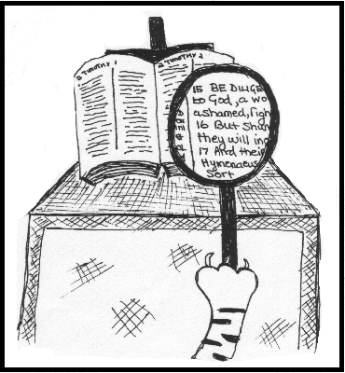

Hermeneutics
Correctly Interpreting The Word of God

Slide 2



Introduction
The Scope of Scripture Interpretation
“All Scripture is given by inspiration of God and is profitable for doctrine, for reproof, for correction, for instruction in righteousness”.
2 Timothy 3:16

Slide 3

English Word | Greek Word | Meaning
Inspiration | Theopneustos
Profitable | Ophelimos
Doctrine | Didaskalia
Reproof | Elegchos
Correction | Epanorthosis
Instruction | Paideia
God-breathed
From the root ‘to heap up’ (accumulate for benefit)
Teaching, instruction of doctrine / precepts.
A proof, that by which a thing is tested (SIN)
Restoration to an upright state. Correction, improvement of life or character (ERROR)
Used of the whole training and education of children

Slide 4
English Word | Greek Word | Meaning
Inspiration | Theopneustos
Profitable | Ophelimos
Doctrine | Didaskalia
Reproof | Elegchos
Correction | Epanorthosis
Instruction | Paideia
Doctrine:
What should I believe?
Reproof:
How should I not behave?
Correction:
What should I not believe?
Instruction:
How should I behave?
God-breathed
From the root ‘to heap up’ (accumulate for benefit)
Teaching, instruction of doctrine / precepts.
A proof, that by which a thing is tested (SIN)
Restoration to an upright state. Correction, improvement of life or character (ERROR)
Used of the whole training and education of children

Slide 5
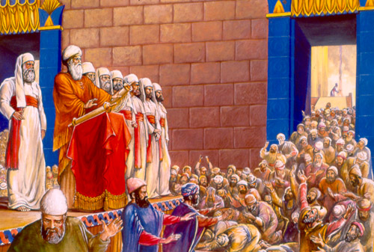
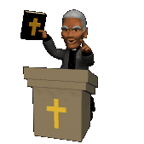
The Biblical Approach to Studying Scripture. See Nehemiah 8:5-12

Slide 6
The Biblical Approach to Studying Scripture. See Nehemiah 8:5-12
worshipful
Approach with a spirit (v5-6)
Recognize those good in and in (v7)
Read (v8a)
Give the (v8b) – Exegesis (observation).
(v8c) – Exegesis to Hermeneutics (Interpretation)
Respond in (v9-12) – Appl.
teaching
interpretation
distinctly
sense
Understand
holiness

Slide 7
Word | Meaning
Exegesis
Hermeneutics
What the writing meant to the people at the time of writing (The Author’s Intention).
What the text means to us today (interpreting the principles and not practices)

Slide 8
Biblical Wisdom
Be Careful
Much Work Ahead
Application
Interpretation
Observation

Slide 9
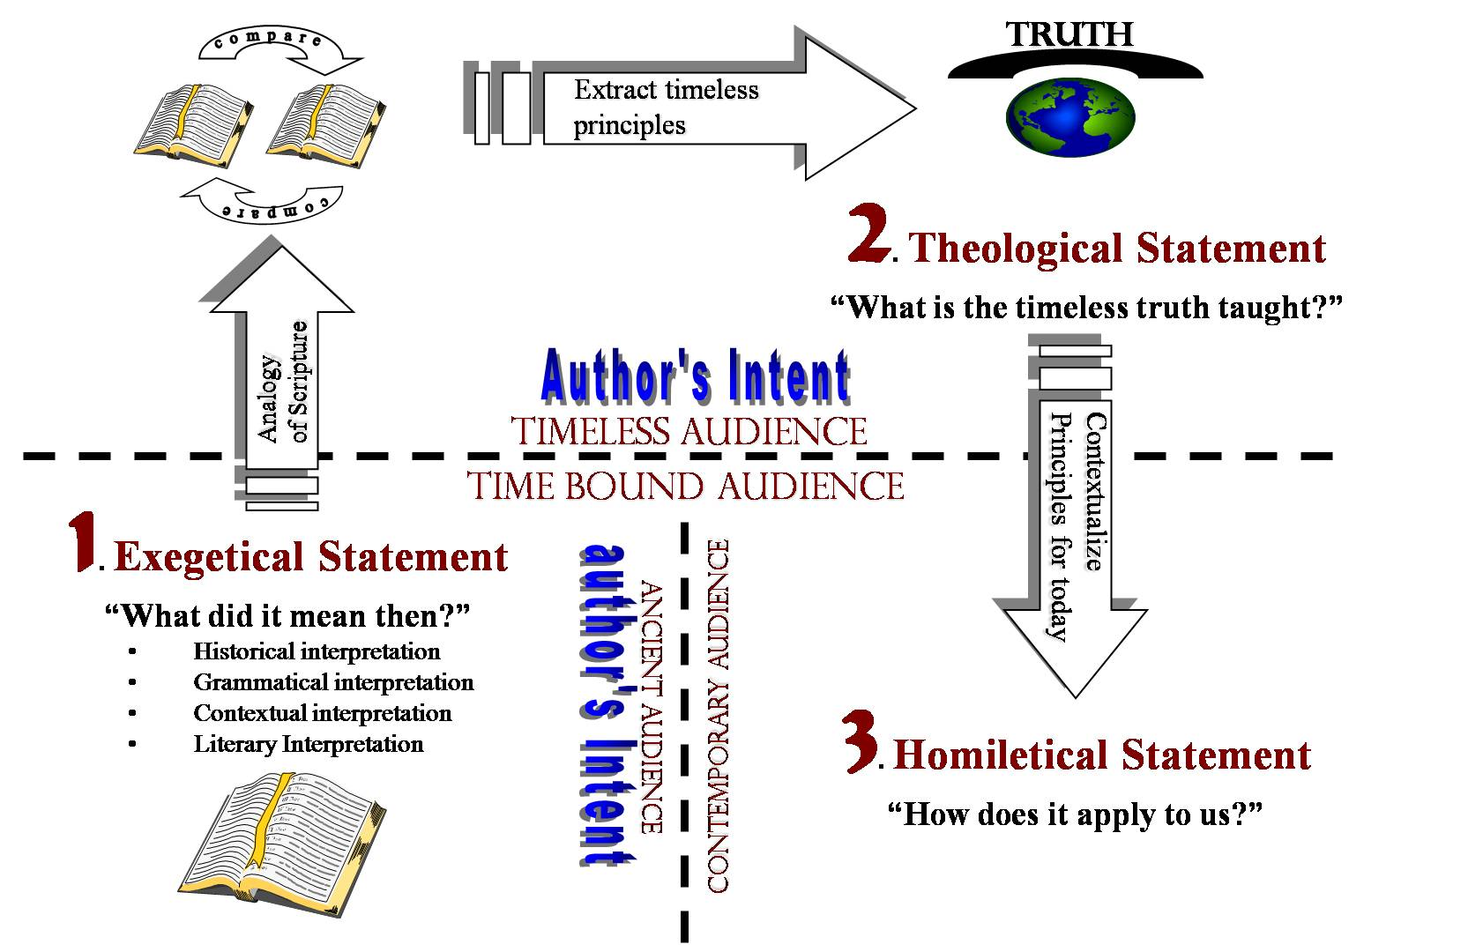

Slide 10
Wrong Interpretations
Type of wrong Interpretation | Examples
a. Taking Isolated Text
b. Misunderstanding the culture of Biblical times.
c. Grammatical error
d. Misunderstanding Biblical Hebrew thought.
e. Presuppositions (Eisegesis)
f. Sensationalism / Super-spirituality
Taking out of context.
Bible Times & Customs
From English or original language.
What something DOES not IS
Reading things INTO instead of OUT OF.
Finding ‘hidden meanings’

Slide 11
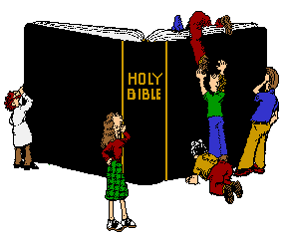
Step by Step Guide to Biblical Interpretation.
1. Get good of the Bible and other
translations
‘tools’.

Slide 12
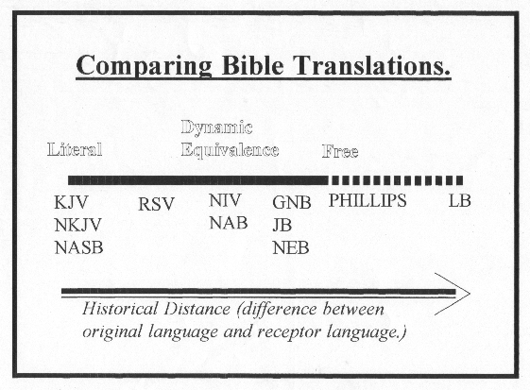
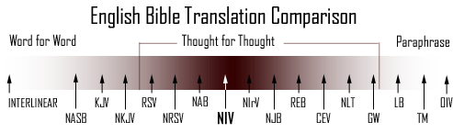

Slide 13
Literal translation of words and thoughts used.
KJV / NKJV
Interpreting words and ideas into modern equivalents
NIV
More of a free interpretation – changing words and grammar more dramatically for ease of understanding.
Living Bible

Slide 14
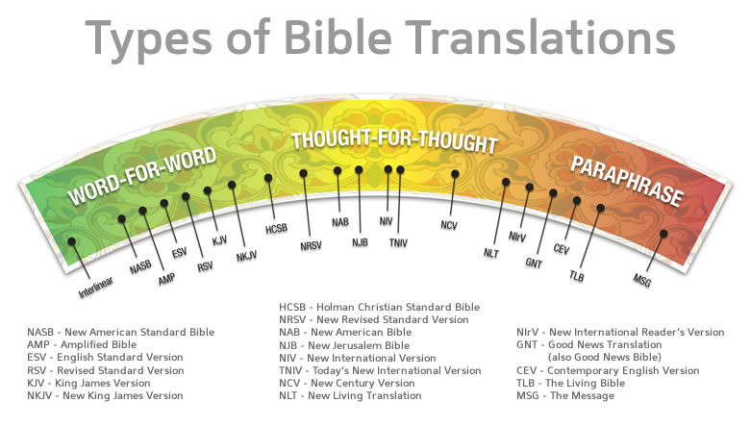

Slide 15
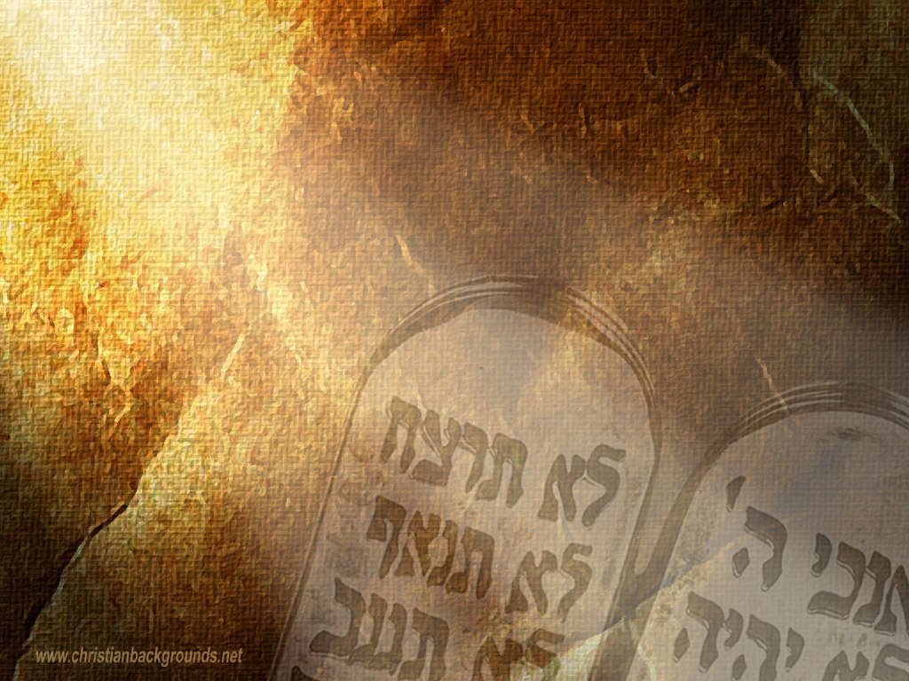
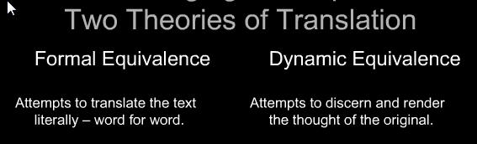
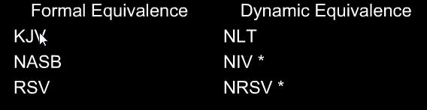
Types of Translation
e.g. 1 Peter 1:13
“Wherefore gird up the loins of your mind” (KJV)
“Therefore prepare your minds for action”
(NIV)

Slide 16
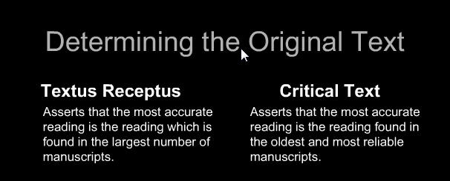
Translation from What Texts?
KJV/NKJV NASB/NIV
This difference in manner of determining the original texts causes many differences in the final reading but none of the differences are major in that they do not change any doctrines or the main message of the texts.

Slide 17
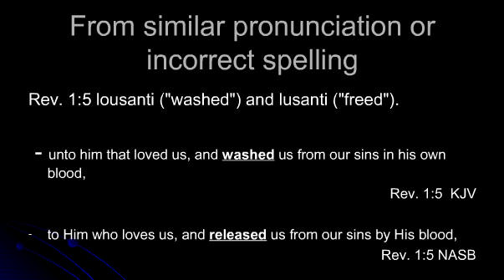
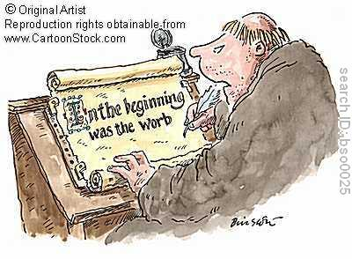
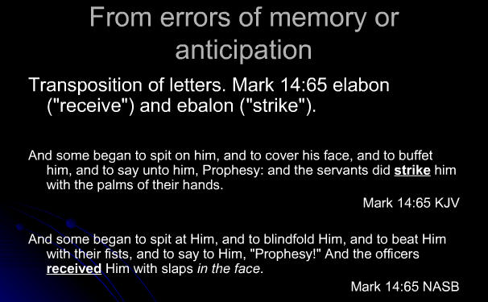
iv. Examples of Translation errors.
Examples of Translation Errors
A.
B.
BIBLIOLOGY: The Doctrine of Scripture

Slide 18
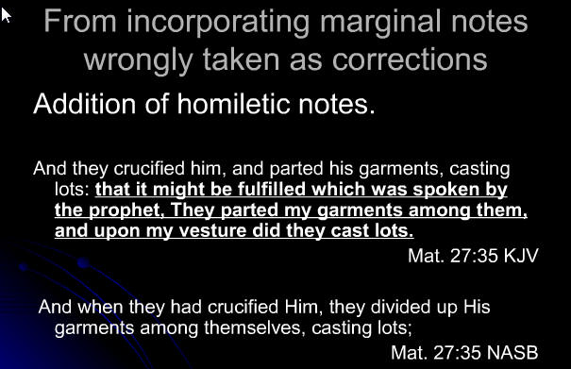
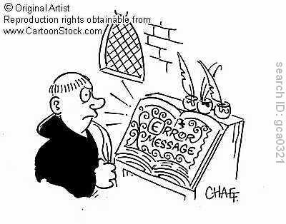
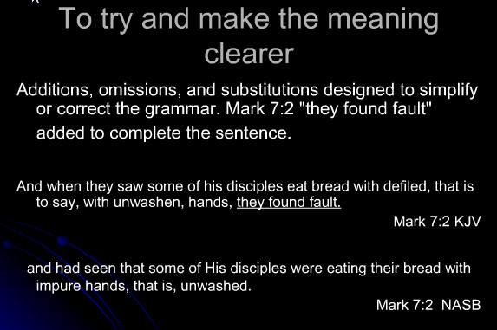
Examples of Translation Errors
C.
D.
BIBLIOLOGY: The Doctrine of Scripture

Slide 19
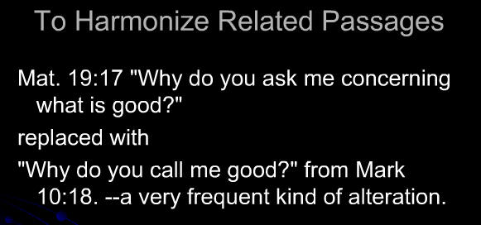
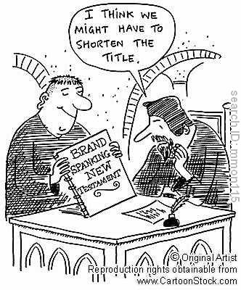
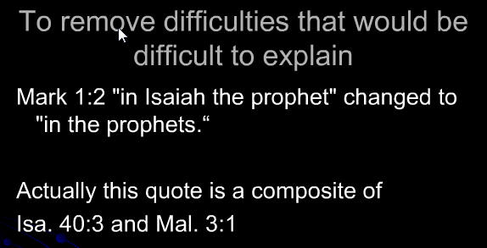
Examples of Translation Errors
E.
F.
BIBLIOLOGY: The Doctrine of Scripture

Slide 20
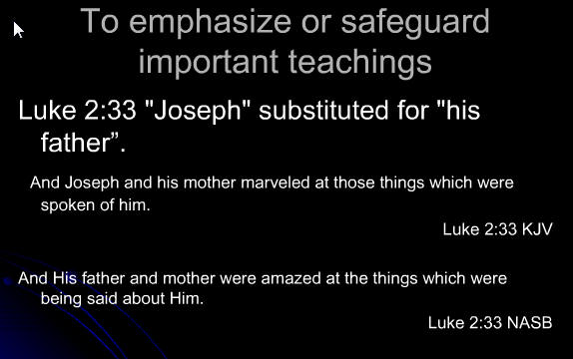
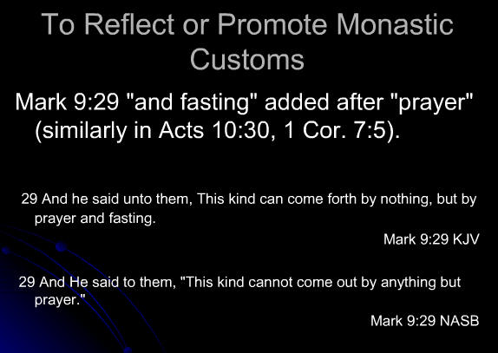
Examples of Translation Errors
G.
H.
BIBLIOLOGY: The Doctrine of Scripture

Slide 21
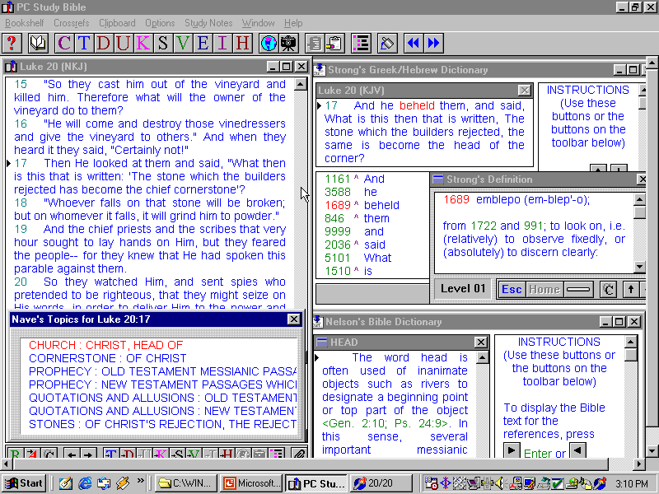

Slide 22

II. Make six basic
OBSERVATIONS
Firstly READ IT OUT ALOUD then ask the 5 W’s and an H…
WHO: Wrote it? Spoke it? About whom? To whom?
WHAT: Are the main events? Are the major ideas?etc
WHEN: Was it written? Did this take place? etc…
WHERE: Was this done? Was it said? Will it happen?
WHY: Was this written? Was this mentioned? etc..
HOW: Is it done? Is this truth illustrated?

Slide 23
II. Make six basic
PEOPLE
PLACE
PLOT
POINT
PRINCIPLES
PRESENT
PARALLELS
PERSONAL
PLAN
OBSERVATIONS
Firstly READ IT OUT ALOUD then ask the 5 W’s and an H…
WHO: Wrote it? Spoke it? About whom? To whom?
WHAT: Are the main events? Are the major ideas?etc
WHEN: Was it written? Did this take place? etc…
WHERE: Was this done? Was it said? Will it happen?
WHY: Was this written? Was this mentioned? etc..
HOW: Is it done? Is this truth illustrated?

Slide 24
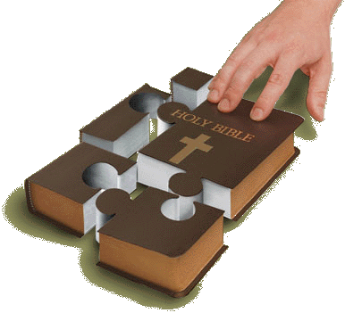

Slide 25
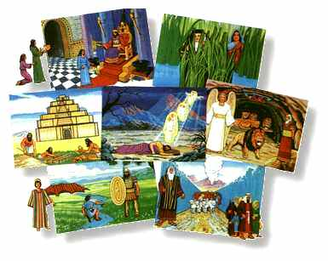
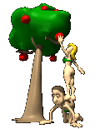
Old Testament
Narrative
Old Testament Narratives
Such as
Three levels…
TOP LEVEL= Whole universal of God worked out through creation.
MIDDLE LEVEL = Centers on
BOTTOM LEVEL = narratives.
Genesis, Exodus, Judges, Ruth, Esther
PLAN
ISRAEL
INDIVIDUAL

Slide 26
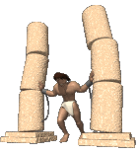
It usually will not teach a directly.
It will usually illustrate a found elsewhere.
Records happens (this is not necessarily what happen).
Not necessarily a good for us.
None of the characteristics are
We are to if their actions were good or bad on the basis of the rest of Scripture.
DOCTRINE
WHAT
SHOULD
EXAMPLE
PERFECT
JUDGE

Slide 27

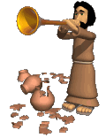
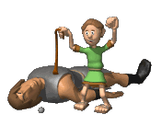
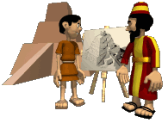
SELECTIVE
INCOMPLETE
7. All narratives are and
8. Not written to answer our questions
9. Teach a specific explicitly or implicitly.
Is the hero of all Biblical narratives.
THEOLOGICAL
POINT
GOD

Slide 28
With OT Biblical Narratives BEWARE OF..
Allegorizing -
Decontextualizing –
Selectivity -
False combinations –
Redefinitions -
Taking the story merely as an allegory rather than what really happened
Taking the story out of context and thus missing the main point.
Selecting only certain portions to get a point across and ignoring the rest.
Combining unrelated elements in the story.
When plain meaning leaves one cold it is tempting to redefine the meaning to seem more ‘spiritual’.

Slide 29
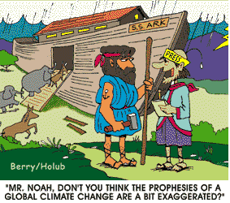

Slide 30
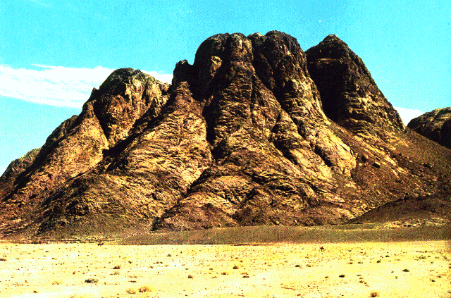

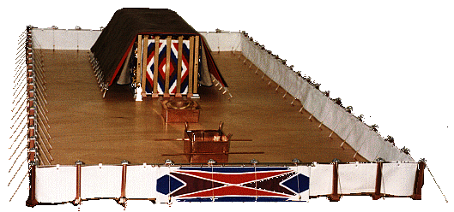
The Law(s) – Covenant
Stipulations to Israel

Slide 31
Such as
Matthew 5:17-18
"Do not think that I came to destroy the Law or the Prophets. I did not come to destroy but to fulfill. For assuredly, I say to you, till heaven and earth pass away, one jot or one tittle will by no means pass from the law till all is fulfilled.” (NKJ)
Jesus came to bring the correct of the Law. He fulfills the Law in His own life - This is seen in Matt 5:2—30; 22:37-40.
Leviticus, Deuteronomy
INTERPRETATION

Slide 32
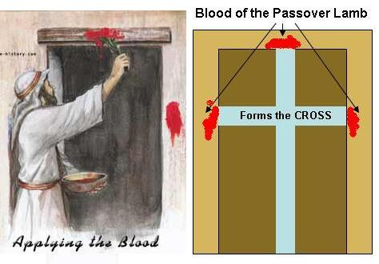
CEREMONIAL LAW:
THE SACRIFICIAL SYSTEM / PRIESTS & FEASTS – All these are no longer carried out by God’s people. The correct interpretation (fulfillment) of these are found in (THE SACRIFICE – all wrapped up in Him, THE PASSOVER LAMB etc..)
PHYSICALLY
JESUS

Slide 33
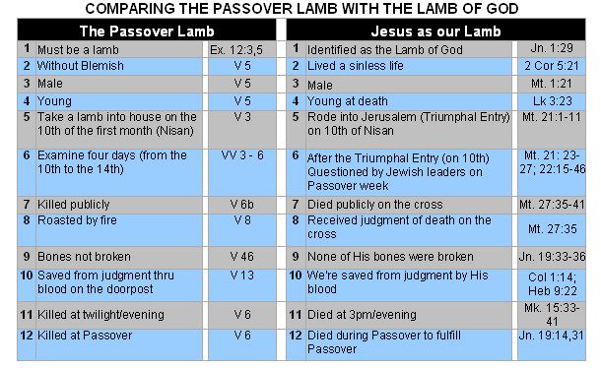

Slide 34
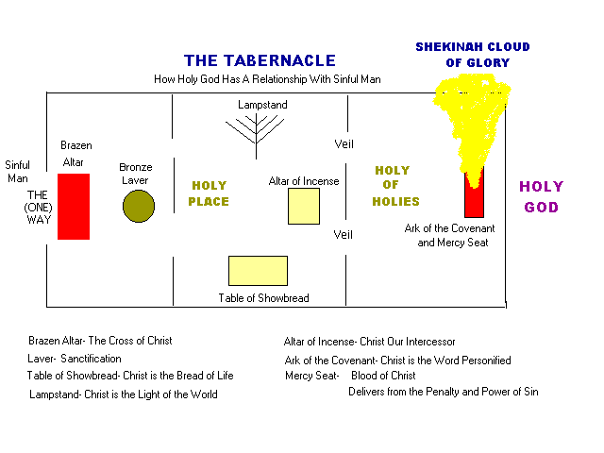

Slide 35
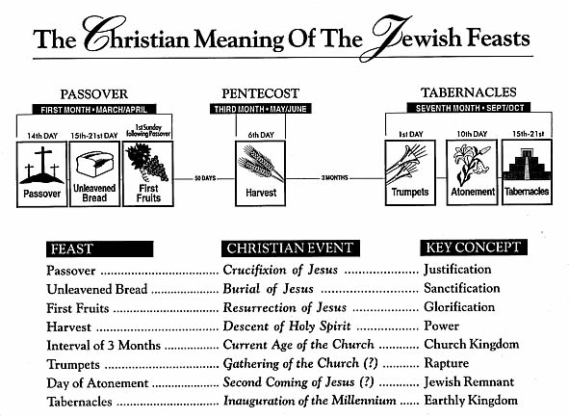

Slide 36
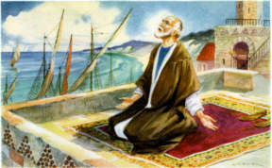
CIVIL LAW:
The FOOD LAWS and CLEANLINESS RULES were specifically for the situation that the Israelites lived in and were helpful to them but are no longer binding on us (should see them in a cultural context).
“In it were all kinds of four-footed animals of the earth, wild beasts, creeping things, and birds of the air. And a voice came to him, "Rise, Peter; kill and eat." But Peter said, "Not so, Lord! For I have never eaten anything common or unclean." And a voice spoke to him again the second time, "What God has cleansed you must not call common." This was done three times. And the object was taken up into heaven again.”
Acts 10:12-16(NKJV)

Slide 37
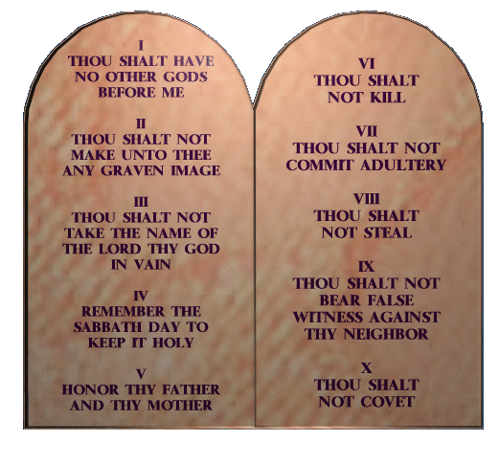
MORAL LAW:
Still in operation – indeed we are to keep the spirit and heart of these laws.
“You have heard that it was said to those of old, 'You shall not murder,' and whoever murders will be in danger of the judgment. But I say to you that whoever is angry with his brother without a cause shall be in danger of the judgment.”
Matt 5:21-22 (NKJV)

Slide 38
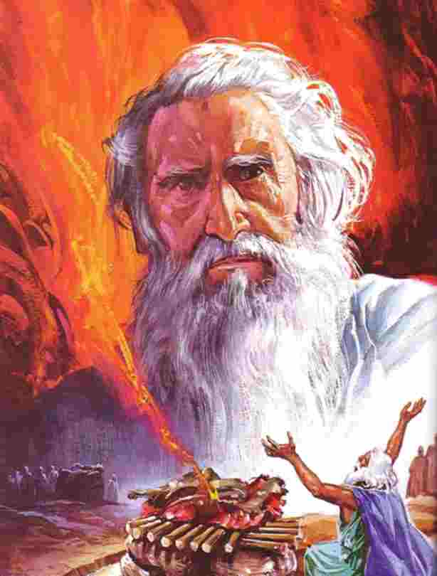

The Prophets
Such as
All major (e.g. Isaiah) and minor prophets (e.g. Haggai).

Slide 39
The Prophets
HISTORICAL
Understand the setting. Who is the Prophet addressing? Why? When ? Etc..
Think Don’t take isolated verses.
The Prophets were . Understand language (same for Proverbs, Psalms, Songs).
ORACLES
POETS
POETIC
Parallelism is widely used (foreign to modern thought)…..
Synonymous Parallelism (Isa 44:22)
Antithetical Parallelism (Hos 7:14)
Synthetic Parallelism (Obad 21)
Same thought.
Contrasting thoughts.
Adding to the thought.

Slide 40
The Prophets
of Prophecy
LEVELS
Immediate =
Cyclic =
Messianic =
End Times =
Fulfilled soon after time it was written.
Fulfilled in cycles through history.
Prophecies concerning the Messiah.
Prophecies solely about End Times.

Slide 41
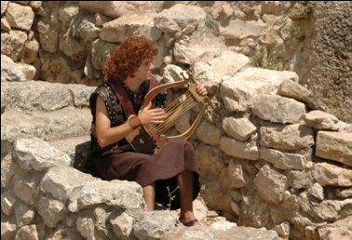
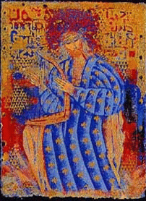
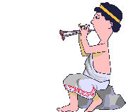
The Psalms
Psalms are and and are prayers and/or songs expressing some deep emotion of the Psalmist.
You must know the Psalm to determine the form and function of the Psalm.
You must treat the Psalms as and not single verses.
Psalms do not teach directly.
Note and study any given for the Psalm.
POETIC
EMOTIVE
TYPE
WHOLES
DOCTRINE
OCCASION

Slide 42


Wisdom Literature
Must be read in - don’t take bits / snatches.
Must understand it in terms of
Trace lines of - don’t live by what is intended to be incorrect (e.g. Job 8:4-6 is in context of bad counsel and is legalism if taken literally).
CONTEXT
Such as
Proverbs, Ecclesiastes, Job
CATEGORIES
ARGUMENT

Slide 43
Wisdom Literature
ECCLESIASTES: Is wisdom - life without God is The view seen is fatalistic wisdom that a godless person can take.
CYNICAL
MEANINGLESS
JOB: Job has counselors who give based on traditions etc. All their advice crumbles when God speaks. Really it shows how not to counsel.
ADVICE

Slide 44
Wisdom Literature
PROVERBS: attitudes.
Proverbs are often - pointing beyond themselves.
They are intensely - not theoretically theological.
They are - not technically precise.
They need ‘ ‘ if they reflect ancient cultures.
PRACTICAL
FIGURATIVE
PRACTICAL
MEMORABLE
TRANSLATION

Slide 45
Wisdom Literature
They are not from God but poetic guidelines of behaviour.
May use highly language or exaggeration to make a point.
Give good advice for approaches to certain aspects of life, but are not exhaustive.
GUARANTEES
SPECIFIC
WISE
Wrongly used, Proverbs may justify crass, materialistic lifestyles. Rightly used they will provide practical advice for daily living.

Slide 46
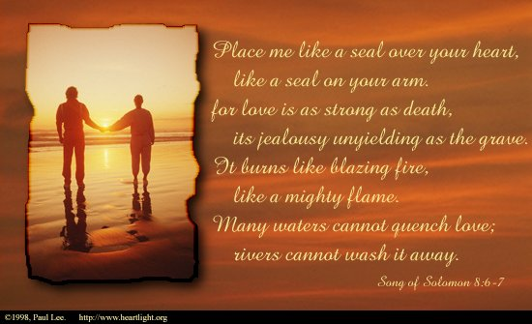
The Song of Songs
Also called: Canticles, Song of Solomon

Slide 47
The Song of Songs
Interpreted on three, simultaneous levels…
love.
God’s love for
love relationship with the
MARRIED COUPLE’S
ISRAEL
CHRIST’S
CHURCH.
The imagery is based on its and is in accordance with the rest of Scripture. We must be careful to identify who is speaking (e.g. 2:1-2 – who is Rose ?)
FUNCTION
US

Slide 48
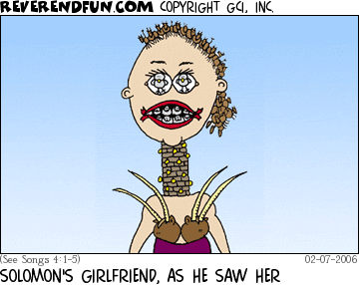
The Song of Songs

Slide 49
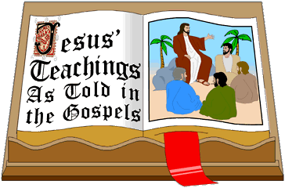
The Gospels
Such as
Matthew, Mark, Luke , John

Slide 50
The Gospels
HORIZONTALLY
Think (Parallel with other Gospels).
Think (Writer’s intention and historical setting).
VERTICALLY

Slide 51
The Gospels
The purpose of writing each Gospel is quite different and greatly affects your interpretation.

Slide 52
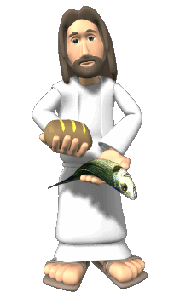
The Gospels
Gospel | Purpose
Matthew | Written to disciples as A manual. Show Jesus as
Mark | Written as an tract to Jew and Gentile. Primarily showing Jesus as
Luke | Written to unbelievers to persuade them. Primarily showing Jesus as the man.
John | Written to Christians for deeper teaching. Primarily showing Jesus as
JEWISH
DISCIPLING
KING
EVANGELISTIC
THE SERVANT
GENTILE
PERFECT
MATURING
GOD

Slide 53
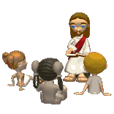
The Gospels
When reading the Gospels you need to identify if you are reading a narrative, parable or straightforward teaching and interpret accordingly.
Narrative = as we learnt for OT narrative.
Parable = see later.
Teaching = See epistles.

Slide 54

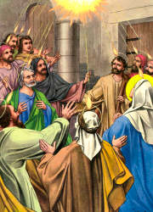

The Book of Acts
Keep in mind Luke’s purpose of tracing the movement of the in the Early Church and Mission. It must be all seen in this light.
HOLY SPIRIT

Slide 55
The Book of Acts
See it in the context of the history and the
of that time. Acts is excellent material to the Epistles.
CULTURE
BACKGROUND
As it’s mostly narrative you should use the same guidelines as for OT narratives.

Slide 56


The Epistles
Such as
Romans, Corinthians, Galatians, Ephesians etc..
Form a tentative but informed
of the situation that the author is speaking to.
ii. Read the letter through as you would any other letter.
iii. Think . Trace the author’s argument and determine the main point of the passage.
RECONSTRUCTION
WHOLE
PARAGRAPHS

Slide 57
The Epistles
Such as
Romans, Corinthians, Galatians, Ephesians etc..
iv. Extract
not practices.
v. Where there are
PARTICULARS (same specific life situations) with the first century setting, God’s word to us is the same as His word to them.
PRINCIPLES
COMPARABLE

Slide 58


Apocalyptic Literature
Such as
Daniel and Revelation

Slide 59
Apocalyptic Literature
PRIMARY
The meaning of the book is what the author intended it to mean.
We must be open to the possibility of a
meaning not seen by the author.
iii. We must be sensitive to the rich
of ideas and imagery (look at pictures as a whole, not small details).
iv. Look for the author’s of images.
SECONDARY
BACKGROUND
INTERPRETATION

Slide 60


IV. Look at the of the passage.
CONTEXT
Remember that the is KING in interpretation.
A TEXT TAKEN OUT OF IS A PRETEXT
CONTEXT
CONTEXT

Slide 61
IV. Look at the of the passage.
CONTEXT
We need to see the…
context (surrounding verses).
context (chapter/ book).
context (way it is worded).
, , context (customs, items, religious practices of the time).
context (historical background / setting).
(geographical setting).
(authors style & other writings)
IMMEDIATE
LITERARY
GRAMMATICAL
CULTURAL
SOCIAL
RELIGIOUS
CONTEXT
HISTORICAL
GEOGRAPHICAL
AUTHORIAL

Slide 62

V. Other Practical Pointers
Accept the Bible as a
Revelation.
Scripture will never Scripture.
Let Scripture Scripture.
If Scripture seems to contradict itself then your interpretation is WRONG.
PROGRESSIVE
CONTRADICT
INTERPRET

Slide 63

V. Other Practical Pointers
Always seek the counsel of God’s Word (e.g. Matt 11:12 comes from Micah 2:12-13).
Practically this means…
Look up all -
Go back to the of
themes / things mentioned.
WHOLE
CROSS
REFERENCES
FIRST MENTION

Slide 64

V. Other Practical Pointers

Slide 65
Always interpret Scripture unless it obviously not to be taken that way.
LITERALLY
MYSTICISM
The Bible is not a book of , nor is it to be over-spiritualized.
Take the Word of God in its , normal sense as you would other writings. When men depart from literal interpretations of the Word of God it becomes a free-for-all.
Literal interpretations means that we should recognize and respect principles and laws of
Allegories, Parables, figures of speech should be treated as such , as should symbols.
NATURAL
GRAMMATICAL
INTERPRETATION

Slide 66

(1) Parables
A story which teaches a lesson or truth.
MORAL

Slide 67
(1) Parables
Ascertain the of the Parable.
Look for the meaning of the Parable.
Identify the idea of the Parable.
Identify and details.
Parables have themes that must be interpreted in the in the light of Biblical , not ours.
Parable should never be the primary basis for
OCCASION
INTENDED
CENTRAL
RELEVANT
IRRELEVANT
CULTURAL
CULTURE
DOCTRINE

Slide 68


(2) Allegory
A story with an meaning different from the surface meaning of the story itself (e.g. John 10,15)
UNDERLYING

Slide 69
(2) Allegory
Can have more than one point of emphasis.
Can teach a number of
The details may be , relating to more than one theme.
Can have details.
Intertwines the story and the
is found within the allegory.
CENTRAL
TRUTHS
MANY
IRRELEVANT
MEANING
APPLICATION

Slide 70

(3) Types
PROPHETIC
A Type is a symbol designated by God that foreshadows the real thing.

Slide 71

(3) Types
Types are preordained representative relationships which certain persons, events and institutions bear to corresponding persons, events and institutions occurring at a later time in salvation history.
‘Tupos’ = ‘mark formed by blow or impression resulting in image. That which it prefigures is called an
ANTITYPE

Slide 72

(3) Types
There must be evidence that the Type is
by God to represent the thing typified (e.g. The Tabernacle (Heb 10:20), The Brazen Serpent (John 3:14-15); Adam (Romans 5:14).
b. If the Bible does not identify something as a Type it may still be alright to draw parallels and use the object, event or person as an illustration, but it is questionable to designate it as a Type.
APPOINTED

Slide 73


(3) Types

Slide 74

(4) Symbols
Something that for another meaning in addition to its ordinary meaning.
STANDS
e.g. Wine is a symbol of the blood of Jesus, Bread of His body and also the word of God.
Brass is the symbol of
JUDGMENT

Slide 75

(4) Symbols
The thing symbolized can symbolize things (e.g. Bread symbolizes Word of God, Jesus and Bible).
A symbol can symbolize many things; but when a symbol does symbolize something, a parallel is intended.
When interpreting symbols, the task of the interpreter is to identify, not from experience or culture, but from culture, what point of reference is between the symbol and the thing symbolized (e.g. Salt)
DIFFERENT
SINGLE
OWN
BIBLICAL

Slide 76

(4) Symbols
d. Look at the of a symbol through Scripture to build up a picture of it’s meaning (e.g. surveying the mention of Fig Tree in Scripture shows it represents Israel).
e. Numbers are sometimes used symbolically in Scripture (40 is the number of testing, 7 is the number of completeness etc.) – use the above process (in d.) to determine the numbers meaning.
PROGRESSION

Slide 77

(5) Figures of Speech
Metaphor – an comparison between two things which are different (e.g. John 6:48 – ‘I am the Bread of Life’.
IMPLIED
Simile – An comparison between two different things or ideas that uses the words ‘like’, ‘as’, ‘as..so’, and/or ‘such as’ (See Matthew 3:16)
EXPRESSED
Hyperboles – a deliberate for effect or emphasis (e.g. Ps 119:20).
EXAGGERATION

Slide 78


(5) Figures of Speech
Personification – A non personal or non-living thing is spoken of as though it were a (e.g. Isa 55:12)
PERSON
Irony – A statement which says the of what is meant
(e.g. 1 Cor 4:8).
OPPOSITE

Slide 79

(5) Figures of Speech
Idiom – An expression unique to a certain culture that will be seen as unintelligible or funny in other cultures (e.g. In English culture, ‘ Lend me your ears’ means, ‘Listen to me’.)
Examples of Hebrew idioms…
Luke 6:22 – ‘cast name out as evil’ .
Matt 6:22-23 – ‘Good and bad eye’.

Slide 80

VI. The Importance of Referring Back To The Hebrew / Greek.

Slide 81
VI. The Importance of Referring Back To The Hebrew / Greek.
Use STRONGS CONCORDANCE and VINES for what the Greek/Hebrew word is as what it precisely means.
Recognize that the same word in English may have many subtle meanings in Greek or Hebrew….

Slide 82


Slide 83


Slide 84
3. Understand the TENSES in the Hebrew and Greek – this will give you a more precise understanding of Scripture.
e.g. Using the Hebrew-Greek Key study Bible you will find that in Ephesians 5:18 the verb ‘be filled’ (with the Spirit) is in the PRESENT IMPERATIVE tense which means ‘a command to do something in the future which involves continuous or repeated action.’
From this we can interpret the passage that we should continuously be filled with the Spirit – indeed Paul commands it as He sees it as imperative to the victorious Christian life.

Slide 85




Slide 86
VII. Applying The Scripture
Remember to always look for the meaning of the passage unless there are obviously other meanings. This will show you the author’s and the original reader’s understanding.
SINGLE
INTENTION
Next is the tricky task of applying what was written to a Biblical culture to our culture today. This is extracting PRINCIPLES, not PRACTICES and applies these PRINCIPLES to today’s context.

Slide 87
VII. Applying The Scripture
This is done by crossing what is called the ‘Hermeneutical Bridge’ as can be seen in the following diagram…

Slide 88




Slide 90

Summary of Interpretation Steps
Use good translations and other reference materials.

Slide 91

2. Read the passage and make observations (should do this several times until it is ‘in’ you).

Slide 92

3. Consider the type of literature the passage is.

Slide 93

4. Take the passage in context (look at cross-references and first mention).

Slide 94

5. Take the passage within the whole counsel of the Word (let Scripture interpret Scripture).

Slide 95

6. Determine the original intention of the passage and extract principles not practices.
TIMELESS
PRINCIPLES

Slide 96

7. Apply the principles to the intended situation.

