Slide 1
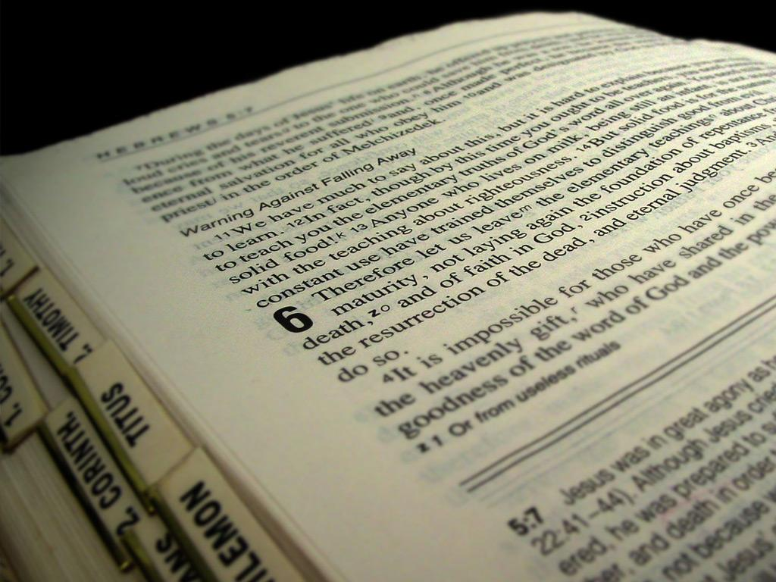
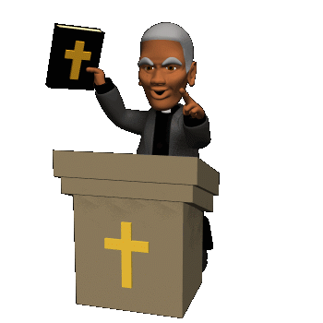
Homiletics

Slide 2


Homiletics
“Pentecostal preaching means a type of message and a style of delivery characteristic of Pentecostal worship. Pentecostal preaching is the best of one’s study and meditation, warmed by the Spirit of God, and made to glow in the heart by the anointing of the same Holy Spirit.” Ray H. Hughes

Slide 3




Homiletics
The power and presence of the Holy Spirit influences and empowers….
The Man The Method The Message
(Preacher) (Preparation) (Preaching)

Slide 4

Homiletics
5 key components that distinguish Pentecostal preaching:
1. True Pentecostal preaching must centre on the Word of God.
2. Pentecostal preaching must always exalt Jesus Christ.
3. Pentecostal preaching should always be directed and empowered by the Holy Spirit.
4. Pentecostal preaching should be prophetic.
5. Pentecostal preaching is uniquely effective (convicting of sin, producing faith, confronting demonic power, producing Godly reverence and being confirmed by the operation of spiritual gifts).

Slide 5

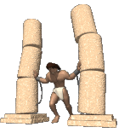

Homiletics
Types of Preaching
Topical
Narrative
Expository

Slide 6

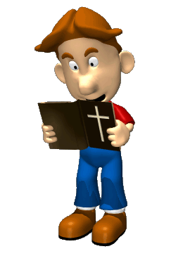
Homiletics
Preparation of the Preacher
Man of Heart
Man of Prayer
Man of the Book

Slide 7
Homiletics
Preparation of the Preaching
Topical Preaching
Definition of a Topical Sermon:
A topical sermon is one in which the main divisions are derived from the topic, independently of a text.
This means that the--
1) A Topical sermon begins with a topic or theme and that the main parts of the sermon consist of ideas which come from that topic.
2) It does not require a text as the basis of its message. That is, a certain text is not the source of the topical sermon, although it is all based on the Word of God.
3) We start with a Biblical topic. The main divisions of the sermon outline must be drawn from this Biblical topic, and each main division must be supported by a Scripture reference.

Slide 8

Homiletics
Preparation of the Preaching
Topical
Preaching
Unity of thought – one central idea
Various kinds – all reveal God’s purposes
Correctly choosing – The leading of the Lord!

Slide 9

Homiletics
7 Basic PRINCIPLES for the PREPARATION of Topical Outlines!
1. The main divisions should be in logical or chronological order.
2. The main division may be an analysis of the topic. Each part of the outline contributes to the completeness of the discussion of the topic.
3. The main divisions may present the various proofs of a topic.
4. The main divisions may treat a subject by comparison or contrast with something else in Scripture.

Slide 10
Homiletics
7 Basic PRINCIPLES for the PREPARATION of Topical Outlines!
5. The main divisions may be expressed by a certain word or phrase of Scripture which is repeated though out the outline.
6. The main divisions may be supported by an identical word or phrase of Scripture though out the outline.
7. The main division may consist of a word study showing the various meanings of a certain word or words in Scripture. (Such as a study of the names of Christ, or the names of God, etc.)

Slide 11

Homiletics
Various ideas about Topical messages!
1. The topical message is suited to the construction of the doctrinal sermon.
2. Many times you may choose to work on a series of topical messages -- such as the Love of Jesus, the Face of, the Hands of, the Tears of, the Cross of, the Blood of, etc.
3. A study of major subjects in a book or a group of books in the Bible will also suggest a series of discourses in topical form.

Slide 12

Homiletics
Expository Preaching
10 Basic Principles for the Preparation of Expository Outlines!
1. Any passage under consideration should be carefully studied to understand its meaning and to obtain the central thought of the text.
2. Significant words or phrases in the text may indicate or form the main divisions of the outline.
3. The outline should be drawn from the expository unit in a chronological way.
4. The important truths suggested by the passage may form the main divisions of the outline.
5. Two or three passages from various parts of Scripture may be put together to form the basis of an expository outline.

Slide 13

Homiletics
10 Basic Principles for the Preparation of Expository Outlines!
6. By means of the method of multiple approach, we may treat a passage of Scripture in various ways and thus have two or more entirely different outlines on the same portion.
7. We should, in study, note the context.
8. In study we should also note the historical background of the passage, whenever possible.
9. The details of the text should be treated properly, but not necessarily exhaustively. Don’t spend too much time on the details.
10.The truths contained in the text must be related to the present day through application of truths to present needs.

Slide 14

Homiletics
The Study Phase
Stage One – Observation
Task 1: Determining the boundaries of the passage.
Task 2: Identify the central idea of the passage in the writer’s own words.
Task 3: Analyze how the biblical writer develops this theme in the passage.
Task 4: Find the “situation clues” and “purpose clues” in the immediate and broader context.

Slide 15

Homiletics
Stage Two – Interpretation
Task 5: Write a paragraph summarizing the situation the passage addresses.
Task 6: Write a paragraph synthesizing the purpose clues of the passage.
Task 7: Develop a descriptive outline tracing the argument of the passage.
Task 8: Engage in further study using quality resources.
Stage Three – Application
Task 9: Identify how the passage applies to similar situations today.
Stage Four – Response
Task 10: Personally respond to the teaching of the passage.

Slide 16

Homiletics
The Strategy Phase
(For all types
of Preaching)
Step 1: Prayerfully reflect on what you have studied.
Step 2: Write a theme statement (proposition) for your sermon.
Step 3: Identify the “felt need” that the passage addresses.
Step 4: State clear objectives for your message.
Step 5: Brainstorm with a creative team about media and drama support.
Step 6: Come up with a good title and introduction.
Step 7: State each point as a principle.
Step 8: Explain and apply the text for each point.
Step 9: Identify apt illustrations and jokes.
Step 10: Prayerfully craft your conclusion and appeal.

Slide 17

Homiletics
Step 2
The Importance of the Proposition!
The proposition is the foundation of the entire structure of the sermon.
The proposition will accurately express the main thought of the sermon.
It clearly indicates to the congregation the course of the sermon.
Types of Propositions!
1. The form most commonly used is the declarative or declaring --
2. Another type is the interrogative or using questions.
3. The third kind of proposition is called the hortatory (exhorting).
4. The fourth kind of proposition is known as the exclamatory.

Slide 18
Homiletics
Step 2
5 Principles for the Formulation of the Proposition!
1. The proposition should contain one main idea.
2. The proposition should generally be expressed in the form of a timeless truth stated simply and clearly
3. The proposition should be stated as concisely and clearly as possible. (Few words – much meaning.)
4. The proposition should be connected to the main body of the discourse by questions and a transitional sentence.
Interrogative -- Why is the Christian life said to be a life of dependence?
Transitional sentence -- There are several reasons why the Christian life may be said to be a life of dependence.
5. The proposition may be formulated by including the key word and the transitional sentence with the statement of the thesis or aim of the message.

Slide 19

Homiletics
Step 6
The Title of a Message or Sermon!
1. The title should be pertinent to the text or to the message.
2. The title should be interesting.
3. The title should be in keeping with the dignity of the pulpit.
4. The title should generally be brief.
5. The title may be stated in the form of either facts, questions, or exclamation.

Slide 20

Homiletics
Step 6
Introduction to a Message or Sermon!
The Purpose is --
To secure the good will of the hearers.
To arouse interest in the theme.
Principles for a Good Introduction!
1. It generally should be brief.
2. It should be interesting.
3. It should lead to the dominant idea or central thought of the sermon or message.
4. It should be stated in the outline in a few brief sentences or phrases, with each successive idea on a different line.

Slide 21

Homiletics
Step 7
eg. “Thank You for Giving to the Lord” (Text: Philippians 4:10-23)
Points Stated as Descriptive Statements | Points Stated as Principles
1. Their Gift: Prompted Paul’s Rejoicing (vv. 10, 20) | 1. Giving Prompts Praise (vv. 10, 20)
2. Their Gift: And an Important Lesson Paul Learned (vv. 11-13) | 2. Giving Helps Put Things in Proper Perspective (vv. 11-13)
3. Their Gift: A Partnership in Ministry (vv. 14-16) | 3. Giving Demonstrates Partnership in Ministry (vv. 14-16)
4. Their Gift: An Investment and More (vv. 17-18) | 4. Giving Is a Heavenly Investment and a Pleasing Sacrifice to God (vv. 17-18)
5. Their Gift: Leads to a Wonderful Word of Assurance (v. 19) | 5. Giving Results in a Wonderful Promise of

Slide 22
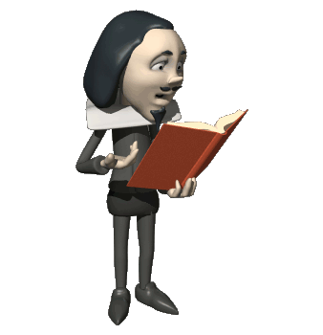
Homiletics
Step 9
The speaker’s greatest asses is the listeners IMAGINATION
3 tactics of Story Telling:
1. PHRASES of truth
CLEVER phrase – “When you come to the end of yourself you come to the beginning of God.”
DEFINITIONS – “Commitment is staying true to a worthy decision long after thee motions have gone.”
QUOTES – “A Bible that is falling apart usually belongs to someone who isn’t” Moody
2. Word PICTURES (e.g. 2 Tim 3:16 – picture of a road – Doctrine = Signpost, Reproof = turning 180 degrees to go right way, correction = coming back on track, instruction = walking with an experienced guide)
3. Illustrative STORIES – listen to good story tellers, Read short stories/illustrations, increase your vocab and be more descriptive.

Slide 23
Homiletics
Step 10
Ten key characteristics should be evident in effective sermon conclusions:
• They should evidence prayer and thoughtful preparation.
• They should be brief and sincere.
• They should be prepared with the purpose of the passage in mind.
• They should the be logical extension of the truth of the passage.
• They should provide the emotional climax of the sermon.
• They should personalize the application – moving the sermon from second and third person (“others”) to first person (“me”).
• They should seek a verdict based on the evidence presented in the message.
• They should seek a commitment from the hearer.
• They should be specific about what the preacher expects the audience to do at the close of the service.
• They should be sensitive to the working of the Spirit in the heart of the hearer.

Slide 24

Homiletics
The Preaching Itself
Overcoming Nervousness
Be CONVINCED
LIVE it out.
Get the MESSAGE in you.
Deal with NEGATIVE ROOTS of nervousness
Visualize an audience of ONE.

Slide 25

Homiletics
The Preaching Itself
Presentation Tips
PREPARE and over-PREPARE
MEMORIZE your first 50 words.
Stay SIMPLE
Stay HUMBLE
Before you go up to speak - BREATH
Speak SLOWLY
Develop a greater PASSION than your FEAR

Slide 26
Homiletics
The Preaching Itself
The Holy Spirit enhances the presentation of the Pentecostal preacher.
The preacher should not be bound to outline but led by Spirit.
The Spirit helps overcome distracting mannerisms and idiosyncrasies.
The Spirit free preachers from the destructive self-consciousness that destroys effective communication.
He is also able to help the preacher maintain a clear sense of objective so that freedom and flexibility do not degenerate into pointless and aimless wanderings.
The Holy Spirit will enable a realistic evaluation of time so that a fully developed sermon can be preached (exercise self control - Gal 5:22-23)
There is an appropriate sense of authority that comes from the Spirit of God at work in the preacher’s life (Mt. 7:29; Mk. 1:22).
The guidance of the Holy Spirit along with the preacher’s interpersonal skills are critical to dealing with unexpected disruptions (1 Cor 14:40)

Slide 27

Homiletics
Important Points for effective preaching:
- Eye contact
- Voice control
- Correct Gestures & Posture
- Dress appropriately
- Never disqualify yourself as a teacher or your content
- Speak both as a fellow-learner/sinner and as a prophet.
- Be sensitive to the non-Christian and the new Christian.
- Use slang only if it is appropriate to your audience..
- Avoid verbal "fat."
- If you blank out or mess up, go on to the next point.

Slide 28

Homiletics
The Holy Spirit leads into congregational response and ministry.
The preaching of the Word should give rise to faith and the Holy Spirit’s activity among God’s people that provide the setting for the miraculous to occur (I Cor 12:8-10)
The Holy Spirit pierces hard hearts, smashes resistance, breaks down walls, opens doors, and slips in through the smallest of crevices. He seasons and influences everything (Acts 2:2)

Slide 29
Homiletics

