Slide 1
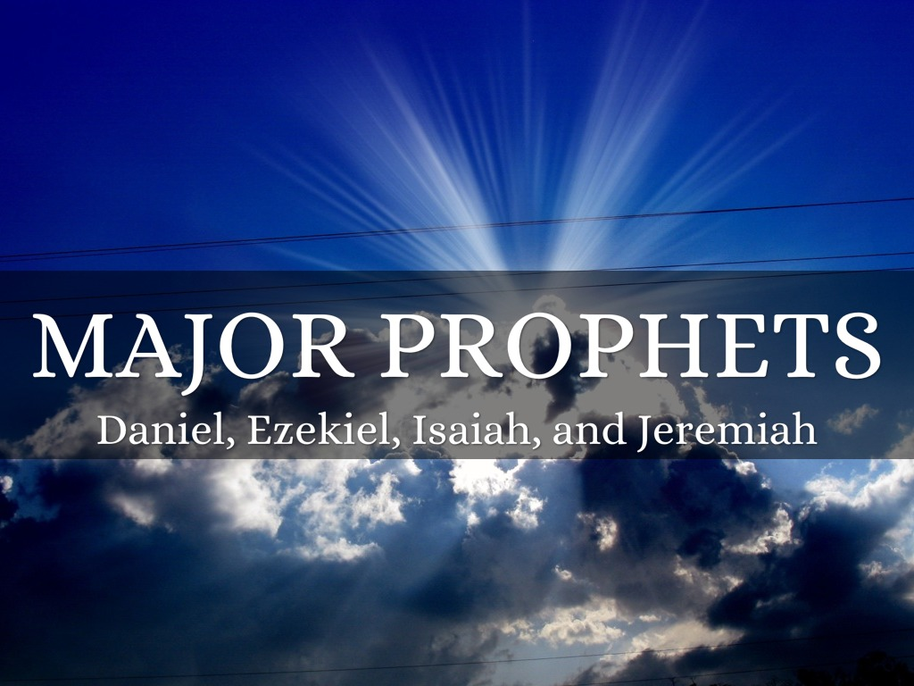

Slide 2
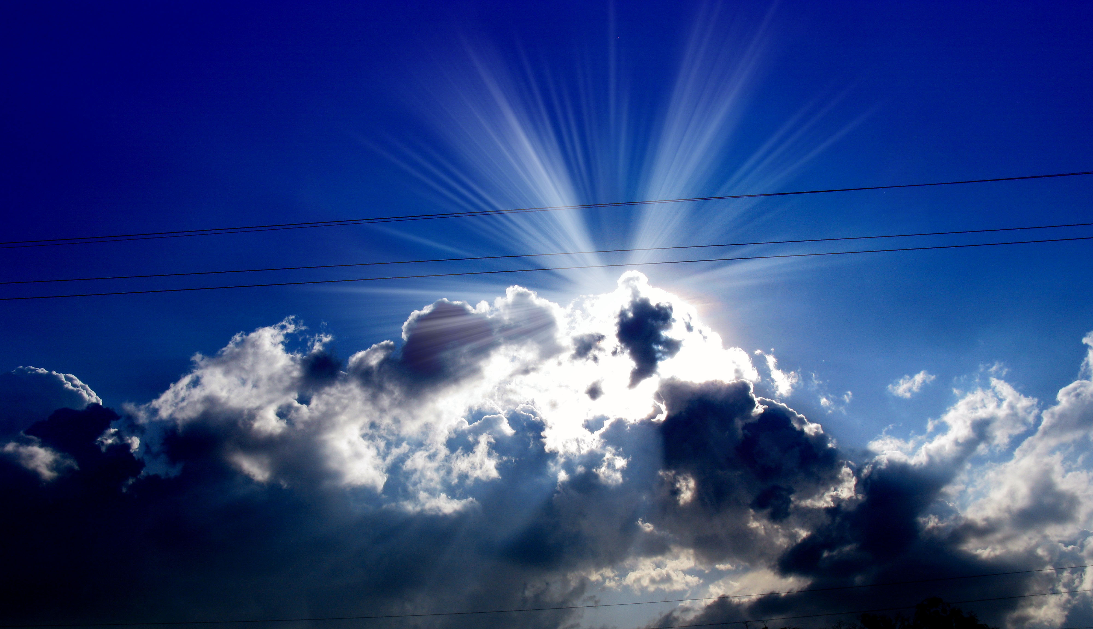
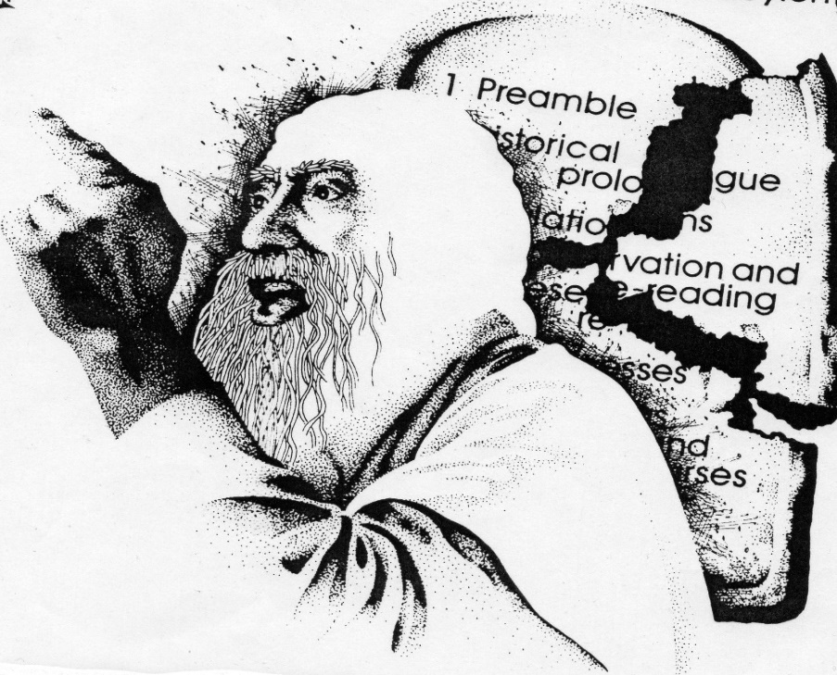
LESSON ONE: OVERVIEW OF THE MAJOR PROPHETS

Slide 3
1. Introduction
The prophets began their messages with statements such as
Thus saith the Lord…
They were FORTH-TELLERS rather than FORE-TELLERS
“ Now you shall speak to him and put the words in his mouth. And I will be with your mouth and with his mouth, and I will teach you what you shall do. So he shall be your spokesman to the people. And he himself shall be as a mouth for you, and you shall be to him as God.” Exodus 4:15-16

Slide 4
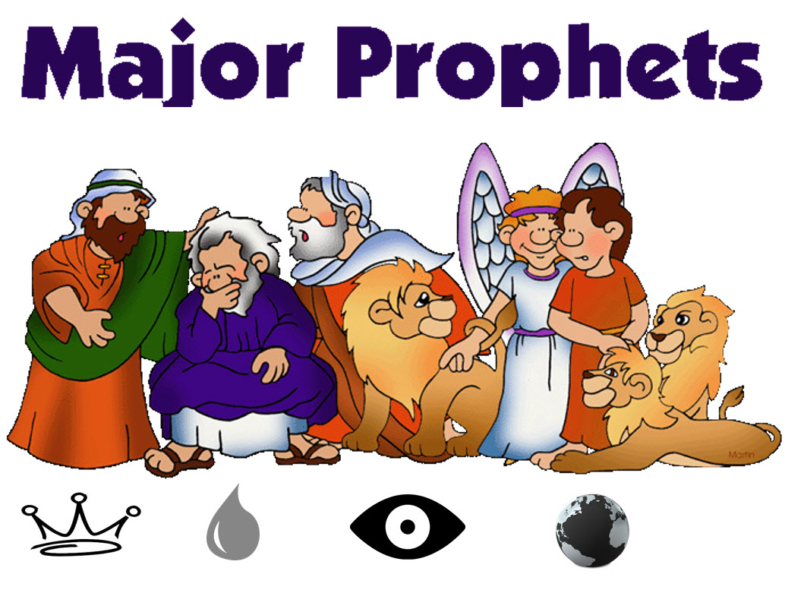
They are not more important than the MINOR Prophets

Slide 5


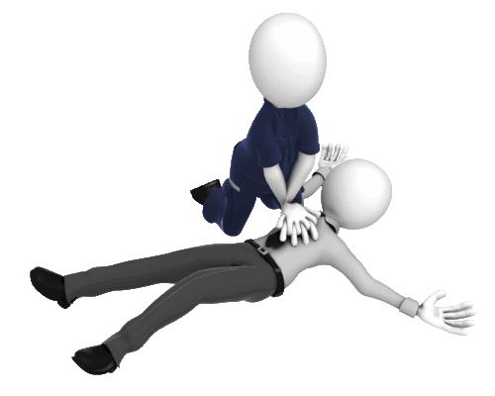

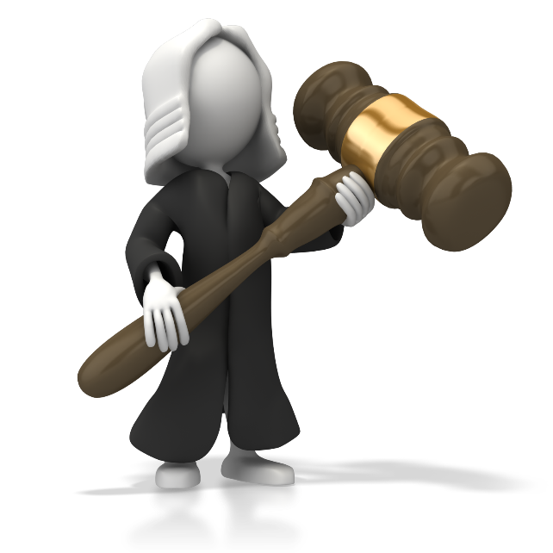
Comparing the Four Prophets
God Saves
God Lifts Up
God Strengthens
God Judges
739-692 BC 627-574 BC 593-559 BC 605-536 BC
47 years 53 Years 34 Years 69 Years

Slide 6
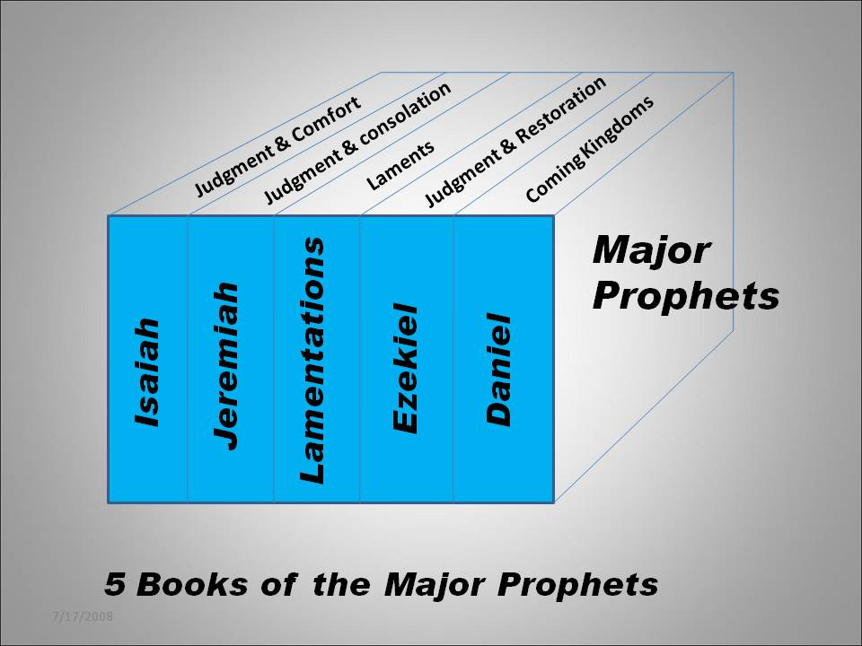

Slide 7
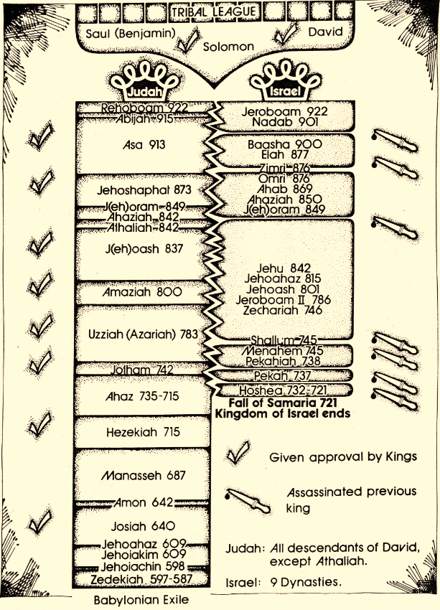
2. The Time of the Prophets
Ministered in context of the divided kingdom and exile.

Slide 8
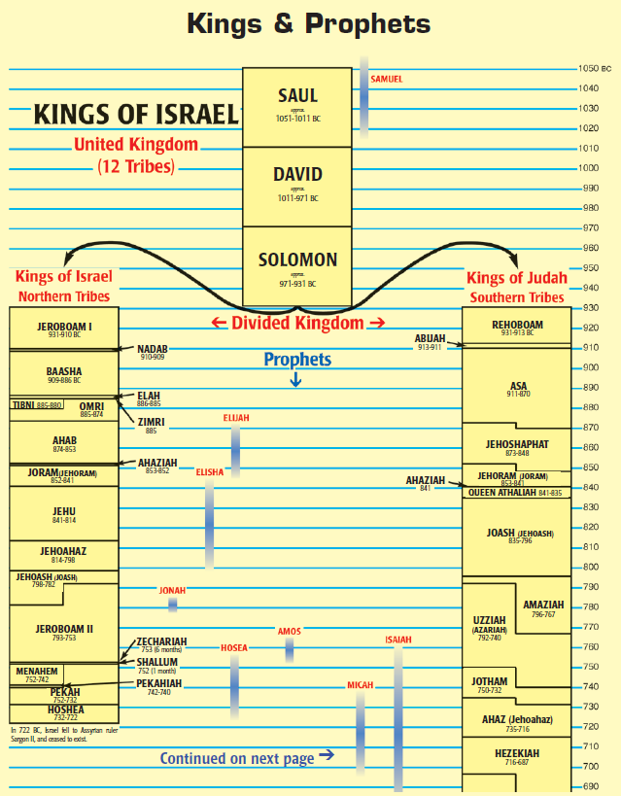
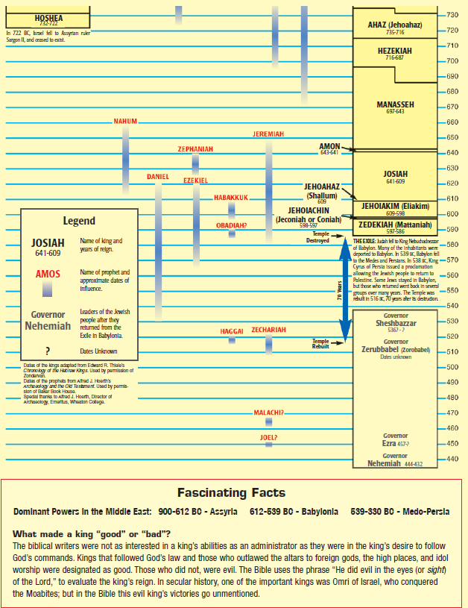

Slide 9
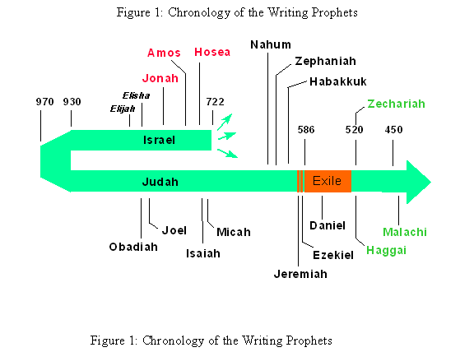

Slide 10
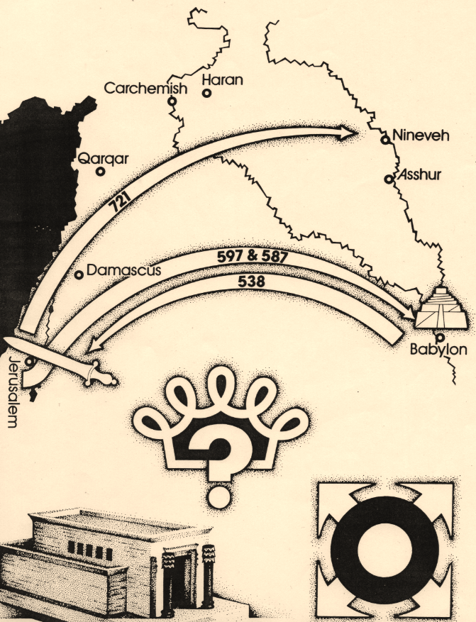
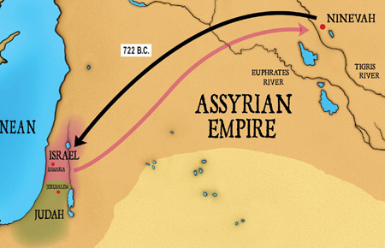
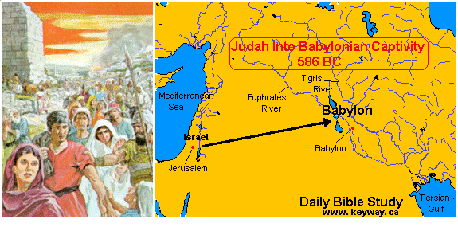
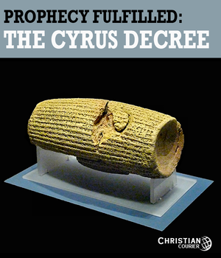
Northern kingdom of Israel exiled to Assyria
Who is king?
Southern kingdom of Judah exiled to Babylon
What about the Temple?
Where is God?
Ezra 5:13

Slide 11
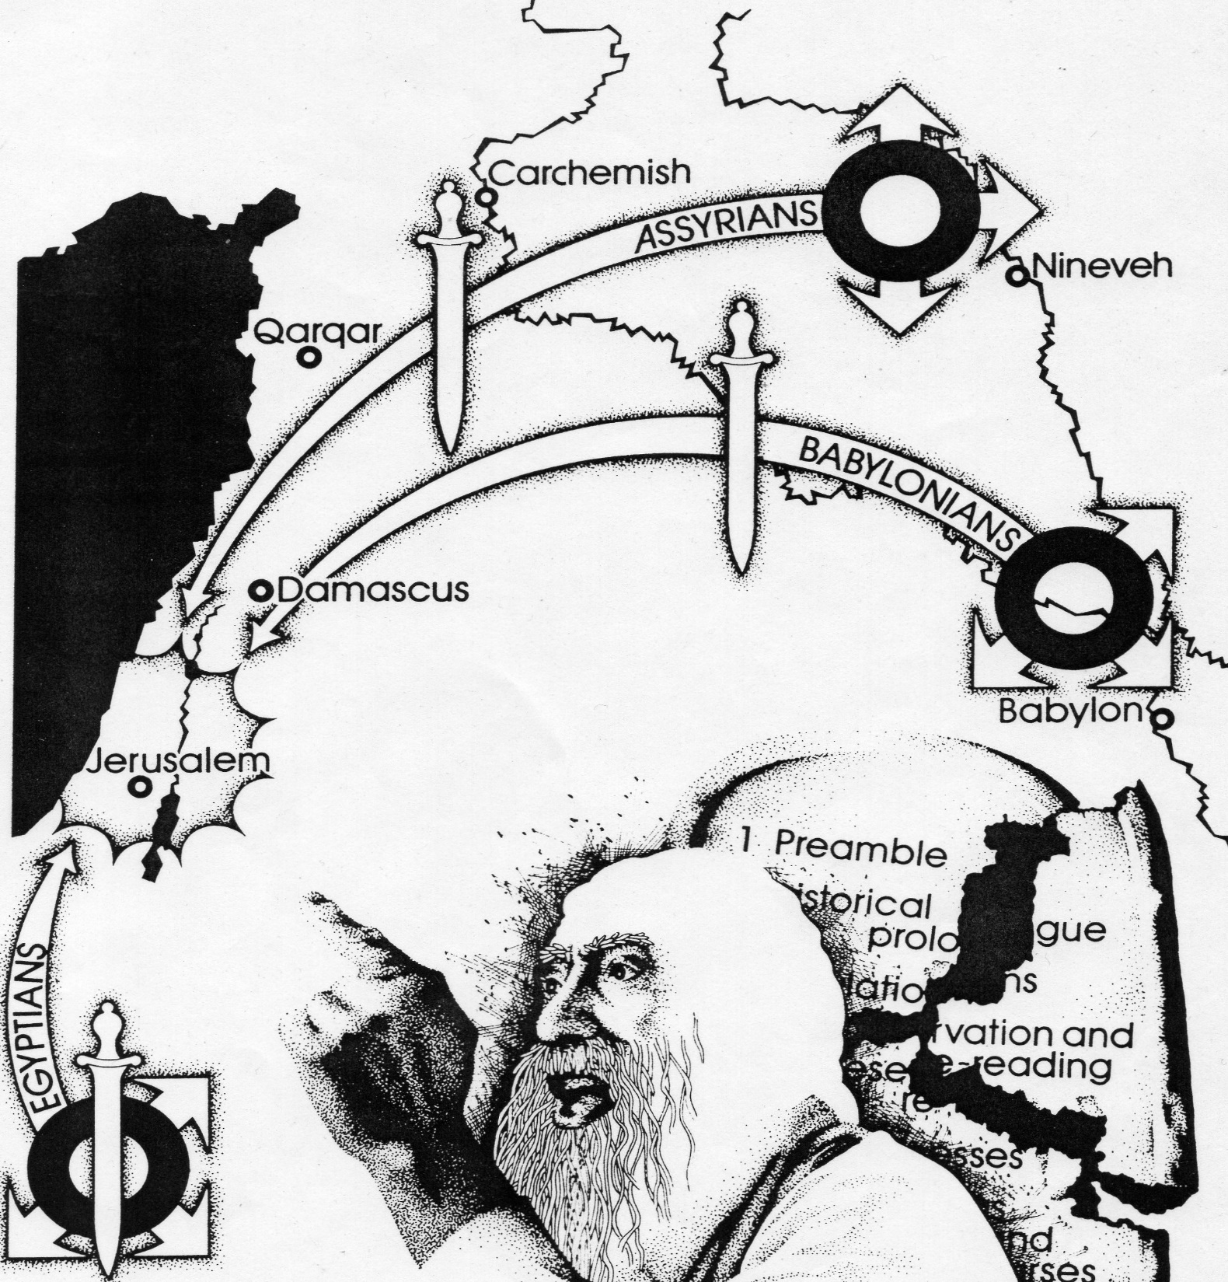
3. The Message of the Major Prophets
Because God’s people have broken the Sinai Covenant they will be judged by the Egyptians, Assyrians and Babylonians.

Slide 12
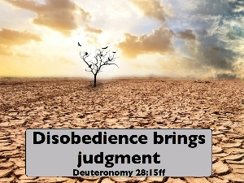
THEMES OF THE MAJOR PROPHETS
Because the people had broken the Sinai COVENANT repeatedly and without remorse, the covenant curses would come into effect (Deuteronomy 28).

Slide 13
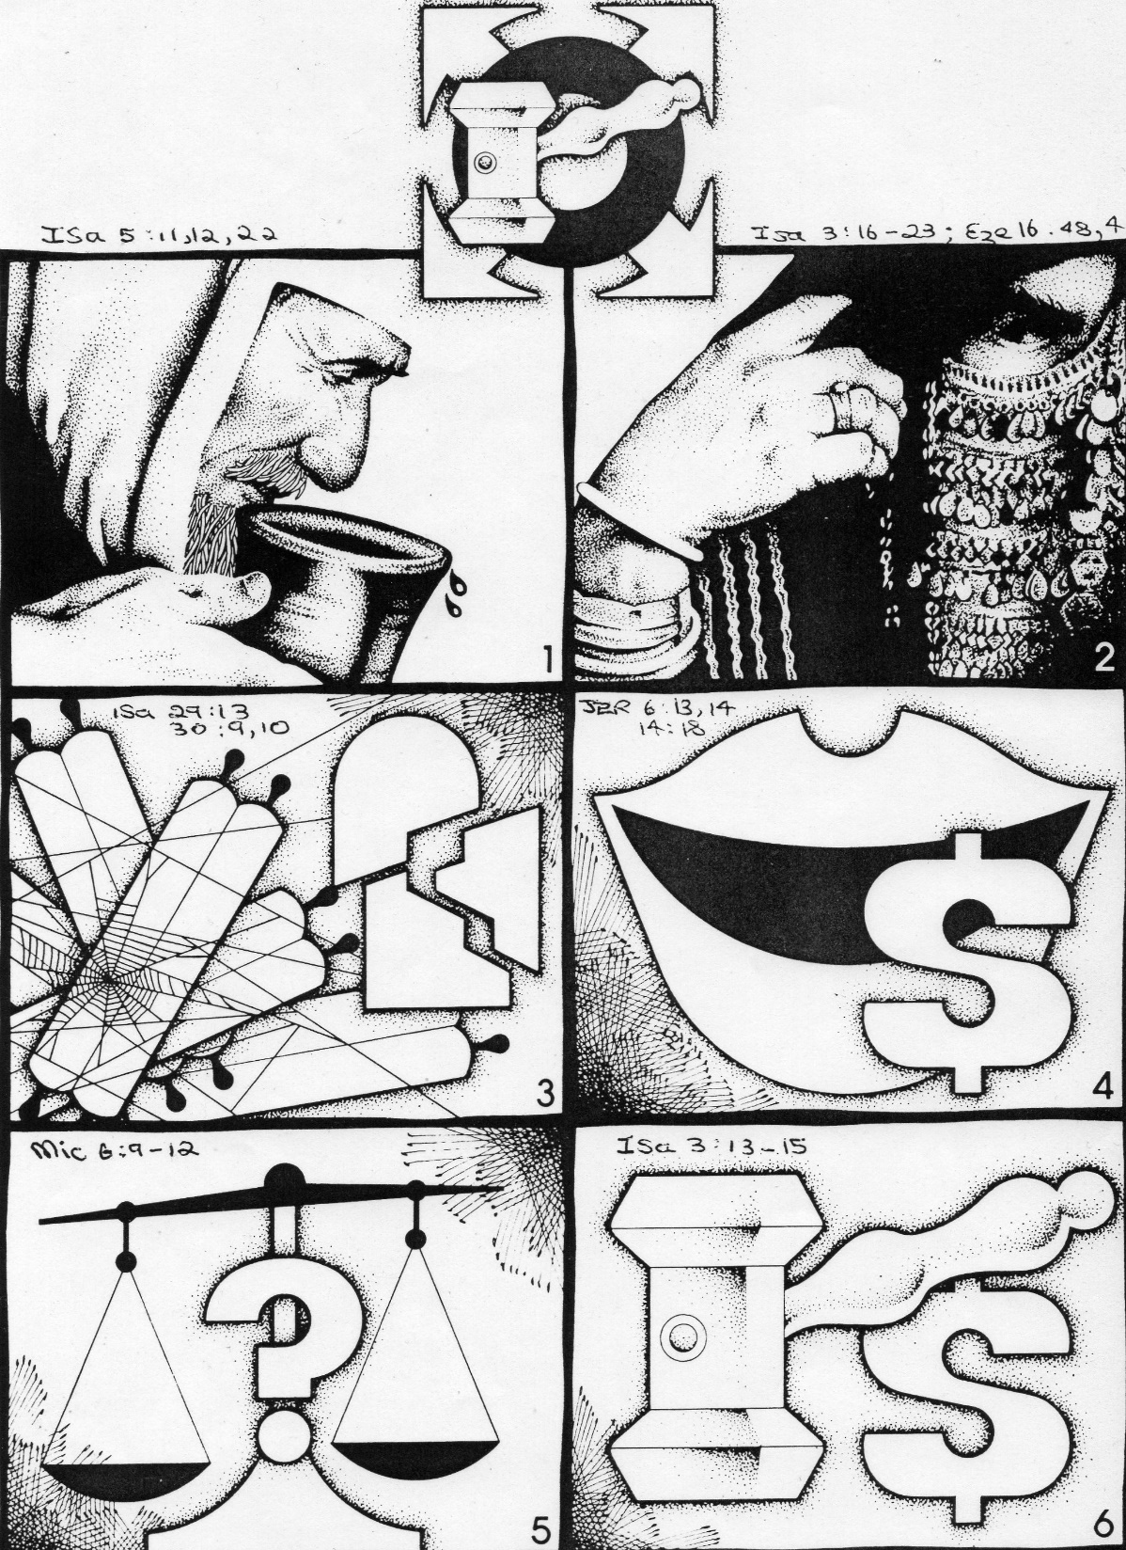
(ii) God was going to judge INDIVIDUAL sin.
Drunkeness.
Pride and Vanity.
Ignore God’s Word.
Greedy for gain.
Corruption.
Oppress the poor.

Slide 14
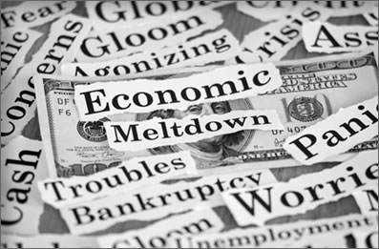
(iii) God would judge national sins:
Turning to foreign _________________ for help.
Trusting in own ____________________ (fortresses etc).
The powerful exploiting the _______________.
National turning away from _____________.
ALLIANCES
STRENGTH
WEAK
GOD

Slide 15
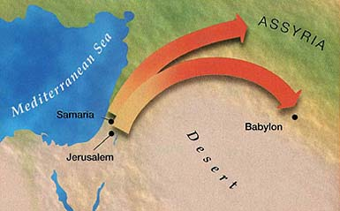
(iv) God was going to judge Israel (Northern Kingdom) with His “Rod of anger” _________________. He was to judge Judah (Southern Kingdom) with ______________. They would be taken into captivity.
ASSYRIA
BABYLON

Slide 16
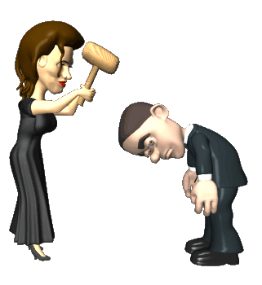
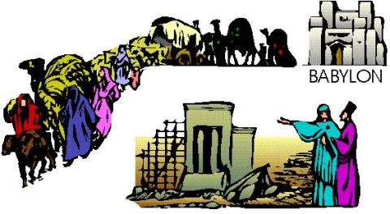
(v) However, God would in time destroy His __________________ of judgement, Assyria and Babylon.
A _______________ of His
people would return to the Promised Land to a restored Jerusalem and Temple.
INSTRUMENTS
REMNANT

Slide 17
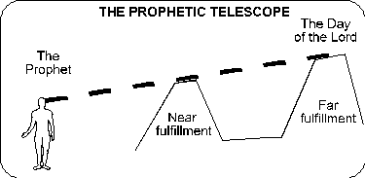
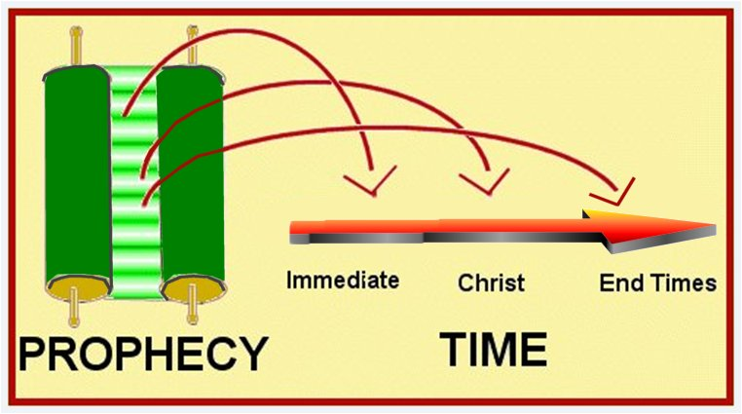
(vi) Many of the prophecies are both ____________________ (for that time) and also tell of a future time –
a _____________ age of peace and restoration.
CONTEMPORARY
MESSIANIC

Slide 18
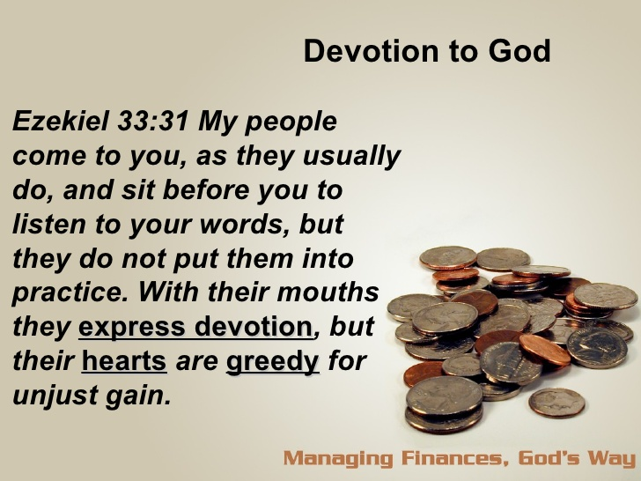
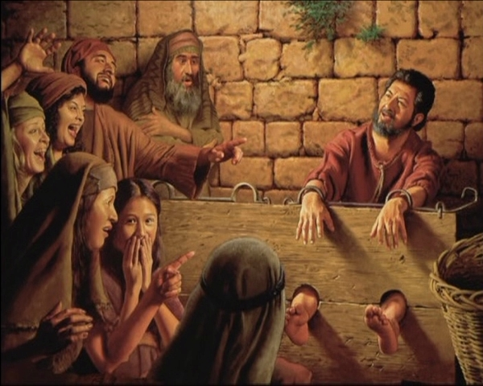
4. The People’s Response
“When the priest Pashhur son of Immer, the chief officer in the temple of the LORD, heard Jeremiah prophesying these things, he had Jeremiah the prophet beaten and put in the stocks at the Upper Gate of Benjamin at the LORD's temple.” Jeremiah 20:1-2
Few took the prophets seriously
Some harassed them

Slide 19
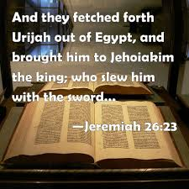
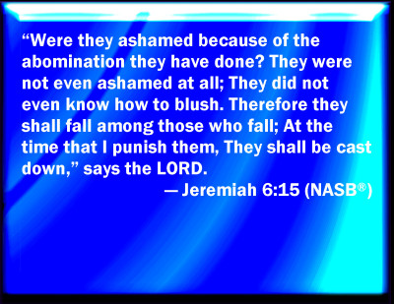
They felt no shame about their sinful ways.
Some put them to death.
They also cared little for God’s Covenant with them feeling they were politically and materially secure – a special people living in a special land.

Slide 20
5. General Principles for Today
The prophets did not just speak to Israel then, they speak to Israel ________ and to the Church.
NOW
JUDGEMENT
________________________ comes first to His people (Israel and the Church).
God has to ____________________ His people of their moral and spiritual rebellion and their refusal to heed the warnings of the prophets.
DISCIPLINE

Slide 21
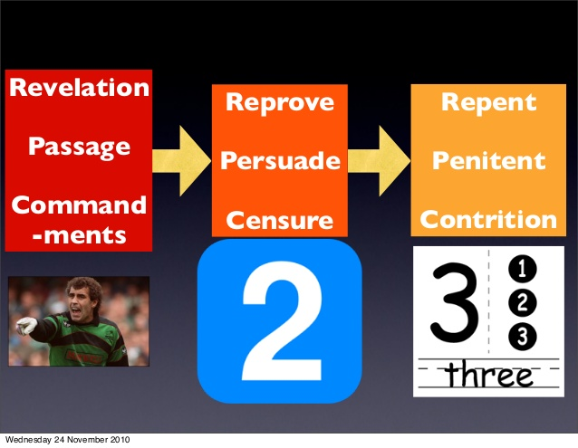
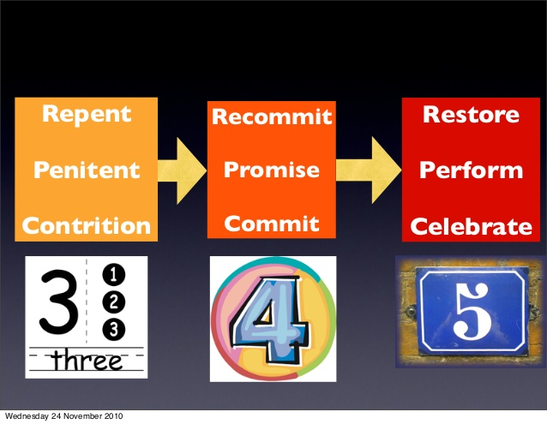

Slide 22
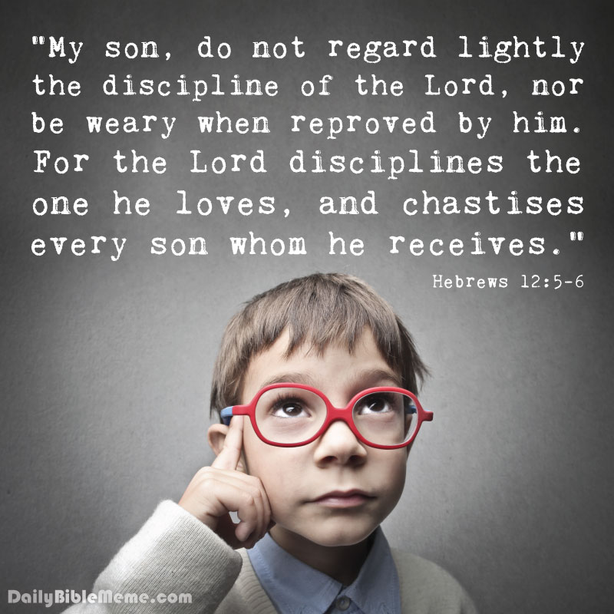
The same prophets who pronounced _________________ also announced the _____________________ of God. Similarly, because God loves us, He must sometimes chasten us as His children to train us in the ways of righteousness.
CONDEMNATION
CONSOLATION

Slide 23
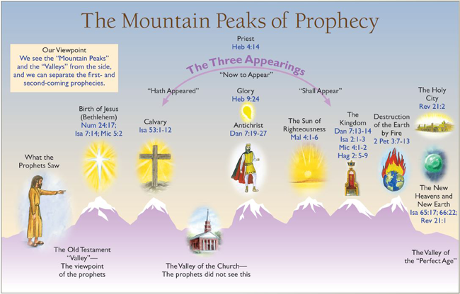
6. Prophetic Messages for this Generation
The Major Prophets, by the Spirit, saw events far beyond their present day. They spoke of Jesus’ first and second coming (we will see this as we study each book). They spoke of a future MESSIANIC ear (The Millennium).

Slide 24
Modern day events we see happening in the Middle East were prophesied by the prophets:
The ________________ of the nation of Israel (Isaiah 66:8) – Happened in 1948.
The return of the Jews to Israel (Jeremiah 31:10, 16-17; Isaiah 11:11-12)
From the ___________________ (Russia) (Jeremiah 23:7-8; 3:14,18)
From the ___________________ (Ethiopia (Ezekiel 34:25-31)
From ____________________ (Sinim) (Isaiah 49:12)
(3) Restoration of the _____________ language (Zephaniah 3:9) and of productivity of the land (Jeremiah 31:5, 12).
_________________ especially shows, with some detail, the end-time events which are near and we need to be aware of and be ready for.
REBIRTH
NORTH
SOUTH
CHINA
HEBREW
DANIEL

Slide 25
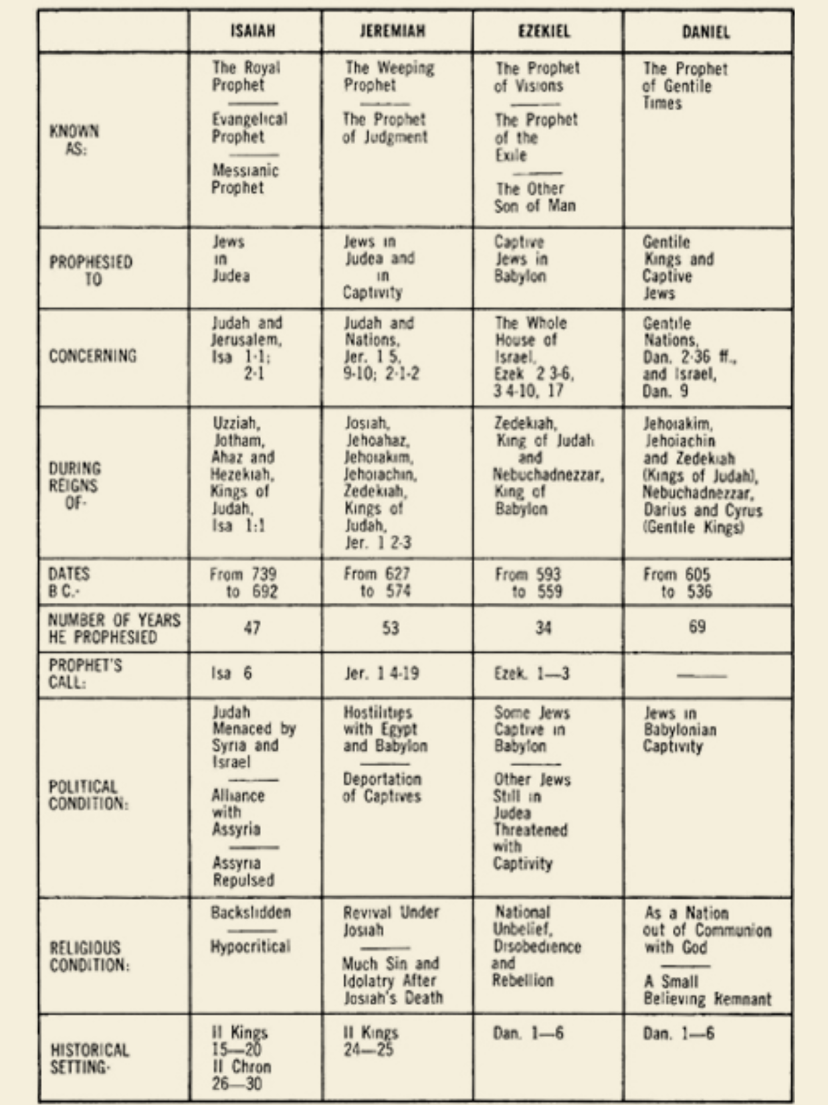
7. Comparing the Four Prophets

Slide 26
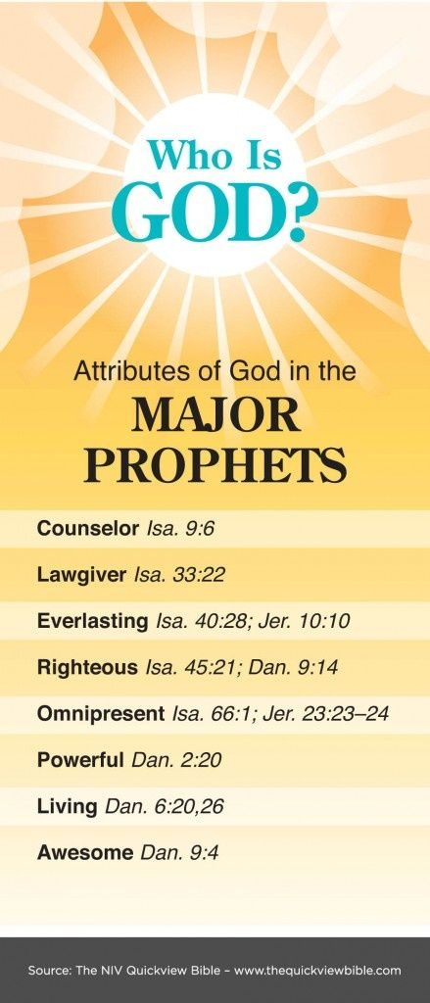
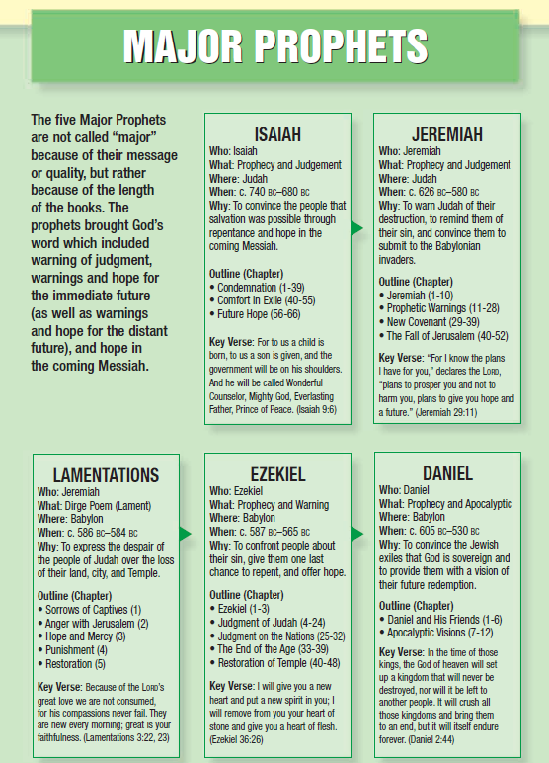

Slide 27
8. Themes of Each Book
Book | Main Theme
Isaiah | The Justice and Mercy of God.
Jeremiah | Judgement is coming; repent!
Lamentations | Mourning over sin; the severity of God’s judgement; hope in His mercy.
Ezekiel | God will be known through His judgement and restoration.
Daniel | God’s sovereignty over kingdoms and His unfolding plan for the future.

Slide 28
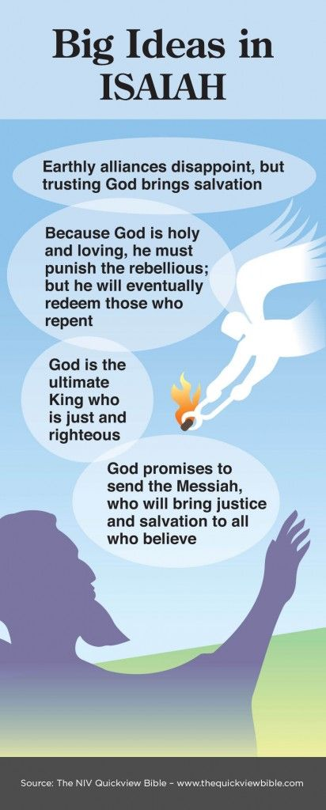
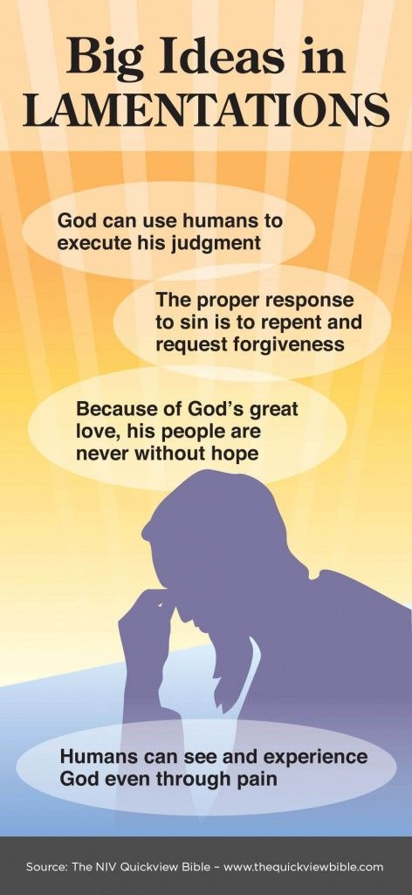
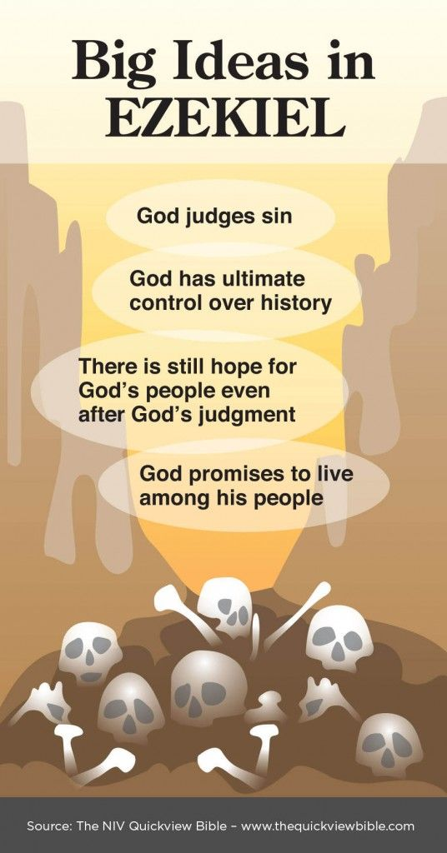
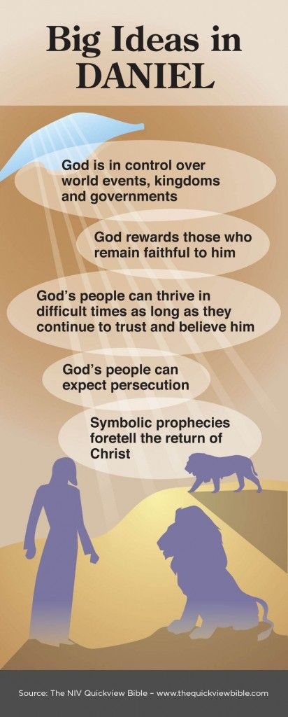
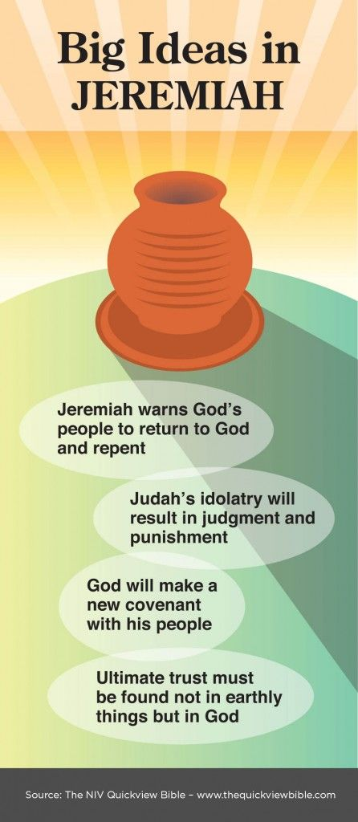

Slide 29
LESSON TWO: ISAIAH 1
OVERVIEW OF ISAIAH

Slide 30

1. Introduction
Isaiah = Yesha’yahu = “Yaheweh is SALVATION”.
39
Judgement
27
Hope
Isaiah is like a miniature BIBLE.

Slide 31
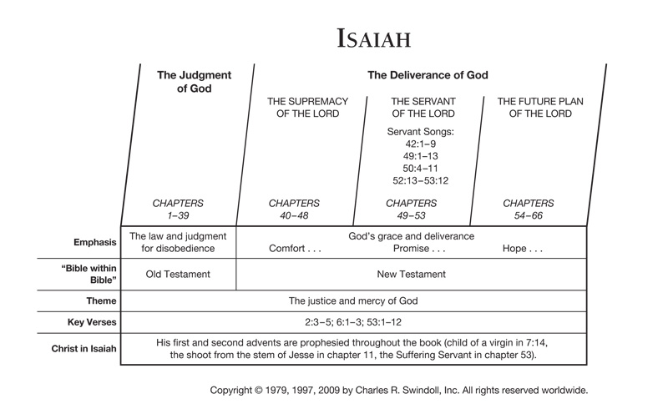
2. Outline of Isaiah

Slide 32
3. The Prophet Isaiah and His Time
King | Key Events
Uzziah (740-739 BC) | Isaiah started his ministry the year King Uzziah dies (Isaiah 6:1)
Jothan (739-735 BC) | Isaiah continues his ministry.
Ahaz (735-715 BC) | The Syro-Ephraimitic war. Northern kingdom falls to Assyria.
Hezekiah (715-686 BC) | Deadly alliance with surrounding nations. Assyrians surround Jerusalem – God intervenes
Manasseh (686 - ?? BC) | Isaiah sawn in two by order of the king.

Slide 33
UZZIAH
He received his call in the year _______________ dies (6:1-8).
When Isaiah did his work, ____________ was experiencing one of the most difficult periods in her history.
FROM WITHOUT: The _______________ menace on the horizon.
FROM WITHIN: A _________________ crisis plagued Judah within.
Some ____________ the Lord’s ability to care adequately for His covenant.
Some insisted the nation would ____________ fall, no matter what.
JUDAH
ASSYRIAN
SPIRITUAL
DOUBTED
NEVER

Slide 34
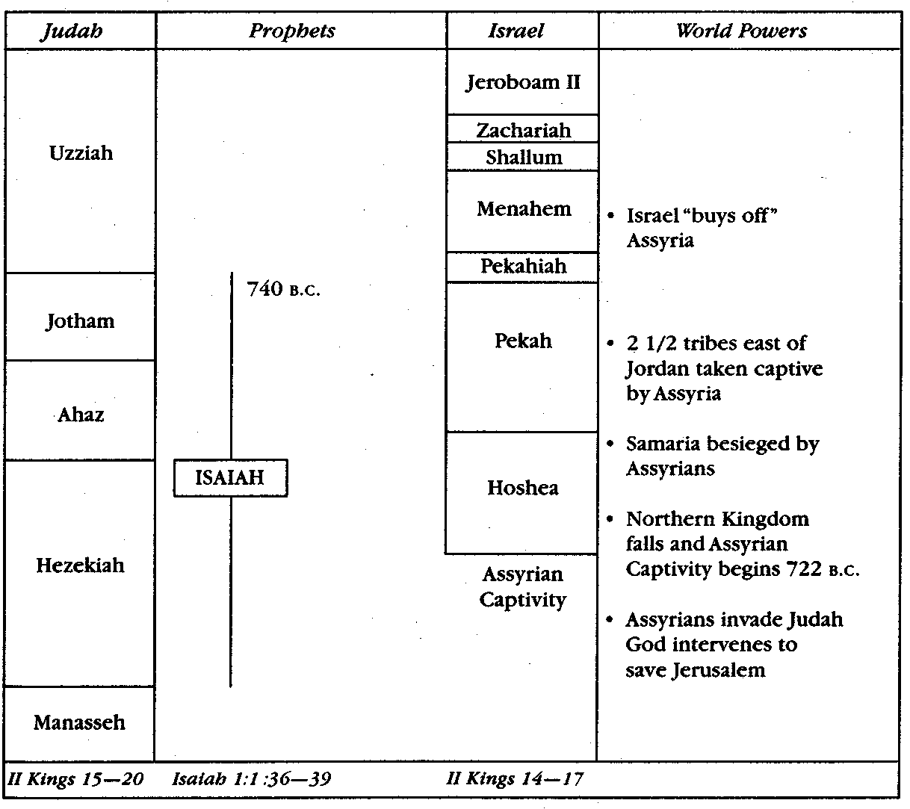
4. Historic Setting and Events

Slide 35
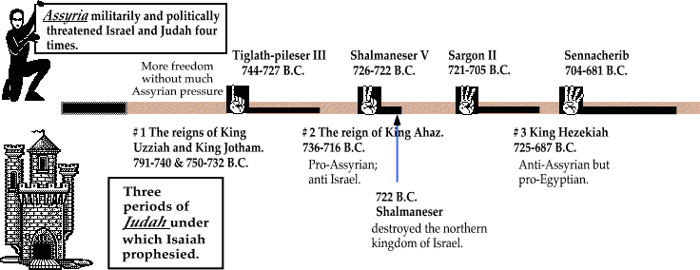

Slide 36
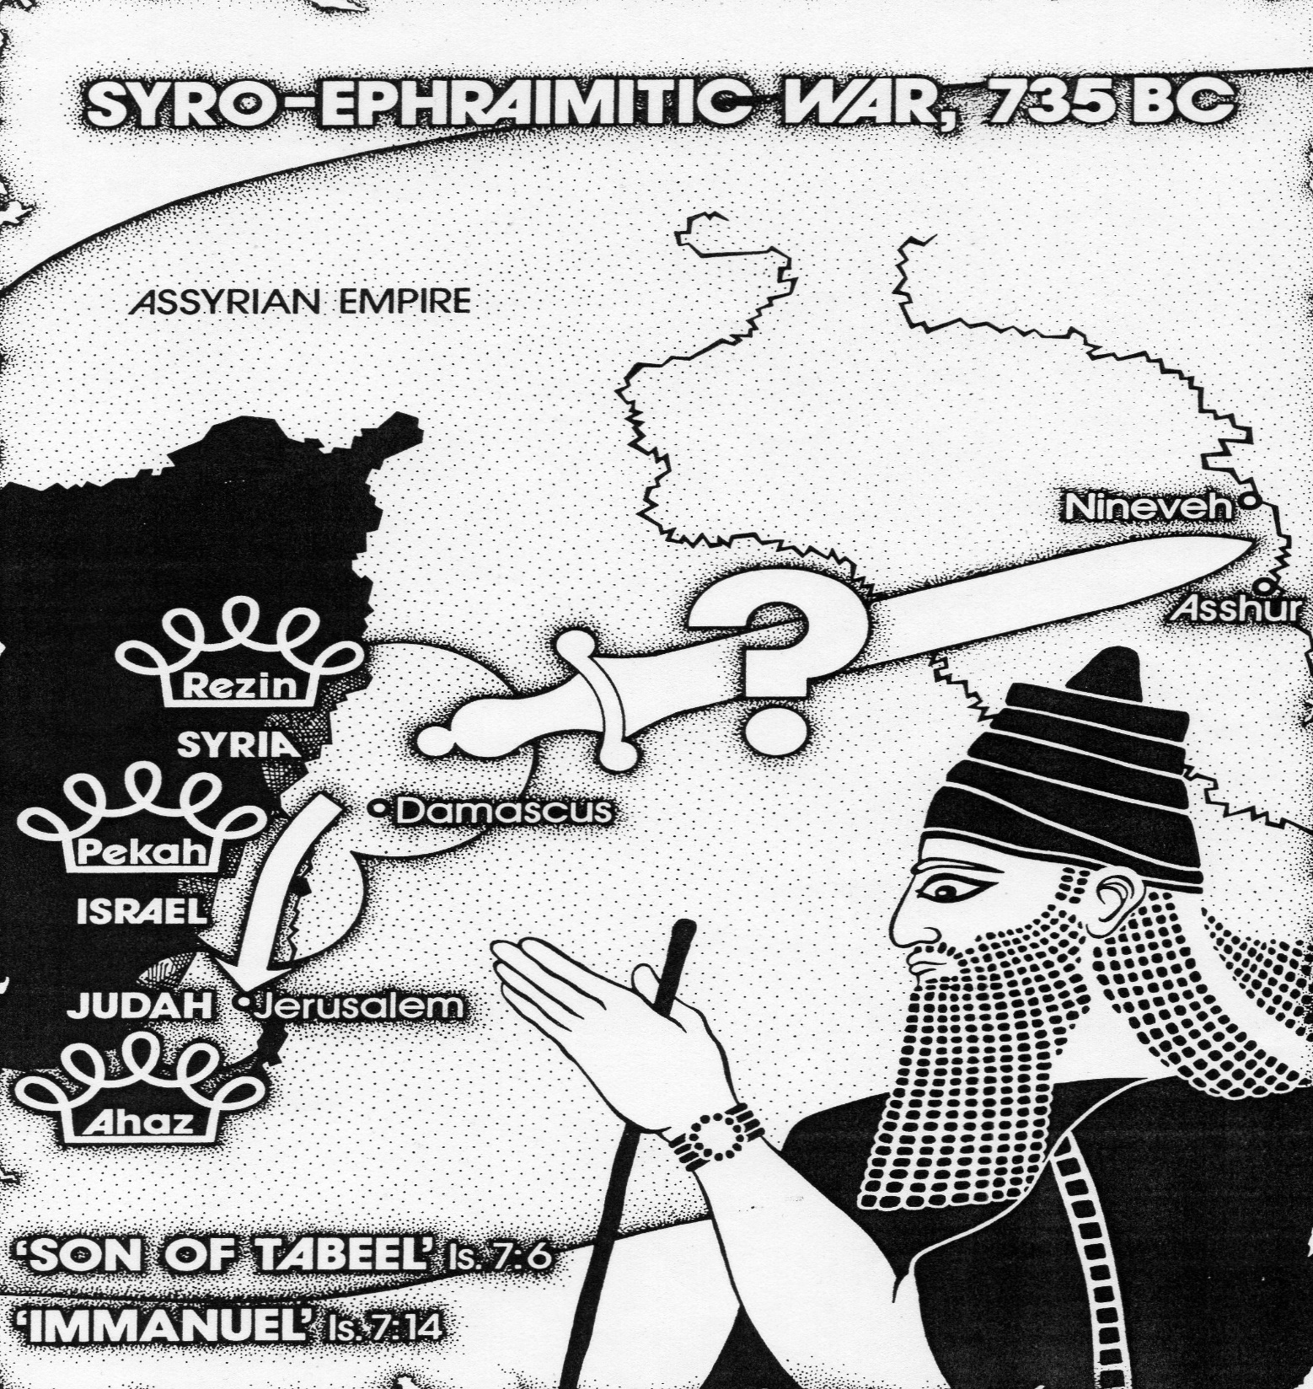
The main events that form the background of Isaiah are:
735 BC:
The CRISIS of the Syro-Ephraimitic war.

Slide 37
722 – 721 BC : The __________ of the Northern Kingdom.
711 BC : The Assyrian army under ______________ II put down a rebellion centred around Ashdod
705 BC : ________________ joined a coalition of neighbouring nations to try to win freedom from the Assyrian threat.
701 BC : Assyrians surrounded _______________ and demanded its surrender. God redeemed them due to Hezekiah’s actions
FALL
SARGON
HEZEKIAH
JERUSALEM

Slide 38
Isaiah 40-66 speaks of a time when Judah’s ____________ is about to return. Judah has been ravaged, the temple destroyed and Jerusalem flattened (44:26; 49:19; 51:3)
605 BC : Nebuchadnezzar becomes king of Babylon.
586 BC : Judah taken into Babylonian exile.
562 BC : Nebuchadnezzar dies, 3 kings in short succession.
555 BC : Persians conquer Babylonians (48:14, 20; 52:11, 12)
King Cyrus (44:28; 45:1)
538 BC : Exiles return to Judah.
CAPTIVITY

Slide 39
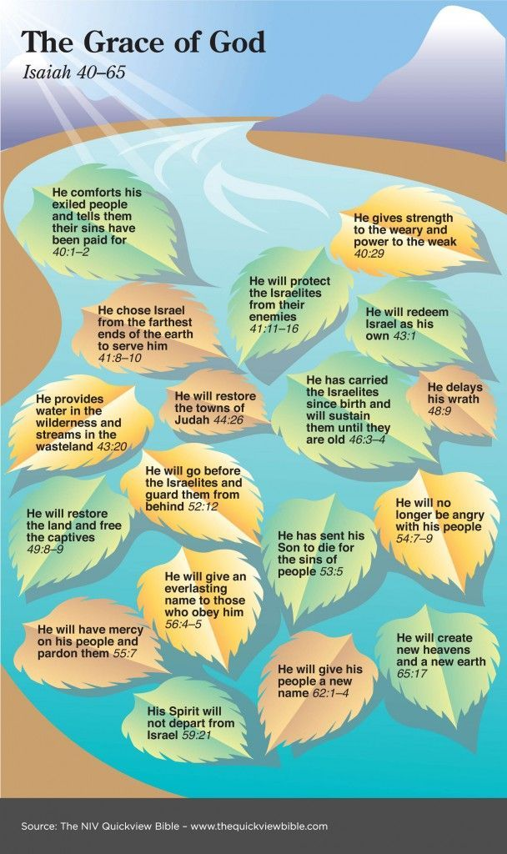

Slide 40
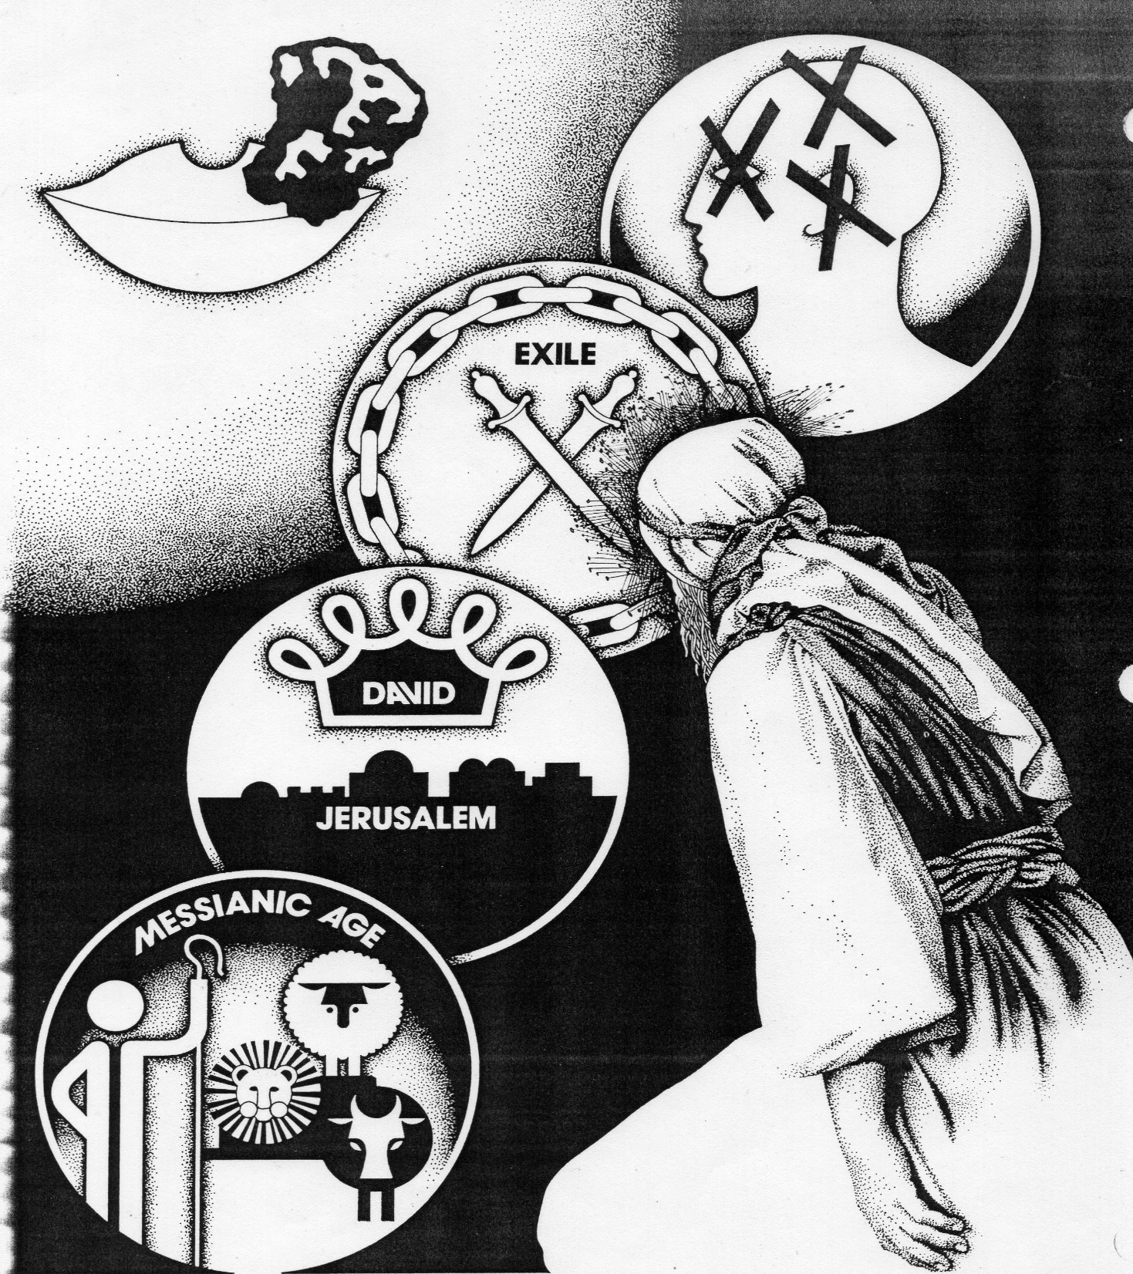
5. Major Themes of Isaiah
Isaiah is made up of segments which repeat the same themes over and over again.
Segment 1 = Chapters 1-2
Segment 2 = Chapters 3-4
Segment 3 = Chapters 5-6 and so on..

Slide 41
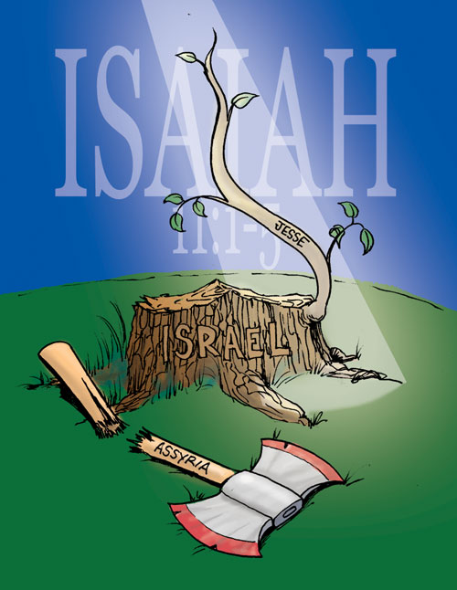

Slide 42
6. Contemporary and Eschatological Levels of Prophecy
LEVELS
The prophecies in Isaiah have _____________ of meaning.
For ___________: LEVEL 1: Contemporary message for that time.
LEVEL 2: Patterns repeated through Israel’s history until The return of the Messiah – Jesus.
ISRAEL

Slide 43
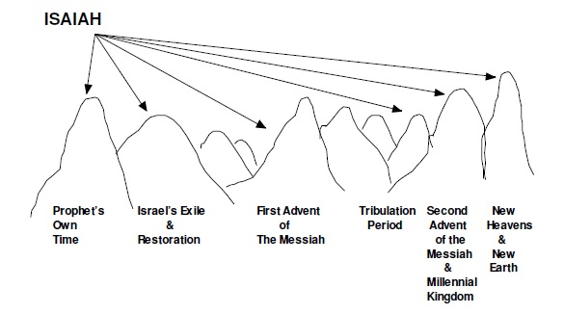
Israel
through
history

Slide 44
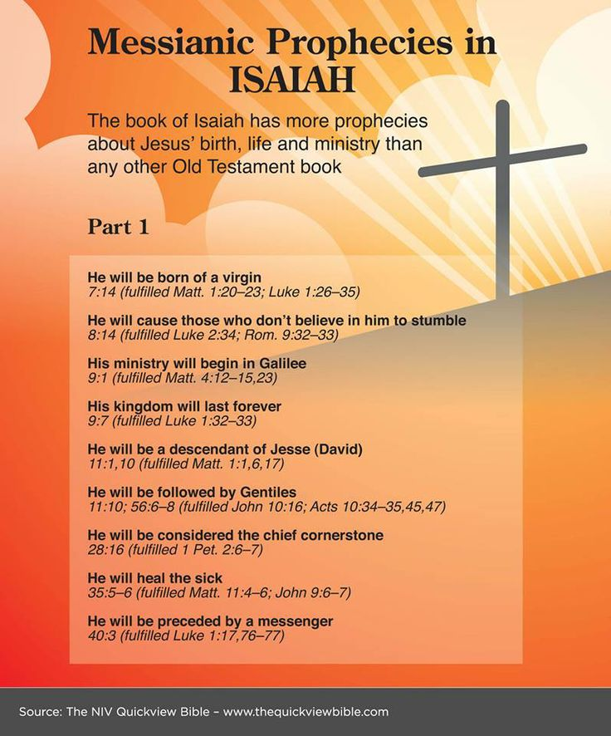
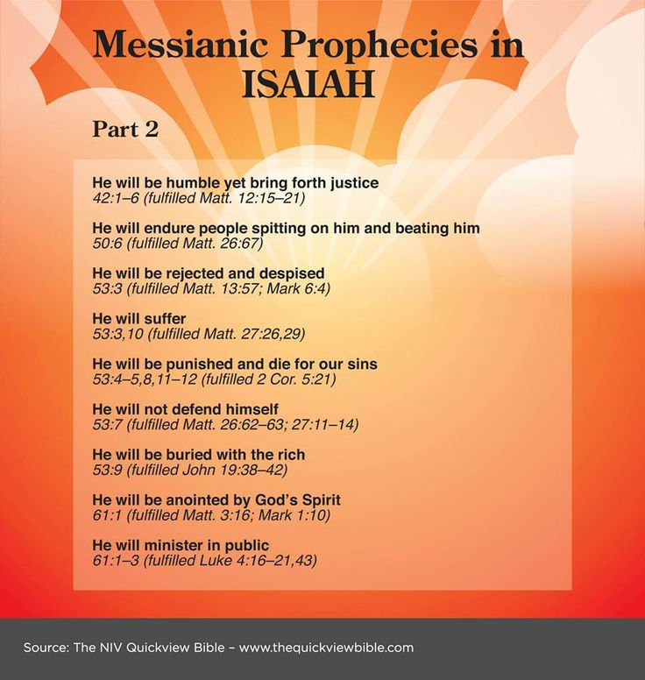

Slide 45


7. Prophetic Pictures and Acts in Isaiah

Slide 46
LESSON THREE: ISAIAH 2
Chapters 1-39

Slide 47


Slide 48

1. Introduction
SECTION I: Prophecies against Judah (1:1-12:6) 743-733 BC
SECTION II: Prophecies against other nations (13:1 - 23:18)
SECTION III: “The Little Apocalypse” (24:1 – 27:13) 743-687 BC
SECTION IV: Events during Hezekiah’s reign (28:1 – 39:8)

Slide 49

IV
I
II
III

Slide 50

2. SECTION I:
Chapters 1 to 5
Chapters 1 to 5 of Isaiah basically introduces the ________________ of Judah. It has sinned, there is imminent judgement but future restoration and glory awaits a remnant (starting a continuing theme).
SITUATION

Slide 51

Song of the Vineyard
Isaiah Chapter 5
Despite the CARE the Lord has bestowed on His vineyard, Israel, it is producing no fruit. Therefore He will tear it from the ground and smash it.

Slide 52
The SIX WOES on Israel (5:8-23)
Woe Number | Verses | Description of woe and application
ONE | 5:8-10 | Woe to those greedy for more property. Will become desolate.
TWO | 5:11-17 | Woe to those seeking pleasure and not God’s ways. Shall be humbled.
THREE | 5:18-19 | Woe to those continuing in sin and mocking God
FOUR | 5:20 | Woe to those calling evil good and good evil.
FIVE | 5:21 | Woe to those wise in their own eyes.
SIX | 5:22-23 | Woe to those who drink too much and do injustice.

Slide 53

The TEMPLE Vision
(6:1-13)
The Call and Commissioning of Isaiah
PERCEIVING
PURGING
PREPARING
PROCLAIMING
PERSISTING
Isaiah’s COMMISSION = To proclaim imminent judgement on Judah. His hearers would reject his message.

Slide 54

The Crisis of the Syro-Ephraimitic War (Ch. 7-12)
CHAPTER 7
Ahaz NEGLECTED Isaiah’s advice (v4) and sought help.

Slide 55


The babies names are symbolic of what God will do in the nation (Ahaz neglects these symbols).
(7:3)
The DELIVERED
The DOOM
(8:1)
(7:14-16)
The DELIVERER

Slide 56


Chapter 8:5-8
Because Ahaz sought ASSYRIAN help Isaiah spoke this oracle. They had refused the “waters of Shiloah that flowed gently” and put their trust in the mighty Euphrates of Assyria.
Shiloah = Conduit bringing constant flow of water from spring Gihon to a reservoir in Jerusalem.

Slide 57
Chapters 9-12
Ahaz had shown that he was an UNWORTHY descendant of David, but the Lord would raise up a righteous King (Isaiah 9:1-7 and 11:1-3) – speaking ultimately of Jesus.
The Assyrians were to overrun Judah as they had ISRAEL (9:8-10:5) but when they had served their purpose He would pour out His wrath on them (10:12-19) and restore the remnant of His people (10:20-27). He would bring both Israel and Judah back from far places to restore the Land (11:11-16 and Chapter 12).

Slide 58

3. SECTION II:
Prophecies against Nations (Chapters 13-23)
These are both CONTEMPORARY and ESCHATALOGICAL.

Slide 59

10
2
5
3
9
1
Jerusalem (Isa 22:1-25)
Siege and destruction
4
7
6
8

Slide 60
4. SECTION III: “The Little Apocalypse” (24:1-27:13)
WRATH
The ______________ of God (but salvation of a remnant (24:1-23)
Praise for Kingdom ____________________ (25:1-12)
Kingdom _____________ (26:1-21)
____________________ in the Kingdom (27:1-13)
BLESSINGS
SONG
BLOSSOMING
DAY
This section foretells of THE ________ OF THE LORD.

Slide 61
THE DAY OF THE LORD
JUDGEMENT
(a) ______________ on the Wicked (God’s wrath) by God’s raised up instrument of judgement.
(b) The ___________________ of a righteous remnant from out of tribulation to a time of peaceful rule.
SALVATION
This ultimately speaks of the
SECOND COMING OF CHRIST

Slide 62
THE DAY OF THE LORD
“Behold, the day of the LORD comes, cruel, with both wrath and fierce anger, to lay the land desolate; And He will destroy its sinners from it. For the stars of heaven and their constellations will not give their light; The sun will be darkened in its going forth, and the moon will not cause its light to shine.” Isaiah 13:9-10 (NKJV)
Judgement
“The sun shall be turned into darkness, and the moon into blood, before the coming of the great and awesome day of the LORD. And it shall come to pass that whoever calls on the name of the LORD shall be saved.” Joel 2:31-32 (NKJV)
Salvation
Notes:
“Then I took the little book out of the angel's hand and ate it, and it was as sweet as honey in my mouth. But when I had eaten it, my stomach became bitter.” Revelation 10:10 (NKJV)
Really when the book of life will be opened at this time it will declare the start of the Day of the Lord. In the Old Testament this Day is looked forward to in prophecy as a time of judgment on God’s enemies:
“Behold, the day of the LORD comes, cruel, with both wrath and fierce anger, to lay the land desolate; And He will destroy its sinners from it. For the stars of heaven and their constellations will not give their light; The sun will be darkened in its going forth, and the moon will not cause its light to shine.” Isaiah 13:9-10 (NKJV)
It will also be a time of full salvation of His people:
“The sun shall be turned into darkness, and the moon into blood, before the coming of the great and awesome day of the LORD. And it shall come to pass that whoever calls on the name of the LORD shall be saved.” Joel 2:31-32 (NKJV)
Hence its message is both bitter and sweet and that is why when John eats this scroll it is sweet in his mouth but bitter in his stomach. This time will be both bitter and sweet for God’s people, bitter as it will mean much suffering and pain for those who are lost but sweet as it marks the fullness of what God has promised the saints.

Slide 63
Rapture of Saints
Isaiah 26:19
The Wrath of God
Isaiah 24; 26:20-12
Time of Peace
(Kingdom Rule)
Isaiah 24:23; 26:1-2
The Great Blackout
Isaiah 13:10; Joel 2:31; Matthew 24:29
MILLENNIUM
Isaiah 2:2-4; 4:2-6; 11:4-10; 32:1-8
Satan cast into Pit
Isaiah 27:1
THE DAY OF THE LORD

Slide 64

4. SECTION IV: Hezekiah’s Reign (Chapters 28-39)
These chapters deal with the time Hezekiah joined a ___________ of neighbouring nations to try and win freedom for his realm (705 BC)
______________ were useless and wrong.
There was a coming ___________ (32:1-20) with His _______________ (35:1-10)
COALITION
ALLIANCES
KING
KINGDOM

Slide 65
Because Hezekiah stayed with the alliance, Assyrian armies surrounded Jerusalem (701 BC)
Assyria ______________ God (36:1-22)
God _______________ Assyria (37:1-38)
Hezekiah’s life _________________ (Chapter 38)
______________ would eventually come to judge Judah in full (Chapter 39)
CHALLENGES
DESTROYS
PROLONGED
BABYLON

Slide 66



Slide 67
LESSON FOUR: ISAIAH 3
Chapters 40-66
COMFORT FOR THE CAPTIVES

Slide 68
1. The Situation
CAPTIVITY
In this section of Isaiah we see that Judah is in ___________ in Babylon (49:19). Temple destroyed, Jerusalem flattened.
The Prophet is commissioned to speak “______________” to “Jerusalem” (Israel) (40:1, 2)
TENDERLY
Because Isaiah prophesies in detail of a time after his death many scholars have postulated that there was a second Isaiah. If you believe in supernatural fore-telling prophecy then there should be no problem accepting is was simply the same Isaiah prophesying of future events.

Slide 69


Slide 70

Cyrus
(Isaiah 44:28; 45)
In 539 BC the Persians and Babylonians fought a decisive battle at _______ on the river Tigris. The Persians won and Cyrus was King of new superpower. In ____ BC he issued a decree for the Jews to return to their homeland.
OPIS
538

Slide 71


“Thus says the Lord to His anointed, To Cyrus, whose right hand I have held— To subdue nations before him And loose the armor of kings, To open before him the double doors, So that the gates will not be shut.” Isa 45:1

Slide 72

2. Outline of Isaiah 40-66

Slide 73


Slide 75
DELIVERANCE
SECTION 1: Prophecies of Israel’s _________________ (40:1-48:22)
SECTION 2: Prophecies of Israel’s _________________ (49:1-57:21)
SECTION 3: Prophecies of Israel’s _________________ (58:1-66:24)
DELIVERER
DESTINY (glorious future)

Slide 76

3. The Message of Comfort.
Numerous _________ weave their way through this section. They are put in the form of a dialogue between the Lord and His people.
THEMES

Slide 77

1
Lord, we are thrilled that you plan to rescue us from Babylon, but will the Babylonian gods simply stand back and let you lead us out of their land?
There are no other gods like me. I am above all and they are not really gods but are useless and powerless before me.

Slide 78
2
Lord, there are many temples in Babylon! Are you saying that the Babylonians who go to them worship NOTHINGS?
That’s right. There’s none like Me. I have created all things with a purpose. These idols are nothing compared to me.

Slide 79
3
Do you really have power to get us out of Babylon?
There’s none like me in power. I made you , the world and the heavens. Look around and see my power.

Slide 80
4
If you are the only God, and if you created and control the universe, why did you allow us to go to Babylon in the first place? Have you increased in power lately?
You went to Babylon because you continued in sin and did not call out to me. I am testing and refining you and will rescue you.

Slide 81
5
How will you get us out from under the Babylonian yoke?
I will make them useless and judge them. I raise up nations and I cause them to fall. I will use Babylon to judge you but then I will bring them down using the Persians.

Slide 82
6
Lord, it’s a massive undertaking to rescue us from Babylon and get us back to our land! How?
I will do a new thing and make a way in the wilderness, rivers in the desert. You will not be harmed and will have all you need to eat and drink. As I parted the sea before I will make a way for you.

Slide 83
7
So you have not forgotten us after all?
I will never forget you but will nourish and care for you as a mother. Wait on me and I will give you power in my time. I have made you and will take care of, carry and deliver you.

Slide 84
8
Lord, it’s a long walk back to Judah. What will we do for shade and water along the way? Will we be safe?
I will cause water to flow in the desert and plants and trees to grow. I will make a way. I will protect you and multiply you because you are precious to me. Leave with singing for I will redeem you fully.

Slide 85
9
Lord, the Babylonians really wrecked our land. Is it worth going back to?
I will comfort you and transform the barren land into a garden of Eden where there is joy and gladness. Jerusalem will be rebuilt and inhabited as sure as I created all things.

Slide 86
10
We are so few. Can we become a great people again?
Remember Abraham. He became a great nation and so will you once again. Indeed the place will be too small to contain all your descendants.

Slide 87
11
Lord, what moves you to be so good to us?
I love you and will blot out your sins if you cry to me. Return to me and I will shower mercy and grace on you. For my name’s sake I will turn from my anger.

Slide 88
12
You still have a purpose for us then?
Yes – you are to be my witnesses to the nations. I will put my spirit on you to bring Jews and Gentiles to me. You will be my servant, my light and bring salvation to the ends of the earth.

Slide 89

4. The Servant of the Lord.
Servant Songs
SONG 1: Isaiah 42:1-4
SONG 2: Isaiah 49:1-6
SONG 3: Isaiah 50:4-11
SONG 4: Isaiah 52:13 – 53:12
The Servant is both GOD’S PEOPLE and the MESSIAH (God’s people and Jesus)

Slide 90


Slide 91
LESSON FIVE: JEREMIAH 1
Overview of Jeremiah

Slide 92
The Prophet and His Time.
40
Jeremiah’s ministry spanned about ________ years, 626-580 BC. He was a prophet divinely called in his youth (1:6) from the Priest-City of Anathoth.
His ministry took place during a time of political _____________. The Assyrians were in their death throes. The Babylonians had gained their independence from them and Egypt was coming to life.
He is often called the “_______________ Prophet”
TURMOIL
WEEPING

Slide 93

Historical Span of Jeremiah’s Teaching.
The Reign of Kings
i. JOSIAH’S REIGN
Jeremiah’s _________ and early __________. Great __________.
ii. JEHOIAKIM’S REIGN
He was a ______ king. Chapters 7-23 of Jeremiah written.
iii. ZEDEKIAH’S REIGN
Lacked _________________.
Jeremiah 24-39 written.
Destruction of Jerusalem.
Jeremiah also wrote _______________
CALLING
PREACHING
REFORMS
BAD
BACKBONE
LAMENTATIONS

Slide 94
Ch 29-31
LAMENTATIONS

Slide 95


Slide 96


Slide 97


Slide 98


Slide 99

2. Outline of Jeremiah

Slide 100


Outline of Lamentations

Slide 101

3. Overview of Jeremiah’s Message
From this picture say what are the main contents of Jeremiah’s message.

Slide 102

4. Prophetic Acts of Jeremiah

Slide 103


Slide 104

5. Christ in Jeremiah
Christ is seen in 23:1-8 (Coming Shepherd, Righteous Branch, and the Lord our Righteousness). He is also seen as the bringer of the New Covenant (31:31-34).

Slide 105



Slide 106
LESSON SIX: JEREMIAH 2
Message of Jeremiah

Slide 107
⁵“Before I formed you in the womb I knew you; Before you were born I sanctified you; I ordained you a prophet to the nations.”
⁶ Then said I:
“Ah, Lord God! Behold, I cannot speak, for I am a youth.”
⁷ But the Lord said to me:
“Do not say, ‘I am a youth,’ For you shall go to all to whom I send you, And whatever I command you, you shall speak. ⁸ Do not be afraid of their faces, For I am with you to deliver you,” says the Lord.
⁹ Then the Lord put forth His hand and touched my mouth, and the Lord said to me:
“Behold, I have put My words in your mouth. ¹⁰ See, I have this day set you over the nations and over the kingdoms, To root out and to pull down, To destroy and to throw down, To build and to plant.”
THE CALL – From womb to be prophet
THE COMPLAINT – I’m too young
THE COMMAND – Go and speak
Jeremiah’s Call (Chapter 1)
THE CONTENT – Pull down, build up

Slide 108

¹¹ Moreover the word of the Lord came to me, saying, “Jeremiah, what do you see?”
And I said, “I see a branch of an almond tree.”
¹² Then the Lord said to me, “You have seen well, for I am ready to perform My word.”
¹³ And the word of the Lord came to me the second time, saying, “What do you see?”
And I said, “I see a boiling pot, and it is facing away from the north.”
¹⁴ Then the Lord said to me:
“Out of the north calamity shall break forth On all the inhabitants of the land. ¹⁵ For behold, I am calling All the families of the kingdoms of the north,” says the Lord; “They shall come and each one set his throne At the entrance of the gates of Jerusalem, Against all its walls all around, And against all the cities of Judah.
Jeremiah’s Call in Two Signs

Slide 109


2. Jeremiah’s Early Preaching (Chapters 2-6)
EXODUS
Jeremiah reminds Judah of the _____________ and wilderness experience:
HONEYMOON
Was like the perfect ___________________
Things changed for the worse on entering Canaan.
Judah had changed “gods”.
Judah had rejected the fountain of life.
She was now in an ‘unholy alliance.
She had become a stained harlot.
She felt no guilt about her wrong.
She would soon be desperate, without help.
She should have learnt her lesson from Israel,
but because she didn’t ________________ was coming!
There was, however, still hope.
The Lord wanted to heal the broken relationship and transform her inner life
He wanted to restore her to His original intention for Judah –to bless the nations.
DIVORCE

Slide 110
3. Preaching During Jehoiakim’s Reign (Chapters 7-23)

Slide 111

TEMPLE
In the first year of Jehoiakim’s reign was Jeremiah’s famous ___________ SERMON
The Situation his sermon addresses
All _____________ had cleansed out of the Temple was brought back after his death
The people trusted in ________________ rather than the Lord:
The ____________________________ (3:16)
___________________(4:4)
The ________ (8:8)
_________________ (7:21-26)
The ____________ (7:4)
JOSIAH
THINGS
ARK OF THE COVENANT
CIRCUMCISION
LAW
But no one trusted anyone else!! (9:4-6)
SACRIFICES
TEMPLE

Slide 112
The fact that there was a _________________ did not guarantee the people safety (7:4). The Temple would be destroyed (7:12-14), Judah would go into Exile (7:15) for 70 years (Chapter 25:11-12). The Lord had run out of patience (15:6) and would break her like a pot (Chapter 18).
TEMPLE
Jeremiah’s Prophecy

Slide 113

The False Prophets Also Speak
OPPOSITION
Jeremiah’s prophecy met _____________ from the many “Band-Aid Cure” Prophets who saw no need for deep surgery and inner healing (5:12-15; 14:13-16; 23:9-44).
They spoke of an _________ and quick restoration (27:12-22), crying out “peace, peace” where there was no peace. They were no more prophets than straw is wheat (23:28).
__________________ was the most vehement oppose of Jeremiah (28:1-17).
EASY
HANANIAH

Slide 114

Jeremiah sees the coming doom and weeps (8:18-9:3). He proclaims it’s coming not only in ____________ but also in ______________. There are five main signs stretching though Jehoiakim’s reign into Zedekiah’s reign:
WORDS
SIGNS
Tattered Loin Cloth (13:1-11)
Stocks (20:1-6)
4. Preaching During Zedekiah’s Reign (Chapters 24-39)
(3) Two Baskets of Figs (24:1-10)
(4) Yoke (27:1-15)
(5) In Prison With a Scroll (32:1-15)

Slide 115


“And it happened on the next day that Pashhur brought Jeremiah out of the stocks. Then Jeremiah said to him, “The Lord has not called your name Pashhur, but Magor-Missabib. For thus says the Lord: ‘Behold, I will make you a terror to yourself and to all your friends; and they shall fall by the sword of their enemies, and your eyes shall see it. I will give all Judah into the hand of the king of Babylon, and he shall carry them captive to Babylon and slay them with the sword.” Jeremiah 20:3-4
“Thus the Lord said to me: “Go and get yourself a linen sash, and put it around your waist, but do not put it in water.” So I got a sash according to the word of the Lord, and put it around my waist.
And the word of the Lord came to me the second time, saying, “Take the sash that you acquired, which is around your waist, and arise, go to the Euphrates, and hide it there in a hole in the rock.” So I went and hid it by the Euphrates, as the Lord commanded me.” Jeremiah 13:1-5

Slide 116




Slide 117


5. God’s Promises

Slide 118


Slide 119
6. Jeremiah’s “Open Life”
CONFESSIONS
There are passages known as “Jeremiah’s _____________________” which reveal his personal struggles with the Lord:
His own hometown of Anatoth plotted to kill him.
11:18-23 –
12: 1 – 6 –
15:10-12 –
15:15-21 –
17:14-18 –
18:18-23 –
20: 7 -12 –
20:14-18 - –
He suffers but the wicked prosper.
Everyone curses him. He wishes he was not born.
He has done right but his pain is unending.
He cannot see the immediate fulfilment of his words.
People do not listen to him and persecute him.
Felt deceived by the Lord, ridiculed by man.
Cursed the day he was born..

Slide 120

7. “The Little Book of Comfort” (Chapters 30-33)
This section of Jeremiah is so called because part of Jeremiah’s calling contains much hope (see 1:10c).
Jeremiah saw a new community in which the divided kingdom is no more – United by a common redemption (31:17-20).
They would eventually return (31:15-22; 30:7).
Future days of a __________ COVENANT were coming (31:31-34).
NEW

Slide 121


Slide 122


Slide 123

Jeremiah 36 - King Jehoiakim

Slide 124

Jeremiah 37-38 - King Zedekiah

Slide 125


Slide 126


Slide 127

8. Ministering in Jerusalem and Egypt after the fall of Judah (Chapter 40-52).

Slide 128


Slide 129


Slide 130



Slide 131
LESSON SEVEN: EZEKIEL 1
Overview of Ezekiel

Slide 132


About the Man and his Times
PRIEST
Ezekiel was a ___________/Prophet. He ministered during the darkest days of Judah’s history – The Exile.
His name means “God will __________________”
Ezekiel was born in 623 BC and, when he was _______ years old (598 BC), he was taken to Babylon.
In 593 BC (when he was 30 years old) he received his prophetic commission (1:2- ).
Ezekiel was about _______ when Daniel was deported to Babylon in 605. His home in Babylon became __________________, principal colony of the Jewish Exiles along the River Chebar, Nebuchadnezzar’s “Grand Canal” (1:1; 3:15, 23).
STRENGTHEN
25
17
TEL ABIB

Slide 133


Slide 134

2. Ezekiel’s Message in Overview

Slide 135
Before the Fall of Jerusalem: From 592 – 586 BC
Ezekiel found it necessary to convince the ________________ Jewish Exiles that there was no hope of immediate deliverance from the Babylonian Yoke.
Ezekiel’s Initial vision and call (Chapters 1-3)
Oracles of doom against Judah and Jerusalem (Chapters 4-24)
Oracles against the nations (Chapters 25-32)
(2) After the Fall of Jerusalem: From 586 – 573 BC
When they heard that Jerusalem was ______________ their false hopes of returning were abandoned and Ezekiel concentrates on prophecies of hope.
Oracles of Promise (Chapters 33-39)
The Millennium (Chapters 40-48)
DISBELIEVING
DESTROYED

Slide 136


Slide 137

3. Ezekiel’s Message
Overview in Picture Form

Slide 138

Top Section:
Ezekiel began his prophetic work in Babylon in 592 BC. The Exiles were confident that they would soon return to their own land. Ezekiel assured them that Jerusalem would fall and others from Jerusalem would be joining him – he constructed a model of a city under siege to illustrate what was happening to Jerusalem (4:1-3). In a vision, he saw the Lord’s winged, wheeled throne-chariot leave Jerusalem and head east to take up residence among the Exiles (11:22-25).
Bottom Section:
After Jerusalem’s fall (586 BC), Ezekiel assured the Exiles of their eventual return. The Lord would put flesh about the dead bones of the nation, revive it and lead it back like a gentle shepherd leading his flock (Chapter 37).
Jerusalem will be rebuilt and a new Temple will be erected. God will return to take up residence in it. From the east gate of the Temple a stream of water will flow forth to revive growth in the land and turn the Dead sea into an expanse of fresh water, with an abundance of fish.

Slide 139

4. Ezekiel’s Vision and Call: (Chapters 1-3)

Slide 140


Slide 141
The Call (Chapters 1-3)
VISION
CALLING
PRESENCE
READINESS
EMPOWERING
SETTING
SENDING
OPPOSITION
DEVOURING
DECLARING
IDENTIFYING
WATCHING
(1:1) “I saw visions of God”
(1:3a) “The word of God came expressly to Ezekiel”)
(1:3b) “..the hand of the Lord was upon him”
(2:1) “..stand on your feet and I will speak to you”
(2:2a) “The Spirit entered me when He spoke..”
(2:2b) “..and set me on my feet” (cf. Hebrews 9:14)
(2:3-5) “I am sending you to…” (cf. Acts 13)
(2:6-8) “..do not be afraid of them..though briers and thorns..”
(2:9-10) “Eat what you find; eat this scroll.”
(3:11) “..and go..speak to them..and tell them “Thus saith the Lord””
(3:14) “..so the Spirit lifted e up and took me away..”“..I sat where they sat..”
(3:15-22) “..Son of man, I have made you a Watchman for the House of Israel.”

Slide 142


Slide 143
LESSON EIGHT: EZEKIEL 2
Message of Ezekiel

Slide 144


Ezekiel’s Message in Signs

Slide 145

SIGN 1

Slide 146

SIGN 2: Eat Bread and Water only Ezekiel cooked with human dung (4:9-11 and 12:18-20) (God allowed cow dung)
Food and water will be scarce and no animals will be left.

Slide 147



SIGN 3: Cut your Hair Ezekiel (5:1-12)
“Now, son of man, take a sharp sword and use it as a barber’s razor to shave your head and your beard. Then take a set of scales and divide up the hair. ² When the days of your siege come to an end, burn a third of the hair inside the city. Take a third and strike it with the sword all around the city. And scatter a third to the wind. For I will pursue them with drawn sword. ³ But take a few hairs and tuck them away in the folds of your garment. ⁴ Again, take a few of these and throw them into the fire and burn them up. A fire will spread from there to all Israel.” Ezekiel 5:1-4
Meaning
The hair represents the Israelites still in Judah. They are soon to be cut off and judged (scales). A third will be destroyed by fire in Jerusalem. A third will die by the sword around Jerusalem. A third will be taken away captive to Babylon and elsewhere (hair in wind).

Slide 148

SIGN 4

Slide 149

SIGN 5

Slide 150

SIGN 6: Ezekiel, Your Wife is Dead (24:15-27)
Meaning
“Say to the people of Israel, ‘This is what the Sovereign Lord says: I am about to desecrate my sanctuary—the stronghold in which you take pride, the delight of your eyes, the object of your affection. The sons and daughters you left behind will fall by the sword. ²² And you will do as I have done. You will not cover your mustache and beard or eat the customary food of mourners.” verses 21-22
^{“15} The word of the Lord came to me: ¹⁶ “Son of man, with one blow I am about to take away from you the delight of your eyes. Yet do not lament or weep or shed any tears. ¹⁷ Groan quietly; do not mourn for the dead. Keep your turban fastened and your sandals on your feet; do not cover your mustache and beard or eat the customary food of mourners.”

Slide 151
2. Ezekiel’s Message in Words
Before the Fall of Jerusalem (Chapters 4-24)
This section contains Ezekiel’s ______________ ATTACKS.
Chapter 6 : Attacks the Mountains (places of idols). Evils on the nation as a consequence.
Chapter 7 : The ‘end’ is near. Disaster will come on all commercial undertakings.
Chpts 8-11: Visions of the Temple (See Message in Visions)
Chapter 12: After fleeing the city the fugitives will eat and drink the little that they have with trembling.
Chapter 13: The prophets utter lies like repairing a broken wall with whitewash. They will reap their due reward.
Chapter 14: Idols and idolatry are mere “dung balls”. Even the pleading of Noah, Daniel or Job wouldn’t stop God’s coming destruction.
Chapter 15: The people of Judah are as useless as charred grapevine wood.
VERBAL

Slide 152
Chapter 16: Jerusalem is a ________________ – fallen from early relationships beauty by prostituting herself with Baal. She must become an object of shame among the nations. This discipline is designed to restore her to her senses and bring her back into covenant fellowship with God.
Chapter 17: The allegory of eagles is based on events in the royal household. Nebuchadnezzar took Jehoiachin to Babylon and replaced him with Zedekiah who sought Egyptian alliance.
Chapter 18: (see 1-4) Each person is responsible for his own destiny (against current thought at that time).
Chapter 19: The nation is like a tapped lion or a withered vine.
Chapter 20: An outline of the history of the nation to show how consistently wicked and rebellious they have been.
Chapter 21: See Message in Signs number 5.
HARLOT

Slide 153

Chapter 22:
The prophet lists out
specific sins which
are ______________ Jerusalem and driving the Lord from the Temple.
POLLUTING

Slide 154

Chapter 23: Allegory of sisters Oholah and Oholibah directed against the harlots Samaria and Jerusalem.
Chapter 24: The final attack on Judah and Jerusalem. Written on January 15th, 588 – the day Nebuchadnezzar’s forces commence the siege.

Slide 155

Verbal attacks on the
________________
(Chapters 25-32)
NATIONS

Slide 156


Slide 157
(b) After the Fall of Jerusalem (Chapters 33-39)
HOPE
This section contains messages of ______________ – contemporary future events and end time events (the telescope of prophecy).
Will restore people for His name (36:22)
Will create heart of flesh in them (36:25-32)
Will transform promised land into Eden (36:35)
Will raise up dry bones an make them a strong people (37:1-14)
Will restore a united nation (37:15-23) with one king (37:24)
Israel’s enemies will harass her no more.
Chapters 38 and 39 speak of the end time war of Gog of Magog..

Slide 158



Slide 159



Slide 160

3. Ezekiel’s Message in Visions
LEAVING
The Lord ___________ The Old Temple (Chapters 8-11)
Chapters 8-11 describe the condition of the Temple and the Lord leaving Jerusalem in disgust to head east and take up residence among the Babylonian Exiles.

Slide 161


Slide 162
The New Temple – A New Community (Chapters 40-48)
Ezekiel begins with a vision of God in the plains of Babylon. It ends with a vision of God returning in glory to a new Temple to reside in the midst of His people once again, never to leave them.
This Temple differs from the pre-exilic (before Exile) or post-exilic (after the Exile) Temples in that:
It stands on a succession of _________________ (Chapter 40:20-49)
It stands alone (43:10-12)
Those who minister in it are free from the ________________________ of pre-exilic priests (Chapters 44-46).
God returns from the east (43:1-5) to live in glory in the Temple forever (sf. Revelation 21-22).
Power and life flow from the divine presence in the Temple. A vast life-giving river flows eastwards into the wilderness to make the Dead sea live (47:1-12)
PLATFORMS
CONTAMINATIONS

Slide 163


Slide 164


Slide 165

The City is given a new name: “The Lord is There” (48:35).
The ____________________ of the new community approximate with those during David’s rule (47:13-20) - see the diagram to the left.
These boundaries have never yet been attained after this prophecy.
God will restore all this to Israel in the Millenninum (1000 years rule and reign of Jesus with the saints) after Jesus’ Second Coming.
BOUNDARIES

Slide 166
LESSON NINE: DANIEL
God’s Person for God’s Program

Slide 167
Background to Daniel
Daniel covers the time period of c.605 – 536 BC and is located in ________________ and it covers the time of the 70 years captivity of Judah in Babylon and into the first few years of King Cyrus’ reign (Persian king).
The literary form of Daniel is ________________________, which includes the following:
Record of God’s truth in _______________.
Intensive use of symbols/signs.
Gives revelation concerning God’s future program.
Prose is used and not poetry (which is more usual for prophecy).
BABYLON
APOCALYPTIC
VISIONS

Slide 168



Slide 169


Slide 170


Slide 171


Slide 172
2. Outline of Daniel
The book falls naturally into 2 parts:
Part 1: Chapter 1-6 – Six _________________ of Daniel’s life and work.
Part 2: Chapters 7-12 – Four ______________ of God’s plan (plus Chapter 2)
Another outline can be based on the original writing used:
1:1-2:4a and Chapters 8-12: Written in ____________ and outline God’s
plans for the Jews.
2:4b – 7:28 : Written in Aramaic and outlines God’s plan
for the Gentile nations.
STORIES
VISIONS
HEBREW

Slide 173
3. The Purpose of Daniel
DEDICATION
Daniel’s personal ___________________ to God would have been example to the people of how to live in a heathen society (Chapter 1).
(b) Emphasizes God’s sovereign _________________over Gentile nations (4:35).
(c) Gives examples of God’s ­­­­­­­­­­­­­­______________________ to His covenant people in
protecting and preserving them.
(d) Outlines the prophetic period known as the “times of the _____________”
(e) Reveals Israel’s future ______________________ and the blessings she will
enjoy in the coming millennial age.
AUTHORITY
FAITHFULNESS
GENTILES
DELIVERANCE

Slide 174
4. The Message of Daniel
Key Theme : God’s program for __________.
Key Verses : Daniel 2:20-22 and Daniel 2:44.
Key Chapter : Chapter 9 – Daniel’s 70 Weeks (verses 24-27) gives us the timeframe from Daniel’s time to the coming Kingdom Age.
ISRAEL

Slide 175


Slide 176


Slide 177
The Message of the 6 Stories.
DANIEL
STORY 1: Chapter 1: The Man __________________.
STORY 2: Chapter 2: ______________________’s Dream.
STORY 3: Chapter 3: The Fiery ___________________.
STORY 4: Chapter 4: Nebuchadnezzar’s ____________________.
STORY 5: Chapter 5: The ___________________ on the Wall.
STORY 6: Chapter 6: Daniel and the _________________’s Den
NEBUCHADNEZZAR
FURNACE
PRIDE
HANDWRITING
LION

Slide 178


Slide 179

Vision 1
Daniel 2
Nebuchadnezzar’s dream of the ____________
STATUE

Slide 180

Vision 2
Daniel 7
The Four
_____________
(These beasts are seen in different forms in Revelation – especially Revelation 13)
Lion was popular symbol of Babylon (many images survive).
Winged Lion
BABYLON
Ribs represent Persia’s victim – Babylon, Lydia and Egypt.
BEASTS
Bear Eating Three Ribs
PERSIA
Alexander the Great swiftly conquered the Middle East, which was divided among four generals after he died.
Winged Leopard 4 Heads
GREECE
The ten horns are the same as the ten toes on the statue – 10 end time nations from where Antichrist arises..
Terrifying beast 10 Horns
ROME

Slide 181

Vision 3
Daniel 8
The _____________
Goat and Ram
FIGHTING

Slide 182


Slide 183

Vision 4
Daniel 10
The _____________
Man
(During reign of Cyrus)
This man then prophecies about specific events in the future.
GLORIOUS

Slide 184


Slide 185


Slide 186


Slide 187

The Antichrist
All the way through the visions there is mention of the LITTLE ____________.
See 7:8, 11, 20-21, 24-26.
HORN
TYPE
There was a ________
Of the Antichrist from 175 – 164 BC.
His name was ________________ ________________.
ANTIOCHUS
EPIPHANES

Slide 188


Slide 190

What is the destiny of the Antichrist? (See 7:11, 26; 8:25; 11:45 - Compare with Rev 19:20).
He will be taken before a court and his power totally taken away. He will be slain by God, not human power, and thrown into fire.

Slide 191
What happens to the Saints in the time of the Antichrist? (See 7:21-22, 25-27; 12:1-3).
The Antichrist will wage war against them and be defeated by him until Jesus returns to destroy him. The Antichrist will oppress and persecute God’s people during the Great Tribulation.

Slide 192
5. Conclusion
Daniel reveals our destiny if we are to live the life that Daniel demonstrated – a life of ____________________ - of walking in God’s will in troubled time. We see no compromise in Daniel and his friends even in times of great persecution. This is a comforting message to us Saints in the End Times. We are to rise to be GOD’S PERSON FOR GOD’S PROGRAM. We must learn from Daniel the characteristics that are to be found in us in order to persevere through the End Time troubles – not only persevere but OVERCOME.
INTEGRITY

