Slide 1
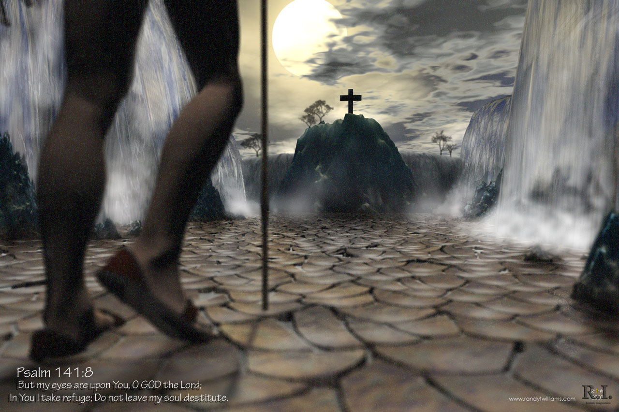
Know your Bible:
Old Testament Survey
Part Two
Joshua to David

Slide 2

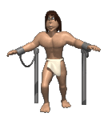
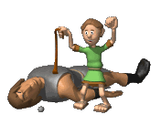
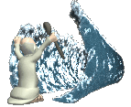
Know your Bible: Old Testament Survey Part Two – Joshua to David
The Four
Points
Post
Exile
The Divided
Kingdom and Exile
The Davidic
Kingdom
The
Exodus
Around which
OT Books
Cluster

Slide 3
Know your Bible: Old Testament Survey Part Two – Joshua to David

Slide 4
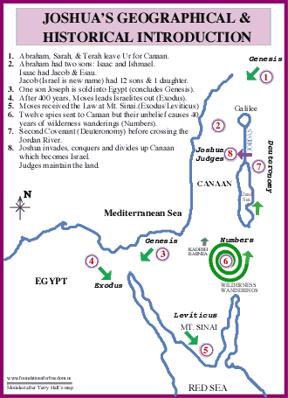

Know your Bible: Old Testament Survey Part Two - Joshua to David
Summary of what we have learnt.
Round in ever increasing circles until they come into the promised land (same with us)

Slide 5
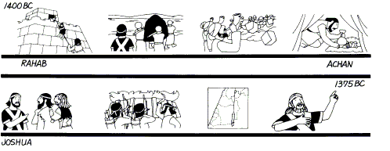
Know your Bible: Old Testament Survey Part Two - Joshua to David
1. Overview of the Book of Joshua
Joshua leads Israel across the Jordan into the promise land.
After main power bases of the heathen Canaanites were destroyed, smaller armies were still scattered.
He divides up the land and the tribes are separated. It was the duty of the tribes to defeat them in their inherited area.
Length of book is almost 30 years. Conquest is 5-7 years
After the death of Joshua, there was no central leader in Israel

Slide 6
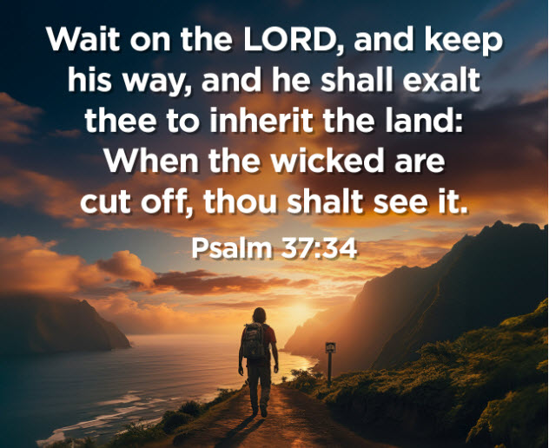
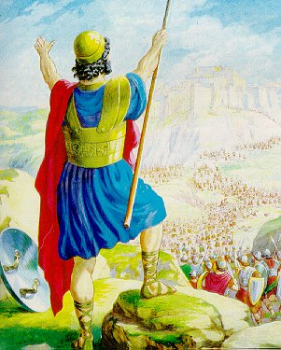
Know your Bible: Old Testament Survey Part Two - Joshua to David
(a) Orientation of the Book of Joshua.
Tradition has ascribed authorship to JOSHUA, with a date of writing approximately 1390 B.C.
Four basic divisions:
PREPARATION of the People (Joshua 1-5) 1 Month
CONQUERING the Land (Joshua 6-12) 7 Years
DIVIDING the Land (Joshua 13-21) 18 years
RENEWAL of the Covenant (Joshua 22-24)
“To this day” infers an editor or second author. This a foundational book in the last era of formation.

Slide 7
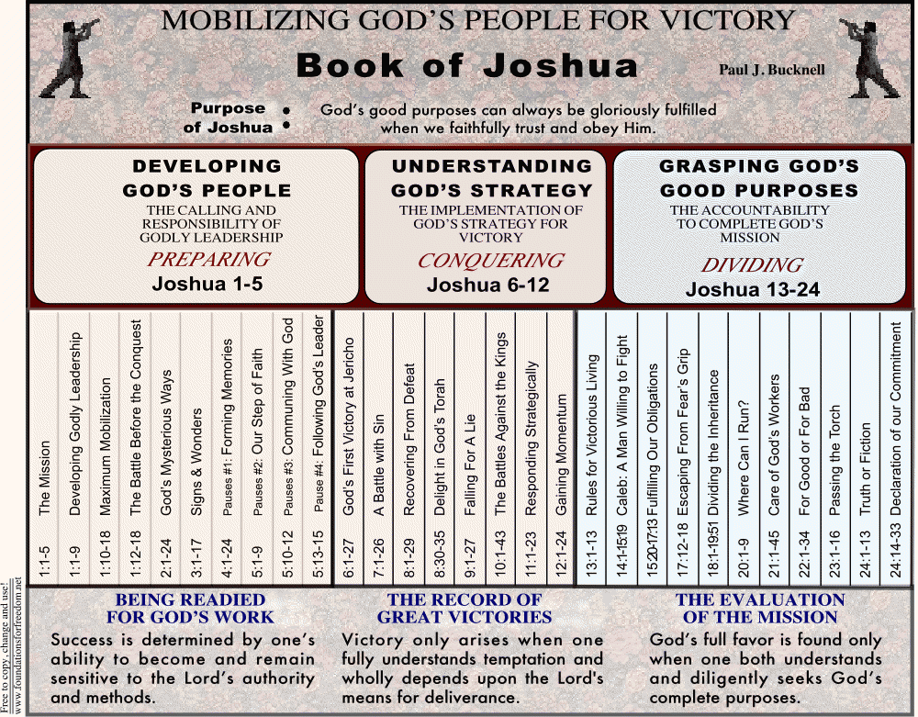
Know your Bible: Old Testament Survey Part Two - Joshua to David
Passion for Word, Presence and Holiness
Power over enemy, moving in Victory
Moving in area of Inheritance
Heart Skills
Ministry Skills
Ministry Proper
PREPARING
POSSESSING
PLACING

Slide 8
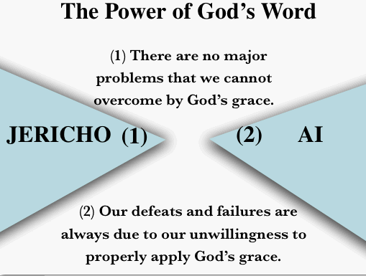
Know your Bible: Old Testament Survey Part Two - Joshua to David
(c) Helpful Hints for Reading Joshua
  1. Notice how the battles of JERICHO and AI are told in detail: These battles establish the pattern for the rest of the conquest.
(1) When Israel obeys God and recognizes that it is the Lord who fights for them, they have victory at Jericho.
(2) When Israel disobeys, they experience defeat at Ai.

Slide 9
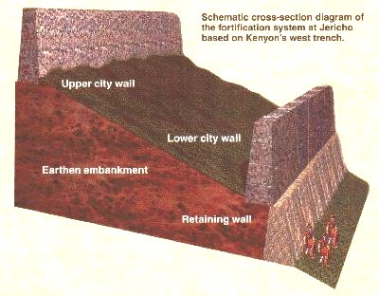
Know your Bible: Old Testament Survey Part Two - Joshua to David
Helpful hints for reading Joshua

Slide 10

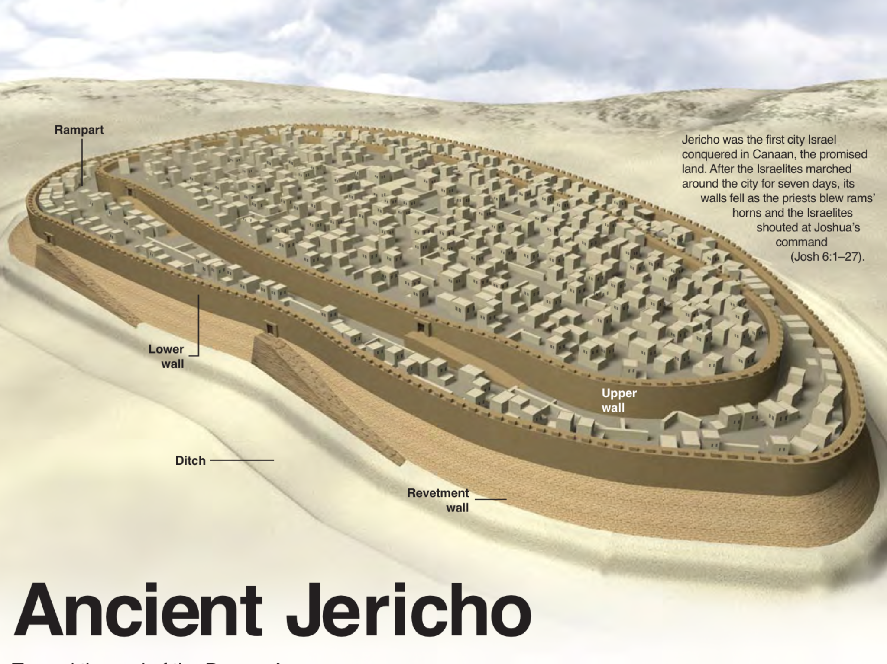
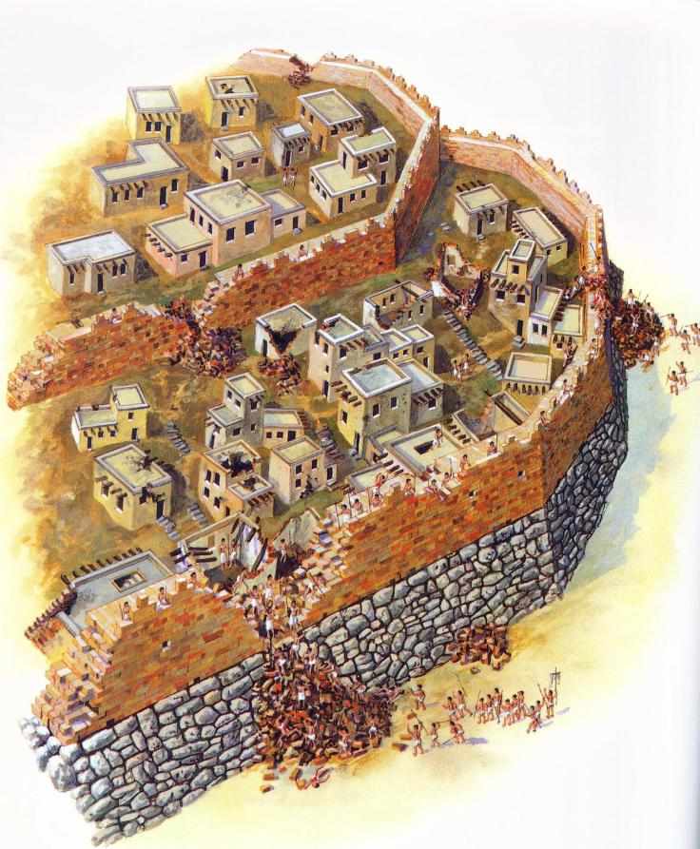

Slide 11
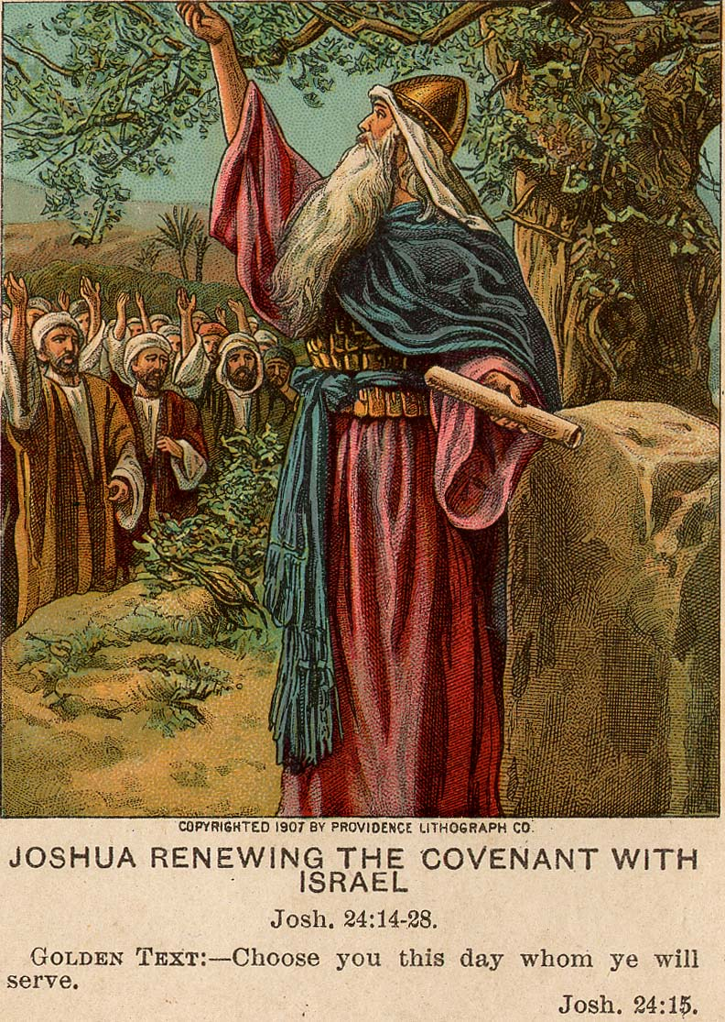
Know your Bible: Old Testament Survey Part Two - Joshua to David
Helpful hints for reading Joshua
  2. Notice the emphasis on keeping the COVENANT: Both the military conquest and Israel’s continued enjoyment of the land depends entirely on the people’s faithfulness to God. The book begins and ends with emphasis on keeping God’s commands.

Slide 12
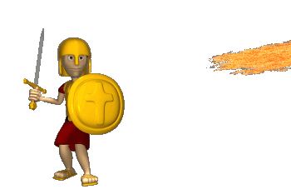
Know your Bible: Old Testament Survey Part Two - Joshua to David
Helpful hints for reading Joshua
  3. Understand the purpose of Holy WAR: God’s command to kill every man, woman and child in the land often prompts two important questions:
Why was it necessary?
“And the LORD drove out from before us all the people, including the Amorites who dwelt in the land. We also will serve the LORD, for He is our God." But Joshua said to the people, "You cannot serve the LORD, for He is a holy God. He is a jealous God; He will not forgive your transgressions nor your sins. If you forsake the LORD and serve foreign gods, then He will turn and do you harm and consume you, after He has done you good." And the people said to Joshua, "No, but we will serve the LORD!”
Joshua 24:18-21 (NKJV)

Slide 13
Know your Bible: Old Testament Survey Part Two - Joshua to David
Helpful hints for reading Joshua
  Understand the purpose of Holy WAR: God’s command to kill every man, woman and child in the land often prompts two important questions:
Why was it necessary?
• God is jealous for his glory Since Israel was to reflect his glory to the world, it was imperative that they remain holy (i.e., separate) from the pagan nations around them. For this reason, it was necessary to completely destroy the pagan inhabitants of the land. Otherwise, the Israelites would inevitably be influenced by their immorality and idolatry (which of course is exactly what happened).

Slide 14
Know your Bible: Old Testament Survey Part Two - Joshua to David
Helpful hints for reading Joshua
Doesn’t this conflict with God’s loving nature?
• All of us are by sinners by nature and prior to faith in The Messiah, we were ‘objects of wrath’ (Eph 2:3). We are all sinners from birth and we all deserve the judgment that came upon the Canaanites.
  Understand the purpose of Holy WAR: God’s command to kill every man, woman and child in the land often prompts two important questions:

Slide 15
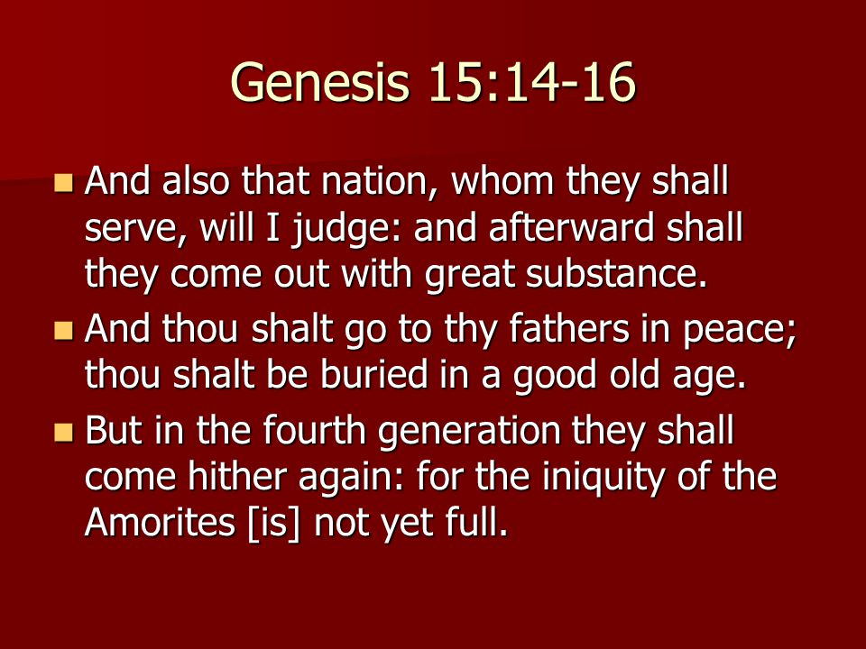
Know your Bible: Old Testament Survey Part Two - Joshua to David
Helpful hints for reading Joshua
“Why was God so harsh with them?” and “Why has God been so gracious with us?”
• The Canaanites’ sin was extreme and cried out for God’s judgment (see Lev. 18.21-30). Their culture was a picture of complete depravity. They practiced divination, idolatry, all kinds of sexual immorality, and even child sacrifice as part of their worship of Molech. God had been very patient with the Canaanites. They had been storing up wrath for over 400 years! (see Genesis 15.16).
• God is sovereign over all life. If we recognize God as the creator of life, it
logically follows that He also has the right to take it away. The Israelites were simply God’s instrument of judgment – they did not act on their own accord.

Slide 16
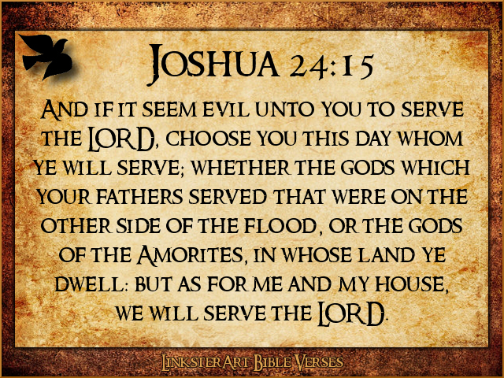
Know your Bible: Old Testament Survey Part Two - Joshua to David
(d) Key Verses in Joshua
Key Verses:
1:3 Every place on which the sole of your foot treads, I have given it to you, just as I spoke to Moses. [In this regard, Joshua compares to Ephesians 1:3 in the New Testament, “… blessed with every spiritual blessing in the heavenlies.”]
1:8-9 This book of the law shall not depart from your mouth, but you shall meditate on it day and night, so that you may be careful to do according to all that is written in it; for then you will make your way prosperous, and then you will have success. 9 Have I not commanded you? Be strong and courageous! Do not tremble or be dismayed, for the Lord your God is with you wherever you go.
11:23 So Joshua took the whole land, according to all that the Lord had spoken to Moses, and Joshua gave it for an inheritance to Israel according to their divisions by their tribes. Thus the land had rest from war.

Slide 17
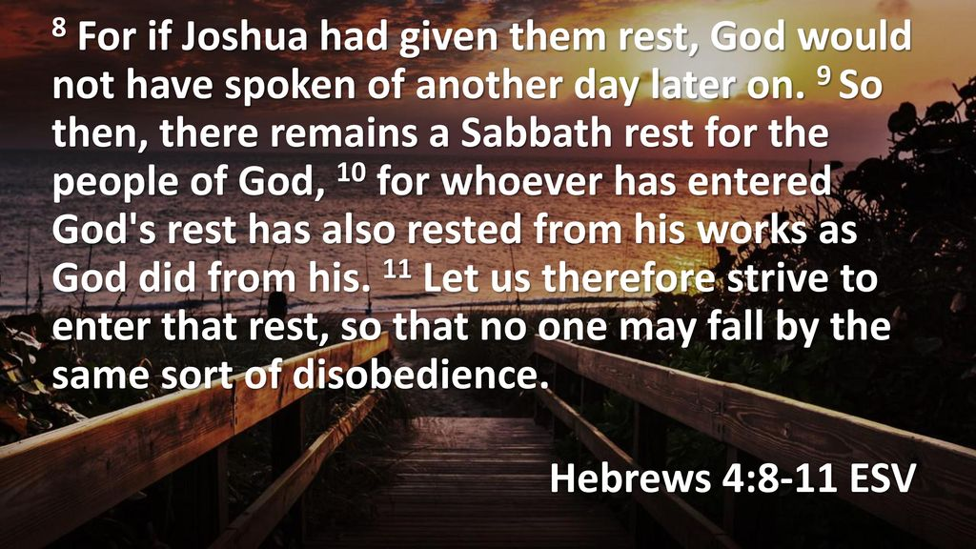
Know your Bible: Old Testament Survey Part Two - Joshua to David
(e) Messianic Christology in Joshua
Joshua is a type of the Messiah in two very important ways.
First, his name, Yeshua, a contracted form of Yehoshua, meaning, “YHVH is salvation,” is the Greek equivalent of the name Jesus. Joshua is actually called by the name Yeshua (Jesus) in Acts 7:45.
Second, Joshua is seen as a type of the Messiah in his work of leading Israel triumphantly into the rest of their promised possession, the land of Canaan (cf. Heb. 4:8). This is but a foretaste of the rest we enter by faith in the Messiah. He surely foreshadows the Saviour who leads “many sons to glory” (Heb. 2:9-10).

Slide 18
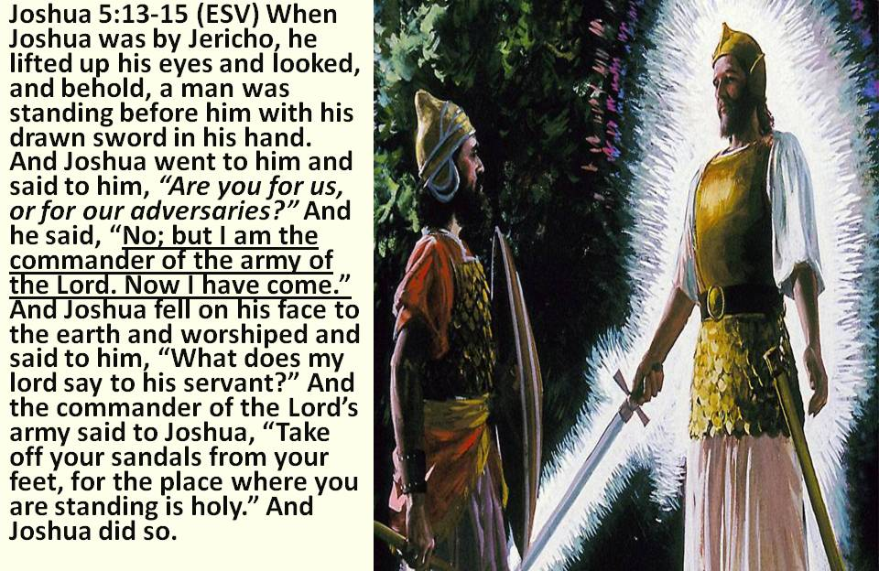
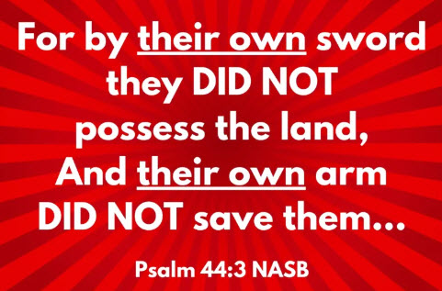
Know your Bible: Old Testament Survey Part Two - Joshua to David
Messianic Christology in Joshua
Joshua was met by the COMMANDER of the Lord’s army. This is undoubtedly The Theophany, a preincarnate appearance of the Messiah.

Slide 19
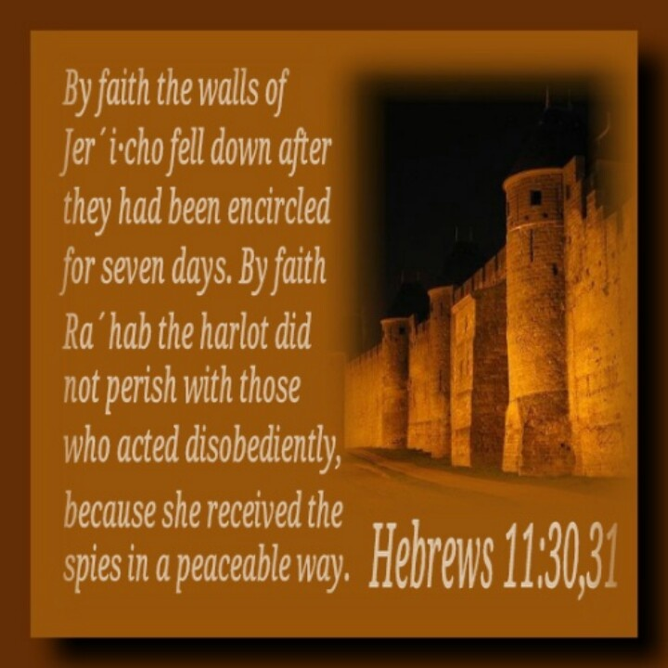

Know your Bible: Old Testament Survey Part Two - Joshua to David
Messianic Christology in Joshua
RAHAB’s scarlet cord (2:21) portrays salvation through the blood and death of the Messiah (cf. Heb. 9:19-22). This Gentile prostitute heard of the mighty works of God, believed, hid the spies, was delivered when Jericho was destroyed, and is found in the genealogy of the Messiah (Matt. 1:5).

Slide 20
Know your Bible: Old Testament Survey Part Two - Joshua to David
(f) Contribution to Jewish History
Joshua shows how God fulfils his PROMISE to Abraham.
PROMISE
FULFILLMENT
“Abram passed through the land to the place of Shechem, as far as the terebinth tree of Moreh. And the Canaanites were then in the land. Then the LORD appeared to Abram and said, "To your descendants I will give this land." And there he built an altar to the LORD, who had appeared to him.”
Genesis 12:6-7 (NKJV)
“So the LORD gave to Israel all the land of which He had sworn to give to their fathers, and they took possession of it and dwelt in it. The LORD gave them rest all around, according to all that He had sworn to their fathers. And not a man of all their enemies stood against them; the LORD delivered all their enemies into their hand. Not a word failed of any good thing which the LORD had spoken to the house of Israel. All came to pass.” Joshua 21:43-45 (NKJV)

Slide 21
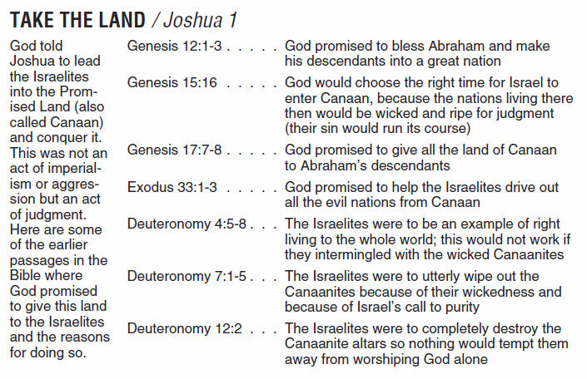
Know your Bible: Old Testament Survey Part Two - Joshua to David
Joshua shows how God fulfils his PROMISE to Abraham.
God has now finished the process of birthing a new nation that he began in Genesis 12. Possession of the land completes the formation of Israel as a nation. They now have people, a law, and land of their own.

Slide 22
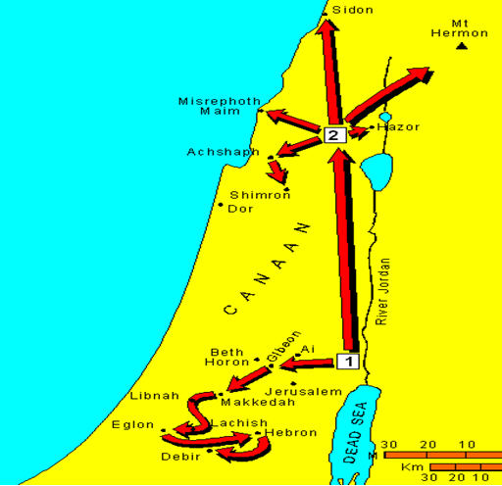
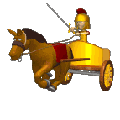

Know your Bible: Old Testament Survey Part Two - Joshua to David
(g) Possession of the Land
The CENTRAL Campaign
The SOUTHERN Campaign
The NORTHERN Campaign
3
2

Slide 23
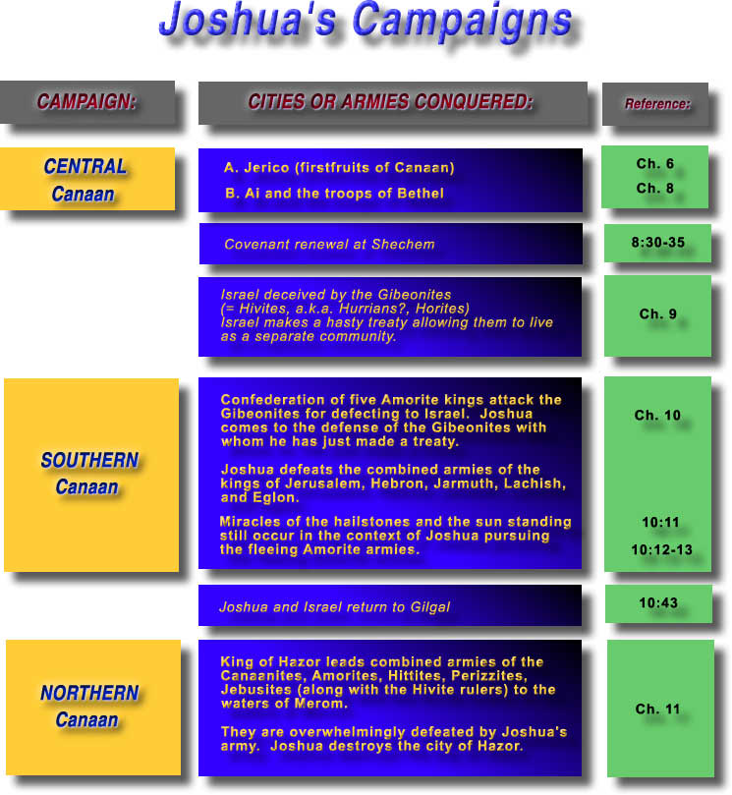
Know your Bible: Old Testament Survey Part Two - Joshua to David

Slide 24
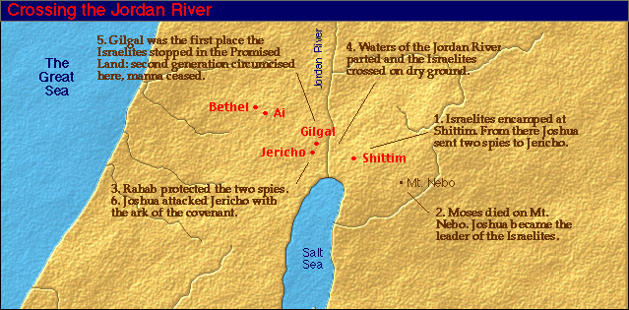
Know your Bible: Old Testament Survey Part Two - Joshua to David
Entering the Land

Slide 25
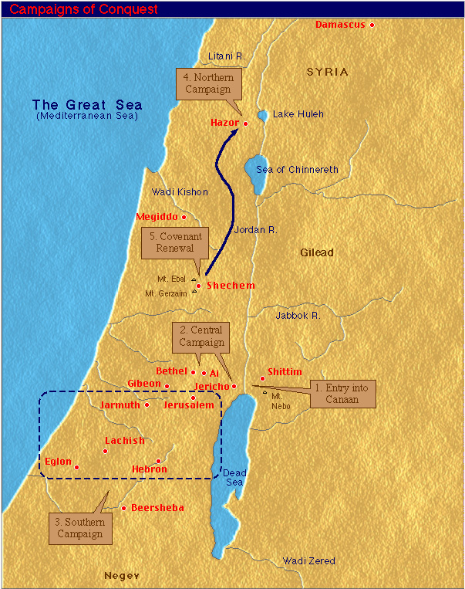
Know your Bible: Old Testament Survey Part Two - Joshua to David

Slide 26
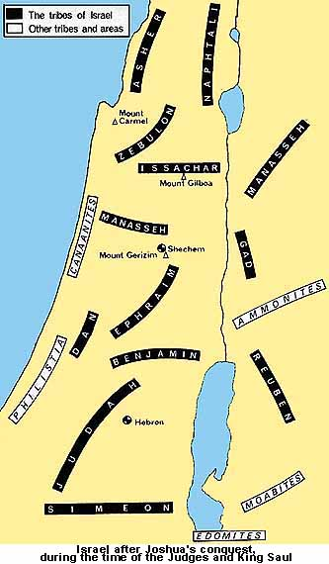
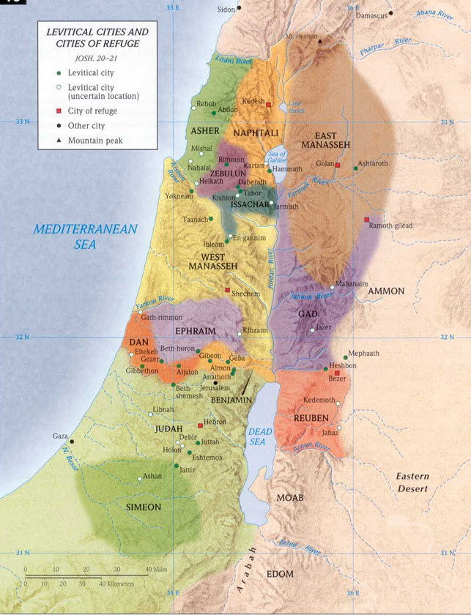
Know your Bible: Old Testament Survey Part Two - Joshua to David
Division of the Land

Slide 27
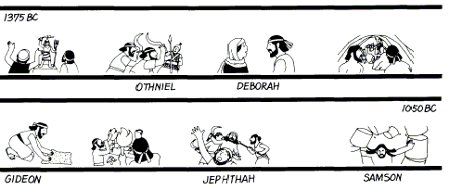
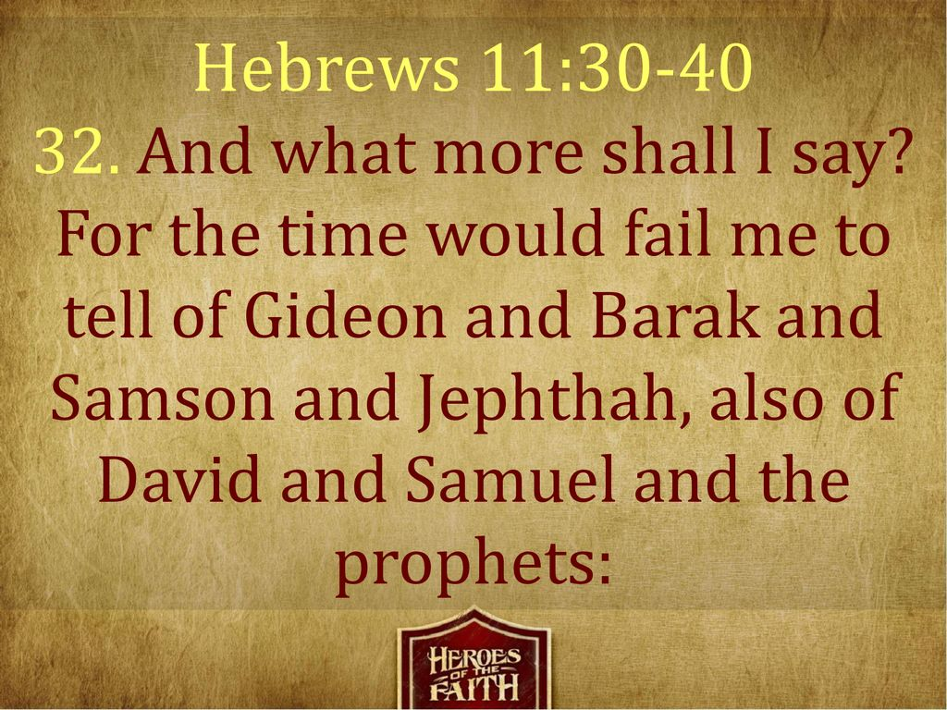
Know your Bible: Old Testament Survey Part Two - Joshua to David
The Book of Judges
The Israelites did not possess all the land (Judges 1:2)
God sent Judges (Judges 3-16)
The Israelites did not keep God’s laws (Judges 17-21)

Slide 28
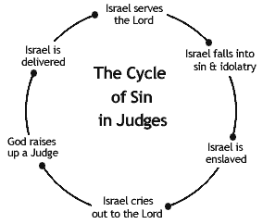
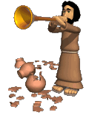
Know your Bible: Old Testament Survey Part Two - Joshua to David
2. Overview of the Book of Judges
This was a DIFFICULT time in the history of Israel.
The Individual tribes were judged in the absence of a central GOVERNMENT.
Israel follows the same circle for many years.
Service
Salvation
Sin
Saviour
Slavery
Supplication

Slide 29
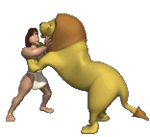
Know your Bible: Old Testament Survey Part Two - Joshua to David
332
Length of time represented by the book - ________ years.
Other books that were written during the time of Judges – ____________
Authorship has traditionally been assigned to __________ with a date of writing about 1000 B.C. The book of Judges is a foundational book that spans from the beginning of the Era of Theocracy to almost the end of theocracy, approximately 1375 to 1043 B.C. The Hebrew title for Judges is better translated as ‘Chieftain’.
RUTH
(a) Orientation
SAMUEL

Slide 30
Know your Bible: Old Testament Survey Part Two - Joshua to David
(b) Helpful Hints for Reading Judges
The nature of the Judges: They were regional CIVIL and MILITARY leaders – they were not kings nor were they primarily judicial in function.
The nature of Theocracy: Theocracy means rule by GOD.
Notice that God did not appoint a successor to Joshua – this was not an oversight on God’s part. Moses and Joshua were
temporary rulers that served while the nation was still being formed. Afterward, God intended to rule the nation through the leadership provided by heads of households, clans (groups of families) and tribes.

Slide 31
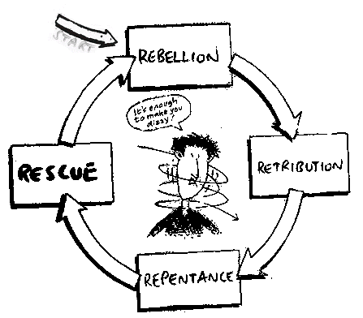
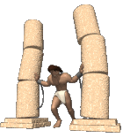
Know your Bible: Old Testament Survey Part Two - Joshua to David
(b) Helpful Hints for Reading Judges
Note the downward spiral of MORAL degeneration:

Slide 32
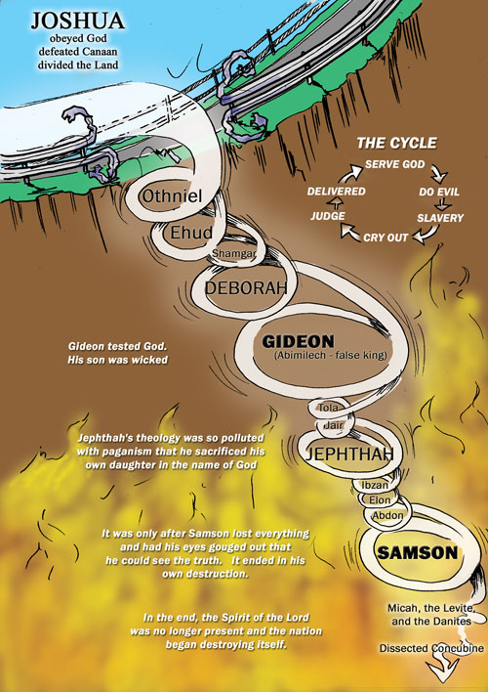
Know your Bible: Old Testament Survey Part Two - Joshua to David

Slide 33
Know your Bible: Old Testament Survey Part Two - Joshua to David
(b) Key Verses in Judges
Key Verses:
2:15-16 Wherever they went, the hand of the Lord was against them for evil, as the Lord had spoken and as the Lord had sworn to them, so that they were severely distressed. 16 Then the Lord raised up judges who delivered them from the hands of those who plundered them.
2:20-23 So the anger of the Lord burned against Israel, and He said, “Because this nation has transgressed My covenant which I commanded their fathers, and has not listened to My voice, 21 I also will no longer drive out before them any of the nations which Joshua left when he died, 22 in order to test Israel by them, whether they will keep the way of the Lord to walk in it as their fathers did, or not.” 23 So the Lord allowed those nations to remain, not driving them out quickly; and He did not give them into the hand of Joshua.
21:25 In those days there was no king in Israel; everyone did what was right in his own eyes.

Slide 34
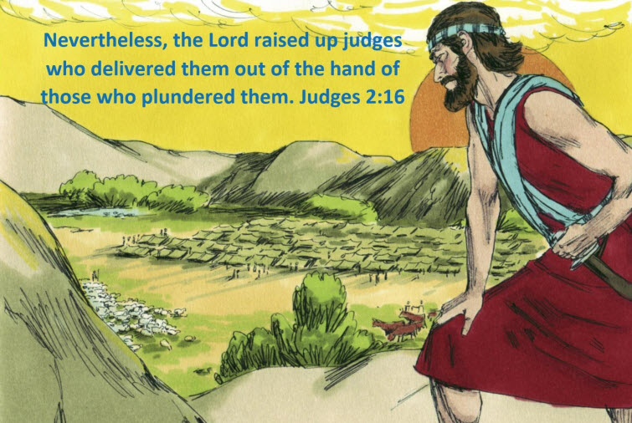

Slide 35
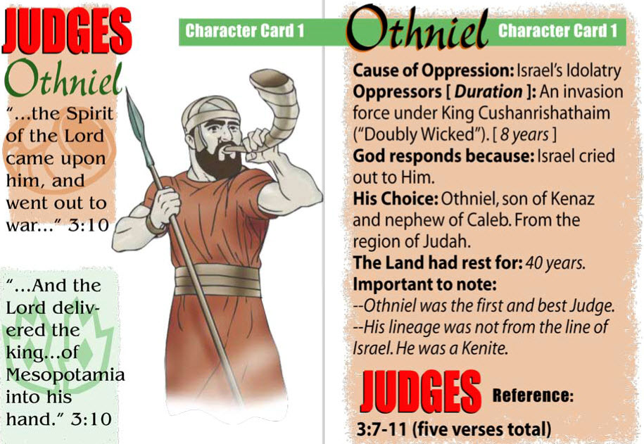
Know your Bible: Old Testament Survey Part Two - Joshua to David

Slide 36
Know your Bible: Old Testament Survey Part Two - Joshua to David
(c) Messianic Christology as seen in the Book of Judges
e.g. Gideon as a type of Christ
Heralded by a prophet preaching repentance.
He first made an onslaught on the adversary.
In the same action, he built an altar, and himself offered sacrifice, as though he were a priest.
The altar was named Jehovah-Shalom -- the Lord of Peace.
His own people cried out against his worthy action.
A sign, a prophecy, of dew (foreshadowed the work of the Holy Spirit).
Those who were gathered unto him, by the sound of the trumpet, were reduced to a faithful remnant.
The coming victory was symbolized in barley bread -- (Lev 23:10 -- barley).
The destruction of the Midianite host prefigures the greater destruction of the Last Day oppressor, in the same plain of Jezreel (Armageddon)
A victory accompanied by the blast of trumpets, the smashing of earthenware vessels and the manifestation of torches of fire (Trumpet and Bowl judgements).
Seventy sons correspond in number with the nations of the world. (Gen 10 lists 70 names.)
All the Judges are TYPES of Christ

Slide 37
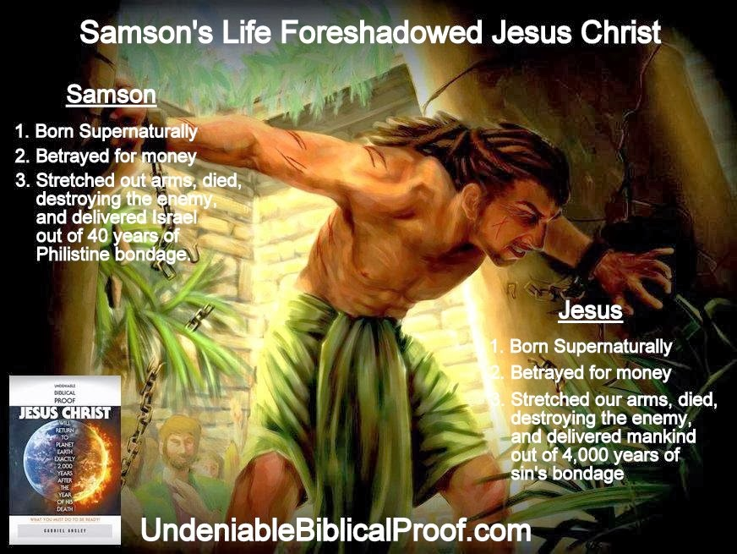

Know your Bible: Old Testament Survey Part Two - Joshua to David

Slide 38
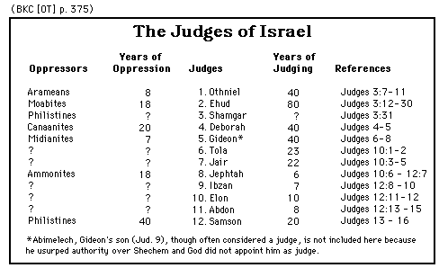
Know your Bible: Old Testament Survey Part Two - Joshua to David
(d) Contribution to Jewish History
Judges illustrates quite graphically Israel’s break with the COVENANT. In particular, Judges highlights their failure to drive out the Canaanites and the resulting consequences: Immorality, idolatry & division
Repetition of the phrase, “in those days there was no king in Israel, and everyone did what was right in his own eyes.” This prepares the way for the next major chapter in the Old Testament story, the Era of Monarchy.

Slide 39
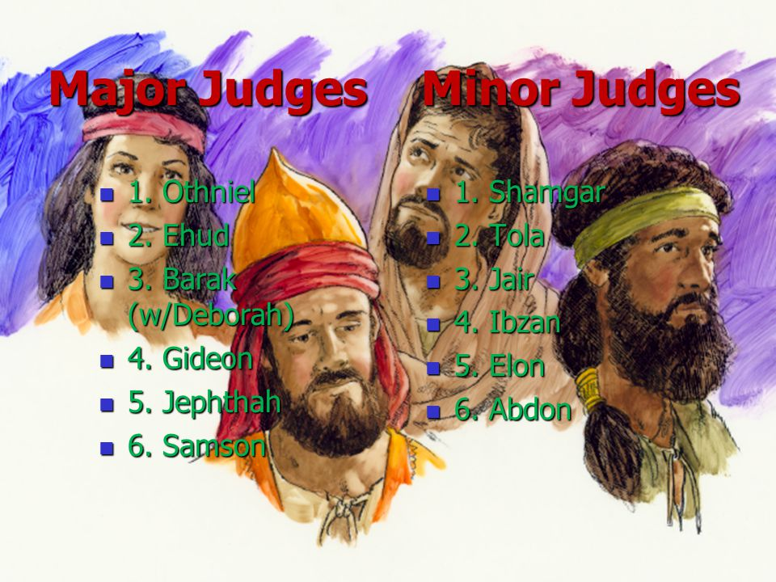
Know your Bible: Old Testament Survey Part Two - Joshua to David

Slide 40
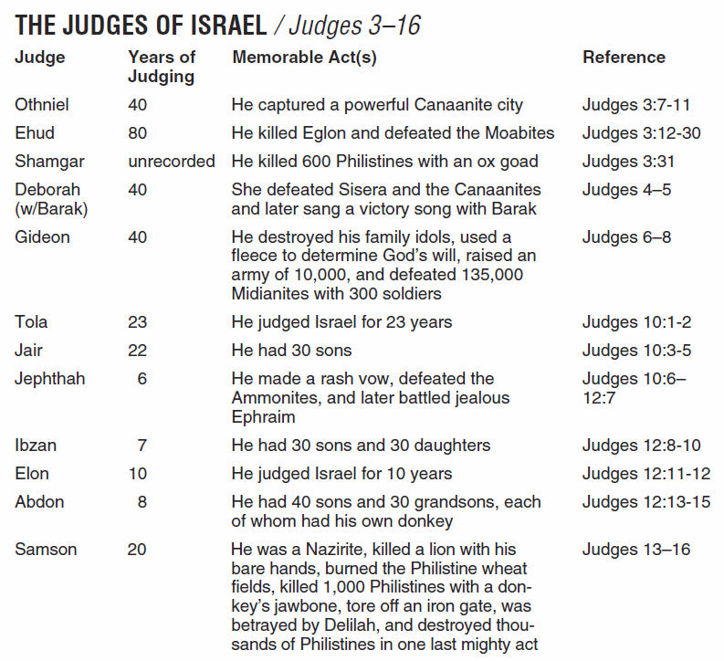
Know your Bible: Old Testament Survey Part Two - Joshua to David

Slide 41
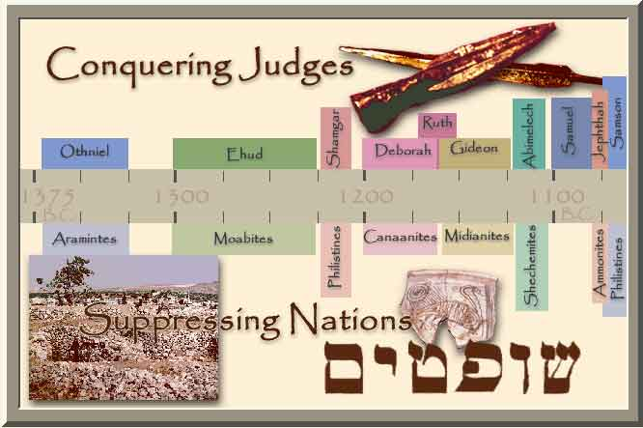
Know your Bible: Old Testament Survey Part Two - Joshua to David

Slide 42
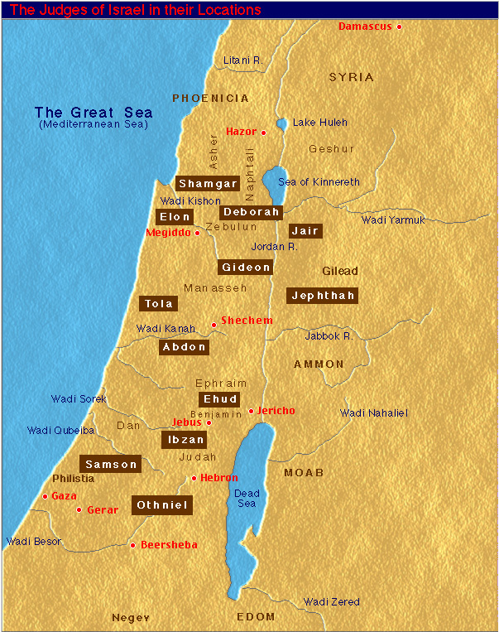
Know your Bible: Old Testament Survey Part Two - Joshua to David
Representing all tribes and all land.

Slide 43
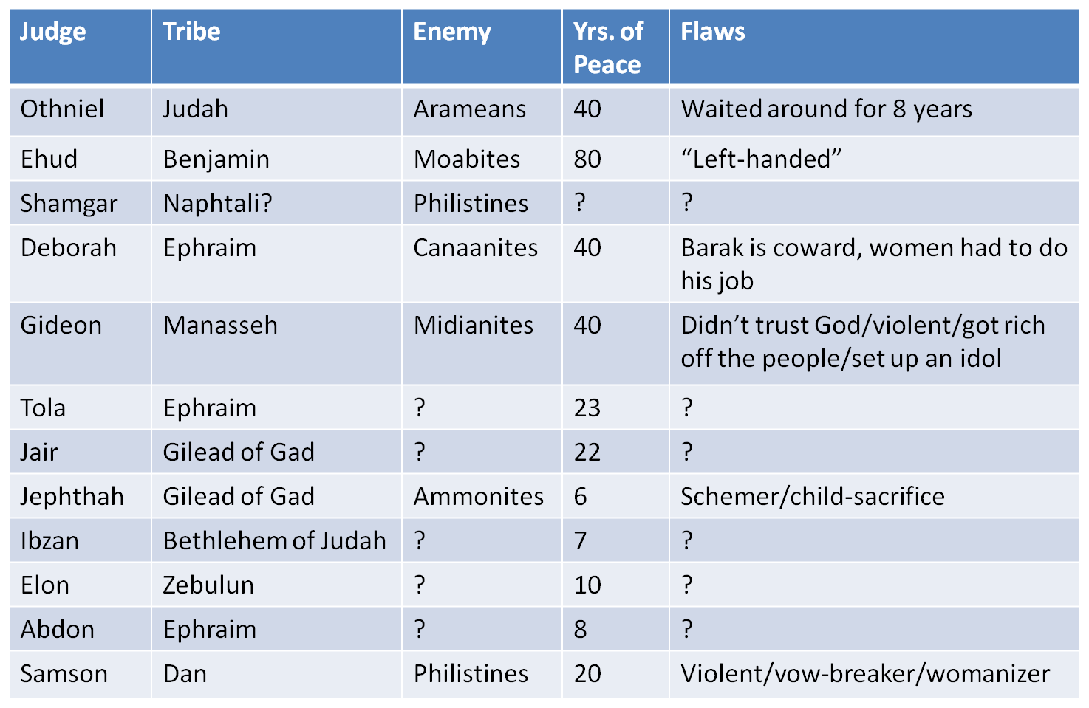
Know your Bible: Old Testament Survey Part Two - Joshua to David

Slide 44
Know your Bible: Old Testament Survey Part Two – Joshua to David

Slide 45
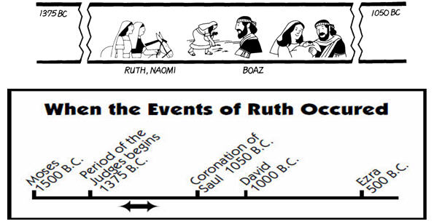
Know your Bible: Old Testament Survey Part Two - Joshua to David
3. Overview of the Book of Ruth
Around the time of Deborah/Gideon

Slide 46
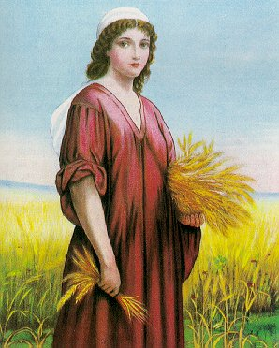
Know your Bible: Old Testament Survey Part Two - Joshua to David
(a) Orientation of the Book of Ruth
Authorship has traditionally been assigned to SAMUEL, with a date of writing about 1000 B.C. Ruth is not a foundational book, but is complementary to the book of Judges, also set in the Era of Theocracy (Ruth 1.1).
Overview and Outline
Ruth’s DECISION to follow Naomi (Ch. 1)
Ruth’s FAITHFULNESS to Naomi (Ch. 2)
Ruth’s CLAIM upon Boaz (Ch. 3)
Ruth’s REDEMPTION by Boaz (Ch. 4)

Slide 47
Know your Bible: Old Testament Survey Part Two - Joshua to David
(b) Helpful Hints for Reading Ruth
The laws concerning the KINSMAN-redeemer
The nearest male relative was to “redeem” or buy back the inheritance of a relative. This could take the form of buying back land of a poor relative (Lev. 25.25), buying a poor relative out of slavery (Lev. 25.47-49), or raising up a family for a relative that died without an heir (Deut. 25.5-10). Boaz did two of these – buying Naomi’s property to keep it in the family and taking Ruth as his wife. Both actions served to preserve the inheritance of his dead relative Elimelech.

Slide 48
Know your Bible: Old Testament Survey Part Two - Joshua to David
(b) Helpful Hints for Reading Ruth
The laws concerning the KINSMAN-redeemer
"If brothers dwell together, and one of them dies and has no son, the widow of the dead man shall not be married to a stranger outside the family; her husband's brother shall go in to her, take her as his wife, and perform the duty of a husband's brother to her. And it shall be that the firstborn son which she bears will succeed to the name of his dead brother, that his name may not be blotted out of Israel. But if the man does not want to take his brother's wife, then let his brother's wife go up to the gate to the elders, and say, 'My husband's brother refuses to raise up a name to his brother in Israel; he will not perform the duty of my husband's brother.' "Then the elders of his city shall call him and speak to him; and if he stands firm and says, 'I do not want to take her,' "then his brother's wife shall come to him in the presence of the elders, remove his sandal from his foot, spit in his face, and answer and say, 'So shall it be done to the man who will not build up his brother's house.' "And his name shall be called in Israel, 'The house of him who had his sandal removed.'
Deuteronomy 25:5-10 (NKJV)

Slide 49
Know your Bible: Old Testament Survey Part Two - Joshua to David
Naomi serves as a picture of ISRAEL ________________
  Naomi, whose name means “sweetness” or “blessedness,” starts the story in her land with an inheritance (land, a husband and sons).
  Naomi is removed from her land and loses her inheritance (her husband and sons die). She then calls herself Mara, which means “bitterness,” because of the way the Lord has dealt with her.
  Then as a result of God’s kindness and grace (as expressed through Ruth), Naomi returns to her land and regains her inheritance (she has a grandson through Ruth). She is again called blessed.

Slide 50
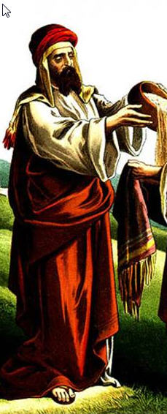
Know your Bible: Old Testament Survey Part Two - Joshua to David
(c) Messianic Christology in the Book of Ruth
BOAZ, as Kinsman-Redeemer is a Type of Christ as he…
Was a blood relative (a kinsman) of those he redeems (Deut. 25:5, 7-10; John 1:14; Rom. 1:3; Phil. 2:5-8; Heb. 2:14-15)
Was able to pay the price of redemption (cf. 2:1; 1 Pet. 1:18-19);
Was willing to redeem or pay the price (cf. 3:11; Matt. 20:28; John 10:15, 19; Heb. 10:7);
Was free himself, as the Messiah was free from the curse of sin, being without sin (2 Cor. 5:21; 1 Pet. 2:22; 1 John 3:5)

Slide 51
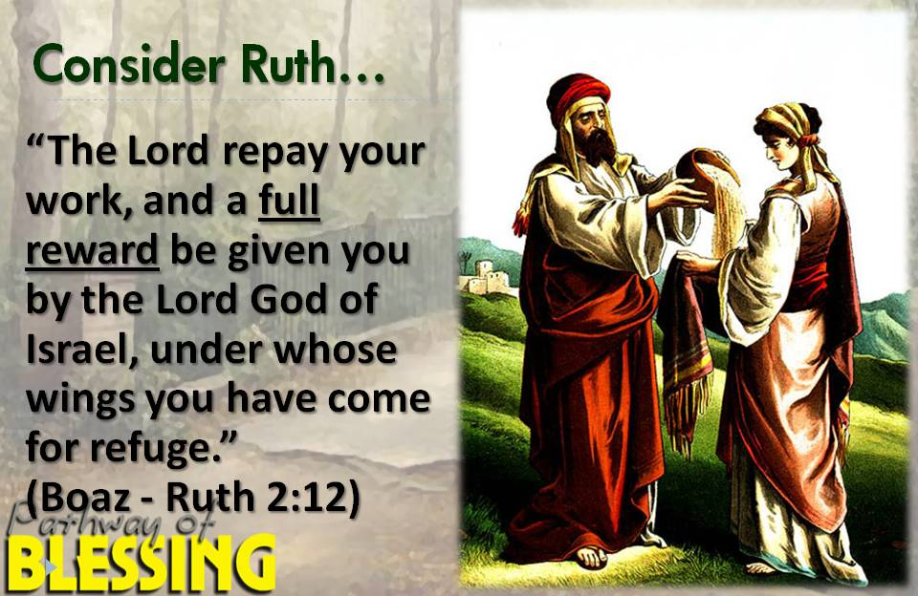
Know your Bible: Old Testament Survey Part Two - Joshua to David
Ruth foreshadows the gentiles that would be grafted into the true Israel (Romans 11:11-31)

Slide 52

Know your Bible: Old Testament Survey Part Two - Joshua to David
(d) Contribution to Jewish History
Ruth shows that even in time of great trouble for the nation, some remain FAITHFUL to the covenant.

Slide 53


Know your Bible: Old Testament Survey Part Two - Joshua to David
Ruth serves as another illustration of how God fulfills his promise to Abraham to bless all the nations of the earth through his descendants.
Ruth also gives us a piece of David’s genealogy, and therefore also a piece of The Messiah’s genealogy.

Slide 54

Know your Bible: Old Testament Survey Part Two - Joshua to David

Slide 55

Know your Bible: Old Testament Survey Part Two - Joshua to David
4. 1 and 2 Samuel
(parallels 1 Chronicles 9-29)

Slide 56

Know your Bible: Old Testament Survey Part Two - Joshua to David
4. 1 and 2 Samuel
(parallels 1 Chronicles 9-29)
or Ezra

Slide 57

Know your Bible: Old Testament Survey Part Two - Joshua to David
(a) Orientation of 1 & 2 Samuel
1 & 2 Samuel were originally ONE book in the Hebrew canon. It was divided into two by the translators of the Septuagint (a Greek translation of the Old Testament) in the third century B.C. Our English Bible follows this same pattern.
For 1 Samuel 1-24, SAMUEL is suggested as the author. For the remainder, NATHAN and Gad are likely candidates. Time of writing is approximately 975 B.C. These books describe the end of theocracy and the reigns of Israel’s first two kings, Saul and David.

Slide 58

Know your Bible: Old Testament Survey Part Two - Joshua to David
(b) Overview Outline of 1 & 2 Samuel
SAMUEL - Judge and Prophet in Israel (1 Sam 1-7)
SAUL: The First King of Israel (1 Sam 8-12)
The DECLINE of Saul and the Rise of David (1 Sam 13-31)
David’s Rule over JUDAH (2 Sam 1-4)
David’s Rule over all ISRAEL (2 Sam 5-24)

Slide 59

Know your Bible: Old Testament Survey Part Two - Joshua to David
(c) Messianic Christology of 1 & 2 Samuel
The first obvious and interesting portrait of Christ is SAMUEL in that he was a prophet, a priest, and though he was not a king, he was a judge who was used of God to inaugurate a new age.
The primary portrait and anticipation of Messiah is found in the life of DAVID.
David, as a Type of Christ was a shepherd born in Bethlehem, a hero, had to endure the wilderness and the trials there and finally became king of Israel.

Slide 60
Know your Bible: Old Testament Survey Part Two - Joshua to David
(c) Messianic Christology of 1 & 2 Samuel
With the exception of his sins, David remains a type of Christ as the king of Israel. It is in this chapter that God establishes the Davidic Covenant (2 Sam 7:13-16) which ultimately has its fulfillment in the person of Christ. God’s promise to David explains why the title “Son of David” was used in New Testament times as another name for the Messiah, or the Anointed One. Notice how the phrase “the Lord’s anointed,” is used frequently throughout Samuel.

Slide 61

Quoting Psalm 110:1

Slide 62



Know your Bible: Old Testament Survey Part Two - Joshua to David
(d) Contribution to Jewish History
The prophet Samuel acts as a BRIDGE between the Judges and the kings and shows us God’s purposes for the monarchy

Slide 63

Know your Bible: Old Testament Survey Part Two - Joshua to David
Israel Demands a King
- Shepherd Boy

Slide 64
Know your Bible: Old Testament Survey Part Two - Joshua to David
(d) Contribution to Jewish History
God’s plans for monarchy were much different than what the people envisioned. Israel’s king was not to be like the kings of other nations. He was not a god or a law unto himself, but instead he was subject to the covenant law and the prophets as God’s enforcers of the covenant. Israel’s king was also to reflect the character of God because he led the nation spiritually as God’s representative. God’s design for the monarchy and the failure of Israel’s kings to conform to that design are key points that help us to understand the rest of the Old Testament story. Samuel introduces us to the Davidic Covenant (see 2 Sam 7.11-16). God promises David a house (a dynasty) and a kingdom that will never end. This was partially fulfilled in the days of Israel’s monarchy (Judah had only one dynasty, in contrast to many dynasties in Israel). However, ultimate fulfilment of this covenant promise awaits Yeshua’s (Jesus’) second coming.

Slide 65
Know your Bible: Old Testament Survey Part Two - Joshua to David
1 Samuel
United Monarchy - 1st Samuel is a transition period. Israel is still young and in training.
There was a loose confederacy-1 banner over all.
Samuel appoints first king to begin monarchy: SAUL. He had a good start but a bad finish.
God rejected Saul and another king, DAVID was appointed.
1 Samuel records the rise & fall of Saul.
David kills Goliath.
Struggle between Saul & David.
Deaths at end of 1st Samuel-Saul, Jonathan, Samuel.

Slide 66

Know your Bible: Old Testament Survey Part Two - Joshua to David
Saul

Slide 67

Know your Bible: Old Testament Survey Part Two - Joshua to David

Slide 68



Know your Bible: Old Testament Survey Part Two - Joshua to David
Many Psalms of David written during this period.
e.g. Psalms 34,57,142 written from Caves of Adullam.

Slide 69


Know your Bible: Old Testament Survey Part Two - Joshua to David

Slide 70

Know your Bible: Old Testament Survey Part Two - Joshua to David
2 Samuel
Struggles with Saul are behind David.
David comes to power first over Southern portion of Israel- King in Hebron then over all Israel a few years later.
David’s real enemy is revealed- Himself.
Adultery with Bathsheba, murder of Uriah marks David’s fall.

Slide 71

Know your Bible: Old Testament Survey Part Two - Joshua to David

Slide 72

Know your Bible: Old Testament Survey Part Two - Joshua to David
David

Slide 73

Know your Bible: Old Testament Survey Part Two - Joshua to David

Slide 74


Know your Bible: Old Testament Survey Part Two - Joshua to David
David
Highs and Lows

Slide 75


Know your Bible: Old Testament Survey Part Two - Joshua to David

Slide 76

Know your Bible: Old Testament Survey Part Two - Joshua to David
How the Sin of Kings was Handled
1. Saul’s sin = taking on the role of priest and offering burnt offerings (1 Sam. 13:1-15) & not obeying the Lord completely by not destroying all the Amalekites and their property (1 Sam. 15).
2. David’s sin = Adultery/murder (2 Sam. 11) and counting Israel (2 Sam. 24).
3. Why the different treatment?
a. Different hearts
b. God did not reject Saul because of the sin.

Slide 77
Know your Bible: Old Testament Survey Part Two - Joshua to David
Saul didn’t care about (despised) the Lord’s commands and David did care. Their sins and type of repentance (or lack of) revealed their heart before God. David was known as a “Man after God’s heart.” This is seen even in the way he repented after he fell into sin (Psalm 51).
The sin of Saul was a demonstration of a king who was never meant for God’s people. In other words – “This is the type of king you should not have to rule over you. See the lack of devotion he has towards Me? He was never meant for you to begin with.”

Slide 78

Know your Bible: Old Testament Survey Part Two - Joshua to David
Take Away Points:
1. Potential discrepancy
"When you come to the land which the LORD your God is giving you, and possess it and dwell in it, and say, 'I will set a king over me like all the nations that are around me,' "you shall surely set a king over you whom the LORD your God chooses; one from among your brethren you shall set as king over you; you may not set a foreigner over you, who is not your brother.”
Deuteronomy 17:14-15 (NKJV)
“But the thing displeased Samuel when they said, "Give us a king to judge us." So Samuel prayed to the LORD. And the LORD said to Samuel, "Heed the voice of the people in all that they say to you; for they have not rejected you, but they have rejected Me, that I should not reign over them.”
1 Samuel 8:6-7 (NKJV)
?

Slide 79
Know your Bible: Old Testament Survey Part Two - Joshua to David
Take Away Points:
?
1. Potential discrepancy
God was displeased with Israel when they asked
for a king (1 Sam. 8:6-9); Israel was warned about what a king would do to them (1 Sam. 8:10-22); God gave them Saul as a king with apparent resignation (1 Sam. 12:6-15); yet God had already been planning on giving them a king (Deut. 17:14-20). The underlying truth of this is that God wanted them to be ruled with His king and under His conditions. Israel wanted a king for their own reasons and under their conditions – Saul was a failure, and David was God’s first true king.

Slide 80



Know your Bible: Old Testament Survey Part Two - Joshua to David
2. Israel chose a king based on looks and the appearance of strength; God chose based on heart qualities.
God uses the unexpected, unimpressive, and inexperienced to accomplish remarkable things.

Slide 81

Know your Bible: Old Testament Survey Part Two - Joshua to David
SAUL | DAVID
A man after the people’s heart (1 Samuel 8:5) | A man after God’s heart (1 Samuel 13:14)
He was the people’s choice. | He was God’s choice.
He disobeyed God’s Word (1 Samuel 15:11). | He obeyed God’s Word (Acts 13:22).
Man of Unbelief
Man of Faith

Slide 82

Know your Bible: Old Testament Survey Part Two - Joshua to David
“You have rejected the word of the Lord, and the Lord has rejected you from being king over Israel” 1 Samuel 15:26

Slide 83

Know your Bible: Old Testament Survey Part Two - Joshua to David
Saul was a head above most men. David was ruddy and smaller in stature. Saul was driven by an evil spirit and died a crazed, God-forsaken man. David drove an evil spirit from Saul with the sound of his lyre. Saul hid out in his tent when Goliath taunted the Israelites. David stood up for his people and God and defeated Goliath.
What made all the difference between these two men was their Spirit.
“And the Spirit of the Lord rushed upon David from that day forward. And Samuel rose up and went to Ramah. Now the Spirit of the Lord departed from Saul…”
1 Samuel 16:13-14
One man was Spirit-filled and led. The other was Spirit-devoid and distrusting. David would plead with God not to take his Spirit (Ps 51:11). God, on the other hand, would take his Spirit from Saul.

Slide 84


Know your Bible: Old Testament Survey Part Two - Joshua to David
3. All men are sinners (David and Saul). What happens after the sin makes a big difference in one’s relationship with God.
4. God has always planned on being King of His people. He showed the people their own failure to rule themselves (Judges) and their need for a godly king. David and his throne is a type foretelling the coming of Christ as the King of Kings.

Slide 85

Know your Bible: Old Testament Survey Part Two - Joshua to David

Slide 86

Know your Bible: Old Testament Survey Part Two - Joshua to David
5. God dwelt with His people in the Tabernacle and Temple by the Ark of the Covenant.
There were strict conditions place on His dwelling. With the coming of Christ and His final sacrifice of His own body for the sins of His people, God was able to now dwell inside His people – the Holy Spirit dwells in believers and the Church (the Body of Christ). In the New Jerusalem, there will be no temple, only the glory of the Lord dwelling directly with God’s people.
There were strict conditions placed on His dwelling. With the coming of Christ and His final sacrifice of His own body for the sins of His people, God was able to now dwell inside His people – the Holy Spirit dwells in believers and the Church (the Body of Christ). In the New Jerusalem, there will be no temple, only the glory of the Lord dwelling directly with God’s people.

Slide 87

Know your Bible: Old Testament Survey Part Two - Joshua to David

Slide 88



Journey of the Ark of the Covenant (God’s Manifest Presence)
Know your Bible: Old Testament Survey Part Two - Joshua to David
1
2
4
5
3
6
Tabernacle finally placed in David’s Tabernacle awaiting the building of the Temple.
7

Slide 89


Slide 90


Slide 91


