Slide 1

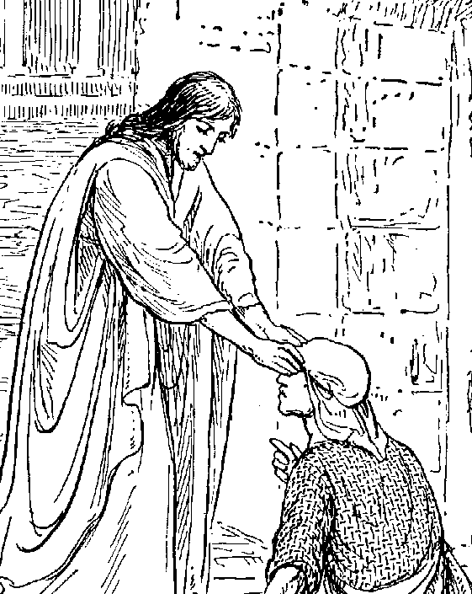
New Testament Survey 1
Background to the New Testament and the Gospels

Slide 2

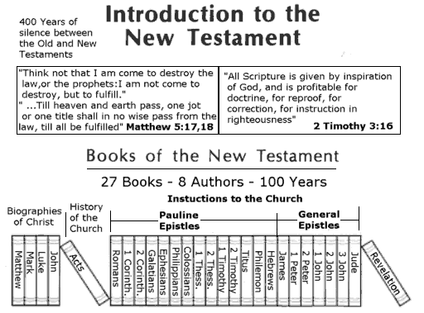
(1) Introduction to the New Testament

Slide 3
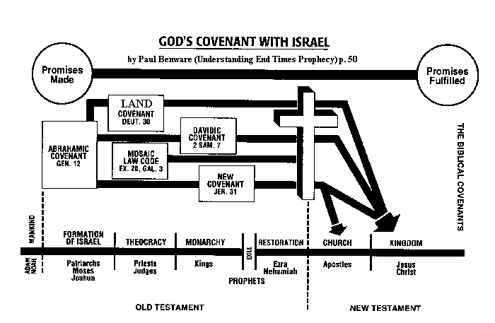
(1) Introduction to the New Testament
a. Relationship with Old Testament….

Slide 4
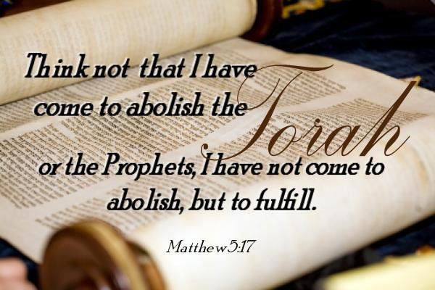
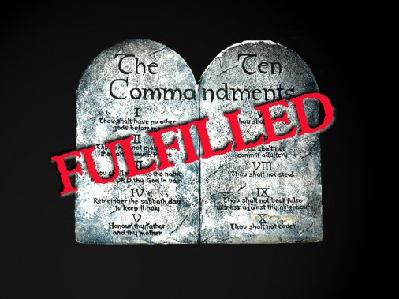
(1) Introduction to the New Testament
a. Relationship with Old Testament….
“Filled to
Fullness”
“Correctly
Interpreted”

Slide 5

End as in destination not termination
(1) Introduction to the New Testament
a. Relationship with Old Testament….

Slide 6

(1) Introduction to the New Testament
a. Relationship with Old Testament….
Only for
Israel
Fulfilled
in Christ
Unchanged but with deeper meaning

Slide 7
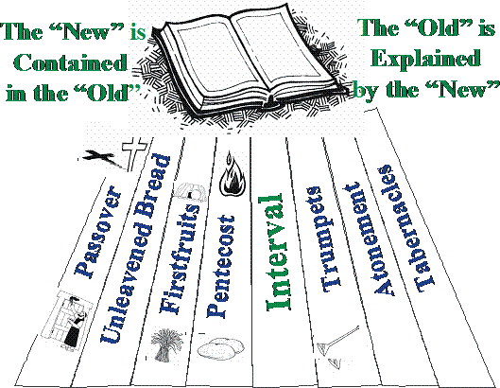
(1) Introduction to the New Testament
a. Relationship with Old Testament….

Slide 8
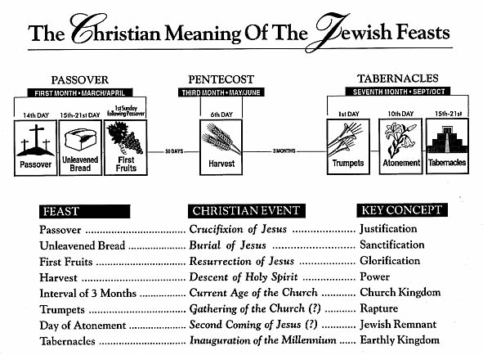
(1) Introduction to the New Testament
a. Relationship with Old Testament….

Slide 9
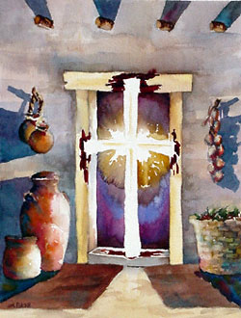
How the Testaments are Related
The ________________ is concealed in the ___________________.
The _______________ is revealed in the _________________.
The term ‘New’ is used NOT in the sense of _______________
the OLD but in the sense of being ______________ and
__________________ the OLD.
New Testament
Old Testament
Old Testament
New Testament
REPLACING
FRESH
FULFILLING

Slide 10
How the Testaments are Related
"Do not think that I came to destroy the Law or the Prophets. I did not come to destroy but to fulfill. For assuredly, I say to you, till heaven and earth pass away, one jot or one tittle will by no means pass from the law till all is fulfilled.”
Matthew 5:17-18 (NKJV)
UNDER
We are not to be ______________ the Law (Romans 2:12; 1 Corinthians 9:20; Galatians 4:21)
nor ______________ it (James 4:11) but
_______ the Law of the Spirit of Life (Romans 8:2)
- This is by _____________ (Romans 3:31)
ABOVE
IN
FAITH

Slide 11
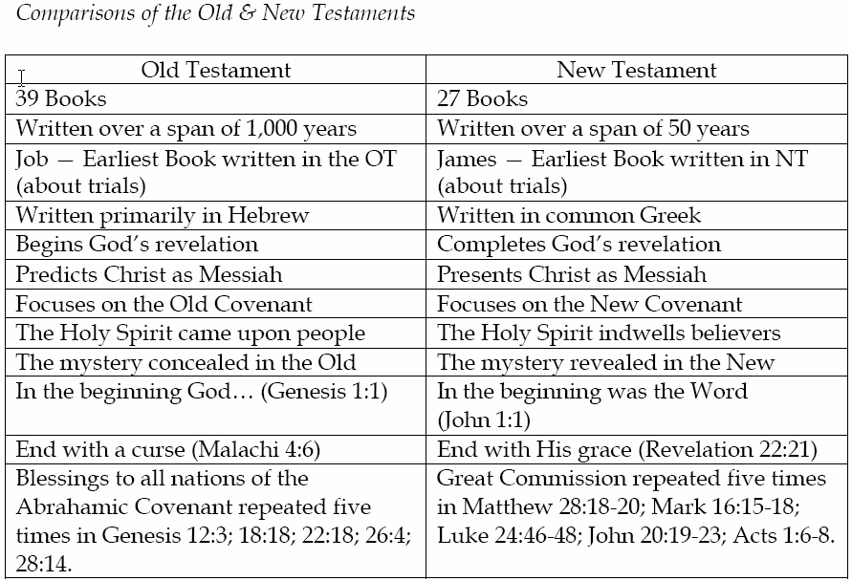
How the Testaments are Related

Slide 12
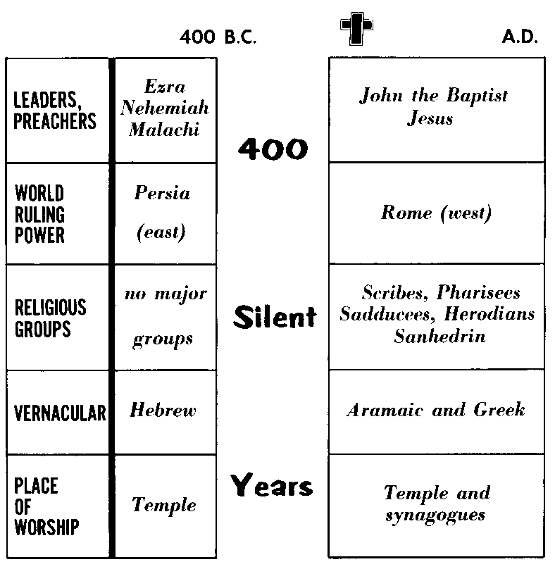

Slide 13
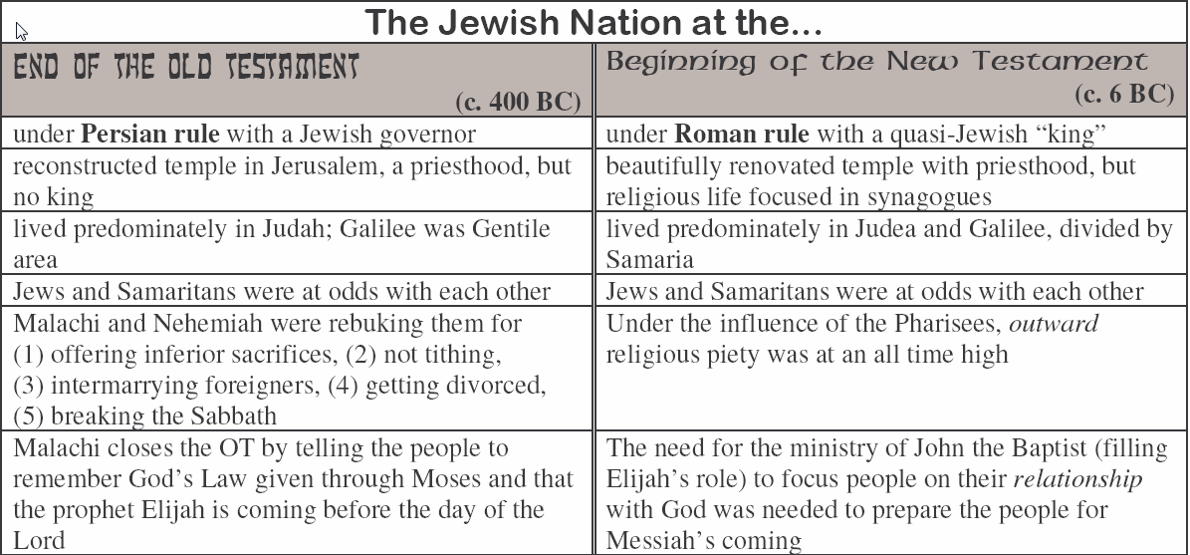

Slide 14
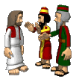
b. Divine Preparation for the New Testament
“But when the fullness of the time had come, God sent forth His Son, born of a woman, born under the law, 5 to redeem those who were under the law, that we might receive the adoption as sons.” Galatians 4:4-5 (NKJV)
1. Preparation through the Jewish Nation.
Messianic Expectations
Strong Jewish Groups
Scattered in the nations
From Temple to Synagogues

Slide 15

b. Divine Preparation for the New Testament
“But when the fullness of the time had come, God sent forth His Son, born of a woman, born under the law, 5 to redeem those who were under the law, that we might receive the adoption as sons.” Galatians 4:4-5 (NKJV)
2. Preparation through the Greeks.
Hellenization
LXX (Septuagint)
- Led to New Testament being written in a common language that could be understood by majority.

Slide 16
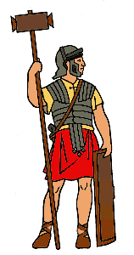
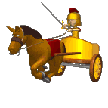
b. Divine Preparation for the New Testament
“But when the fullness of the time had come, God sent forth His Son, born of a woman, born under the law, 5 to redeem those who were under the law, that we might receive the adoption as sons.” Galatians 4:4-5 (NKJV)
3. Preparation through the Romans.
Pax Romanus
Roads and Infrastructure
- Ensured the speedy spread of early Christianity through established and relatively safe routes.

Slide 17
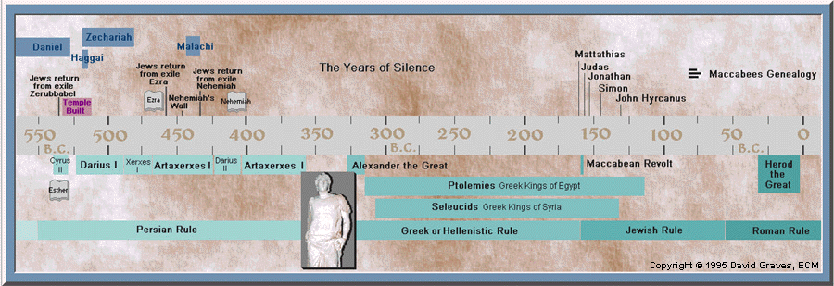
What happened in 400 Silent Years?

Slide 18
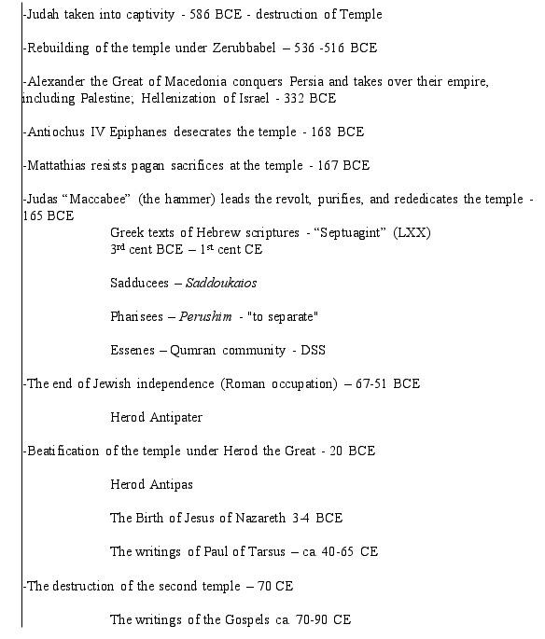

Slide 19
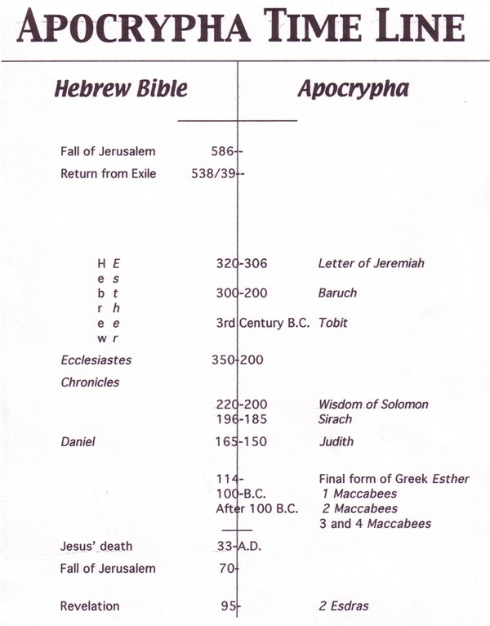

Slide 20
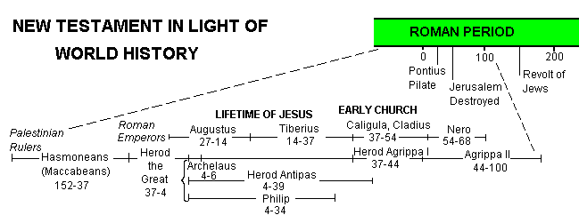

Slide 21
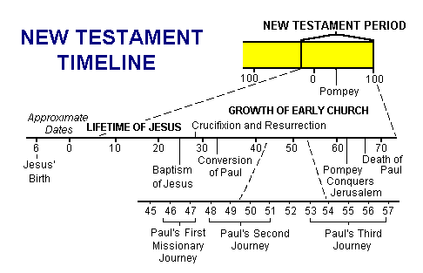

c. Overview of Events in N.T

Slide 22
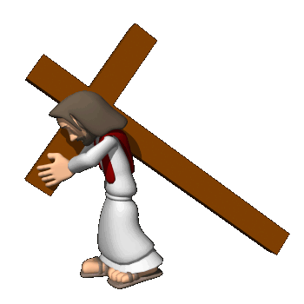




d. An Overview as to Focus
HISTORICAL | The Gospels: Story of the SAVIOUR | Manifestation: Of MESSIAH and KINGDOM
 | Acts: The Acts of the HOLY SPIRIT. | MESSAGE of Saviour. HISTORICAL.
EPISTOLARY | LETTERS on Kingdom LIVING | WORK of Christ. WALK of Christians
PROPHETIC | APOCALYPSE of Jesus. | RETURN of Lord. ETERNAL

Slide 23
e. New Testament as Scripture
Authorship and authority
Jesus’ pre-_________________ of apostolic writing- John 14:26; 16:13
Apostles’ awareness of the _____________ of their own writing - 1 Cor.14:37,28
Apostles’ awareness of the inspiration of ______ apostles’ writing - 2 Peter 3:16
Early attestation by “__________ ___________" (the ‘canon’)
AUTHENTICATION
INSPIRATION
OTHER
CHURCH FATHERS

Slide 24
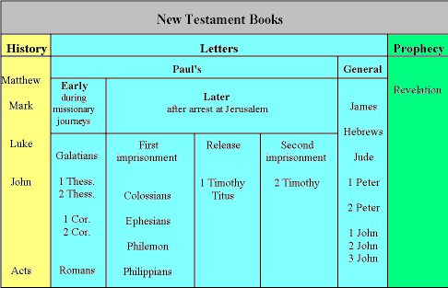


Slide 25
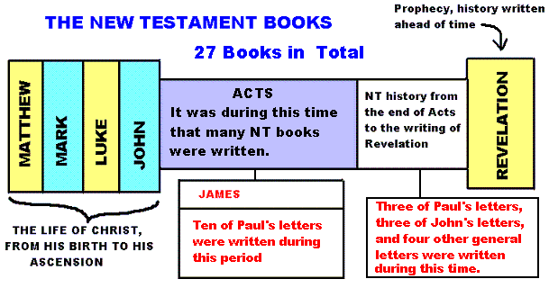

Slide 26
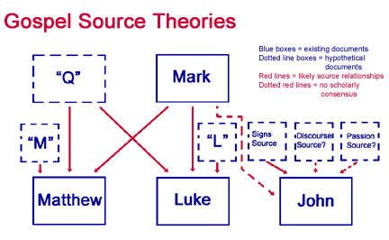
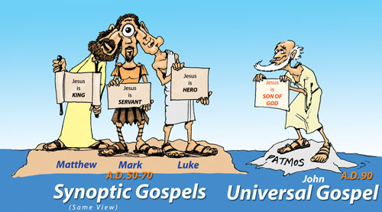
(2) The Historical Books
a. The Gospels
The Gospels: Acts 1:1-3 gives reason for the Gospels – That is…
TO SHOW THE LIFE AND WORK OF JESUS CHRIST.
SYNOPTIC
The _______________ Gospels = Matthew, Mark, Luke
Q Theory = Matthew, Luke taken from common texts (commonly believed to be Mark and Q).

Slide 27
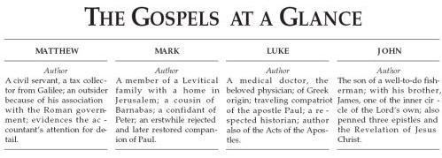

Comparing the Gospels

Slide 28
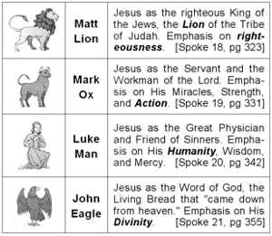
Comparing the Gospels

Slide 29
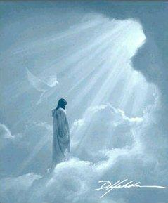
MATTHEW MARK LUKE JOHN
KING SERVANT MAN GOD
LION OX MAN EAGLE
TO JEWS ROMANS GENTILES CHRISTIANS
PASTOR/
TEACHER
APOSTLE EVANGELIST PROPHET
CHOLERIC SANGUINE MELANCHOLY PHLEGMATIC

Slide 30
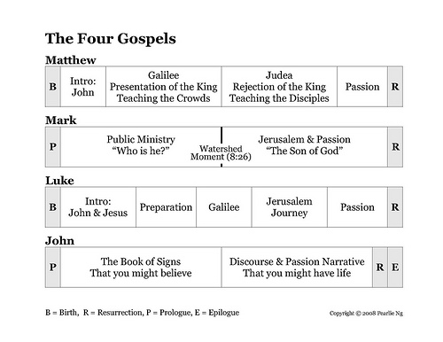
Overview of Jesus’ Ministry

Slide 31
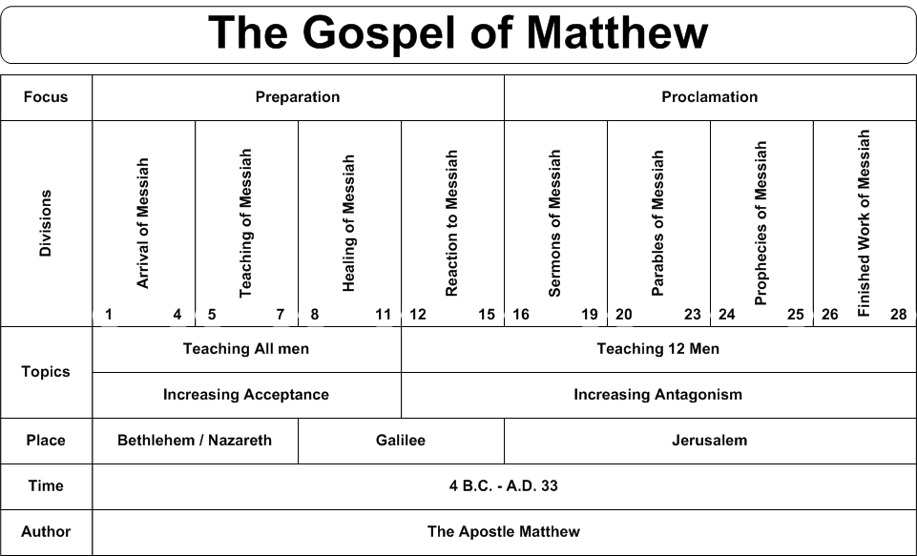

Slide 32
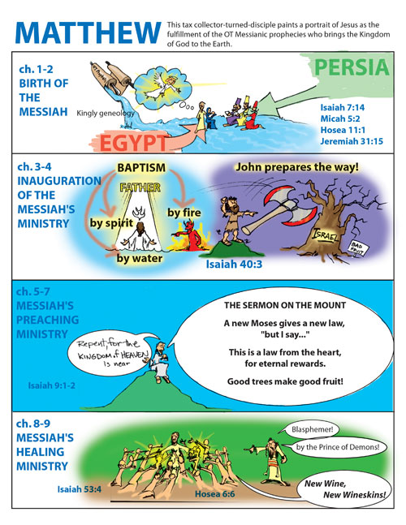

Slide 33
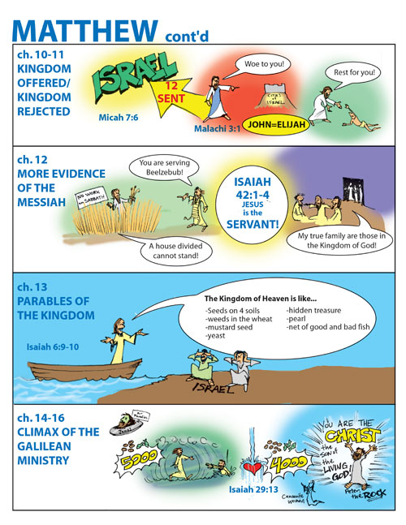

Slide 34
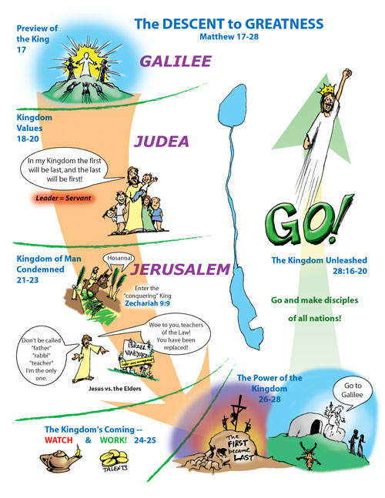

Slide 35
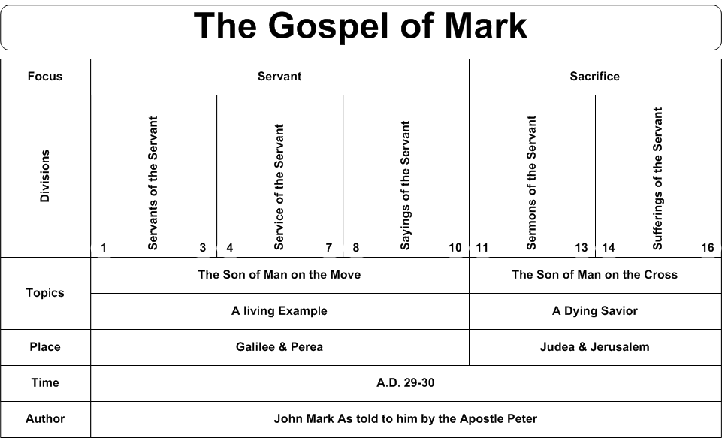

Slide 36
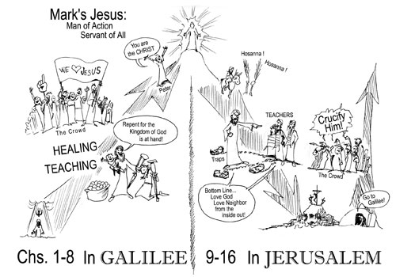

Slide 37
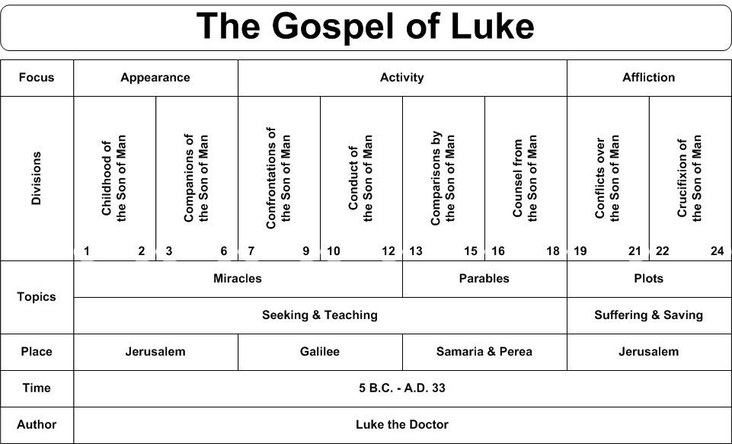

Slide 38
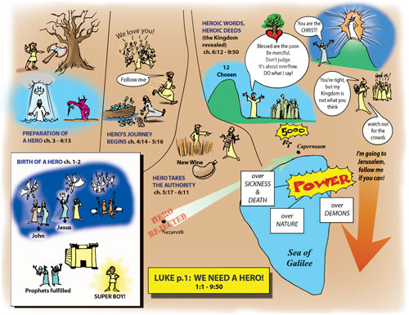

Slide 39
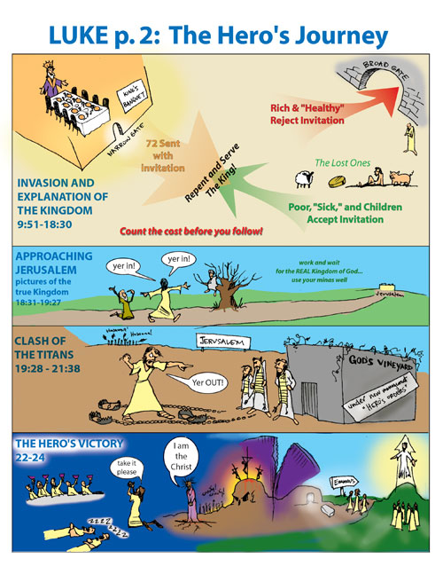

Slide 40
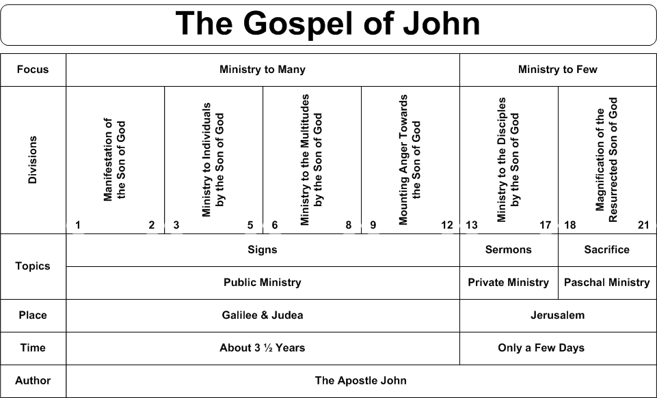

Slide 41
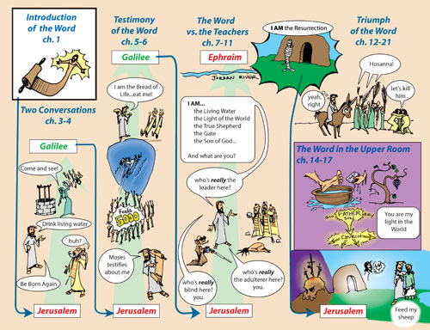

Slide 42
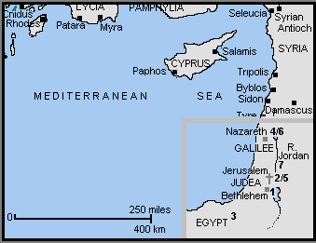

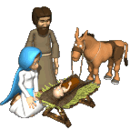
Jesus’ Birth
and Upbringing
[1] c 6BC - The Birth of Jesus at Bethlehem
[2] Presentation at the Temple
[3] c 4BC – To Egypt to escape the "massacre of the infants" by Herod the Great
[4] c 3BC - Settle in Nazareth in Galilee
[5] c AD6 - The 12 year old Jesus in the Temple
[6] c AD6-27 - Nazareth - stays for the next 20 or so years, and follows in his father's footsteps as a carpenter
[7] c AD27 - Jesus travels from Nazareth to the River Jordan to be baptised by John the Baptist

Slide 43
Significance of Genealogies
Question:
Why are there two different genealogies for Jesus? One in Matthew 1 and also in Luke, chapter 3? And why does Matthew 1 record Joseph's genealogy?
Answer:
The Gospel of Matthew records Joseph’s genealogy and the Gospel of Luke records Jesus’ genealogy through Mary.
Matthew points out Jesus' place in the royal succession (Son of David – the Messiah).
Luke gives us His actual physical ancestry through Mary's bloodline (Son of Man)

Slide 44
John the Baptist’s Ministry
His Mission: (1) To bring wayward Israelites back to God (Mal 4:5-6)
(2) To prepare the Jewish nation for the Lord’s coming (Isa 40:3)
His Message: Repent! The kingdom of God is near and you’ve got to be ready. Being Abraham’s descendant isn’t enough, you have to get your heart right with God. The Son of God and Lamb of God (cf. Isaiah 53) is coming; he is greater than I and will baptize with the Holy Spirit (those who believe) and with fire (those who don’t believe).
His Method: Baptized Jews, which had never been done. Gentile converts to Judaism, proselytes, were publicly baptized as the final step in their conversion. Jews presumed a close relationship with God because of God’s covenant with their fathers. It was a great act of humility for a Jew to be baptized (the Pharisees and Sadducees wouldn’t submit to it) and it prepared people to follow Jesus (Luke 7:29-30).

Slide 45
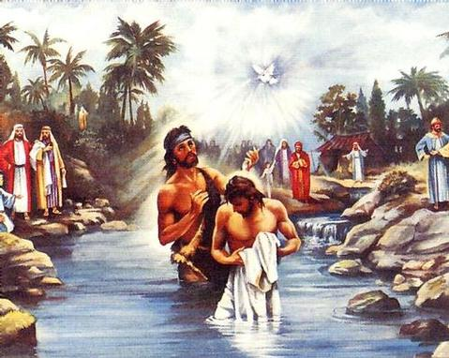
Significance of Jesus’ Baptism
· Jesus identifies with Israel, like in his birth, circumcision and presentation at the temple.
· His first public step toward bearing our sin (baptism was for repentance, for which he had no need) and for being our mediator.
· “Fulfill all righteousness” (Mt 3:15) is consistent with Isaiah 53:11-12.

Slide 46
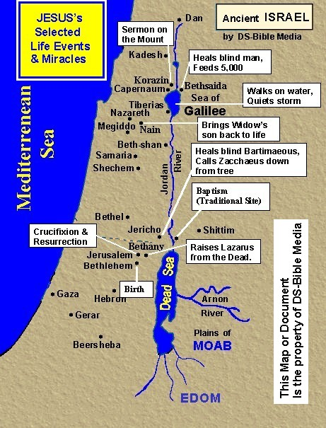

Overview of Jesus’ Ministry
Jesus’ ministry is punctuated by two events:
______________ (identification with humanity) and
______________________________ (resolving human dilemma)
Early Judean Ministry: Year of ___________________.
Galilean Ministry: Year of _____________ (Luke 10:1)
Perean Ministry: Period of _________________.
BAPTISM
CRUCIFIXION/RESURRECTION
  OBSCURITY
POPULARITY
REJECTION

Slide 47
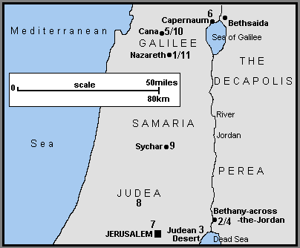
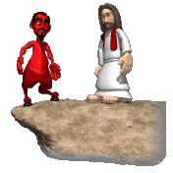
Early Judean Ministry:
Year of Obscurity
[1] Leaves Nazareth
[2] Baptised by John
[3] Wilderness Temptation
[4] Call first 5 disciples
[5] Returns to Galilee - Cana
[6] Stays in Capernaum [7] To Jerusalem for Passover (cleansing of Temple, Nicodemus)
[8] Judean countryside – Disciples baptise believers
[9] Samaritan woman
[10] Heals official’s son
[11] Preaches in Nazareth

Slide 48
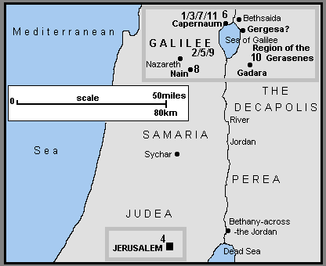
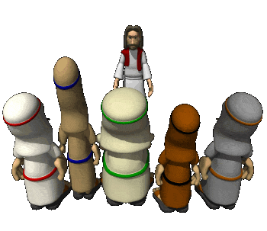
Galilean Ministry:
Year of Popularity
[1] To Capernaum – heals madman and Peter’s Mother-in-Law
[2] Travels through Galilee preaching and healing (e.g. Leper)
[3] In Capernaum heals paralyzed man and calls Mathew.
[4] To Jerusalem for Passover – heals crippled man by pool of Bethesda.
[5] Return to Galilee – heals man with shriveled hand and many others.
[6] Selects 12 and gives sermon on Mount.
[7] In Capernaum heals Centurion’s servant.
[8] In Nain brings widow’s son back to life.
[9] Second Galilee tour.
[10] Calms storm & heals madman.
[11] Raises Jairus’ daughter from dead.

Slide 49
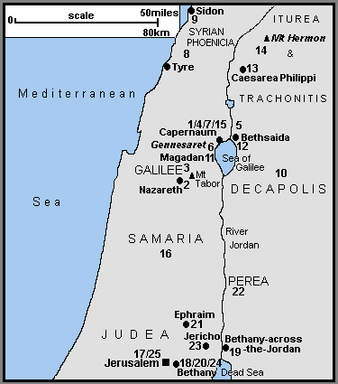

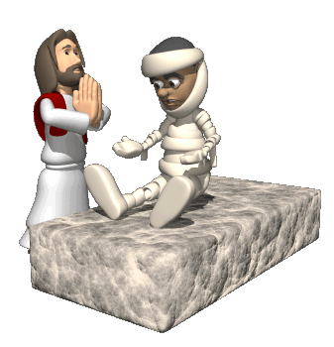
Perean Ministry:
Year of Rejection
[1] From Capernaum to Nazareth
[2] Rejected in Nazareth
[3] Sends 12 to preach
[4] 12 return to Capernaum
[5] Feeding of 5000
[6] Jesus walks on water
[7] Jesus teaches about Bread of Life
[8] Heals gentile woman’s daughter
[9] Travels through Galilee to Decapolis
[10] Heals deaf and mute & feeds 4000
[11] Crosses Galilee – Pharisees ask for sign
[12] In Bethsaida blind man is healed
[13] To Caesarea Philippi – Peter’s confession
[14] Jesus Transfigured Epileptic healed
[15] Jesus pays Temple tax with fish
[16] Samaria – heals 10 lepers but rejected
[17] Forgives woman caught in adultery & heals blind man
[18] Visits Mary and Martha in Bethany
[19] Withdraws to Bethbara
[20] Raises Lazarus
[21] Withdraws t Ephraim [22] Withdraws to Perea (children, rich young man)
[23] Heals 2 blind men & converts Zacchaeus
[24] Mary anoints Jesus, Triumphal entry
[25] Passion week

Slide 50
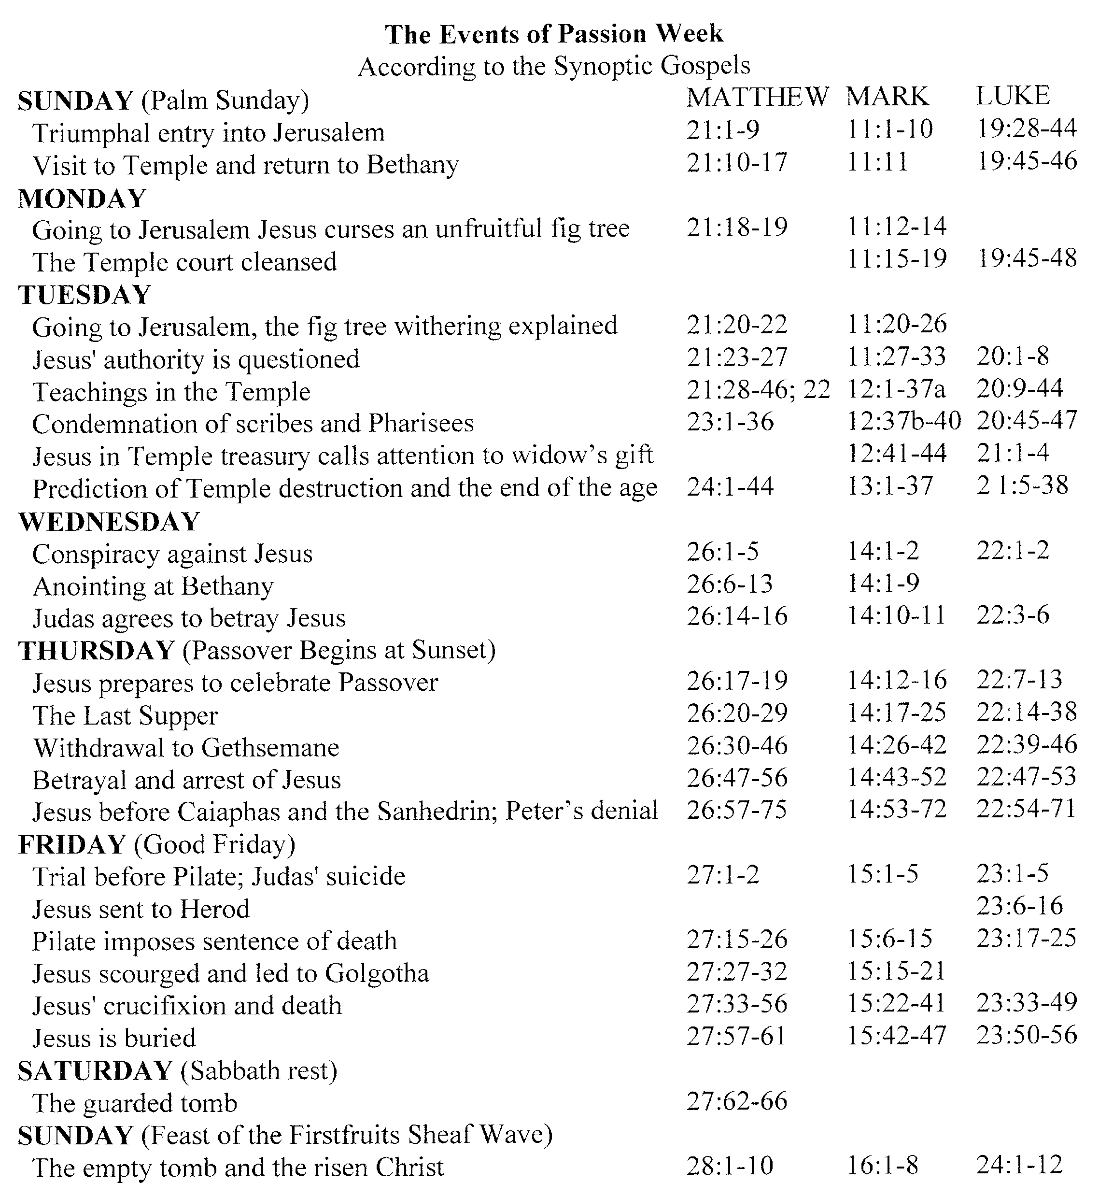

Slide 51





Passion Week

Slide 52

Good Friday

Slide 53


Slide 54


The Teaching of Jesus
Jesus' identity
1. "I ___" (Exodus 3:14; John 8-10, 14) – Jn 8:12,48-59; 8:12; 10:7,9; 14:6
AM

Slide 55

The Teaching of Jesus
Jesus' identity
2. _____________ with God (Jn. 10:30; Jn. 17:5,8)
3. Claims ____________ prerogatives ( to forgive sins (Luke 5:20) and granter of eternal life (Jn. 17:2; 14:6)
4. Unique ____________ Son (Luke 20:41-44; cf Ps. 110:1)
EQUALITY
DIVINE
DAVIDIC

Slide 56

The Teaching of Jesus
Jesus’ Sermons (on the Mount)
- Kingdom __________
Jesus’ Parables
- Kingdom ___________
Olivet Discourse
- Kingdom ___________
Upper Room Discourse
- Kingdom ___________
LIVING
TRUTHS
COMING
POWER

