Slide 1

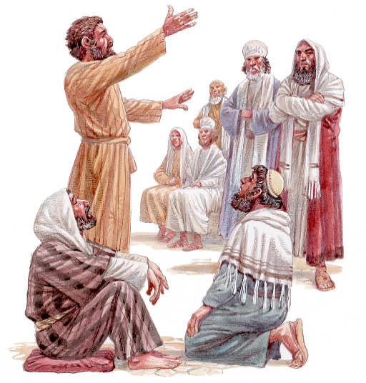
New Testament Survey 2
The Spread of Christianity

Slide 2
(1) Book of Acts – The Early
Christian Community
Overview of Acts (Continuation of Luke)
1. Spread of Christianity in fulfillment of the ___________________________________ (Ac. 1:8…2= Jerusalem; 6:7= Judea; 9:3= Samaria; 12:24=Gentiles).
2. Vindication of Christianity as rooted in legal ____________. A continuation of _________.
3. Introduction of Paul and the mission to the _______________.
GREAT COMMISSION
JUDAISM
LUKE
GENTILES

Slide 3
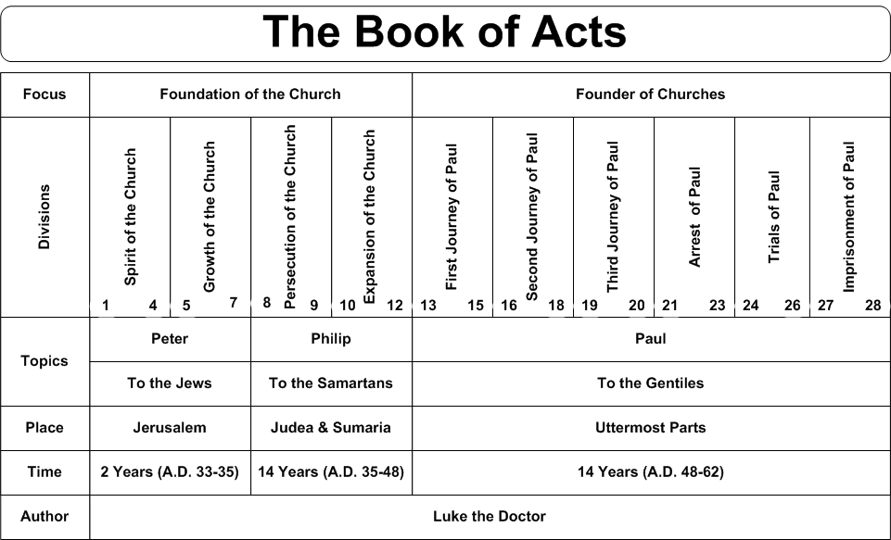
(a) Thematic Outline of Acts

Slide 4
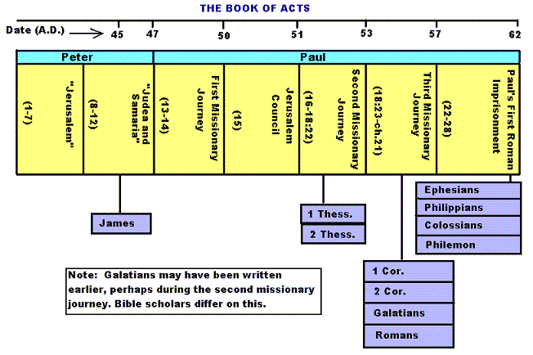
(b) Historical Outline of Acts

Slide 5
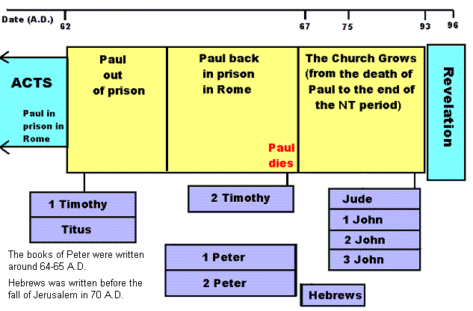
(c) Historical Overview immediately after Acts

Slide 6
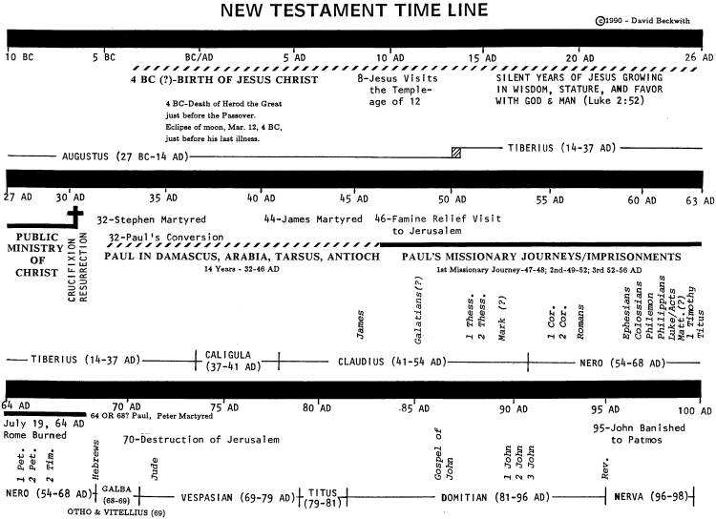

Slide 7
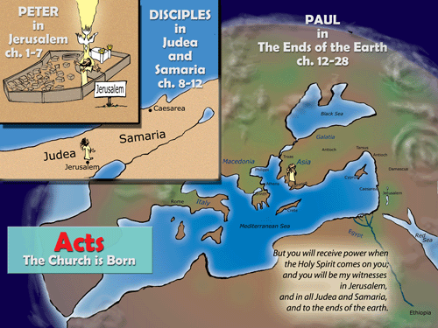

Slide 8



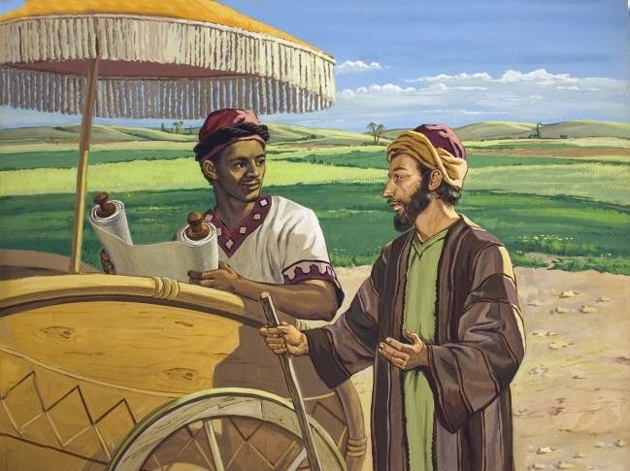
BEFORE PENTECOST AFTER
“And they cast their lots, and the lot fell on Matthias.”
Acts 1:26
“And they were all filled with the Holy Spirit and began to speak with other tongues” Acts 2:4
“Then the Spirit said to Philip, “Go near and overtake this chariot.” Acts 8:29

Slide 9
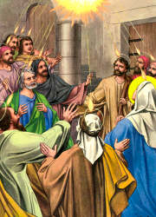
i. The birth of the church (ch. 1,2)
1. ____________________ (2:1-36)
ii. The Jerusalem church (2:41-6:15)
Period of _____________
______________ mounts (3:1-4:31, 5:17-42)
3. Emphasis on ___________ life (2:41-47; 4:31-5:16)
PENTECOST
GROWTH
RESISTANCE
COMMUNITY

Slide 10
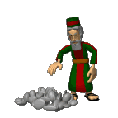
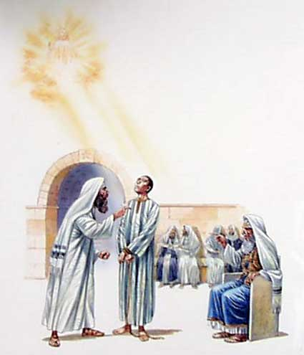
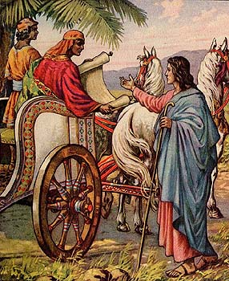
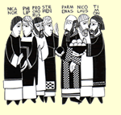
Stephen, Philip and the spread of Christianity outside of Jerusalem
Appointing of Deacons (Acts 6:1-8)
Stephen’s Martyrdom led to a forced exodus from Jerusalem (Acts 7)
Philip witnesses to Samaritans (Acts 8:5-25) and Ethiopian Eunuch.

Slide 11
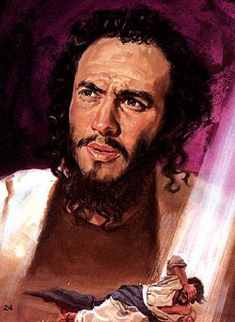
Peter, Paul and the spread of Christianity to the Gentiles
Paul's _____________ and ____________ (9:1-31): Door to the Gentiles seen (peter opens it).
1. Paul’s commission (9:15)
2. Peter's ministry to the Gentiles (9:32-10:18)
CONVERSION
COMMISSION

Slide 12
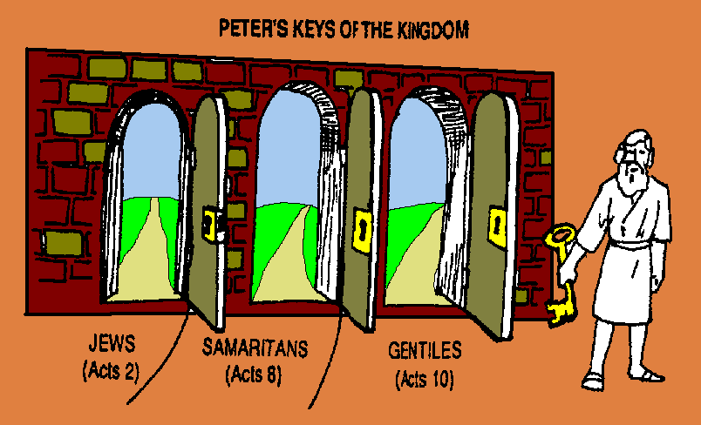
KEYS
Peter used the ______________ to the Kingdom.
“And I will give you the keys of the kingdom of heaven, and whatever you bind on earth will be bound in heaven, and whatever you loose on earth will be loosed in heaven.” Matthew 16:19

Slide 13
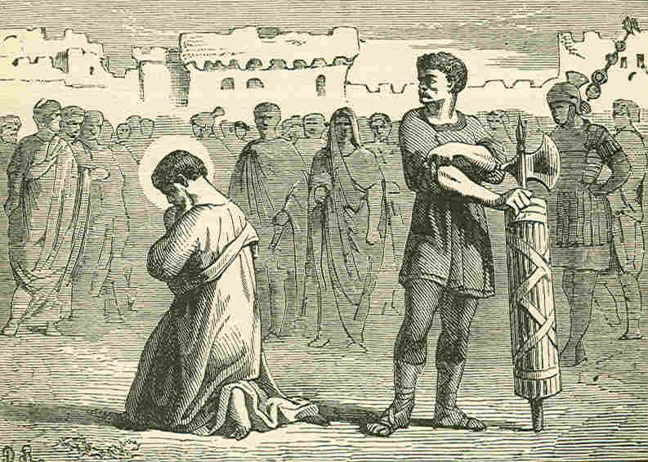
The base for the Christian movement shifted from _____________ to __________. It is from here that the Roman world would be reached for Christ (Acts 11:19-26)
JERUSALEM
ANTIOCH
Resistance in Jerusalem comes to a head with the martyrdom of Apostle James and the imprisonment of Peter by Herod Agrippa I (Acts 12)

Slide 14
Parallels between Peter and Paul
Chapters 1-12 | Chapters 13-24
Jerusalem the center Peter the chief figure Out to Samaria Word rejected by Jews of homeland Peter imprisoned Judgment on Herod | Antioch the center Paul the chief figure Out to Rome Word rejected by Jews of the dispersion Paul imprisoned Judgment on Jews
First Sermon 2 Lame man healed 3 Simon the sorcerer 8 Influence of shadow 5 Laying on of hands 8 Peter worshipped 10 Tabitha raised 9 Peter imprisoned 12 | First Sermon 13 Lame man healed 14 Elymas the sorcerer 13 Influence of handkerchief 19 Laying on of hands 19 Paul worshipped 14 Eutichus raised 20 Paul imprisoned 28

Slide 15
Paul’s first missionary
Journey (13:1-15:35)
ANTIOCH
Sent out by the church at ___________ (13:1-3).
2. Cyprus (13:4-12)
3. Asia Minor (13:13-4:28)
Strategy: Urban centers, Synagogues, Paul's central message (13:16-42), to "God fearers" (13:43), established the church in short time –appoint elders.

Slide 16

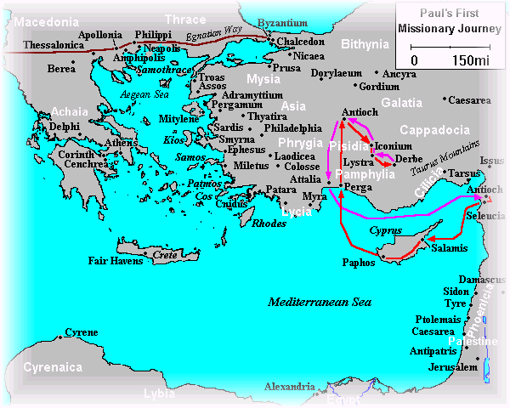
James wrote his letter to Christian Jews (and ultimately all Christians) to emphasize their need for obedient practical works in faith.
Paul wrote Galatians to show man is saved by faith in Jesus Christ alone, not by works (keeping the Law).
James, brother of Jesus, wrote his letter c.AD45 – Matthew or Mark written earliest (c.AD40)
Extra cartoon pictures from: http://www.vibblespace.com/Mind/PaulsLetters/PaulIndex.htm

Slide 17
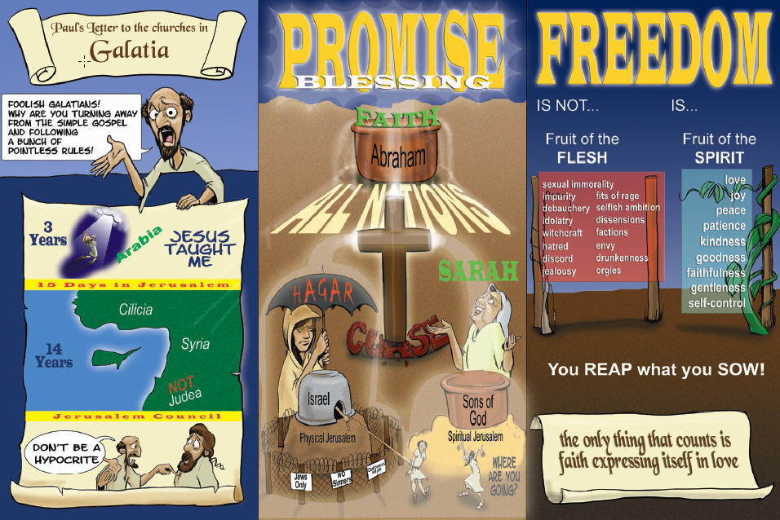
Galatians maybe written from Antioch AD49 to South Galatians before Paul went to Jerusalem Council.
Extra cartoon pictures from: http://www.vibblespace.com/Mind/PaulsLetters/PaulIndex.htm

Slide 18
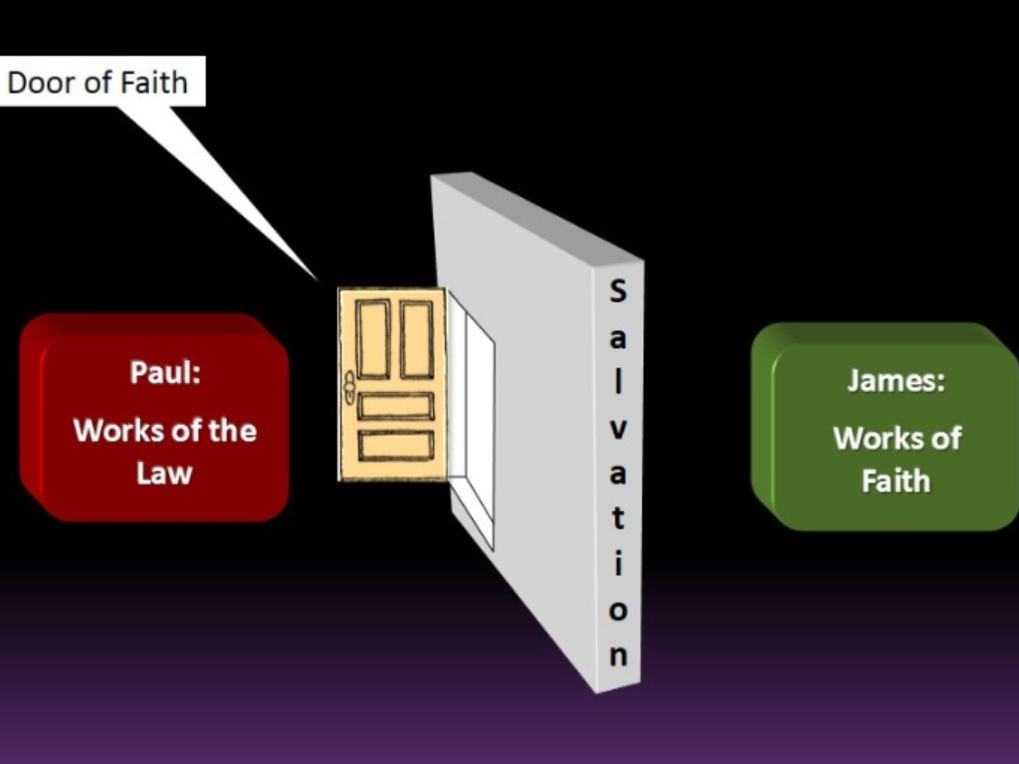
“You see then that a man is justified by works, and not by faith only.”
James 2:24
“Knowing that a man is not justified by the works of the law but by faith in Jesus Christ, even we have believed in Christ Jesus, that we might be justified by faith in Christ and not by the works of the law; for by the works of the law no flesh shall be justified.” Galatians 2:16

Slide 19
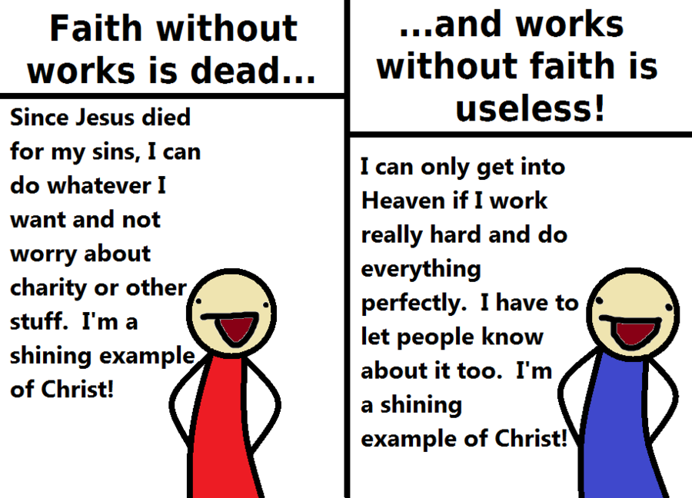
James counters this view
Galatians counters this view

Slide 20
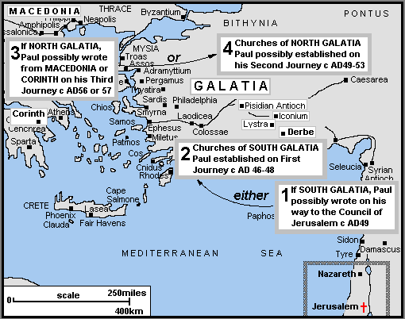
North and South Galatia Theories

Slide 21
Jerusalem Council (15:1-35)
Question: What is the relationship of Christianity to_____________________?
a. Position of the Judaizers (15:1,5).
b. Testimony of Peter (15:7-12).
c. Findings summarized by James, step brother of Jesus (15:13-29)
THE MOSAIC LAW

Slide 22
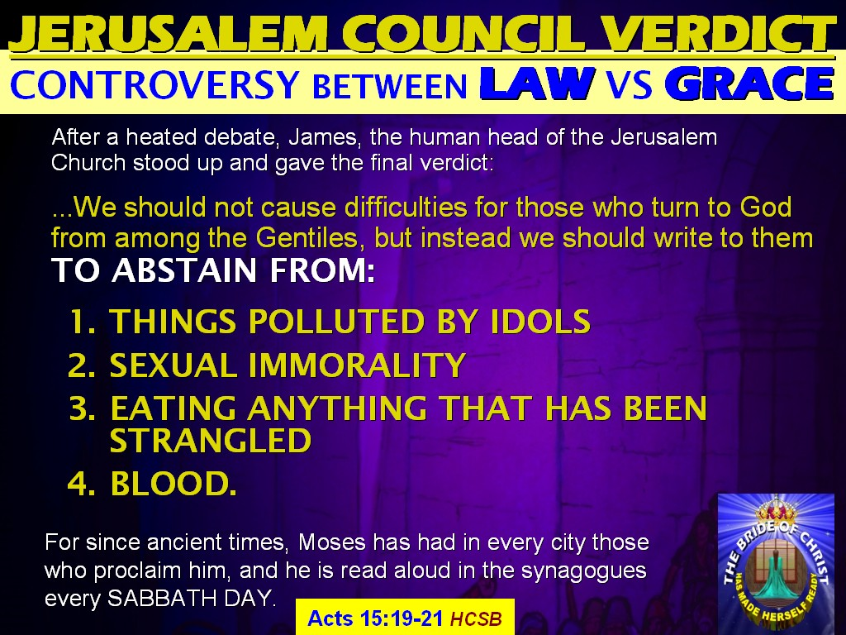

Slide 23
Second Missionary Journey (Acts 15:36-18:22)
A parting of the ways between ______________ and Paul
Asia Minor and Greece
1. The __________________ band
2. Growing _________________(Ac. 17:1-9; 18:12-18)
From Thessalonica to Athens - Ac. 17:16-34.
Paul at Corinth (Acts 18:1-17)
BARNABAS
APOSTOLIC
POLARIZATION

Slide 24
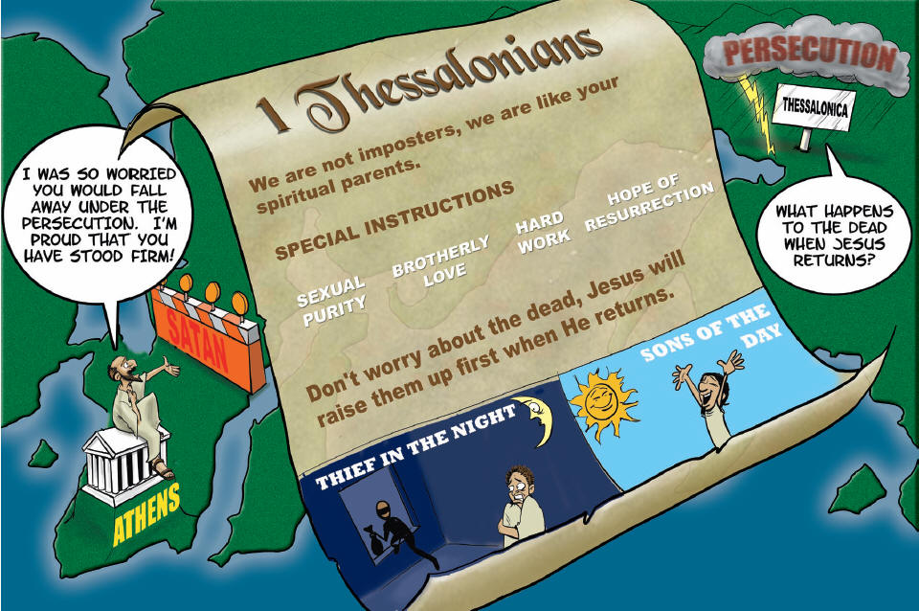
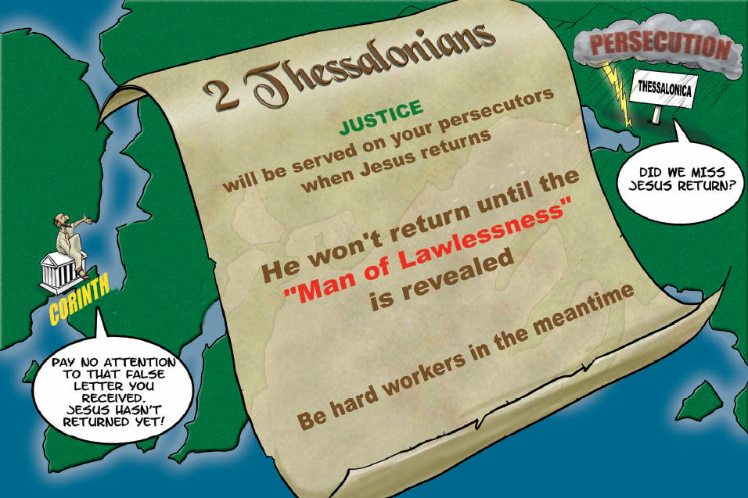
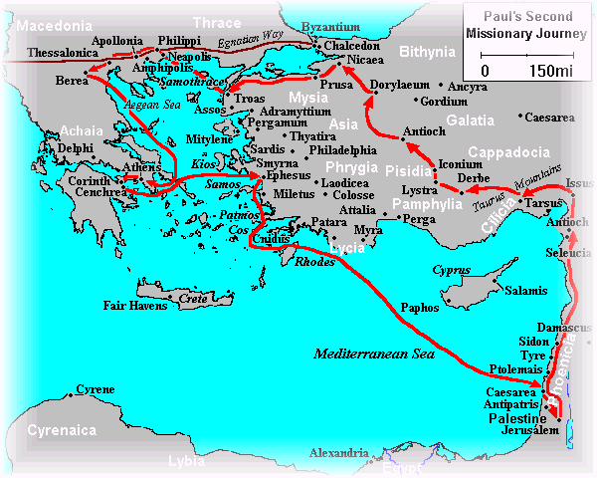
First Thessalonians: _________________ in light of Christ’s return.
Second Thessalonians: Understanding the _______________.
HOLINESS
DAY OF THE LORD
Both First and Second Thessalonians were written by Paul in c.AD.51 from Corinth.

Slide 25
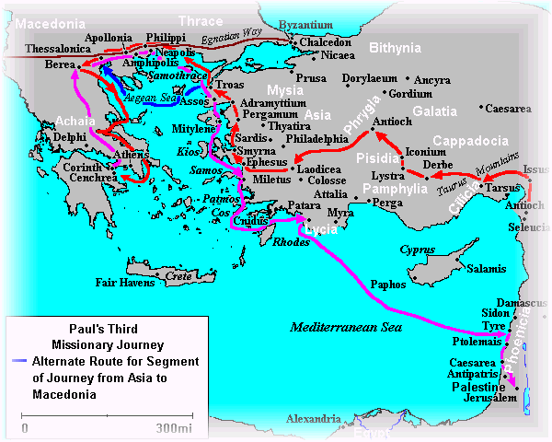
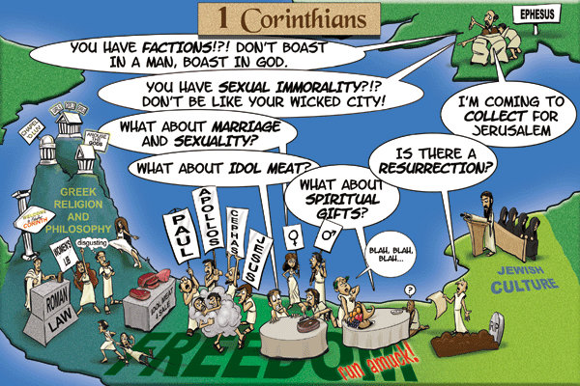
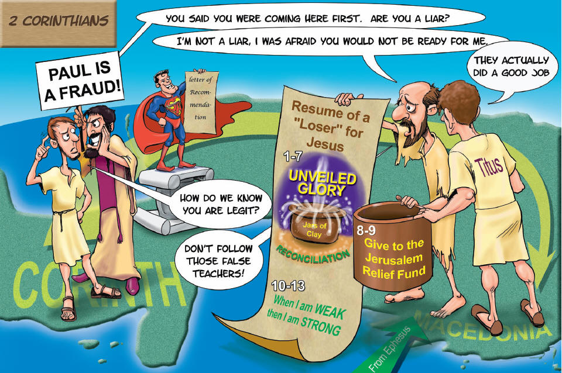
Third Missionary Journey (Acts 18:23-21-14)
Romans written by Paul from Corinth c.AD57
First Corinthians: Correction of ________________ living in Church life.
Second Corinthians: Paul’s defense of the _____________________.
Romans: The _______________________ of God
CARNAL
MINISTRY
RIGHTEOUSNESS
Second Corinthians written probably from Phillipi by Paul in c.AD56.
First Corinthians written from Ephesus c.AD56.

Slide 26
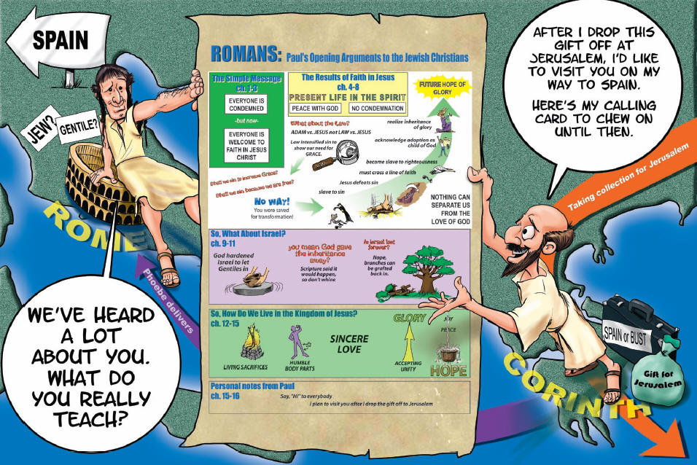

Slide 27
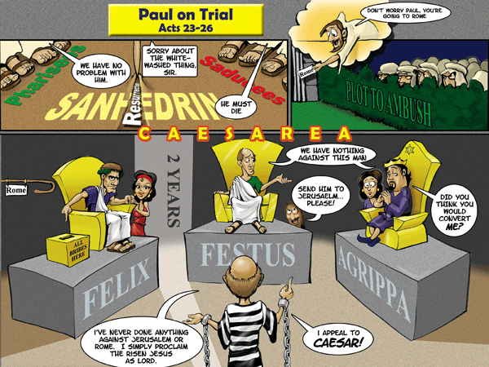

Slide 28
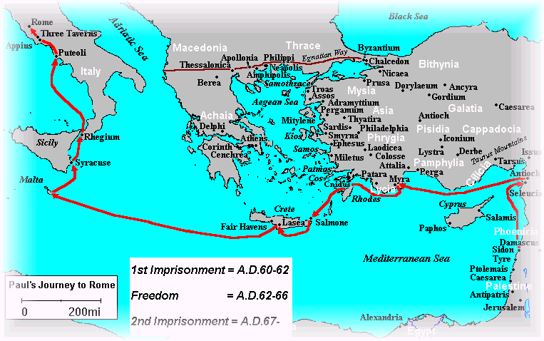
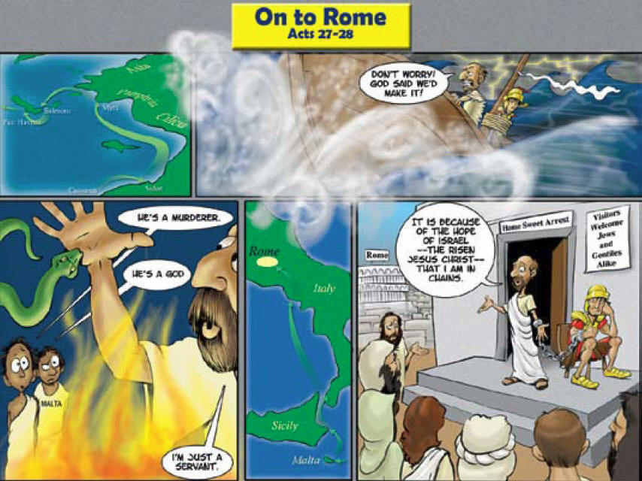
Paul's trek to Rome (Acts 20:2-28:31)
Freedom
First Timothy written from Macedonia to Timothy in Ephesus.
1st Imprisonment
Paul wrote the ‘Prison Epistles’ (Ephesians, Colossians, Philippians and Philemon) from Prison in Rome.
Titus was written by Paul from Corinth before his trip to Spain (AD63)
Second Imprisonment
Second Timothy was last letter of Paul before he was executed.

Slide 29
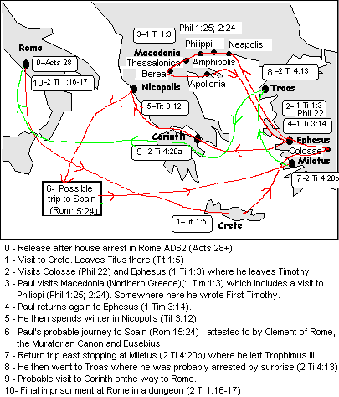
Wrote Letter to Titus

Slide 30
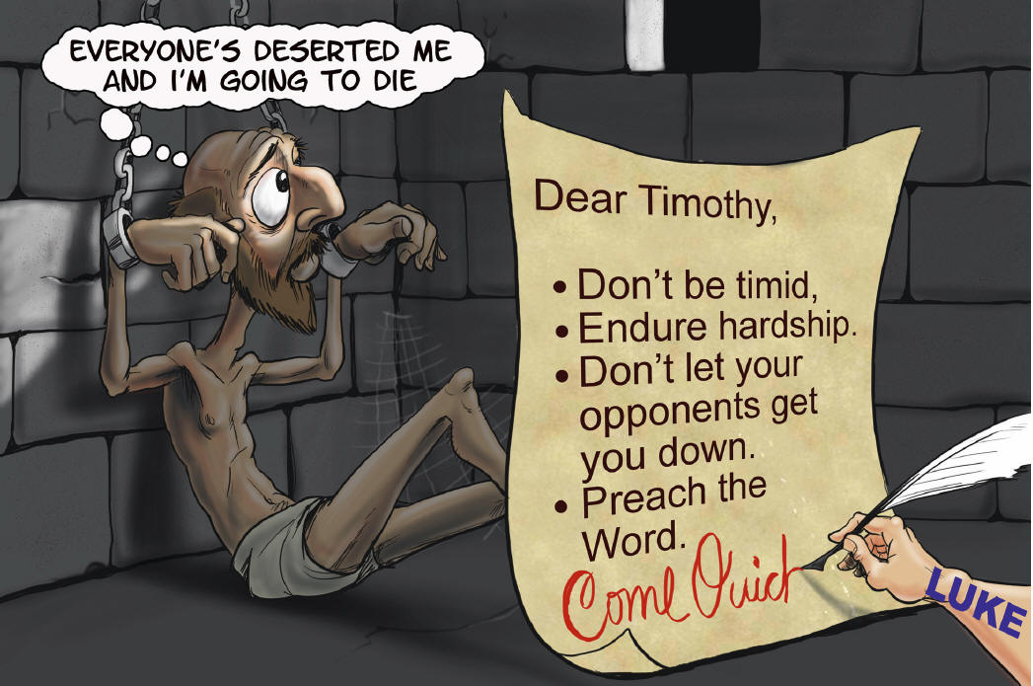
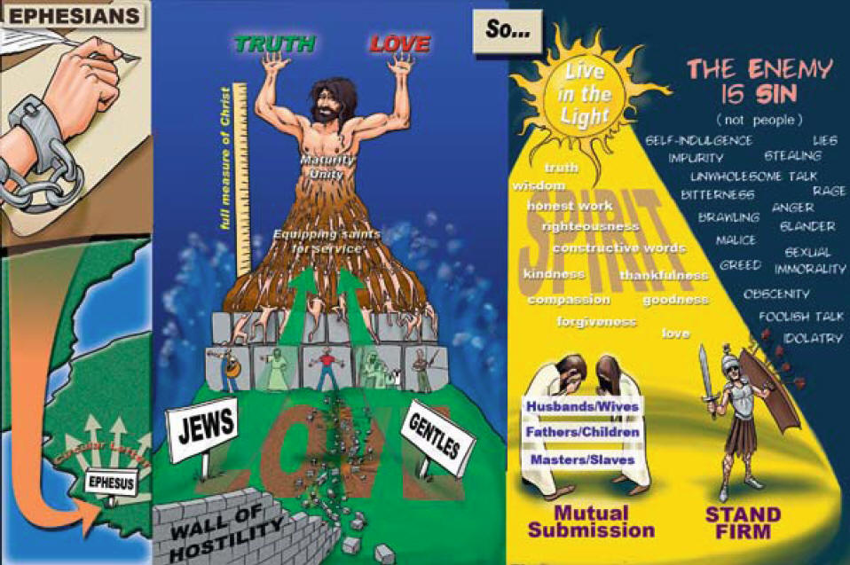
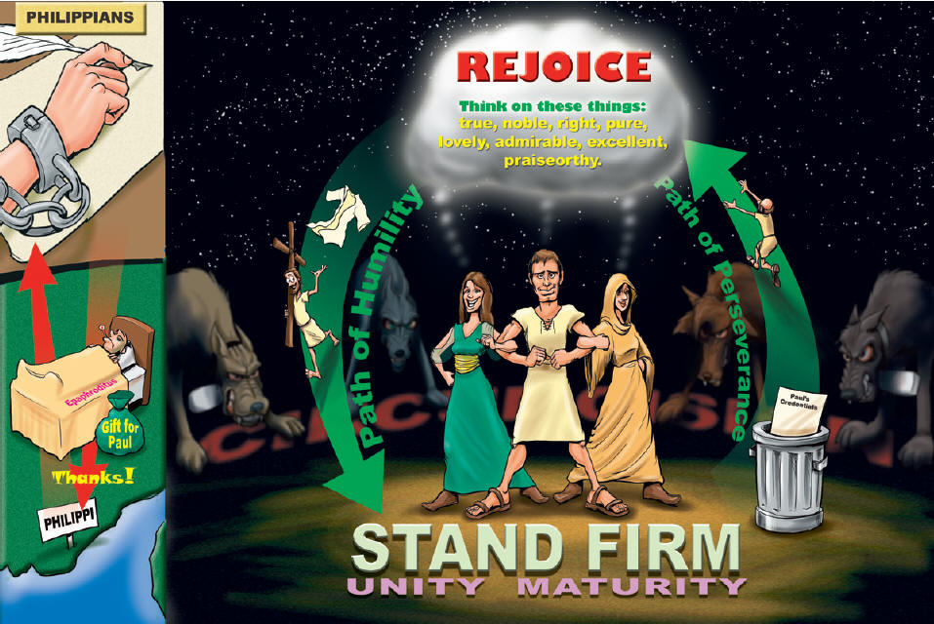
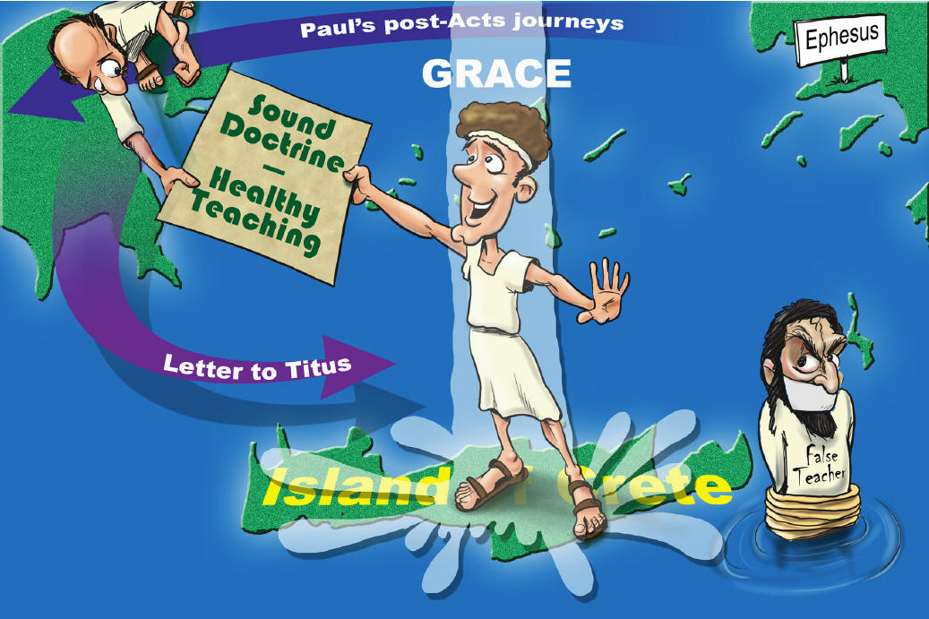
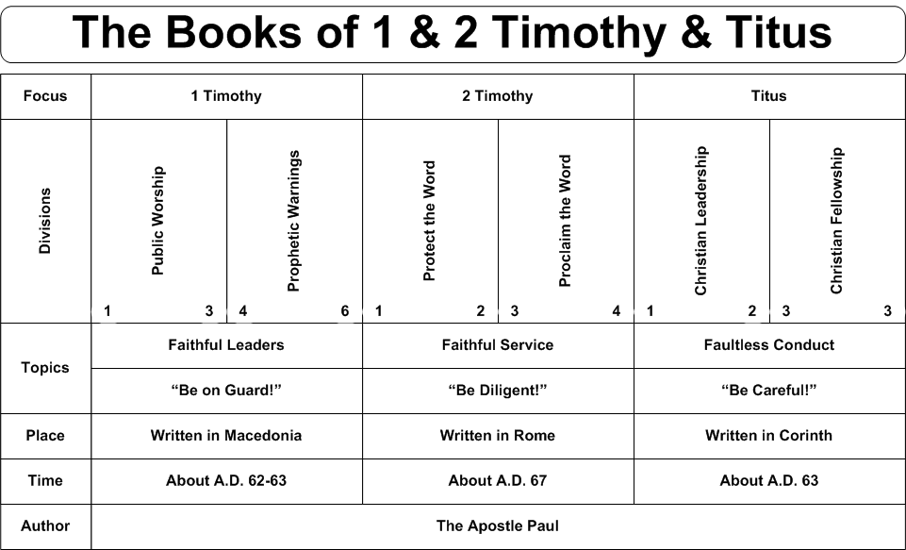
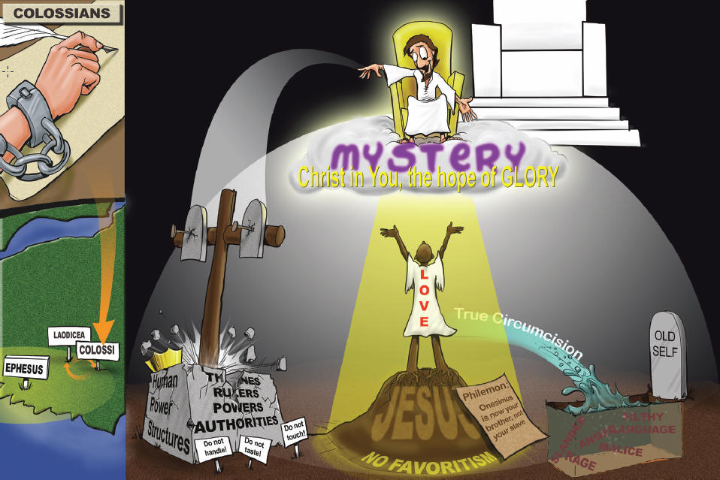
1. Ephesians and Colossians – Twin letters – very similar with slightly different emphasis…
Ephesians – Building the ________ of Christ (theology and practical)
Colossians – Christ the _________ of the Church.
2. Philemon: __________________ from slavery (personal letter to Philemon about Onesimus)
3. Philippians: To Live is _____________ (centrality of Jesus in Christian life)
4. First Timothy: ___________ manual for Church organization.
Second Timothy: _______________ in the Pastoral ministry.
5. Titus: _____________ manual for Church living.
BODY
HEAD
FORGIVENESS
CHRIST
LEADERSHIP
ENDURANCE
CONDUCT

Slide 31
Luke probably wrote his Gospel in c.AD60 as Paul was imprisoned and then he wrote the book of Acts in AD.62 – recounting the event up until the end of Paul’s first imprisonment.
The Gospel of Mark may have been written at same time as Luke (unless you believe the Q theory)
Peter wrote his two epistles c.AD64 probably when Paul was in Spain.

Slide 32
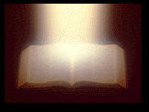
(2) The Epistles
AMENUENSIS
Use of an __________________ (secretary)
Style of letters
Most of Paul's letters were “___________________.“ (That is they were written for a particular occasion/ happening).
The form is typically (i) Greeting, which includes the name of the author, credentials, blessings, name of recipient; (ii) Body, which was typically responses to problems; (iii) Conclusion, which gave greetings for others in the apostolic band.
OCCASIONAL

Slide 33
(2) The Epistles
Content of the letters can be divided into two basic areas….
____________________ themes.
____________________ issues facing the church.
THEOLOGICAL
PRACTICAL

Slide 34
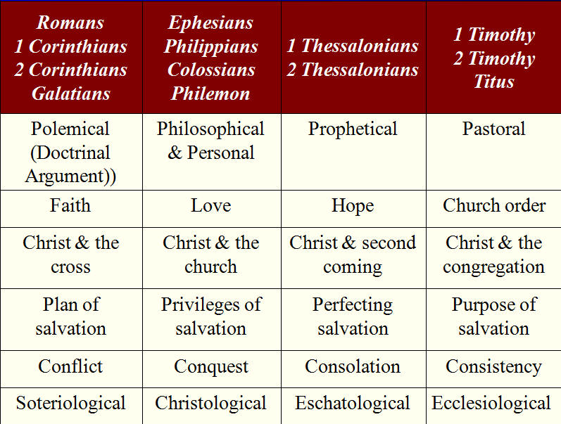
(2) The Epistles
Comparing Paul’s Letters

Slide 35
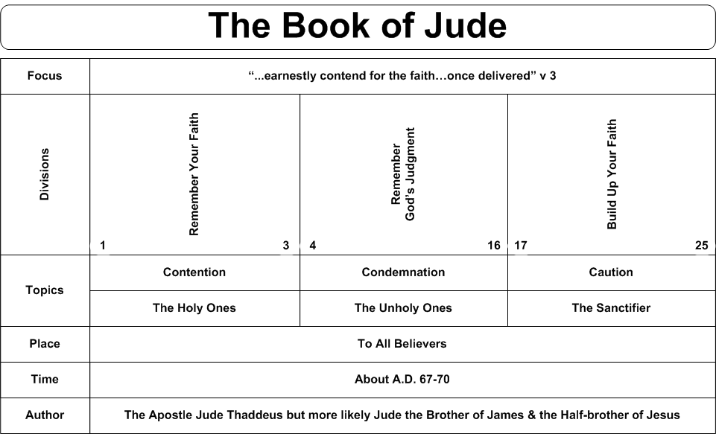
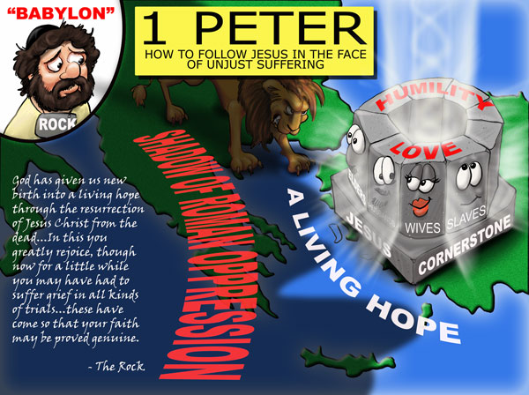
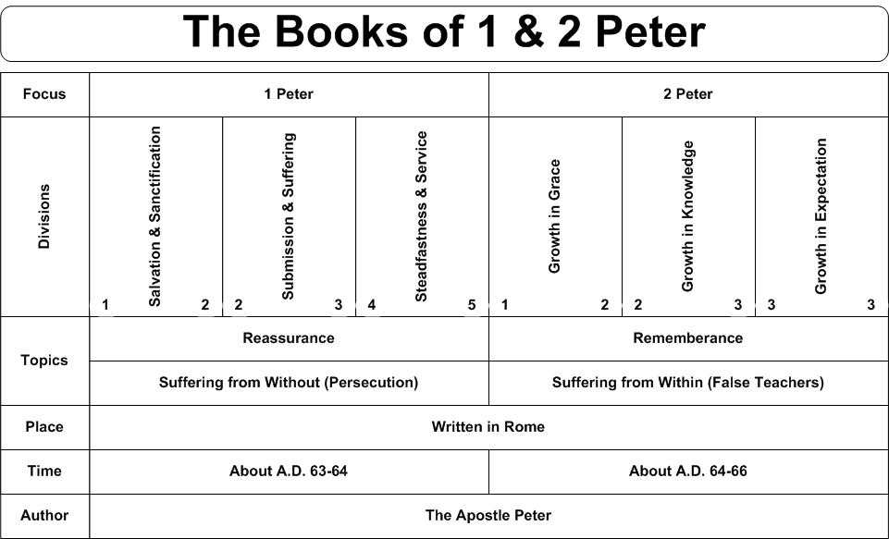
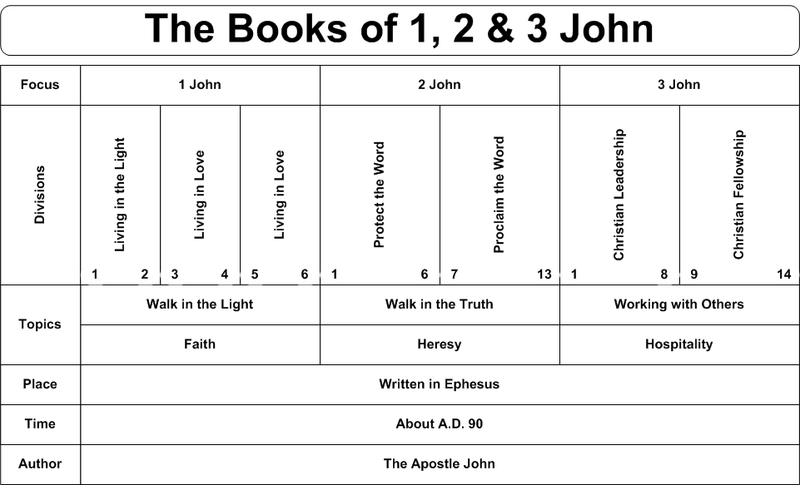
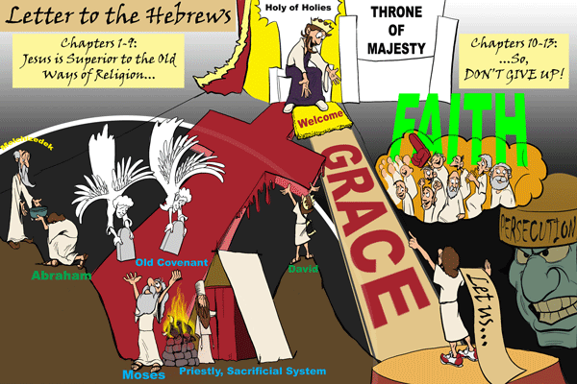
Comments on Hebrews and the General Epistles
OLD
A. Hebrews. This is a theology of the _________ Testament in the light of the person and ministry of Christ.
B. James. To a primarily ____________ audience. James provides practical instruction on godly living.
C. 1 and 2 Peter. To Churches under ________________. Practical instruction on unity during opposition. Explains the role of Satan in their persecution.
D. 1,2,3 John and Jude. Written primarily to a _________ church. The doctrine of Christ's humanity are taught and the call to moral purity and love are emphasized.
JEWISH
PERSECUTION
GENTILE

Slide 36

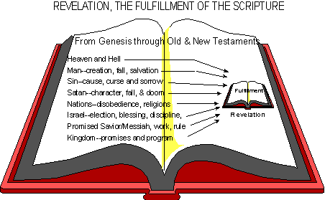
(3) Prophetic Book
Revelation – Written by John (AD 90s)
Is actually the revelation of Jesus Christ in Church History through to eternity.

Slide 37
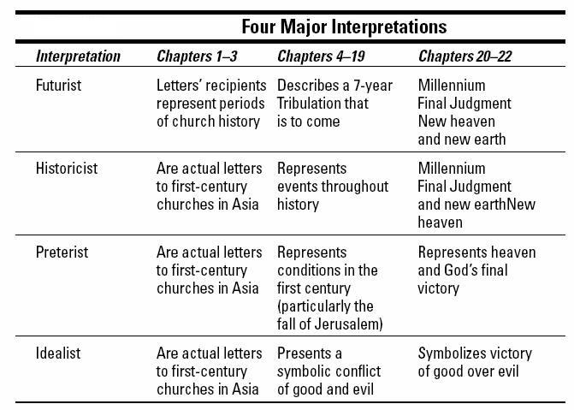
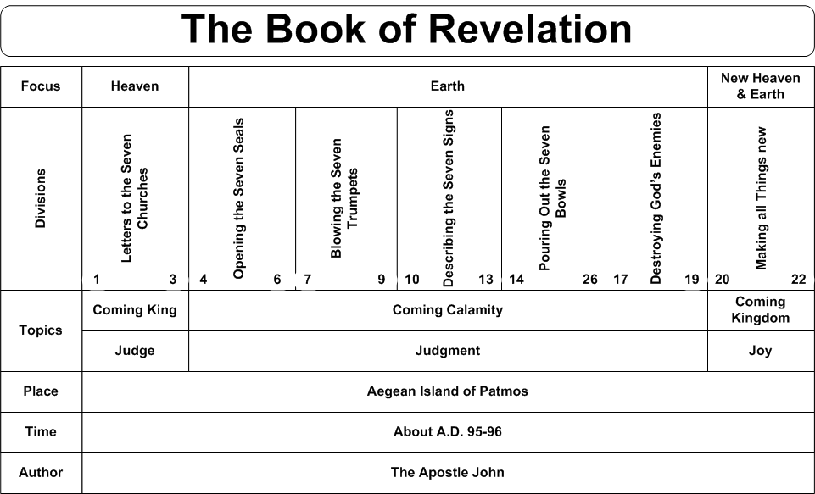
(3) Prophetic Book

Slide 38
Summary of Major Themes in the New Testament
A. Time
1.. Linear v. Cyclical.
Linear: Accountability and ultimate _____________.
Cyclical: Biblical history is like a ________________.
2. Time follows expansion of __________________ of God (through evangelism /and missions).
3. Parousia - everything hinges around Christ’s
______________ _________________.
JUDGEMENT
SYMPHONY
THE KINGDOM
SECOND COMING

Slide 39
B. The Messiah
Prophetic fulfillment, yet in a ___________
(1 Cor. 2:6-9; Rom. 16:25,26; 1 Pet.1:10-12; Mt. 13:11-17; Eph 5:32).
2. _____________________ system and the cross.
MYSTERY
THE SACRIFICIAL

Slide 40
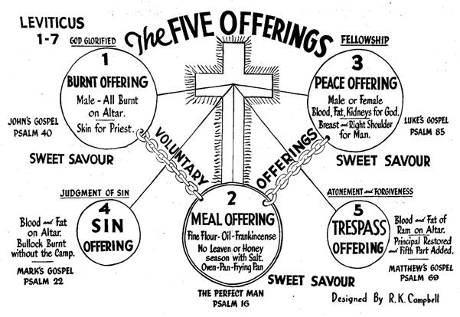
B. The Messiah

Slide 41
C. Grace
1.Polemic (hostile) against
______________ self-righteousness.
2. God's acceptance is extended to
_______.
LEGALISTIC
ALL

Slide 42
D. New Community of God
1. New Covenant and the work of the
___________ ___________.
2. Neither _____ nor ______. Gal. 3:28.
3. ____________ of heaven.
4. Global __________________.
HOLY SPIRIT
JEW
GREEK
CITIZENS
AMBASSADORS

Slide 43
E. Missions Summary
The Gospels: Jesus lays down what the Church’s mission is (to spread the Kingdom to every tongue, tribe and nation) and how to accomplish it (in the character and authority of Christ) – Matthew 24:14; 28:19-20
Acts: Account of how the early Church outworks this mission in the power of the Holy Spirit – Acts 1:8
Epistles: Every aspect of how we, as individuals and the Church, can be set free to fulfill His mission – Rom 16:26
Revelation: The certain truth that His mission will be accomplished – a world full of people bearing His image, the Kingdom filling the earth and Christ ruling and reigning with His saints – Rev. 7:9

